Slide 1
The Controller of Examinations

Slide 2
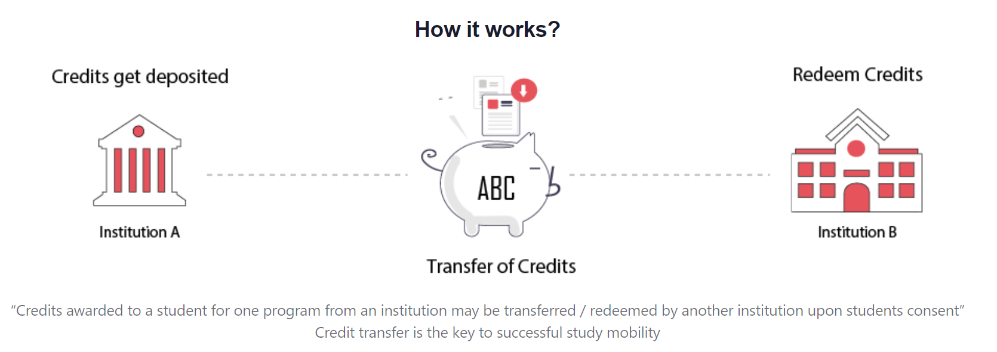

Slide 3
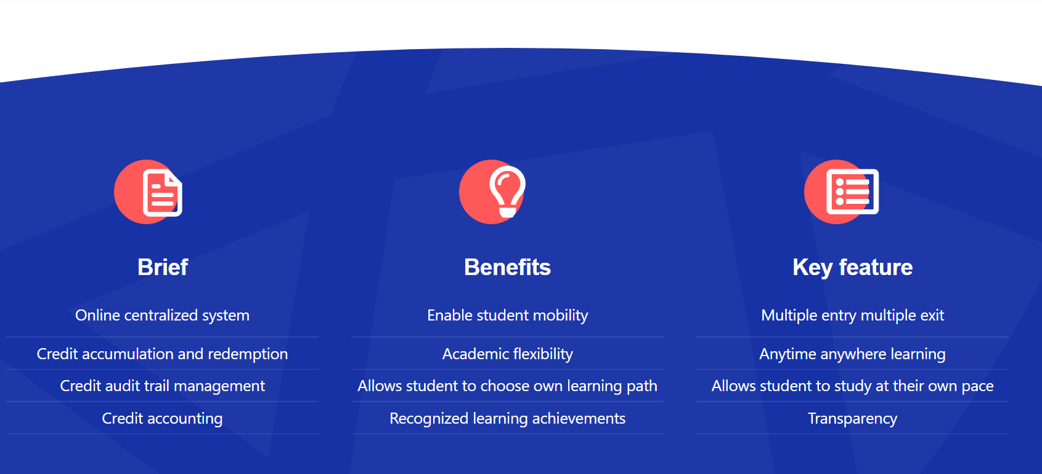

Slide 4
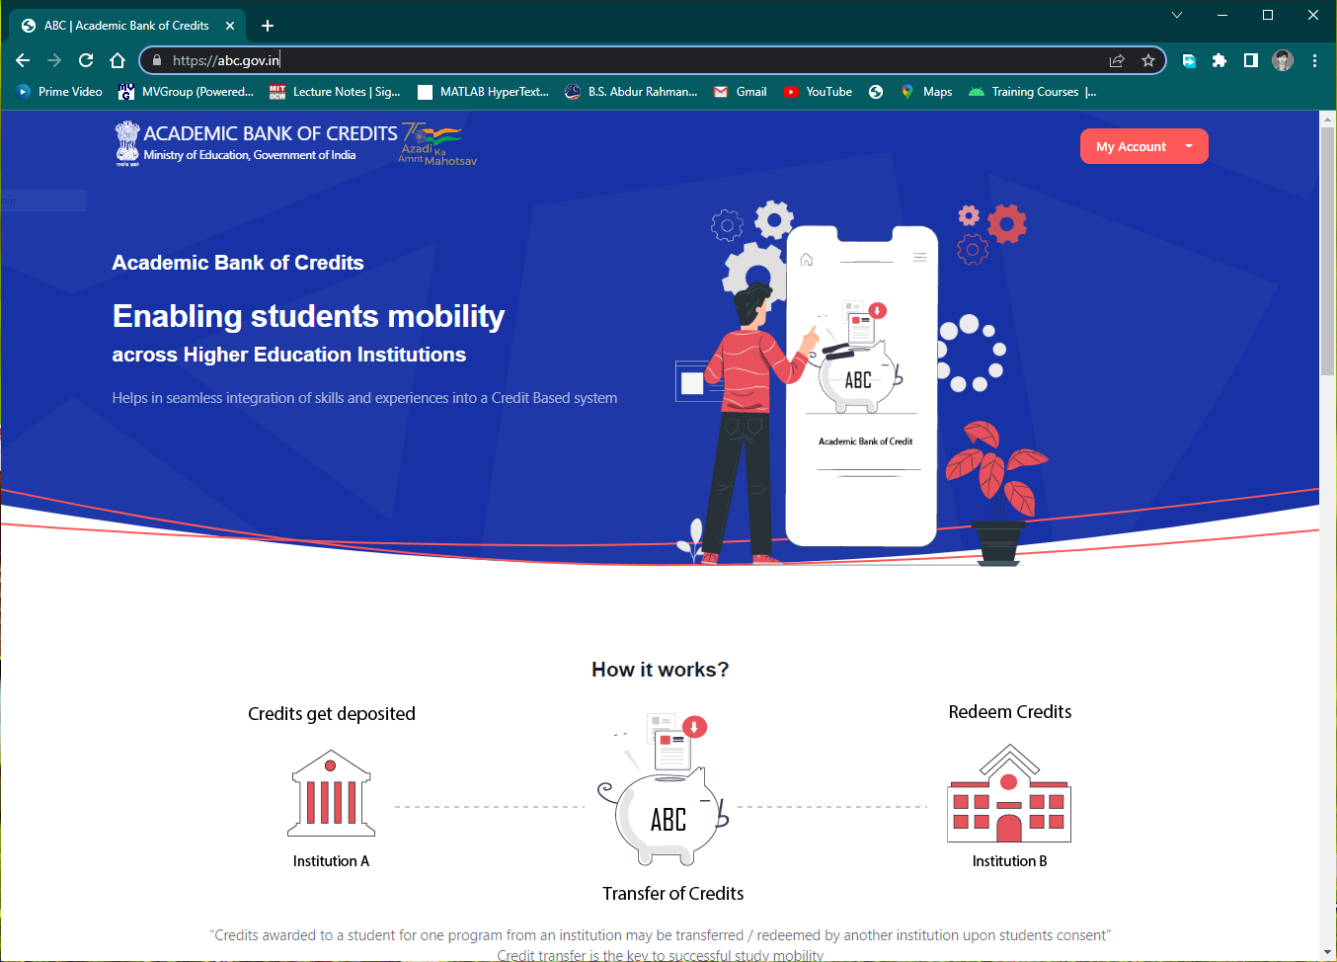
STUDENT REGISTRATION
Step-by-step guide
The students of B.S. Abdur Rahman Crescent Institute of Science and Technology, are eligible to register themselves in the Academic Bank of Credits (ABC) Portal, using their DigiLocker ID.
Step 1
For Students Registration, Open the link https://abc.gov.in in your browser.
Note: The student should have already registered in DigiLocker-NAD before proceeding. In case if the students is not registered himself with DigiLocker-NAD please refer here.

Slide 5
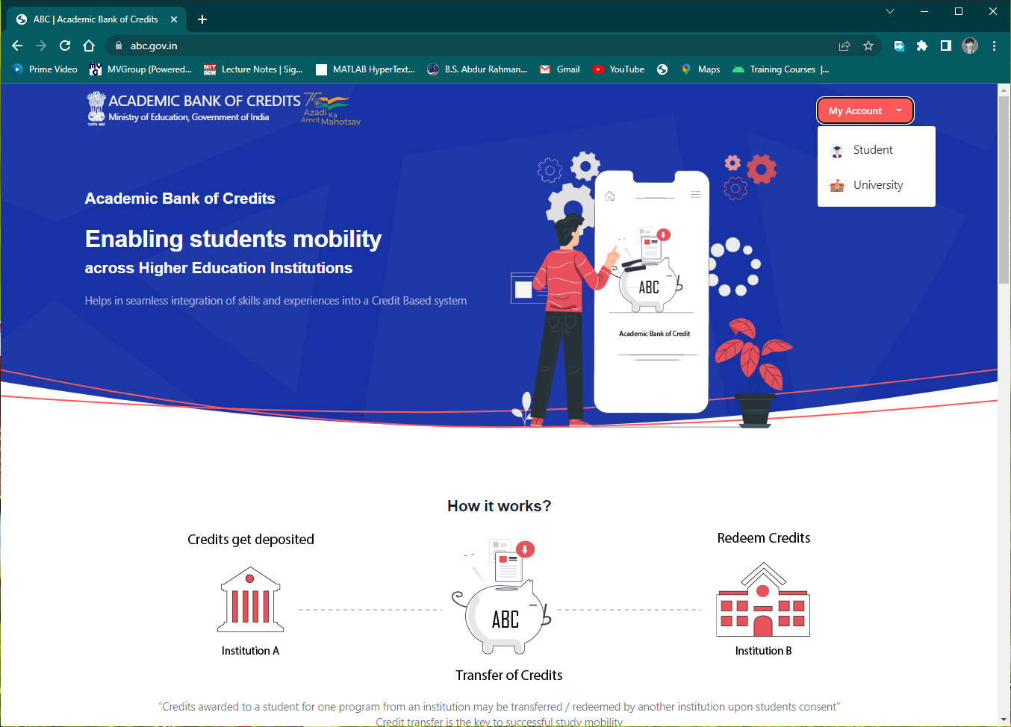
Step 2
Under My Account drop-down select Student

Slide 6
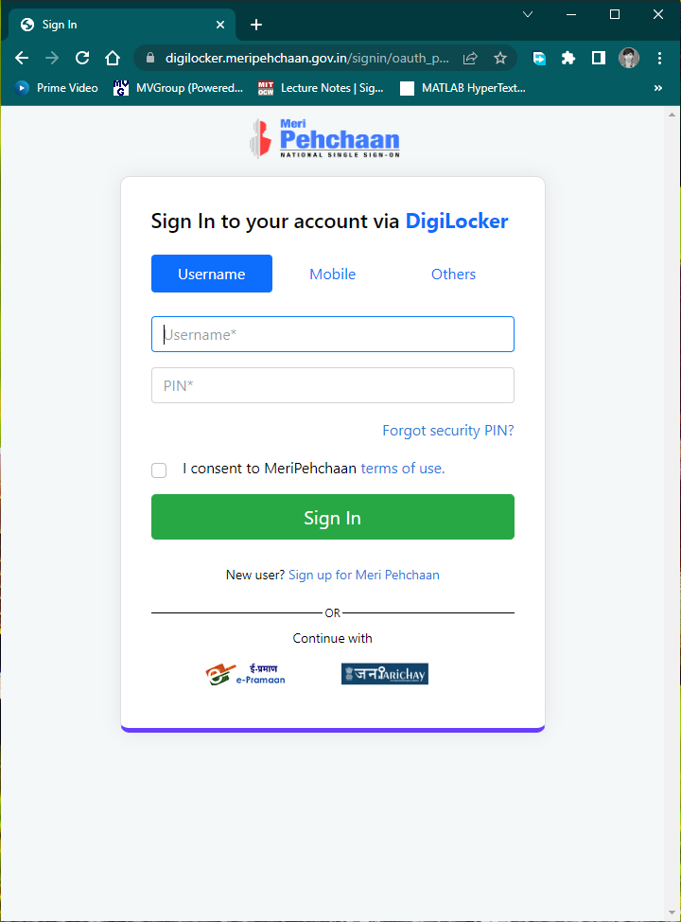
Step 3
Use your DigiLocker Username & Security PIN to login. You can also login using your Mobile number or Aadhaar ID, that was used to register with DigiLocker.

Slide 7
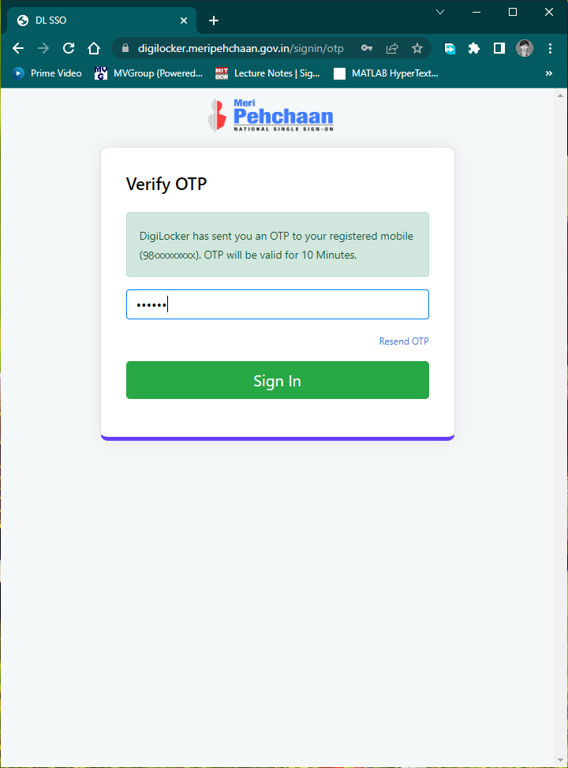
Step 4
Enter the OTP received in your mobile phone and click Sign In

Slide 8
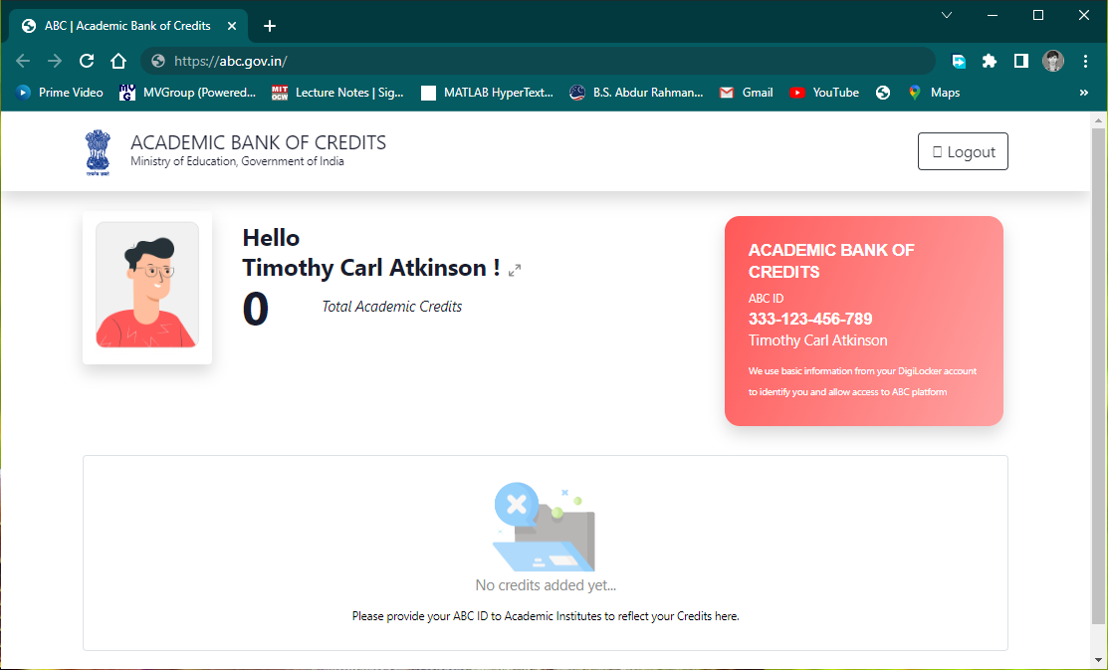
Registered Successfully
If you get this screen, you have been successfully registered with the Academic Bank of Credits.
Note down your ABC ID (12 Digit ID) and produce it to the concern authorities of your University whenever required.

