Slide 1


DEPARTMENT OF ELECTRONICS AND INSTRUMENTATION ENGINEERING
VII SEMESTER EIE
EIC4102 INDUSTRIAL AUTOMATION
PROGRAMMABLE LOGIC CONTROLLERS
G.ANITHA, AP(SEL.G)/EIE

Slide 2
Industrial Automation
Industrial Automation is a set of technologies that results in operation of industrial machines and systems without significant human intervention and achieves performance superior to manual operation

Slide 3
Programmable logic controllers
A PLC is a solid state device designed to perform logic functions previously accomplished by electromechanical relay

Slide 4
Hard Relay Logic
A Relay is an electromagnetic device for remote or automatic control that is actuated by variation in conditions of an electric circuit and that operates in turn other devices (such as switches) in the same or the different circuit
--Merriam webster

Slide 5
PLC Vs Relay
Relays has to be hardwired to perform a specific function
When the system requirements change, the wiring has to be changed or modified
In extreme cases, such as in the auto industry , complete control panels had to replaced since it was not economically feasible to rewire the old panels with each model changeover

Slide 6
Advantages of PLC
It eliminates much of the hand wiring associated with conventional relay control circuits
It is small and inexpensive compared to equivalent relay-based process control systems

Slide 7
Advantages of PLC
In addition to cost savings, PLCs provide many other benefits including:
Increased Reliability
More Flexibility
Communications Capability
Faster Response Time
Easier to Troubleshoot

Slide 8
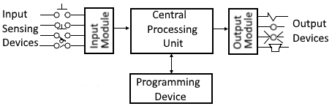
Parts of PLC
CPU
Input/Output modules
Programming Device

Slide 9
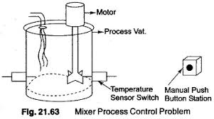
Principle of Operation

Slide 10
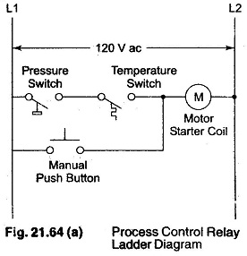
Process control relay ladder diagram

Slide 11
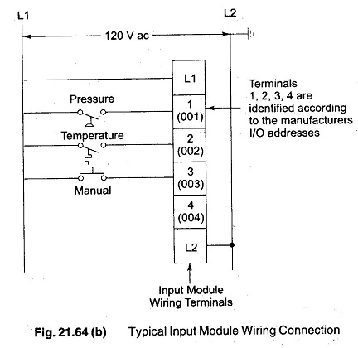
Typical input module wiring connections

Slide 12
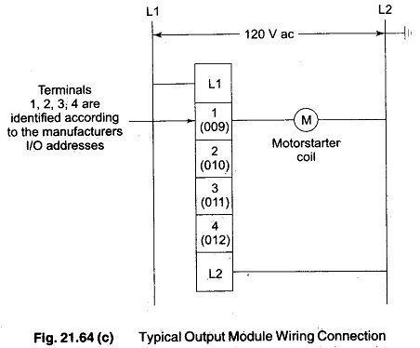
Typical output module wiring connection

Slide 13
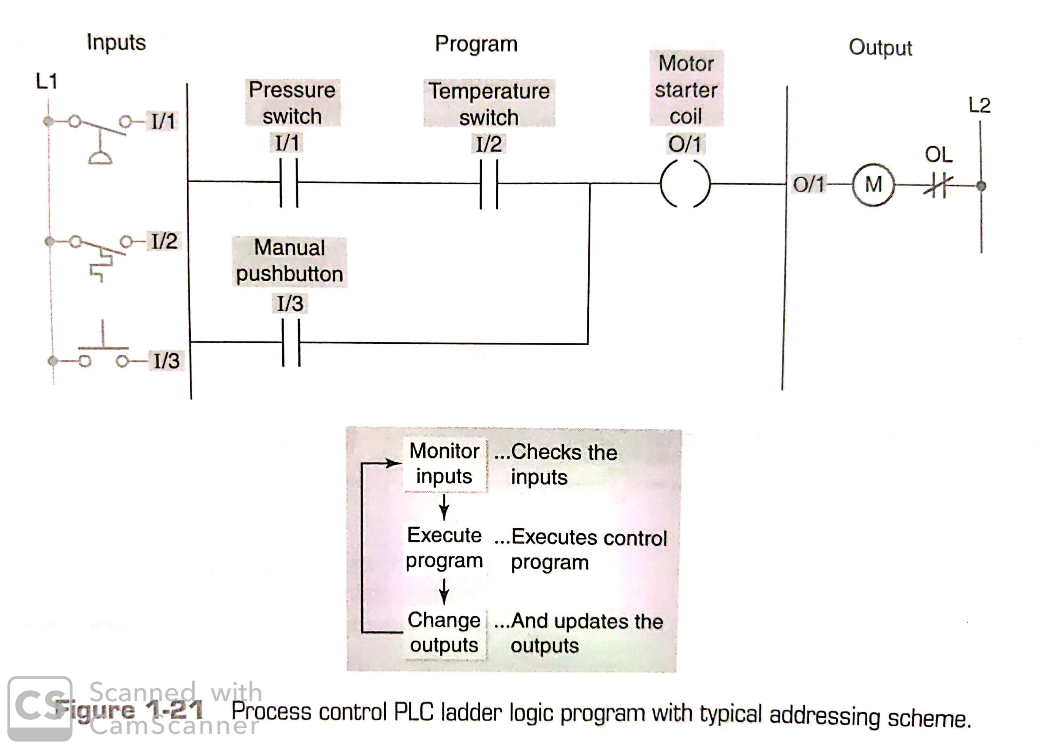
Process control PLC ladder logic diagram

Slide 14
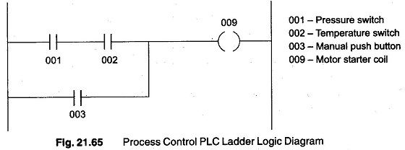
Process control PLC ladder logic diagram

Slide 15
Relay logic diagram for modified process

Slide 16
PLC VERSUS COMPUTERS

Slide 17
PLC size and Application
Three major size categories : Small, Medium and Large
Small : Units with up to 128 I/Os and memories up to 2K bytes.
Medium : Units with up to 2048 I/Os and memories up to 32K bytes.
Large : Units with up to 8192 I/Os and memories up to 750K bytes.

Slide 18
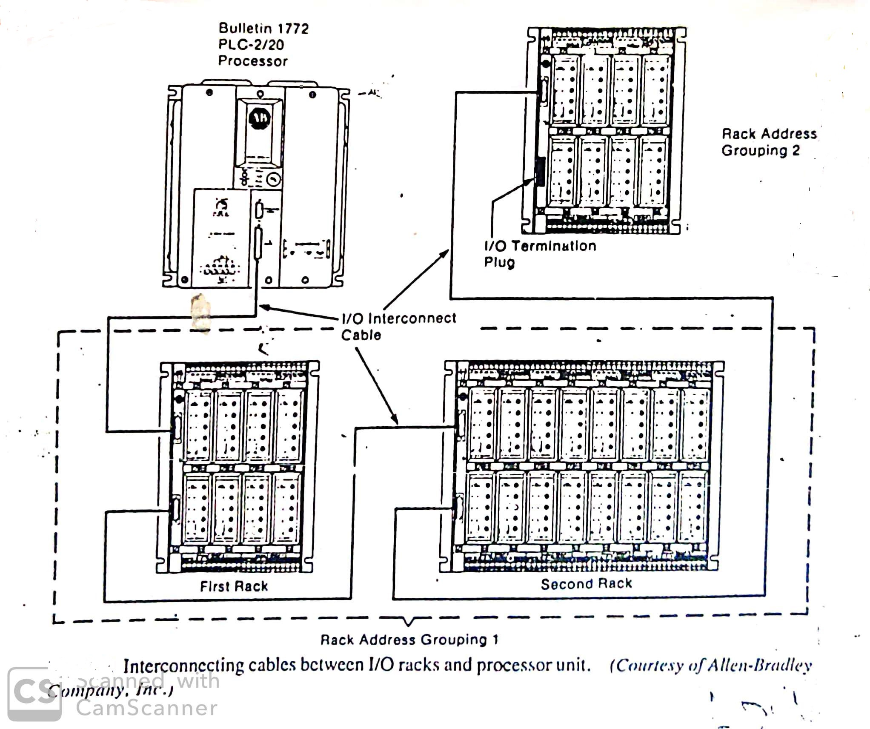
PLC Hardware Components : The I/O Section

Slide 19
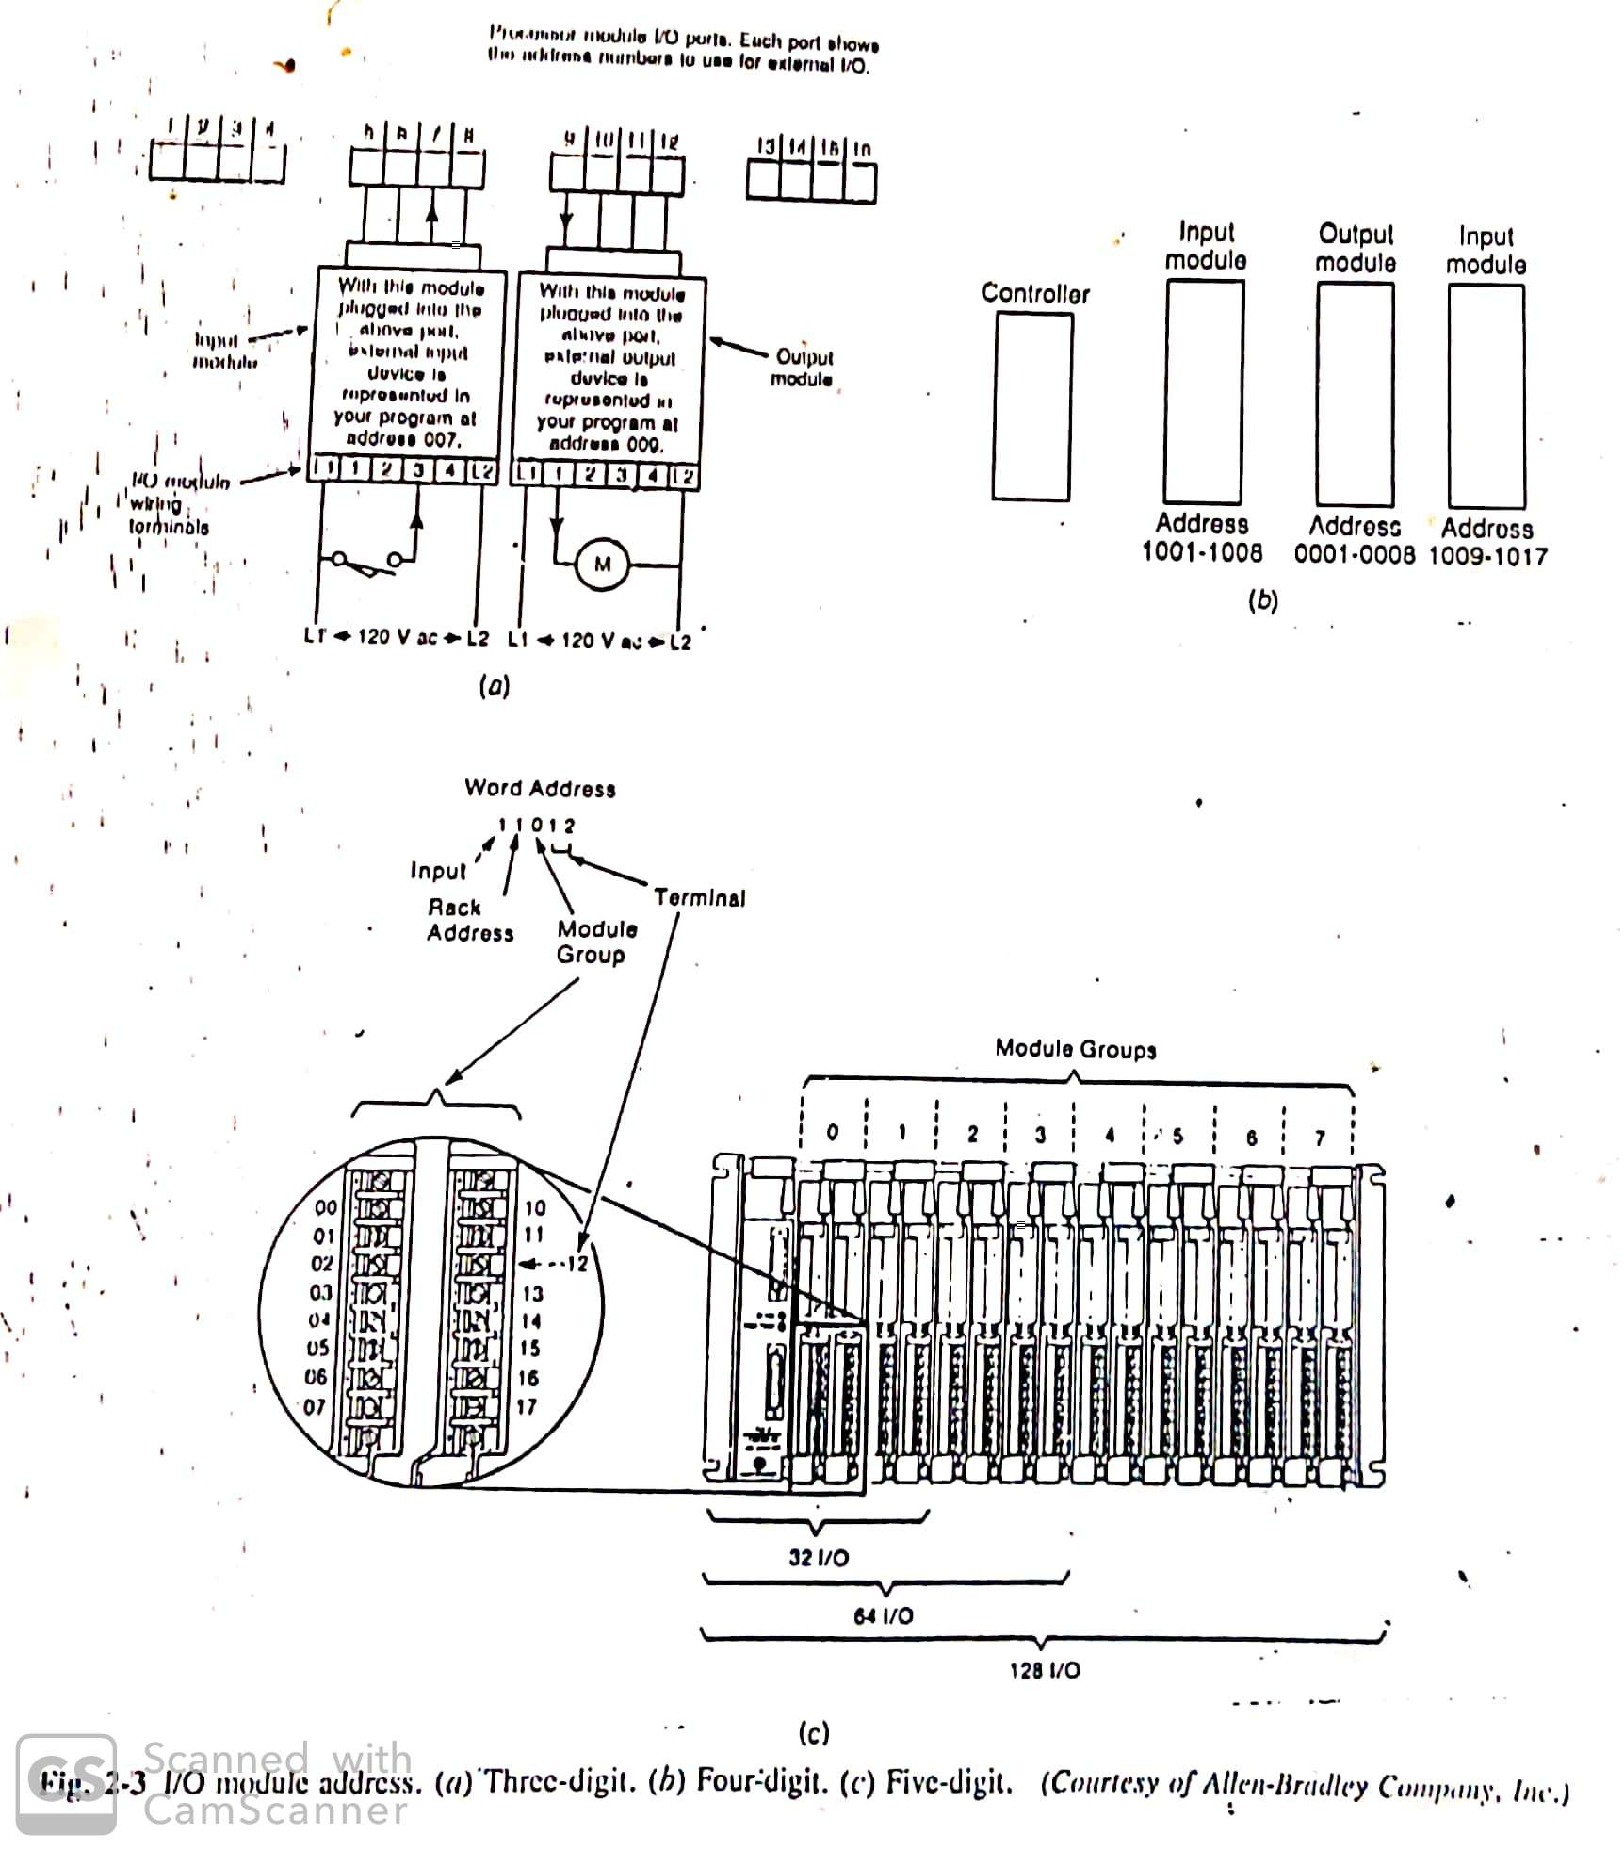
I/O Module Address

Slide 20
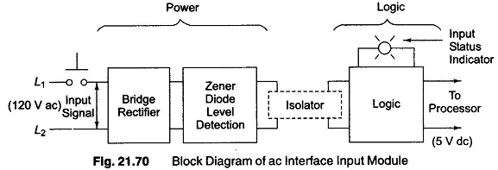
Block diagram of ac interface input module

Slide 21
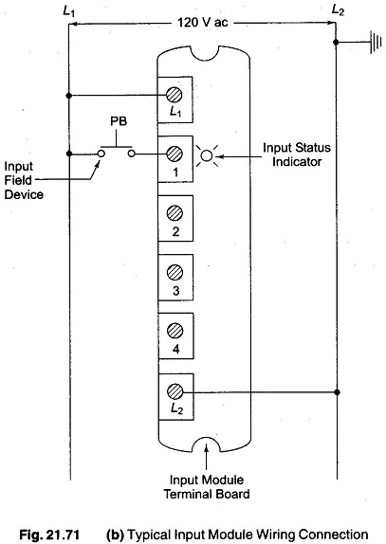
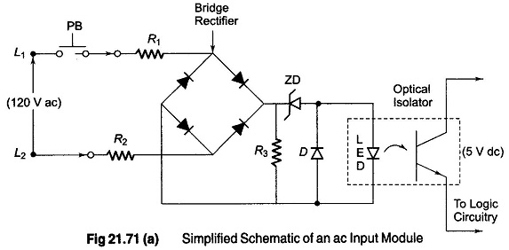
Simplified schematic for an ac input module

Slide 22
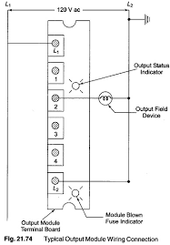
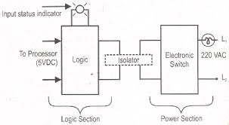
Block diagram of ac output module

Slide 23
Analog I/O Modules
The earlier PLCs were limited to discrete I/O interfaces, which allowed only ON/OFF type devices to be connected
Today, a complete range of both discrete and analog interfaces are available that will allow controllers to be applied to practically any type of control process

Slide 24
I/O specifications
Nominal Input Voltage
Nominal current per input
Nominal output voltage
Output voltage range
Maximum Surge current per output
Off-state leakage current per output

Slide 25
Memory Types
Read only Memory(ROM)
Random Access Memory(RAM)
Programmable Read-Only Memory(PROM)
Erasable Programmable Read only Memory(EPROM)
Electrically Alterable Read only Memory(EAROM)
Electrically Erasable Programmable Read only Memory(EEPROM)
Magnetic Core Memory

Slide 26
THE EVOLUTION OF THE PLC
PLC development began in 1968 in response to a request from an US car manufacturer (GE). The first PLCs were installed in industry in 1969.
Communications abilities began to appear in approximately 1973. They could also be used in the 70’s to send and receive varying voltages to allow them to enter the analog world.
The 80’s saw an attempt to:
standardize communications with manufacturing automation protocol (MAP), reduce the size of the PLC, and making them software programmable through symbolic programming on personal computers instead of dedicated programming terminals or handheld programmers.
The 90’s have seen a gradual reduction in the introduction of new protocols, and the modernization of the physical layers of some of the more popular protocols that survived the 1980’s.
The latest standard “IEC 1131-3” has tried to merge plc programming languages under one international standard. We now have PLCs that are programmable in function block diagrams, instruction lists, C and structured text all at the same time.

Slide 27
Reference
Petruzella, F.D.,Programmable logic controllers. Tata McGraw-Hill Education., 4th Edition,2016.

Slide 28
Thank u…

