Slide 1
Measurements and Instrumentation
A. Paramasivam
Assistant Professor/EEE
B. S. Abdur Rahman
Crescent Institute of Science & Technology

Slide 2
FUNCTIONAL ELEMENTS OF AN INSTRUMENT
Measured Medium
Measured quantity
Primary sensing element
Data storage/ playback element
Variable Conversion element
Variable Manipulationelement
Data Transmission element
Data presentation element
Presented data
Observer

Slide 3
STATIC AND DYNAMIC CHARACTERISTICS
The performance characteristics of an instrument are mainly classified into two categories:
Static Characteristics (do not vary with time)
The set of criteria defined for the instruments, which do not vary with time.
Dynamic Characteristics (vary with time)
The set of criteria defined for the instruments, which varies with respect to time.

Slide 4
The various static characteristics are
Accuracy - Sensitivity
Linearity - Reproducibility
Repeatability - Resolution
Threshold - Stability
Tolerance, etc.
The various dynamic characteristics are
Speed of response
Measuring lag
Dynamic error

Slide 5
Static Characteristics
Accuracy:
degree of closeness of a measured value to a standard or true value.
Sensitivity:
the smallest change in the measured value to which the instrument responds.
In other words, it is the ratio of the changes in the output of an instrument to a change in the value of the quantity to be measured.

Slide 6
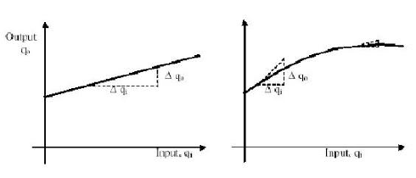
Static Characteristics
Sensitivity can be expressed by:
Sensitivity = Δqo/ Δqi

Slide 7
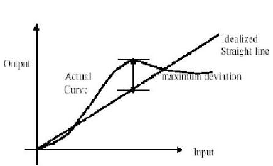
Static Characteristics
Linearity:
the ability to reproduce the input characteristics linearly. The curve shows the actual calibration curve & idealized straight line.

Slide 8
Static Characteristics
Reproducibility:
degree of closeness with which a given value may be repeatedly measured. It is specified in terms of scale readings over a given period of time.
Repeatability:
the variation of scale reading & random in nature.
Resolution:
If the input is slowly increased from some arbitrary input value, it will again be found that output does not change at all until a certain increment is exceeded. This increment is called resolution.

Slide 9
Static Characteristics
Threshold:
If the instrument input is increased very gradually from zero there will be some minimum value below which no output change can be detected. This minimum value defines the threshold of the instrument.
Stability:
the ability of an instrument to retain its performance throughout is specified operating life.
Tolerance:
The maximum allowable error in the measurement is specified in terms of some value which is called tolerance.

Slide 10
Dynamic Characteristics
Speed of response
The rapidity with which a measurement system responds to changes in the measured quantity.
Measuring lag
Delay in the response of a measurement system to changes in the measured quantity.
Dynamic error
Otherwise called as measurement error.
Difference between the true value of the quantity changing with time and the value indicated by the measurement system (provided no static error is assumed)
Fidelity:
degree to which a measurement system indicates changes in the measurand quantity without dynamic error.

Slide 11
Measurement Error
The measurement error is defined as the difference between the true value or actual value and the measured value.
The true value is the average of the infinite number of measurements, and the measured value is the precise value.
In general, the errors in measurement are classified into three types. They are
Gross Error
Systematic Error
Random Error

Slide 12
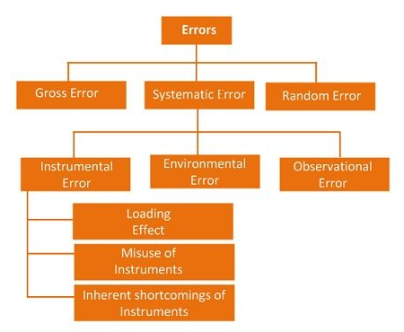
Types of Errors in Measurement

Slide 13
Gross Errors
occurs due to human mistakes. (For example: taking the wrong reading leads to incorrect data)
It can only be avoided by taking the reading carefully.
These errors are very common and the complete elimination is not possible. Some of the gross error easily detected by the experimenter but some of them are difficult to find. Two methods can remove the gross error.
The reading should be taken very carefully.
Two or more readings should be taken of the measurement quantity. The readings are taken by the different experimenter and at a different point for removing the error.

Slide 14
Systematic Errors
The systematic errors are mainly classified into three categories.
Instrumental Errors
Environmental Errors
Observational Errors
Instrumental Errors
These errors mainly arise due to the three main reasons.
Inherent Shortcomings of Instruments
Misuse of Instrument
Loading Effect

Slide 15
Instrument Errors
Inherent Shortcomings of Instruments
Such types of errors are inbuilt in instruments because of their mechanical structure. They may be due to manufacturing, calibration or operation of the device. These errors may cause the error to read too low or too high.
For example
If the instrument uses the weak spring then it gives the high value of measuring quantity. The error occurs in the instrument because of the friction or hysteresis loss.

Slide 16
Instrument Errors
Misuse of Instrument
The error occurs in the instrument because of the fault of the operator. A good instrument used in an unintelligent way may give an enormous result.
For example – the misuse of the instrument may cause the failure to adjust the zero of instruments, poor initial adjustment, using lead to too high resistance. These improper practices may not cause permanent damage to the instrument, but all the same, they cause errors.

Slide 17
Instrument Errors
Loading Effect
It is the most common type of error which is caused by the instrument in measurement work.
For example, when the voltmeter is connected to the high resistance circuit it gives a misleading reading, and when it is connected to the low resistance circuit, it gives the dependable reading. This means the voltmeter has a loading effect on the circuit.
The error caused by the loading effect can be overcome by using the meters intelligently.

Slide 18
Environmental Errors
These errors are due to the external condition of the measuring devices.
Such types of errors mainly occur due to the effect of temperature, pressure, humidity, dust, vibration or because of the magnetic or electrostatic field. The following corrective measures shall be employed to eliminate these undesirable effects,
The arrangement should be made to keep the conditions as constant as possible.
Using the equipment which is free from these effects.
By using the techniques which eliminate the effect of these disturbances.
By applying the computed corrections.

Slide 19
Observational Errors
Such types of errors are due to the wrong observation of the reading. There are many sources of observational error.
For example, the pointer of a voltmeter resets slightly above the surface of the scale. To minimise the parallax error highly accurate meters are provided with mirrored scales.
Random Errors
The error which is caused by the sudden change in the atmospheric condition, such type of error is called random error.
These types of error remain even after the removal of the systematic error. Hence such type of error is also called residual error.

Slide 20
STATISTICAL EVALUATION OF MEASUREMENT DATA
Out of all the various possible errors, the random errors cannot be determined in the ordinary process of measurements. However, these errors can be treated mathematically.
The mathematical analysis of the various measurements is called statistical analysis of the data.

Slide 21
STATISTICAL EVALUATION OF MEASUREMENT DATA
For statistical analysis, the same reading is taken number of times, generally using different observers, different instruments & by different ways of measurement.
The statistical analysis helps to determine analytically the uncertainty of the final test results.
Arithmetic mean & median
Average deviation

Slide 22
STATISTICAL EVALUATION OF MEASUREMENT DATA
When the n umber of readings of the same measurement are taken, the most likely value from the set of measured value is the arithmetic mean of the number of readings taken.
The arithmetic mean value can be mathematically obtained as,
This mean is very close to true value, if number of readings is very large.

Slide 23
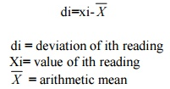
STATISTICAL EVALUATION OF MEASUREMENT DATA
For a set of measurements X1, X2, X3…Xn written down in the ascending order of magnitudes, the median value is given by,
The deviation tells us about the departure of a given reading from the arithmetic mean of the data set,

Slide 24
Calibration & Standards
National Standard Organization
(Primary reference standards)
Standards Laboratory
(Secondary reference standards)
Company Instrument Laboratory
(Working Standards)
Process Instruments

Slide 25
Calibration & Standards
When the working standard instrument has been calibrated by an authorized standards laboratory, a calibration certificate will be issued. This will contain at least the following information:
the identification of the equipment calibrated
the calibration results obtained
the measurement uncertainty
any use limitations on the equipment calibrated
the date of calibration
the authority under which the certificate is issued.

Slide 26
References
Doebelin E.O., "Measurement Systems - Application and Design", McGraw Hill Publishing Company, 1990.
Murthy, D.V.S., "Transducer and Instrumentation", Prentice Hall of India Pvt. Ltd., 1995.
Stout ,M.B., "Basic Electrical Measurement", Prentice Hall of India
Morris, A.S ,"Principle of Measurement and Instrumentation", Prentice Hall of India, 1999.

Slide 27
Thank You

