Slide 1

HIGH VOLTAGE ENGINEERING
Over voltage phenomenon and insulation coordination
Prepared by:
V.Bharanigha,AP/EEE

Slide 2
OVER VOLTAGES
Increase in voltage for very short time
Also Called as voltage surge or voltage transients
Causes:
1. Over voltage due to external causes
2. Over voltage due to internal causes

Slide 3
Over voltage due to internal causes
by connecting or disconnecting the system or due to the systems fault initiation or extinction
Temporary overvoltages: if they are oscillatory of power frequency or harmonics
  under no load or very light load conditions
Switching overvoltages: if they are heavily damped and of short duration
Both types occur together , because of their nature => Design of HV insulation system

Slide 4
Over voltage due to internal causes ctd.,
overvoltages increases with increasing the operating voltage of the system
with increasing the system’s operating voltage a point is reached when the switching overvoltages become the dominant factor in designing the system’s insulation

Slide 5
Over voltage due to external causes
lightning strokes in the cloud
independent of the system’s design
Insulation design depends on
Upto 300kV | 300 kV to 765 kV | Above 765 kV
primarily lightning surges | both lightning and switching surges | switching overvoltages in combination with insulator contamination

Slide 6
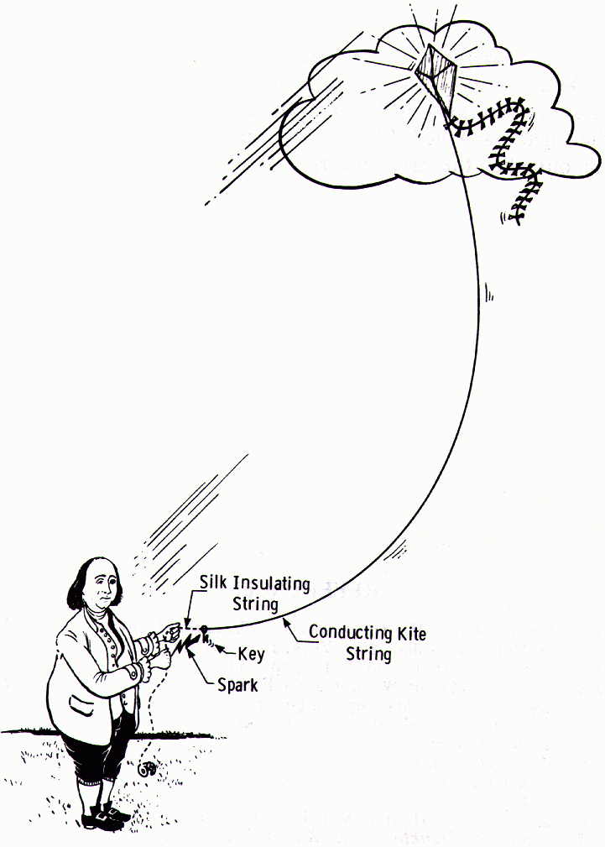
Kite experiment
Benjamin Franklin (1752) and his experiments, in which were demonstrated the electrical nature of lightning

Slide 7
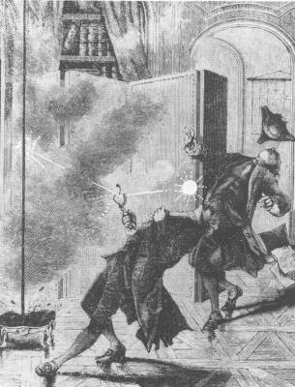
Kite experiment
… such dangerous experiments were stopped after the tragical death of Prof. Richmann (1753) …
→ serious explanations of lightning phenomena exist until the 19th/ 20th century
→ The real incentive to study lightning came when electric transmission lines had to be protected against lightning

Slide 8
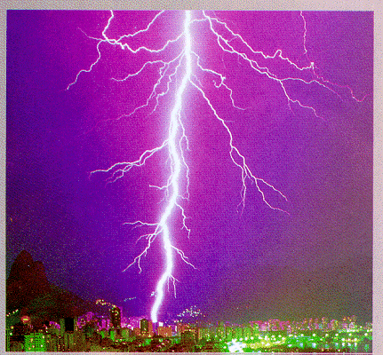
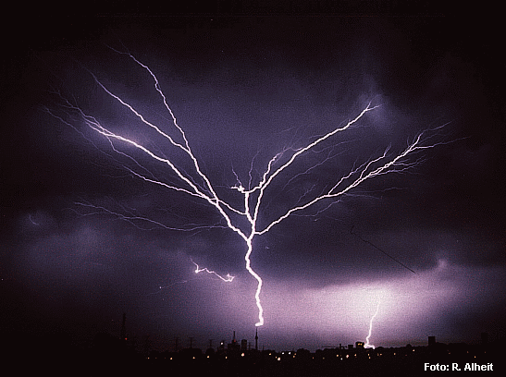
Types of lightning
Intra- Cloud(s) (IC)
Cloud- Ground (CG)
Cloud- Ground (95%)
Ground- Cloud (5%)

Slide 9
Measurements Considered for study
(i) lightning current
(ii) magnetic and electromagnetic radiated fields
(iii) voltages
(iv) use of high-speed photography and radar

Slide 10
PHENOMENA – THUNDER CLOUDS
1.The height of the cloud base above the surrounding ground level may vary from 160 to 9,500 m.
The charged centres which are responsible for lightning are in the range of 300 to 1500 m.
2. The maximum charge on a cloud is of the order of 10 C which is built up exponentially over a period of perhaps many seconds or even minutes.
3. The maximum potential of a cloud lies approximately within the range of 10 MV to 100 MV.
4. The energy in a lightning stroke may be of the order of 250 kWhr.

Slide 11
PHENOMENA – THUNDER CLOUDS
5. Raindrops:
(a) Raindrops elongate and become unstable under an electric field, the limiting diameter being 0.3 cm in a field of 100 kV/cm.
(b) A free falling raindrop attains a constant velocity with respect to the air depending upon its size.
  800 cm/sec for drops of the size 0.25 cm diameter
  zero for spray
This means that in case the air currents are moving upwards with a velocity greater than 800 cm/sec, no rain drop can fall.
(c) Falling raindrops greater than 0.5 cm in diameter become unstable and break up into smaller drops.

Slide 12

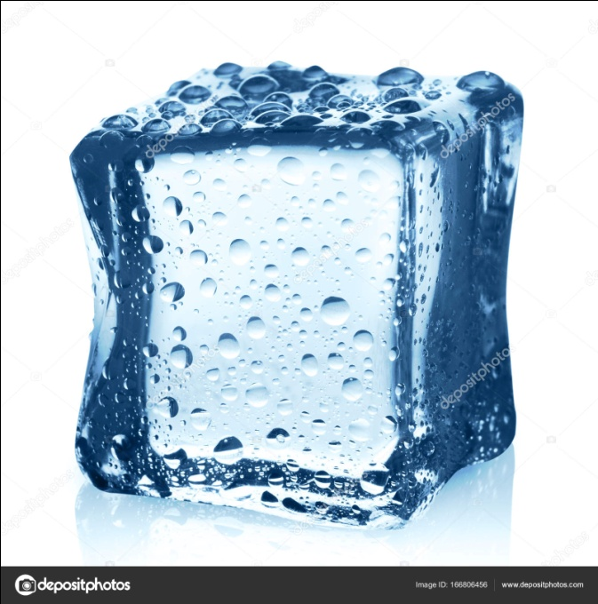
Water drop ice crystal
+ -
+ -
+ -
+ -
- +
- +
- +
- +
- +
Air current
Air current
(d) When a drop is broken up by air currents, the water particles become positively charged and the air negatively charged.
(e) When an ice crystal strikes with air currents, the ice crystal is negatively charged and the air positively charged.

Slide 13
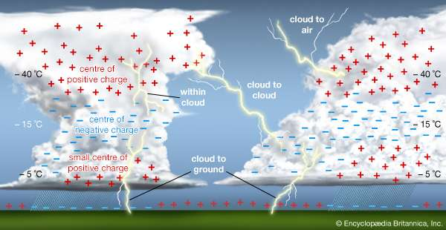
Wilson’s Theory of Charge Separation

Slide 14
wilson’s theory of charge separation ctd.,
assumption that a large number of ions are present in the atmosphere
ions attach themselves to small dust particles and water particles
electric field exists in the earth’s atmosphere during fair weather which is directed downwards towards the earth
The intensity of the field is approximately 1 volt/cm at the surface of the earth and decreases gradually with height so that at 9,500 m it is only about 0.02 V/cm

Slide 15
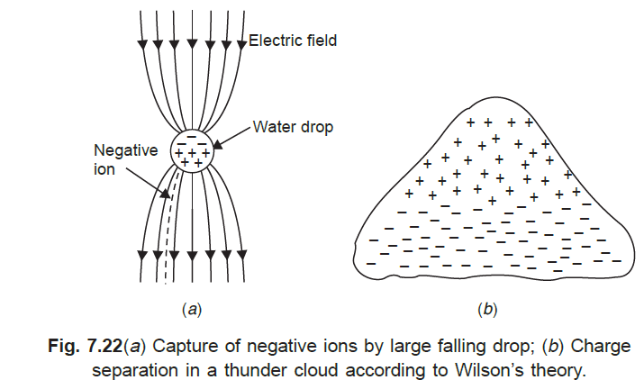
wilson’s theory of charge separation ctd.,

Slide 16
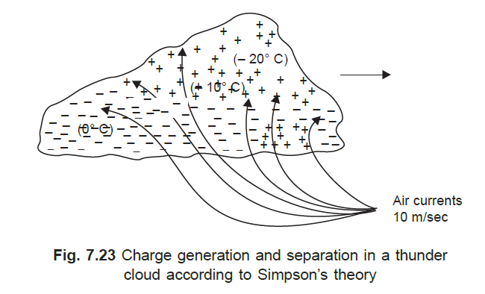
Simpson’s and Scarse Theory
based on the temperature variations in the various regions of the cloud.

Slide 17
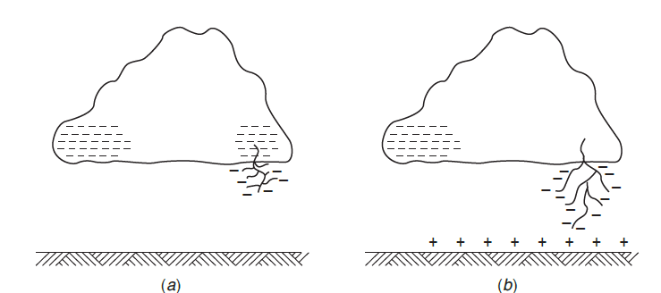
Mechanism of Lightning Stroke
Lightning phenomenon is the discharge of the cloud to the ground

Slide 18
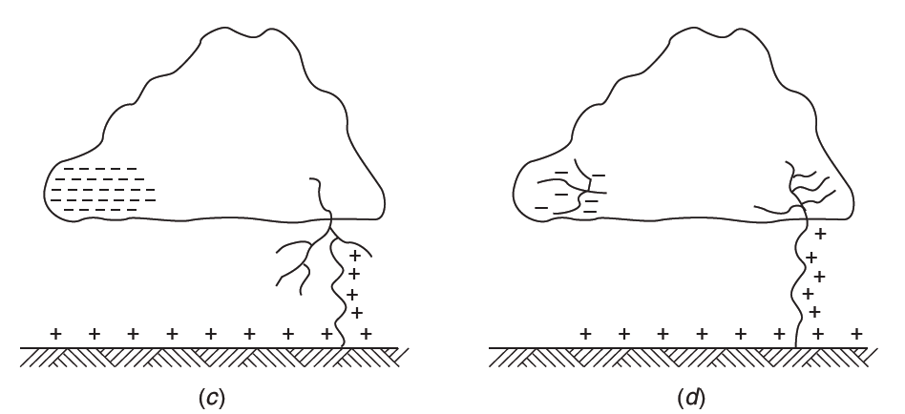

Slide 19
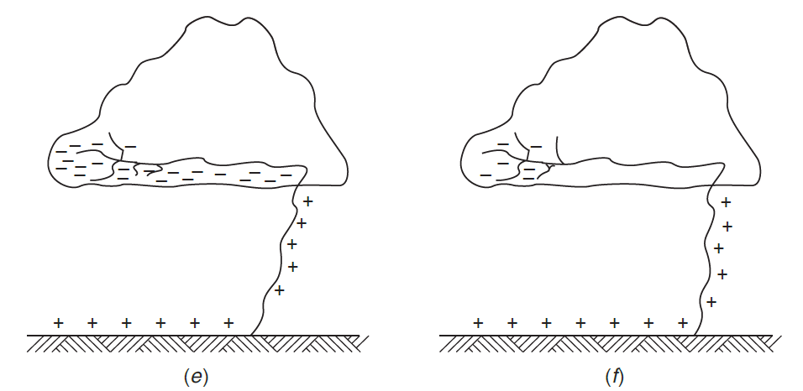

Slide 20
LINE DESIGN BASED ON LIGHTNING
Lightning creates magnetically induced current in all metal items within its influence
  The longer the wire, greater the current
  The closer the strike, greater the current
Any impedance to current flow results in
  Build up of high voltage at that location
  Resulting in arc-over to reach ground
    Ignites flammable material
    Vaporizes metal of insufficient cross-section

Slide 21
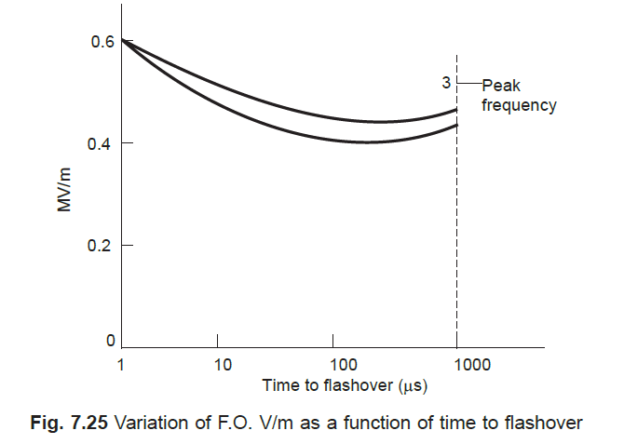
SWITCHING SURGE TEST VOLTAGE CHARACTERISTICS

Slide 22
OVERVOLTAGE DUE TO SWITCHING SURGES, SYSTEM
FAULTS AND OTHER ABNORMAL CONDITIONS

Slide 23
INTRODUCTION
Transmission voltage : 220 kV and below
  Over voltage due to lightning were of high order
  Over voltage generated inside the system were less
Transmission voltage : 400 kV and above
The overvoltages generated inside the system reached the same order of magnitude as those of lightning over voltages, or higher.
The overvoltages thus generated last for longer durations and therefore are severe and more dangerous to the system.

Slide 24
insulation co-ordination
The protective level of any particular kind of surge diverter is proportional to
the maximum voltage
the insulation level
The cost of the equipment
depends on the magnitudes of these overvoltages

Slide 25
Origin of Switching Surges
Power systems have large inductances and capacitances
Making and breaking of electric circuits with switchgear may result in abnormal overvoltages
Overvoltages = 6 times of normal power frequency voltage.
switching surges with a high rate of rise of voltage may cause repeated restriking of the arc between the contacts of a circuit breaker, thereby causing destruction of the circuit breaker contacts.
high natural frequencies of the system
a damped normal frequency voltage component,
the restriking recovery voltage of the system with successive reflected waves from terminations.

Slide 26
Characteristics of Switching Surges
  De-energizing of transmission lines, cables, shunt capacitor, banks, etc.
  Disconnection of unloaded transformers, reactors, etc.
  Energization or reclosing of lines and reactive loads,
  Sudden switching off of loads.
  Short circuits and fault clearances.
  Resonance phenomenon like ferro-resonance, arcing grounds, etc.

Slide 27
Typical waveshapes of switching surge voltages
Recovery voltage after fault clearing Fault initiation

Slide 28
Typical waveshapes of switching surge voltages
Overvoltage at the line end after Energization of long transmission line
fault clearing

Slide 29
Typical waveshapes of switching surge voltages
Overvoltage at line end during energization of long transmission line

Slide 30
overvoltages are irregular (oscillatory or unipolar) and
of high frequency or power frequency with its harmonics
The relative magnitudes of the overvoltages may be about
2.4 p.u. in the case of transformer energizing
1.4 to 2.0 p.u. in switching transmission lines

Slide 31
Switching Overvoltages In EHV and UHV Systems
The insulation has the lowest strength for switching surges with regard to long air gaps.
switching overvoltages are of relatively higher magnitudes as compared to the lightning overvoltages for UHV systems
interruption of low inductive currents (current chopping) by high speed circuit breakers. This occurs when the transformers or reactors are switched off
interruption of small capacitive currents, such as switching off of unloaded lines etc.
ferro-resonance condition - This may occur when poles of a circuit breaker do not close simultaneously
energization of long EHV or UHV lines.

Slide 32
Switching Overvoltages In EHV and UHV Systems
Transient overvoltages will have magnitudes of the order of 1200 kV to 2000 kV on 750 kV systems.
Duration:1 to 10ms
These magnitudes will be higher during lightning and last for several cycles

Slide 33
Switching Overvoltages In EHV and UHV Systems
switching overvoltages of shorter duration (0.5 to 5 ms) and lower magnitudes (2.0 to 2.5 p.u.)are due to
(a) single pole closing of circuit breaker
(b) interruption of fault current when the L-G or L-L fault is cleared
(c) resistance switching used in circuit breakers
(d) switching lines terminated by transformers
(e) series capacitor compensated lines
(f) sparking of the surge diverter located at the receiving end of the line to limit the lightning overvoltages

Slide 34
Switching Overvoltages In EHV and UHV Systems
The overvoltages due to the above conditions are studied or calculated from
(a) mathematical modelling of a system using digital computers
(b) scale modelling using transient network analysers
(c) by conducting field tests to determine the expected maximum amplitude of the overvoltages and their duration at different points on the line.

Slide 35
Switching Overvoltages In EHV and UHV Systems
The main factors that are investigated
(i) the effect of line parameters, series capacitors and shunt reactors on the magnitude and duration of the transients
(ii) the damping factors needed to reduce the magnitude of overvoltages
(iii) the effect of single pole closing, restriking and switching with series resistors
or circuit breakers on the overvoltages, and
(iv) the lightning arrester sparkover characteristics.It

Slide 36
Switching Overvoltages In EHV and UHV Systems
The measures taken to control or reduce the overvoltages are
(i) one step or multi-step energization of lines by pre-insertion of resistors,
(ii) phase controlled closing of circuit breakers with proper sensors,
(iii) drainage of trapped charges on long lines before the reclosing of the lines,and
(iv) limiting the overvoltages by using surge diverters.

Slide 37
POWER FREQUENCY OVERVOLTAGES IN POWER SYSTEMS

Slide 38
The power frequency overvoltages occur in large power systems and they are of much concern in EHV systems, i.e. systems of 400 kV and above.
The main causes for power frequency and its harmonic overvoltages are
(a) sudden loss of loads,
(b) disconnection of inductive loads or connection of capacitive loads,
(c) Ferranti effect, unsymmetrical faults, and
(d) saturation in transformers, etc.
Overvoltages of power frequency harmonics and voltages with frequencies nearer to the operating frequency are caused during tap changing operations, by magnetic or ferro-resonance phenomenon in large power transformers, and by resonating overvoltages due to series capacitors with shunt reactors or transformers.

Slide 39
Sudden Load Rejection
Sudden load rejection on large power systems causes the speeding up of generator prime movers
The speed governors and automatic voltage regulators will intervene to restore normal conditions But initially both the frequency and voltage increase.
The approximate voltage rise, neglecting losses, etc. may be taken as
xs = reactance of the generator (« the sum of the transient reactances of the generator and the transformer)
xc = capacitive reactance of the line at open end
at increased frequency
E’ = voltage generated before the over-speeding and load rejection
f = the instantaneous increased frequency
fo= is the normal frequency

Slide 40
This increase in voltage may go to as high as 2.0 per unit (p.u.) value with 400 kV lines.
The voltage at the sending end is affected by the line length, short circuit MVA at sending end bus, and reactive power generation of the line (due to line capacitive reactance and any shunt or series capacitors).
Shunt reactors may reduce the voltage to 1.2 to 1.4 p.u.

Slide 41
Ferranti Effect
Long uncompensated lines exhibit voltage rise at receiving end
V2=V1/cos βl
Where V1, V2 are the sending and receiving end voltages respectively
l=length of the line
β=Phase constant of the line
= [(R+jωL) (G+jωC)/LC]1/2
=6 degree per 100 km line at 50 Hz frequency
ω=Angular frequency

Slide 42
Approximated solution
Capacitance is concentrated in middle
Solution yields

Slide 43
Ground Faults and Their Effects
SLTG cause rise in voltage in other healthy phases
Solid ground systems, voltage rise is less than the line to line voltage
Effectively ground systems, X₀/X₁< 3.0 and R₀/X₁ < 1.0
rise in voltage of healthy phases does not usually exceed 1.4 pu

Slide 44
SATURATION EFFECTS
When overvoltage(OV) is applied to transformers, their magnetizing currents increase rapidly,
It may be about full rated current for 50% overvoltage
These are not sinusoidal but peaky waveform
3rd,5th and 7th harmonics be 65%,35%,and 25% of rated current with fundamental frequency to OV of 1.2 pu

Slide 45
SATURATION EFFECTS
3rd and multiple harmonics
Zero sequence impedance is effective
Delta connected windings will suppress them
Higher harmonics
Series resonance between transformer L and line C occurs
Higher voltage is produced

Slide 46
CONTROL OF OVERVOLTAGES DUE TO SWITCHING

Slide 47
The overvoltages due to switching and power frequency may be controlled by
(a) energization of transmission lines in one or more steps by inserting resistances and withdrawing them afterwards,
(b) phase controlled closing of circuit breakers,
(c) drainage of trapped charges before reclosing,
(d) use of shunt reactors, and
(e) limiting switching surges by suitable surge diverters.

Slide 48
Insertion of Resistors
common practice to insert resistances R in series with circuit breaker contacts when switching on but short circuiting them after a few cycles.
reduce the transients occurring due to switching
Zo/(R+Zo) per unit The voltage step is reduced to this value
(R-Zo)/(R+Zo) Reflection factor per unit
R = Zo No reflection
The applied step at the first instance is only 0.5 per unit
Notes:
The applied step at the first instance is only 0.5 per unit.
When the resistor is short circuited, a voltage step equal to the instantaneous
voltage drop enters the line. If the resistor is kept for a duration larger than 5ms (for
50 Hz sine wave = 1/4 cycle duration), it can be shown from successive reflections
and transmissions, that the overvoltage may reach as high as 1.2 p.u. for a line length
of 500 km. But for conventional opening of the breaker, the resistors have too high an
ohmic value to be effective for resistance closing. Therefore, pre-insertion of suitable
value resistors in practice is done to limit the overvoltage to less than 2.0 to 2.5 p.u.
Normal time of insertion is 6 to 10 m s

Slide 49
Insertion of Resistors ctd.,
When the resistor is short circuited, a voltage step equal to the instantaneous voltage drop enters the line.
If the resistor is kept for a duration larger than 5ms (for50 Hz sine wave = 1/4 cycle duration).
It can be shown from successive reflections and transmissions, that the overvoltage may reach as high as 1.2 p.u. for a line length of 500 km.
But for conventional opening of the breaker, the resistors have too high an ohmic value to be effective for resistance closing.
Therefore, re-insertion of suitable value resistors in practice is done to limit the overvoltage to less than 2.0 to 2.5 p.u.
Normal time of insertion is 6 to 10 m s.

Slide 50
Phase Controlled Switching
Overvoltages can be avoided by controlling the exact instances of the closing of the three phases separately.
But this necessitates the use of complicated controlling equipment and therefore is not adopted.

Slide 51
Drainage of Trapped Charge
When lines are suddenly switched off, "electric charge" may be left on capacitors and line conductors.
This charge will normally leak through
the leakage path of the insulators, etc.
Conventional potential transformers (magnetic)
temporary insertion of resistors to ground or in series with
shunt reactors and removing before the closure of the switches.

Slide 52
Shunt Reactors
Normally all EHV lines will have shunt reactors to limit the voltage rise due to the Ferranti effect. They also help in reducing surges caused due to sudden energizing.
However, shunt reactors cannot drain the trapped charge but will give rise to oscillations with the capacitance of the system.
Since the compensation given by the reactors will be less than 100%, the frequency of oscillation will be less than the power frequency and overvoltages produced may be as high as 1.2 p.u.
Resistors in series with these reactors will suppress the oscillations and limit the overvoltages.

Slide 53
Protection against Lightning Overvoltages and Switching Surges of short Duration
Overvoltages due to lightning strokes can be avoided or minimized in practice by
(a) shielding the overhead lines by using ground wires above the phase wires,
(b) using ground rods and counter-poise wires, and
(c) including protective devices like expulsion gaps, protector tubes on the lines and surge diverters at the line terminations and substations.

Slide 54
REFERENCES
1. C.L.Wadhwa, “High Voltage Engineering”, by New Age Internationals (P) Limited, 1997.
2. M.S.Naidu and V. Kamaraju - High Voltage Engineering”, by – TMH Publications, 3rd Edition, 2000.
3. https://www.britannica.com/science/lightning-meteorology
4. https://www.youtube.com/watch?v=g5mzFb2hhHY
5. https://www.youtube.com/watch?v=1bgtz81TXWc&t=58s
6. https://youtu.be/Cz_uYBx1G5s
7. https://www.youtube.com/watch?v=DjByja9ejTQ
8. https://www.youtube.com/watch?v=ozeYaikI11g&t=1s

