Slide 1

ELECTRIC ENERGY GENERATION, UTILISATION
AND CONSERVATION OF ENERGY
Prepared by:
Dr.R.Jayashree
Professor/EEE
BSA CRESCENT IS&T
Vandalur,Chennai - 48

Slide 2
Non Conventional Energy Sources

Slide 3
CONTENTS
1.TIDAL ENERGY
2. WIND ENERGY
3.FUEL CELL
4. BIOMASS ENERGY
5. CO-GENERATION
6. DISTRIBUTED GENERATION
7. GEOTHERMAL ENERGY
8. SOLAR ENERGY

Slide 4
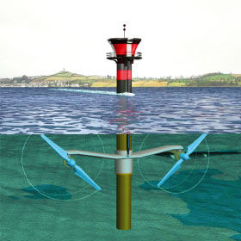
TIDAL energy

Slide 5
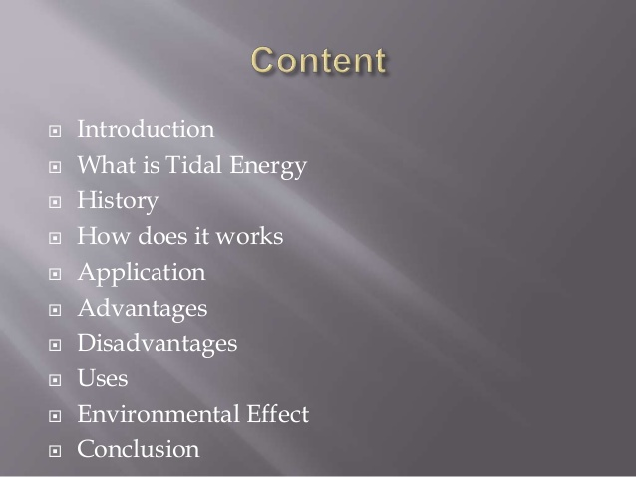

Slide 6
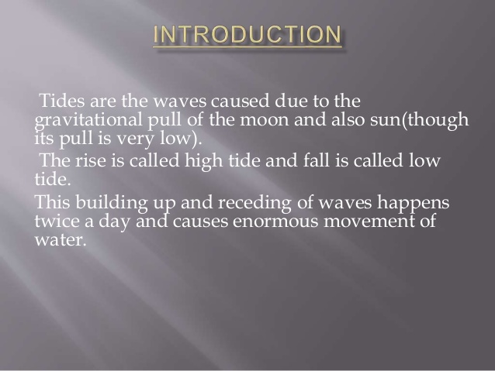

Slide 7
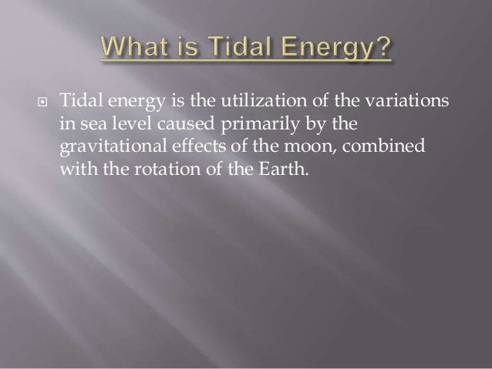

Slide 8
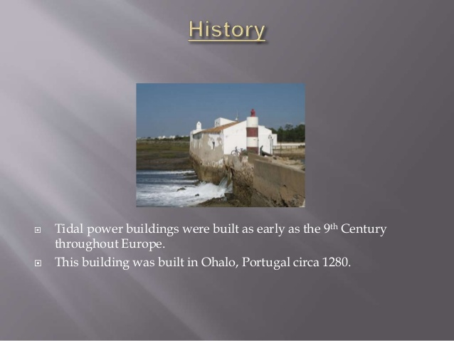

Slide 9
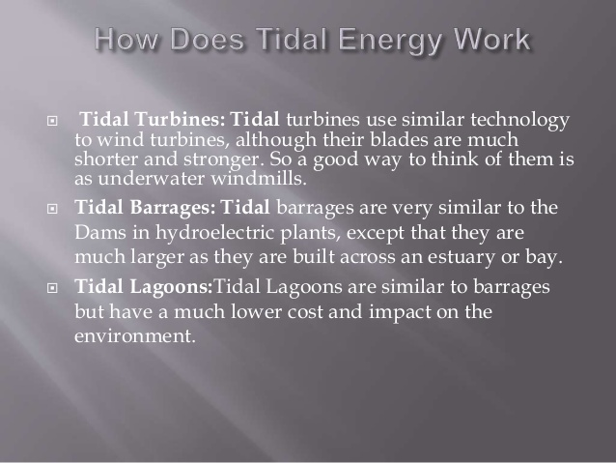

Slide 10
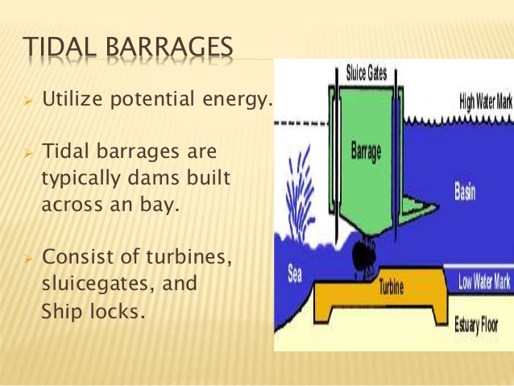

Slide 11
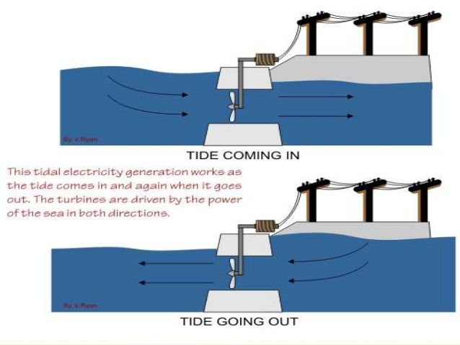

Slide 12
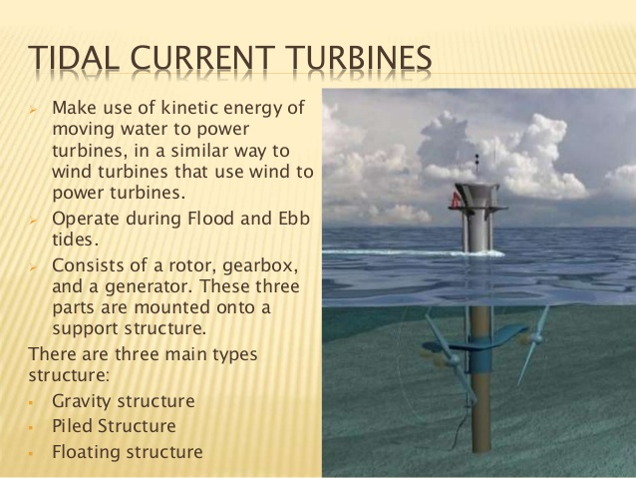

Slide 13
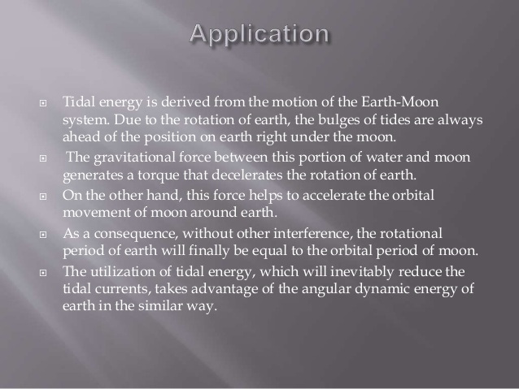

Slide 14
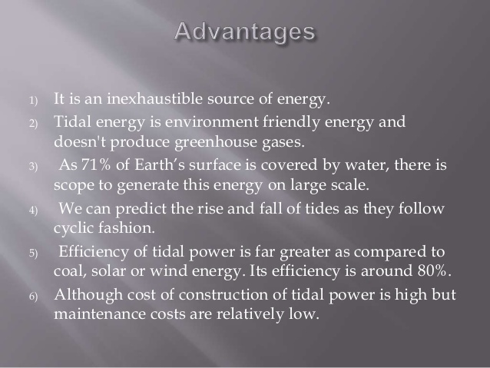

Slide 15
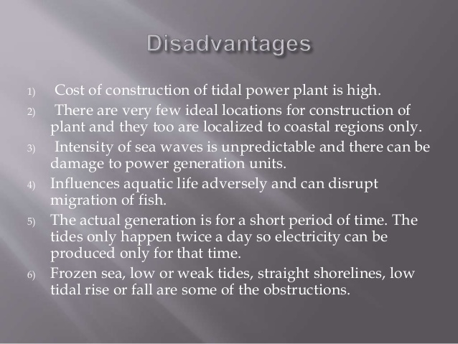

Slide 16
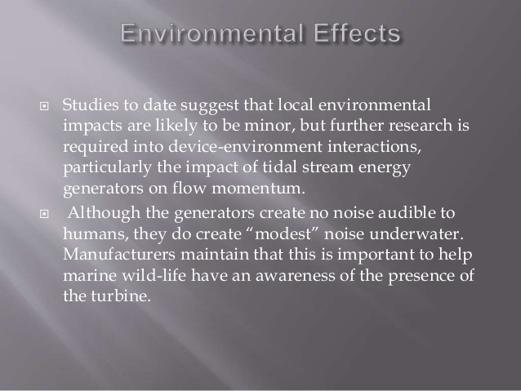

Slide 17
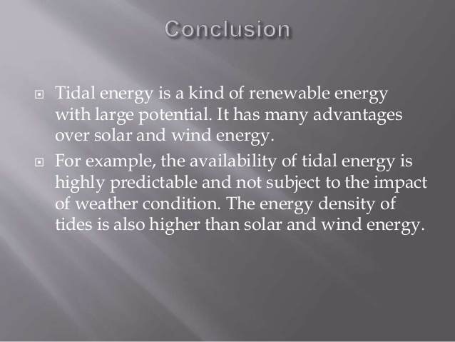

Slide 18
Wind Energy

Slide 19
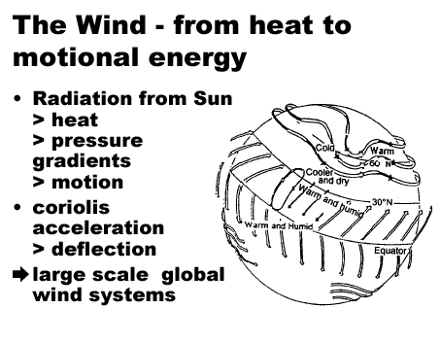

Slide 20
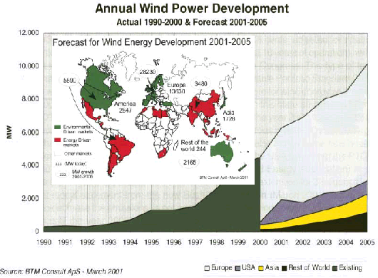

Slide 21
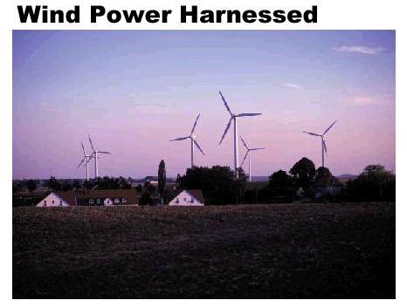

Slide 22
Wind Turbine Power:
  P = 0.5 x rho x A x Cp x V³ x Ng x Nb
P = power in watts (746 watts = 1 hp)
rho = air density (about 1.225 kg/m³ at sea level, less higher up)
A = rotor swept area, exposed to the wind (m²)
Cp = Coefficient of performance (.59 {Betz limit} is the maximum theoretically possible, .35 for a good design)
V = wind speed in meters/sec (20 mph = 9 m/s)
Ng = generator efficiency (50% for car alternator, 80% or possibly more for a permanent magnet generator or grid-connected induction generator)
Nb = gearbox/bearings efficiency (depends, could be as high as 95% if good)

Slide 23
Classes of Wind Power Density at 10 m and 50 m^{(a)}
.
10 m (33 ft)
50 m (164 ft)
Wind
Power
Class
Wind
Power
Density
(W/m²)
Speed^{(b)}
m/s (mph)
Wind
Power
Density
(W/m²)
Speed^{(b)}
m/s (mph)
1
<100
<4.4 (9.8)
<200
<5.6 (12.5)
2
100 - 150
4.4 (9.8)/5.1 (11.5)
200 - 300
5.6 (12.5)/6.4 (14.3)
3
150 - 200
5.1 (11.5)/5.6 (12.5)
300 - 400
6.4 (14.3)/7.0 (15.7)
4
200 - 250
5.6 (12.5)/6.0 (13.4)
400 - 500
7.0 (15.7)/7.5 (16.8)
5
250 - 300
6.0 (13.4)/6.4 (14.3)
500 - 600
7.5 (16.8)/8.0 (17.9)
6
300 - 400
6.4 (14.3)/7.0 (15.7)
600 - 800
8.0 (17.9)/8.8 (19.7)
7
>400
>7.0 (15.7)
>800
>8.8 (19.7)

Slide 24
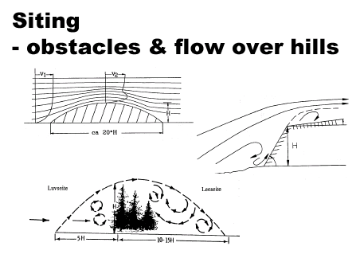

Slide 25
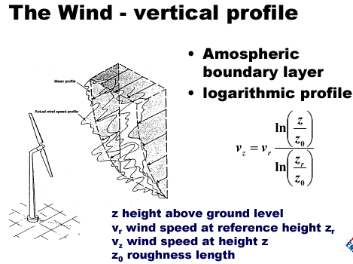

Slide 26
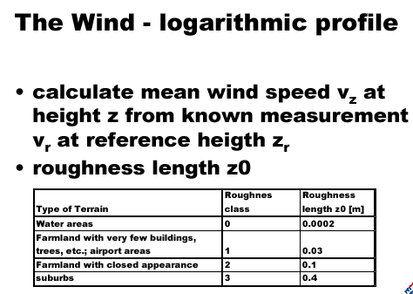

Slide 27
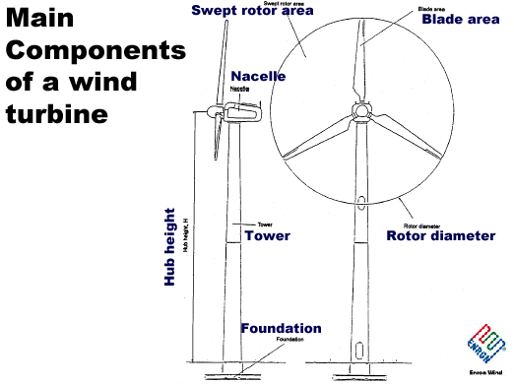

Slide 28
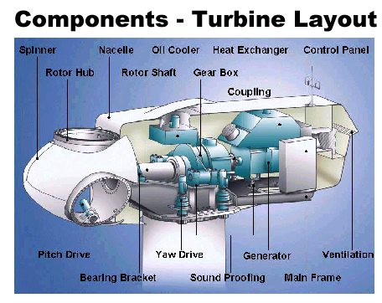

Slide 29
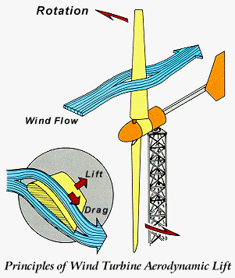

Slide 30
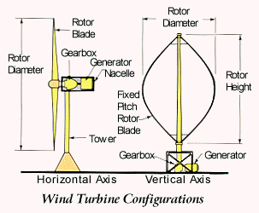

Slide 31

Environmental benefits
  No emissions
  No fuel needed
Distributed power
Remote locations

Slide 32
Limitations of Wind Power
Power density is very low.
  Needs a very large number of wind mills to produce modest amounts of power.
Cost.
Environmental costs.
  material and maintenance costs.
  Noise, birds and appearance.
Cannot meet large scale and transportation energy needs.

Slide 33
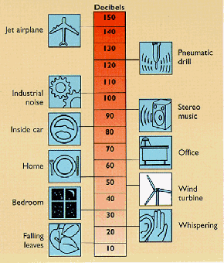
Wind Turbine
Noise Levels

Slide 34
The Future of Wind Energy
Future of wind energy can be bright if government policies subsidize and encourage its use.
Technology improvements unlikely to have a major impact.
Can become cost competitive for electricity generation if fossil energy costs skyrocket.

Slide 35
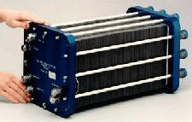
Fuel Cells

Slide 36
The Promise of Fuel Cells
“A score of nonutility companies are well advanced toward developing a powerful chemical fuel cell, which could sit in some hidden closet of every home silently ticking off electric power.”
  Theodore Levitt, “Marketing Myopia,” Harvard Business Review, 1960
Theodore Levitt, “Marketing Myopia,” Harvard Business Review, 1960

Slide 37
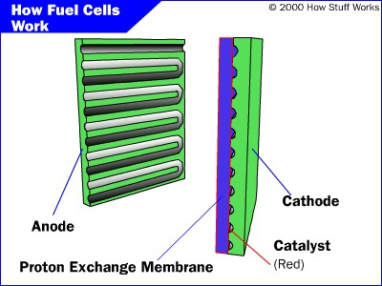
PEM Fuel Cell

Slide 38
Parts of a Fuel Cell
Anode
  Negative post of the fuel cell.
  Conducts the electrons that are freed from the hydrogen molecules so that they can be used in an external circuit.
  Etched channels disperse hydrogen gas over the surface of catalyst.
Cathode
  Positive post of the fuel cell
  Etched channels distribute oxygen to the surface of the catalyst.
  Conducts electrons back from the external circuit to the catalyst
  Recombine with the hydrogen ions and oxygen to form water.
Electrolyte
  Proton exchange membrane.
  Specially treated material, only conducts positively charged ions.
  Membrane blocks electrons.
Catalyst
  Special material that facilitates reaction of oxygen and hydrogen
  Usually platinum powder very thinly coated onto carbon paper or cloth.
  Rough & porous maximizes surface area exposed to hydrogen or oxygen
  The platinum-coated side of the catalyst faces the PEM.

Slide 39
Fuel Cell Operation
Pressurized hydrogen gas (H₂) enters cell on anode side.
Gas is forced through catalyst by pressure.
  When H₂ molecule comes contacts platinum catalyst, it splits into two H+ ions and two electrons (e-).
Electrons are conducted through the anode
  Make their way through the external circuit (doing useful work such as turning a motor) and return to the cathode side of the fuel cell.
On the cathode side, oxygen gas (O₂) is forced through the catalyst
  Forms two oxygen atoms, each with a strong negative charge.
  Negative charge attracts the two H+ ions through the membrane,
  Combine with an oxygen atom and two electrons from the external circuit to form a water molecule (H₂O).

Slide 40
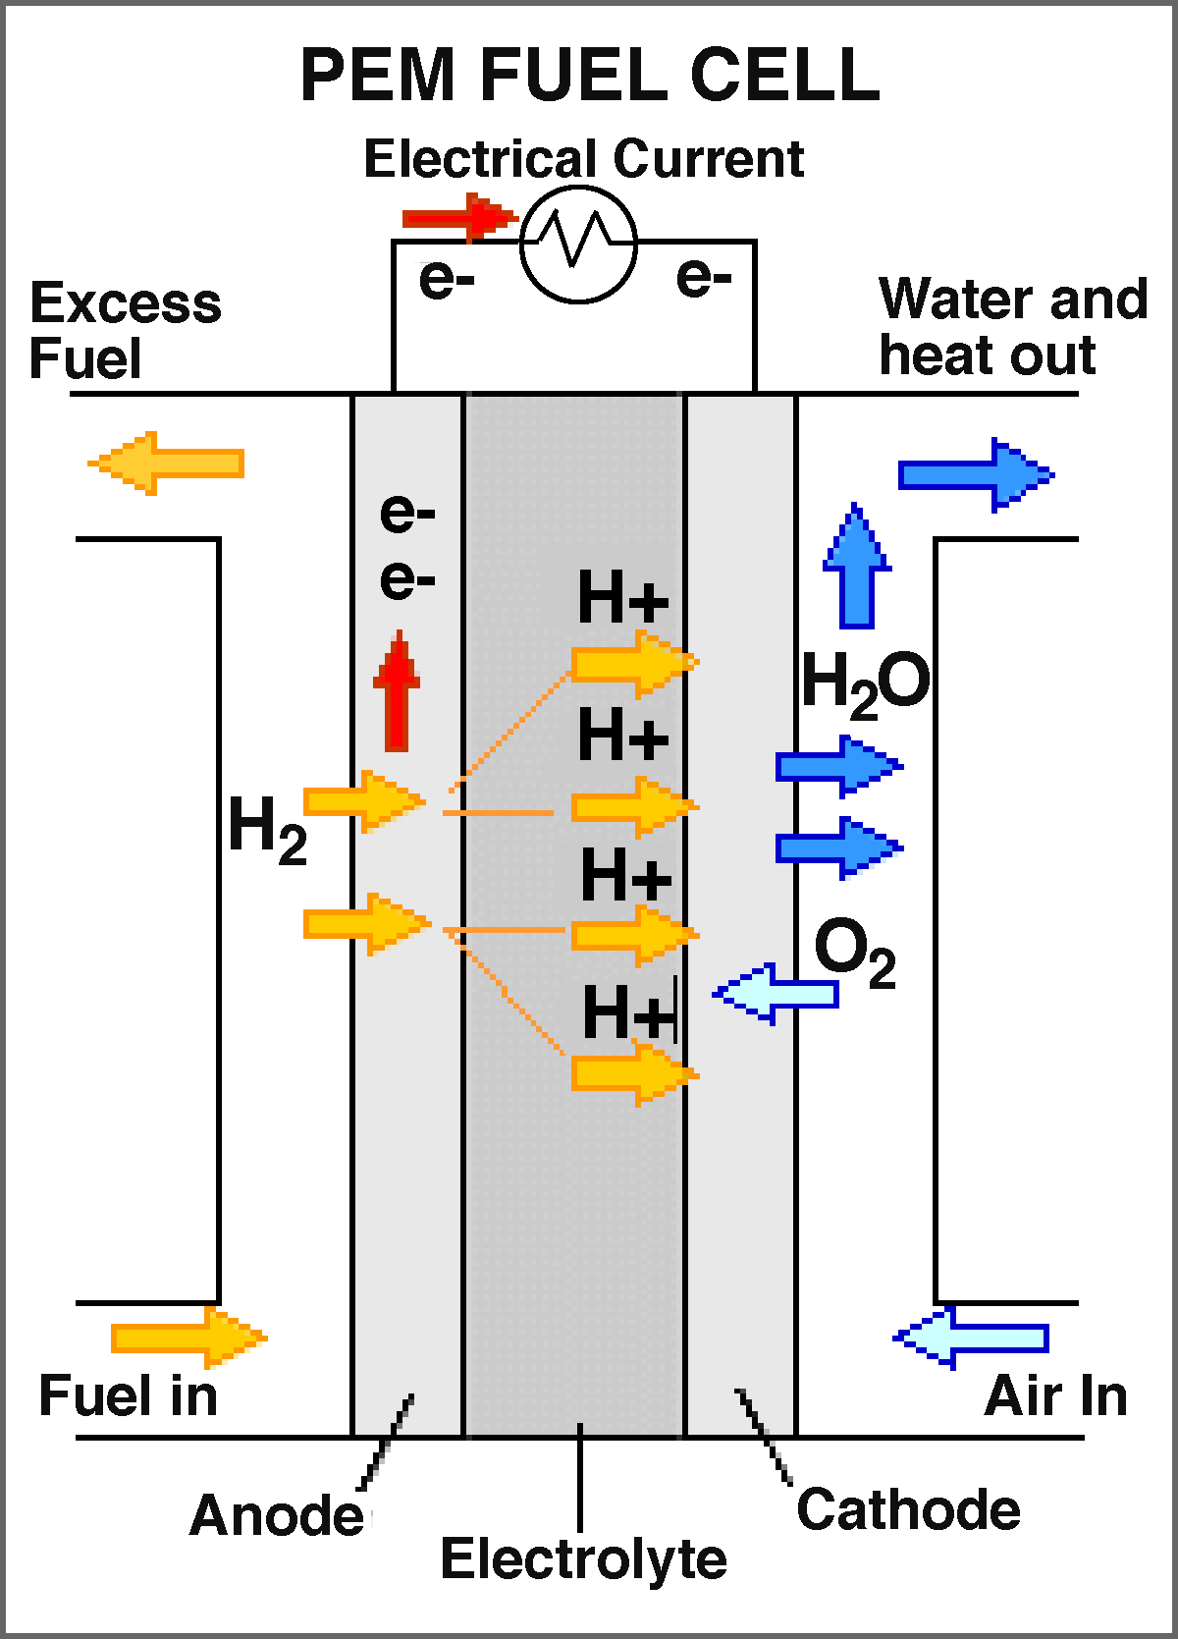
Proton-Exchange Membrane Cell
http://www.news.cornell.edu/releases/Nov03/Fuelcell.institute.deb.html
Notes:
How a fuel cell works: In the polymer electrolyte membrane (PEM) fuel cell, also known as a proton-exchange membrane cell, a catalyst in the anode separates hydrogen atoms into protons and electrons. The membrane in the center transports the protons to the cathode, leaving the electrons behind. The electrons flow through a circuit to the cathode, forming an electric current to do useful work. In the cathode, another catalyst helps the electrons, hydrogen nuclei and oxygen from the air recombine. When the input is pure hydrogen, the exhaust consists of water vapor. In fuel cells using hydrocarbon fuels the exhaust is water and carbon dioxide. Cornell's new research is aimed at finding lighter, cheaper and more efficient materials for the catalysts and membranes.

Slide 41
PEM Fuel Cell Animation

Slide 42
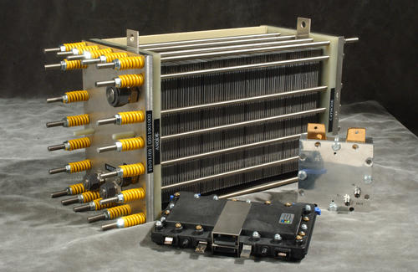
Fuel Cell Stack
http://www.nrel.gov/hydrogen/photos.html
Notes:
Tomorrow, hydrogen's use as a fuel for fuel cells will grow dramatically-for transportation, stationary and portable applications. (PlugPower 5-kW fuel cell (large cell), H2ECOnomy 25-W fuel cell (small silver cell), and Avista Labs 30-W fuel cell).

Slide 43
Hydrogen Fuel Cell Efficiency
40% efficiency converting methanol to hydrogen in reformer
80% of hydrogen energy content converted to electrical energy
80% efficiency for inverter/motor
  Converts electrical to mechanical energy
Overall efficiency of 24-32%

Slide 44
Auto Power Efficiency Comparison
Technology | System Efficiency
Fuel Cell | 24-32%
Electric Battery | 26%
Gasoline Engine | 20%
http://www.howstuffworks.com/fuel-cell.htm/printable
Notes:
Maybe you are surprised by how close these three technologies are. This exercise points out the importance of considering the whole system, not just the car. We could even go a step further and ask what the efficiency of producing gasoline, methanol or coal is.
Efficiency is not the only consideration, however. People will not drive a car just because it is the most efficient if it makes them change their behavior. They are concerned about many other issues as well. They want to know:
Is the car quick and easy to refuel?
Can it travel a good distance before refueling?
Is it as fast as the other cars on the road?
How much pollution does it produce?
This list, of course, goes on and on. In the end, the technology that dominates will be a compromise between efficiency and practicality.

Slide 45
Other Types of Fuel Cells
Alkaline fuel cell (AFC)
  This is one of the oldest designs. It has been used in the U.S. space program since the 1960s. The AFC is very susceptible to contamination, so it requires pure hydrogen and oxygen. It is also very expensive, so this type of fuel cell is unlikely to be commercialized.
Phosphoric-acid fuel cell (PAFC)
  The phosphoric-acid fuel cell has potential for use in small stationary power-generation systems. It operates at a higher temperature than PEM fuel cells, so it has a longer warm-up time. This makes it unsuitable for use in cars.
Solid oxide fuel cell (SOFC)
  These fuel cells are best suited for large-scale stationary power generators that could provide electricity for factories or towns. This type of fuel cell operates at very high temperatures (around 1,832 F, 1,000 C). This high temperature makes reliability a problem, but it also has an advantage: The steam produced by the fuel cell can be channeled into turbines to generate more electricity. This improves the overall efficiency of the system.
Molten carbonate fuel cell (MCFC)
  These fuel cells are also best suited for large stationary power generators. They operate at 1,112 F (600 C), so they also generate steam that can be used to generate more power. They have a lower operating temperature than the SOFC, which means they don't need such exotic materials. This makes the design a little less expensive.
http://www.howstuffworks.com/fuel-cell.htm/printable

Slide 46
Advantages/Disadvantages of Fuel Cells
Advantages
  Water is the only discharge (pure H₂)
Disadvantages
  CO₂ discharged with methanol reform
  Little more efficient than alternatives
  Technology currently expensive
    Many design issues still in progress
  Hydrogen often created using “dirty” energy (e.g., coal)
  Pure hydrogen is difficult to handle
    Refilling stations, storage tanks, …

Slide 47
Fuel Cells

Slide 48
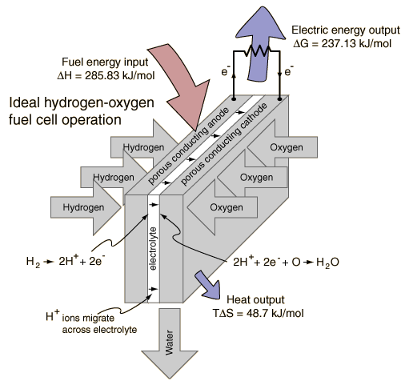
Fuel Cell Energy Exchange
http://hyperphysics.phy-astr.gsu.edu/hbase/thermo/electrol.html
Notes:
Hydrogen and oxygen can be combined in a fuel cell to produce electrical energy. A fuel cell uses a chemical reaction to provide an external voltage, as does a battery, but differs from a battery in that the fuel is continually supplied in the form of hydrogen and oxygen gas. It can produce electrical energy at a higher efficiency than just burning the hydrogen to produce heat to drive a generator because it is not subject to the thermal bottleneck from the second law of thermodynamics. It's only product is water, so it is pollution-free. All these features have led to periodic great excitement about its potential, but we are still in the process of developing that potential as a pollution-free, efficient energy source (see Kartha and Grimes).

Slide 49
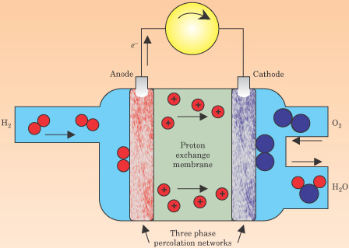
PEM Fuel Cell Schematic
Notes:
Figure 5. In a proton−exchange−membrane fuel cell, hydrogen and oxygen react electrochemically. At the anode, hydrogen molecules dissociate, the atoms are ionized, and electrons are directed to an external circuit; protons are handed off to the ion−exchange membrane and pass through to the cathode. There, oxygen combines with protons from the ion−exchange membrane and electrons from the external circuit to form water or steam. The energy conversion efficiency of the process can be 60% or higher.

Slide 50
Biomass Energy

Slide 51
Biomass Energy
In the past few years, there have been significant improvements in renewable energy technologies along with declines in cost.
The growing concern for the environment and sustainable development, have led to worldwide interest in renewable energies and bio-energy in particular.
Biomass can be converted into modern energy forms such as liquid and gaseous fuels, electricity, and process heat to provide energy services needed by rural and urban populations and also by industry.

Slide 52
Biomass Energy
This paper explains the different ways of extracting energy from biomass and a comparison is made among them.
This paper also explains about the potentiality of biomass energy in India.
Analyses current situation compares bio-energy and other options for promoting development.
Brings out the advantages over the other renewables putting forth the drawbacks to be overcome to make it still more successful.
This paper analyses current situation compares bio-energy and other options for promoting development, explore the potential for bio-energy.

Slide 53
Biomass Energy
Introduction
In past 10 years or so, considerable practical experience has accumulated in India as well as in other developing and industrialized countries, on biomass energy production and conversion.
India is pioneer among developing countries, with significant indigenous efforts in promoting renewable energy technologies.
The importance of bio-energy as a modern fuel has been recognized. India has about 70,000 villages yet to be connected to the electricity grid.

Slide 54
Biomass Energy
The supply of grid power to rural areas is characterized by
  Low loads.
  Power shortages.
  Low reliability.
  Low and fluctuating voltages.
  High transmission and distribution costs and power losses.
Decentralized power generation based on renewables is an attractive option to meet the energy needs.
The availability of biomass such as wood, cow-dung, leaf litter in rural areas is more.
Hence a choice of biomass energy especially in rural areas is more reasonable but at the same time the technology is being developed to meet the large-scale requirements using biomass.

Slide 55
Biomass Energy
Biomass energy has played a key role in the time of Second World War when there was a fuel deficiency.
Many vehicles, tractors and trucks used wood gasifies, which generate producer’s gas, running an internal combustion Engine.
One of the major advantages of biomass energy is that it can be used in different forms.
For e.g., Gas generated from the biomass can be directly used for cooking or it can be used for running an internal combustion Engine for developing stationary shaft power or otherwise coupled to generator for generating electric power.

Slide 56
Motivation
There are several renewable and non-renewable energy options for power generation at the decentralized level.
It is necessary to understand why biomass-based energy options should receive priority over other options and to discuss the advantages to local and global communities as well as the environment.
Biomass is renewable fuel used in nearly every corner of the developing countries as a source of heat, particularly in the domestic sector.
Biomass energy includes energy from all plant matter (tree, shrub, and crop) and animal dung.
Biomass, unlike other renewables, is a versatile source of energy, which can be converted to modern forms such as liquid and gaseous fuels, electricity, and process heat.

Slide 57
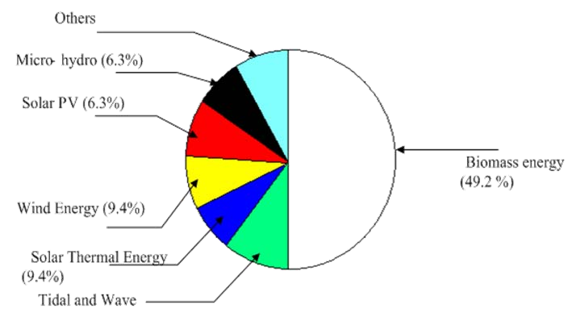
Motivation-1
For example, small-scale (5-100 KW), (110MW), and large scale (about 50 MW).
medium-scale
Fig 1: Expenditure on different renewable energy programmes for 1992-1997 indicating the share of bioenergy technologies for renewables in India

Slide 58
Motivation-2
Advantages of biomass gasify energy over other renewable energy options:
  Suitable in most locations.
  Varying capacity can be installed; any capacity can be operated, even at lower loads; no seasonality.
  Need for storage of energy is not required.
Advantages and
drawbacks of biogas energy over other
renewable energy options:
It can be used directly for cooking, or heating water from the abundantly available dung and dried plant leaves in rural areas.
Capacity determined by availability of dung. Not suitable for varying loads.
Not feasible to locate at all the locations.

Slide 59
Different Ways of extracting energy from biomass
The different methods of biomass extraction can be broadly be classified as:
  Anaerobic Digestion.
  Gasification.
  Liquefaction.
Solid fuel combustion
  The simplest and most common way of extracting energy from biomass is by direct combustion of solid matter.
  Majority of the developing countries especially in rural areas obtain the majority of their energy needs from the burning of wood, animal dung and other biomass. But burning can be inefficient.
  An open fireplace may let large amounts of heat escape, while a significant proportion of the fuel may not even get burnt.

Slide 60
Different Ways of extracting energy from biomass -1
Gasification
Gasification is a process that exposes a solid fuel to high temperatures and limited oxygen, to produce a gaseous fuel.
This is a mix of gases such as carbon monoxide, carbon dioxide, nitrogen, hydrogen and methane.
Gasification has several advantages over burning solid fuel.
One is convenience – one of the resultant gases, methane, can be treated in a similar way as natural gas, and used for the same purposes.
Another advantage of gasification is that it produces a fuel that has had many impurities removed and will therefore cause fewer pollution problems when burnt.

Slide 61
Different Ways of extracting energy from biomass -2
under suitable circumstances, it can produce synthesis gas, a mixture of carbon monoxide and hydrogen.
This can be used to make almost any hydrocarbon (e.g., methane and methanol), which can then be substituted for fossil fuels. But hydrogen itself is a potential fuel of the future.
Paralysis :
Paralysis is an old technology with a new lease of life.
In its simplest form it involves heating the biomass to drive off the volatile matter, leaving behind the black residue we know as charcoal.
This has double the energy density of the original material.

Slide 62
Different Ways of extracting energy from biomass -3
This means that charcoal, which is half the weight of the original biomass, contains the same amount of energy making the fuel more transportable.
The charcoal also burns at a much higher temperature than the original biomass, making it more useful for manufacturing processes.
More sophisticated Paralysis techniques have been developed recently to collect the volatiles that are otherwise lost to the system.
The collected volatiles produce a gas rich in hydrogen (a potential fuel) and carbon monoxide.
These compounds, if desired, can be synthesized into methane, methanol and other hydrocarbons. 'Flash' Paralysis can be used to produce bio-crude – a combustible fuel.

Slide 63
Different Ways of extracting energy from biomass -4
Digestion
Biomass digestion works by the action of anaerobic bacteria.
These microorganisms usually live at the bottom of swamps or in other places where there is no air, consuming dead organic matter to produce, among other things, methane and hydrogen.
We can put these bacteria to work for us.
By feeding organic matter such as animal dung or human sewage into tanks – called digesters - and adding bacteria, we can collect the emitted gas to use as an energy source.

Slide 64
Different Ways of extracting energy from biomass -5
This can be a very efficient means of extracting usable energy from such biomass – up to two-thirds of the fuel energy of the animal dung is recovered
A large proportion of household biomass waste, such as kitchen scraps, lawn clippings and pruning, ends up at the local tip.
Over a period of several decades, anaerobic bacteria are at work at the bottom of such tips, steadily decomposing the organic matter and emitting methane.
The gas can be extracted and used by 'capping' a landfill site with an impervious layer of clay and then inserting perforated pipes that collect the gas and bring it to the surface.

Slide 65
Different Ways of extracting energy from biomass -6
Fermentation
Like many of the other processes described here, fermentation isn't a new idea.
For centuries, people have used yeasts and other microorganisms to ferment the sugar of various plants into ethanol.
Producing fuel from biomass by fermentation is just an extension of this old process, although a wider range of plant material can now be used, from sugar cane to wood fiber.
For instance, the waste from a wheat mill in New South Wales has been used to produce ethanol through fermentation.
This is then mixed with diesel to produce 'dishelm', a product used by some trucks and buses in Sydney and Canberra.

Slide 66
Different Ways of extracting energy from biomass -7
Anaerobic Digestion
Anaerobic Digestion is a biochemical degradation process that converts complex organic material, such as animal manure, into methane and other byproducts.
What is Anaerobic Digester?
Anaerobic digester (commonly referred to as an AD) is a device that promotes the decomposition of manure or “digestion” of the organics in manure to simple organics and gaseous biogas products.
Biogas is formed by the activity of anaerobic bacteria. Microbial growth and biogas production are very slow at ambient temperatures.

Slide 67
Different Ways of extracting energy from biomass -8
These bacteria occur naturally in organic environments where oxygen is limited.
Biogas is comprised of about 60% methane, 40% carbon dioxide, and 0.2 to 0.4% of hydrogen sulfide.
Manure is regularly put into the digester after which the microbes break down the manure into biogas and a digested solid.
The digested manure is then deposited into a storage structure.
The biogas can be used in an engine generator or burned in a hot water heater. AD systems are simple biological systems and must be kept at an operating temperature of 100 degrees F in order to function properly..

Slide 68
Different Ways of extracting energy from biomass -9
The first methane digester plant was built at a leper colony in Bombay, India.
Biogas is very corrosive to equipment and requires frequent oil changes in an engine generator set to prevent mechanical failure.
The heating value of biogas is about 60% of natural gas and about 1/4 of propane.
Because of the low energy content and its corrosive nature of biogas, storage of biogas is not practical.
There are two major types of biogas designs promoted in India
  Floating Drum
  Fixed Dome

Slide 69
Different Ways of extracting energy from biomass -10
The floating drum is an old design with a mild-steel, Ferro- cement or fiberglass drum.
which floats along a central guide frame and acts as a storage reservoir for the biogas produced.
The fixed dome design is of Chinese origin and has dome structure made of cement and bricks.
It is a low-cost alternative to the floating drum, but requires high masonry skills and is prone to cracks and gas leakages.
Family biogas plants come in different size depending on the availability of dung and the quantity of biogas required for cooking.
The average size of the family is 5-6 persons, and thus biogas plant of capacity 2-4 m³ is adequate. The biomass requirement is estimated to be 1200 liters for a family.

Slide 70
Different Ways of extracting energy from biomass -11
Comparison between two designs:
Fixed dome | Floating Drum
Digester and gas holder, masonry or concrete structure | Digester, masonry, Gas holder, mild steel or fiberglass
Requires high masonry skills | Low masonry or fabricating skills
Low reliability due to high construction failure | High reliability, gas holder prefabricated
Variable gas pressure | Constant gas pressure
Digester could be inside the ground | Requires space above ground for three tanks; inlet, digester, outlet
Low Cost (2 m³ = Rs.5000) | Low Cost (2 m³ = Rs.8000)

Slide 71
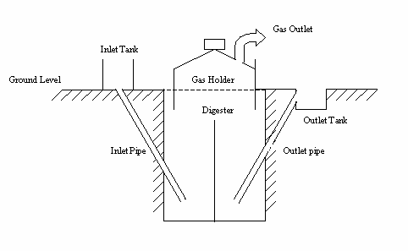
Different Ways of extracting energy from biomass -12
Figure 2: Floating Gasholder drum design (a conventional Indian
design)

Slide 72
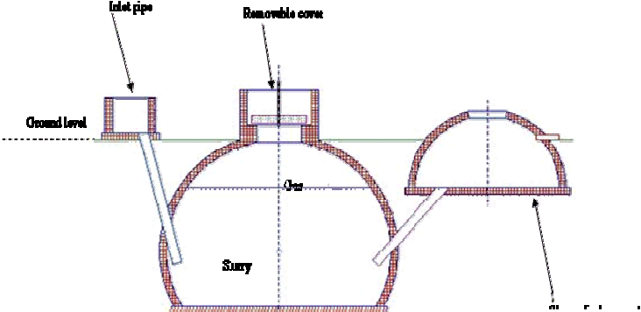
Different Ways of extracting energy from biomass -13
Figure 3: Spherical shaped fixed - dome plant

Slide 73
Uses of Biogas
Biogas can be directly used for cooking by supplying the gas though pipes to households from the plant.
Biogas has been effectively used as a fuel in industrial high compression spark ignition engines.
To generate electricity an induction generator can be used and is the simplest to interface to the electrical grid.
Induction generators derive their voltage, phase, and frequency from the utility and cannot be used for stand-by power.
If a power outage occurs generator will cease to operate.
Synchronous generator can also be used to connect to the grid. However, they require expensive and sophisticated equipment to match the phase, frequency and voltage of the utility grid.
Biogas can also be used as fuel in a hot water heater if hydrogen sulfide is removed from the gas supply.

Slide 74
Case Study of Community Biogas programmes in India
Biogas Electricity in Pure Village:
In India, Biogas option is considered largely as a cooking fuel.
The need for considering decentralized electricity options and the potential of biogas is analyzed.
A field-demonstration programme was implemented in pure village in South India to use cattle dung in a community biogas plant to generated electricity for services such as pumping drinking water and home lighting.

Slide 75
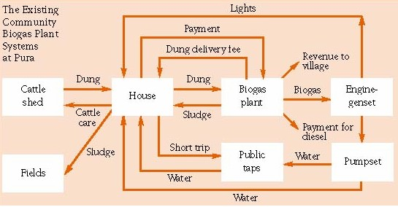
Case Study of Community Biogas programmes in India
Fig 4: Community Biogas Plant in Pura Village

Slide 76
Technology
The Indian floating-drum design shown in fig.1 with modified dimensions for cost reductions was used.
The Pure biogas plants have a capacity to digest up to 1.2 t cattle dung/day and produce 42.5-m3 biogas/day.
Sand bed filters were installed to remove excess water and convert the sludge to dung-like consistency for subsequent use as a fertilizer.
The filtrate, which contains the required anaerobic microorganisms, is mixed with the input dung.
A 5 kW diesel engine is connected to a 5kVA, 440 V three- phase generator of electricity generation.

Slide 77
Lighting
Out of 87 house holds in the village 39 already had grid electricity.
there are 103 fluorescent tube lights of 20 W capacity connected biogas generated electricity.
Forty-seven houses opted for one tube light and 25 houses have two tube lights.
Lighting is provided in the evening for 2.5 hours/day.
Even homes connected to the grid had lighting connections from the biogas system.

Slide 78
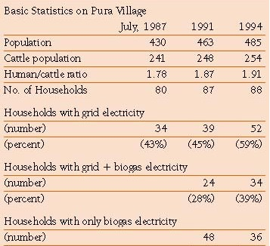
Water supply
A submersible pump is connected to a tube well and water is pumped to storage tanks for 1 hour and 40 minutes/day.
The majority of the households have opted for private taps at their doorsteps.
Fig 5: Table showing the statistics on Pura village

Slide 79
Biomass Gasifies
Biomass, or more particularly wood, can be converted to a high-energy combustible gas for use in internal combustion engines for mechanical or electrical applications.
This process is known as gasification and the technology has been known for decades, but its application to power generation is of recent origin.
A biomass gasified consists of a reactor where, under controlled temperature and air supply, solid biomass is combusted to obtain a combustible gas called Producers gas (consisting of H2 and CH4) .
This gas passes through a cooling and cleaning system before it is fed into a compression ignition engine for generation of mechanical or electricity (by coupling to a generator).

Slide 80
Biomass Gasifies-1
An assessment of its potential concluded that India presents a unique opportunity for large-scale commercial exploitation of biomass gasification technology to meet a variety of energy needs, particularly in the agricultural and rural sectors.
The large potential of biomass gasification for water pumping and power generation for rural electrification was recognized.
Biomass
Internal Combustion Engine
Biomass Gasifier
Generator
Electric Power
Producer’s gas
Mechanical output driving a generator
Figure 6: Block diagram of a producers gas electricity system

Slide 81


Biomass Gasifies-2
Top cover
Cooler
Reactor
Water pump
Air nozzle
Fine Filter
Burner
Blower
air
Water seal
To engine
Figure 7: A 20 kW gasifier with cooling and cleaning system

Slide 82
Feed Stocks for producer-gas systems
A range of crop residues and woody biomass from trees could be used as feedstocks for producer-gas systems.
Currently, wood-based systems are available, and designs using other low-density biomass are under development and should soon be available in India.
Crop residues with fuel potential are limited, since nearly all cereal and most pulse residues are used as fodder or manure and thus are not available as fuel.
It is important to note that currently crop residues are used and have an opportunity cost.
Rice husks are used in the cement industry, in rice mills and in the manufacture of bricks.

Slide 83
Feed Stocks for producer-gas systems-1
Coconut leaves are used as thatch and the husk as fiber and sugarcane biogases is used in sugar mills.
In Punjab, for rice-husk-based power generation systems, the price of residues such as rice husk could increase once new uses and demands are developed.
Crop residues may continue to be used as fuel in domestic sector assuming that cooking-energy requirements are going to be met from bio-energy options.
Constant supply of crop residues as feedstock cannot be assured over a long period on continuous basis and the transportation of low-density residues is not feasible.

Slide 84
Case Studies of Producer’s gas electricity
Electrification of Hosahalli, a south Indian village
A small-capacity one-top wood gasified has been developed and implemented a field demonstration program in the non- electrified South Indian village of Hosahalli.
The village has a population of 250 and was unelectrified.
A 20 kW one-top wood gasified was setup to meet the demand for electricity.
The plant is providing electricity to the people, who in turn have improved the overall economy and living conditions of the villagers.
The loads being served by the power plant include domestic lights, streetlights, drinking water and irrigation tube wells, and a flourmill. The villagers themselves are managing the power plant.

Slide 85
Services provided with Producer-gas electricity
The electricity produced was used for three services: lighting, pumping domestic water, and flour milling.
Lighting
All the 42 houses were provided with a 40 W fluorescent tube and a 15 W incandescent bulb, along with eight streetlights.
Connected load is 2.68 kW. Hours of operation: 6 p.m. to 10 p.m.
Water Supply
A submersible pump of 3 hp capacity was connected to a deep tube well.
Water is pumped to storage tanks to provide 2-3 hours of water supply per day.

Slide 86
Services provided with Producer-gas electricity
Flour milling
A 7.5 hp flourmill was connected to the producer gas diesel- engine generator.
The flourmill, which operated for 2 hours/day, was operated for a few months in 1992; its operation was suspended, as the rate of milling was lower than the desired rate by the village community due to limitations of the 5-kVA system.

Slide 87


Services provided with Producer-gas electricity
Fig 8: Biomass Gasifier Installed in Hosahalli, Karnataka.

Slide 88
Electrification of Chhotomollakhali, a village in West Bengal
Chhottomollakhali Island in Sunderbans situated in the district of South 24 Parganas, is about 130 km. away from Kolkata.
It has a population of about 28,000. The main occupation of the people is fishing and agriculture.
It is difficult to extend grid electricity to Chhottomollakhali Island due to prohibitive cost involved in crossing of various rivers and creeks.
In the absence of electricity, the economic activities of the Island were suffering.
The switching on of the 4x125 kW Biomass Gasifier based Power Plant on 29th June 2001 has changed the life the inhabitants of this remote Island.

Slide 89
Electrification of Chhotomollakhali, a village in West Bengal
The plant is catering to electricity needs of domestic, commercial and industrial user’s drinking water, hospital, ice factory, etc.
Four villages of Chhottomollakhali Island will be benefited with electricity from the power plant.
Plant capacity: 4 x 125 kW No. Of consumers: 800
Total Project Cost:Rs.1, 46, 70,390/- Hours of operation: 5 PM to 11 PM

Slide 90
Electrification of Chhotomollakhali, a village in West Bengal
Tariff Structure:
  4.00 / unit Domestic
  4.50 / unit Commercial
  5.00 / unit Industrial
Energy Plantation Area:40 hectares Fuel Consumption pattern under full:
Load condition
Biomass:70%
Diesel :30%
Generation cost (per unit) under full load condition: Rs.2.75

Slide 91
Biomass availability issues
Before assessing the country's bioenergy production potential, it is important to:
  Estimate the land availability for biomass production.
  Identify and evaluate the biomass production options— yield/ha and financial viability.
Estimate sustainable biomass production potential for energy.
Estimate the energy potential of biomass production.
Assess the investment required and barriers to producing biomass sustainably for energy.
iii.

Slide 92
Biomass availability issues-1
Different options for wood supply
Conservation potential of wood used in cooking.
Producing wood on community, government, forest land.
or degraded
Producing wood on degraded private or farm land.
Sustainable harvest from existing forest.
Logging waste.
Consideration of options 2 and 3 involves a range of related issues, such as land availability, land quality, competitive uses of land, and sustainability of wood production.

Slide 93
Biomass availability issues-2
Some proportion of wood currently burnt, as cooking fuel would become available for the producer-gas electricity option.
Tree plantations, farm trees, homestead gardens, and degraded lands are the various sources of fuel wood used for cooking.
Among these sources, only wood from tree plantations could be considered as easily available as feedstock for power generation.
Woody biomass would be the dominant source of feedstock for gasification.

Slide 94
Biomass availability issues-3
The availability of woody biomass and production potentials are discussed in the following section. Estimates of degraded land availability in India (Mha):
SPWD; degraded (waste) land quoted in PC | Degraded forest, Degraded non-forest, Total degraded land | Total degraded land 130 Mha
Chambers; land available for tree planting | Cultivated lands, Strips and boundaries, Uncultivated degraded land, Degraded forest land, Land for tree planting | Total Land for tree planting 84 Mha
Kapoor; land available for tree plantation | Agricultural land, Forest land, Pasture land, Fallow, Urban | Total land for tree planting 106 Mha
Ministry of Agriculture | Forest land with < 10% tree crown cover, Grazing land, Tree groves, Culturable waste, Old fallow. | Total degraded land 66 Mha

Slide 95
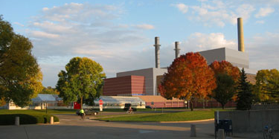
COGENERATION

Slide 96
Outline
What is Cogeneration?
Efficiency
Barriers to Cogeneration
West Campus Cogeneration Facility

Slide 97
What is Cogeneration?
Simultaneous production of electricity and thermal energy
President Carter coined the phrase cogeneration in the 1970s
Also called Combined Heat and Power (CHP)
Thermal demand can include hot water, steam, space heating, cooling, and refrigeration

Slide 98
History of Cogeneration
CHP was most common form of electricity generation around 1900
Cost reduction and reliability of separate electric systems overtook the market
By 1978, only 4% of US electricity was generated using CHP
Currently a stagnation in the CHP market

Slide 99
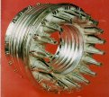
Cogeneration Technologies
Steam or gas turbines
Engines
Fuel cells
Micro turbines

Slide 100
Cogeneration Fuels
Natural gas
Coal
Biomass
  Bagasse (waste product from sugar cane processing)
Waste gas
  Sludge gas from sewage treatment plant
  Methane from landfills and coal bed methane
Liquid fuels (oil)
Renewable gases

Slide 101
Cogeneration Fuels (cont.)
Australian Data

Slide 102
CO₂ Emission by Fuel Type

Slide 103
Three Categories of CHP Market
Industrial plants
District energy systems
Small-scale commercial and residential building systems

Slide 104
Industrial Plant
Largest share of current installed capacity in US
Segment with greatest potential for near-term growth
Example industries include petroleum refining, petrochemical, and pulp and paper
Often have electricity capacity of more than 50MW and several hundred thousand lb/hr of steam
Generally owned by a 3rd party power producer

Slide 105
District Energy Systems (DES)
Distribute steam, hot water, and/or chilled water from central plant to individual buildings through a network of pipes
Provide space heating, air conditioning, domestic hot water, and industrial process energy
Examples include universities, hospitals, and government complexes

Slide 106
Small Scale Systems
Reciprocating engines and micro-combustion turbines are making CHP feasible for smaller commercial buildings
System generates part of the electricity requirements for the building while providing heating and/or cooling
Capacities start as low as 25kW
Examples include small commercial buildings such as fast food restaurants

Slide 107
Barriers to Cogeneration
Current regulations don’t recognize the overall efficiency or credit the emissions avoided using CHP systems
Site-by-site environmental permitting system is complex costly and time consuming
Utilities charge discriminatory backup rates or “exit fees” to customers who build on site CHP facilities

Slide 108
Barriers to Cogeneration (cont.)
Depreciation schedules don’t accurately reflect equipment lifetime
Unfavorable tax treatment
Market is unaware of technology developments that have expanded to potential for CHP

Slide 109
Potential Growth for CHP
If barriers are removed CHP capacity will likely increase

Slide 110
Percent of Electricity from CHP
2000 EU Data

Slide 111
Efficiency
More efficient because it uses the residual thermal energy wasted in standard electrical energy facilities
Uses less fuel than conventional facilities
Overall net efficiency of 65% to 90% (generally around 70%)
Typical power facility is 30% to 35% efficient

Slide 112
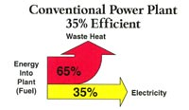
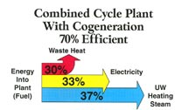
Efficiency (cont.)

Slide 113
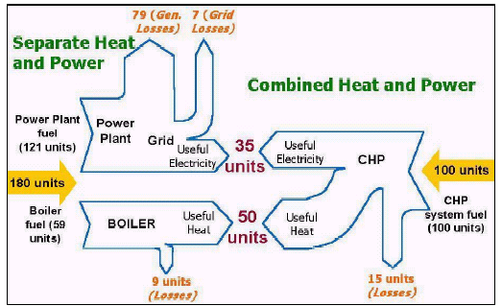
Efficiency (cont.)

Slide 114
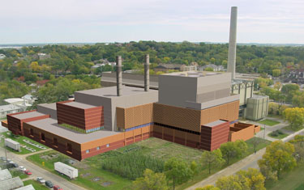

West Campus Cogeneration Facility
Where – On Walnut St. near the WARF

Slide 115

West Campus Cogeneration Facility
Available for peak power needs of summer 2005
Cost about $180 million
One of the cleanest and most efficient energy facilities in the state
Services:
  Electricity needs for MGE customers
  Steam and chilled water demand of UW
  Backup power for UW

Slide 116
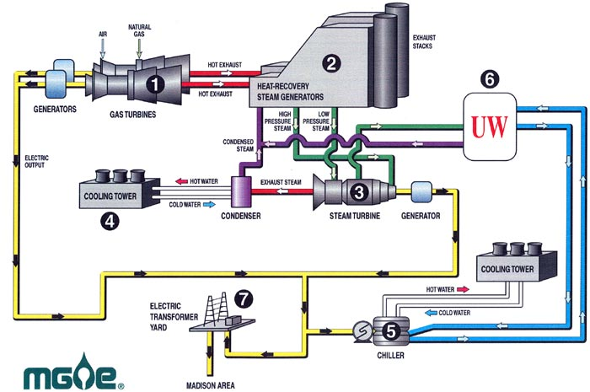
Cogeneration Schematic

Slide 117
Cogeneration Operation
Two natural gas fired combustion turbines drive generators to produce electricity
Hot combustion gases from the turbines pass through a heat-recovery steam generator (HRSG) to produce steam
High and low pressure steam from the HRSG then pass through an extracting/condensing steam turbine which sends heating steam to UW and produces electricity for MGE customers

Slide 118
Cogeneration Operation (cont.)
A condenser and cooling towers turn the exhaust steam into water which is reused
Electricity driven centrifugal chillers produce chilled water for UW, using cooling towers for heat removal
Steam heat and chilled water will be used by UW
Electricity sent to existing substation and used by Madison residents

Slide 119
Capacity
Total plant electrical – 150 MW net
  Electricity for 75,000 homes
2 combustion turbines – 50 MW gross (each)
Steam turbine – 68 MW gross
Steam generation – 400,000 lb/hr firm, 500,000 lb/hr gross
Chilled water – 20,000 tons with provisions for added 30,000 tons

Slide 120
Environmental Aspects
Efficiency – overall net 70%
Nitrogen oxide (NO_{x}) – emissions reduced by up to 150 tons/yr or 80% compared to separate electric generation/cooling facilities (catalytic reduction units result in NO_{x} emissions of 2.5 ppm)
CO₂ – emissions reduced by 50,000 tons/yr or 15% compared to separate facilities

Slide 121
Environmental Aspects (cont.)
Noise level – 60dB at facility boundary
  Normal conversation is 60-65dB
Natural gas usage – in cogeneration mode, 10-15% less gas than separate facilities

Slide 122
References
www.mge.com/about/electric/cogen/needs. htm
www.aceee.org/chp
www.aph.gov.au/library/pubs/rn/1998-99/99rn21.htm
www.cogen.org/projects/future_cogen.htm

Slide 123




Distributed Generation
Also known as
“Distributed Resources”

Slide 124
Success of a System?
"Perfection is achieved not when there is nothing more to add, but rather, when there is nothing left to take away“
French writer Antoine de Saint-Exupéry (1900-1944)

Slide 125
Overview: Distributed Generation
Concept of Central Distribution
Vulnerabilities of conventional electric power
  Overloaded lines and disconnects
  Weak Grid system may fail
  Ice storms that collapse lines and cause shorts
  Terrorist attack, or just falling trees?
  Bury lines at high cost? (~three to five times more)
Distant locations and away from the grid --- use independent power
Multiple sources of diverse types are less likely to fail at the same time --- hybrid systems have redundancy and higher reliability

Slide 126
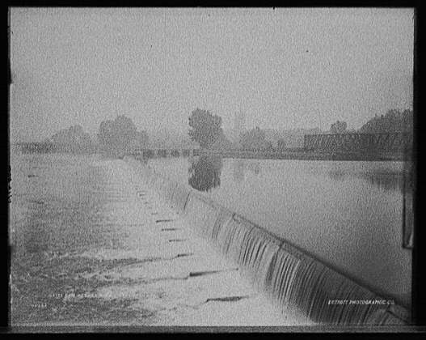
Concept of Central Distribution
Concept of Central Distribution
  Early towns and cities had central power plants, usually steam, but sometimes hydro plants like the 1882 first commercial plant at Appleton, Wisconsin; waterwheel & dc generators
  Thomas Edison’s Pearl Street Station could have been called centralized generation (for six blocks)
Decentralized power is independent power that is not connected off the premises to a centralized power plant, and lately, may be grid-connected to “store” power without batteries

Slide 127
Central Distribution System Vulnerabilities
The Sendero Luminoso or “Shining Path” guerrillas of Peru attacked six remote electrical transmission towers with explosives in 1993, felling towers with the associated long wires and stopping the power flow
A hacksaw (Arizona case) can be used instead of explosives; hard to defeat a low tech approach
In California, Path 15 is the overloaded high line connecting North and South California that might fail if further overload occurs
http://en.wikipedia.org/wiki/Path_15

Slide 128
BPA Offering $25,000 Reward for Information on Transmission Tower Saboteur
Oct 31, 2003 12:00 PM, Bonneville Power Administration
The Bonneville Power Administration, Portland, Oregon, U.S., is offering a reward of up to US$25,000 for information leading to the arrest and conviction of the person or persons who recently attempted to sabotage BPA’s regional high voltage transmission lines in both Washington and Oregon.
Attempted sabotage was found at BPA transmission towers located near The Dalles, Maupin, Boardman and Umatilla, Oregon and Benton City, Washington. In addition to these BPA transmission lines, towers on major transmission lines owned and operated by other utilities were similarly sabotaged. These include PacifiCorp's transmission line near Klamath Falls, Oregon; Western Area Power Administration's transmission line near Anderson, California, and a Pacific Gas and Electric transmission line just outside of Sacramento, California. Because all the sabotage attempts were similar, there is strong reason to believe that they may all be the work of the same perpetrator(s).
http://tdworld.com/news/power_bpa_offering_reward/

Slide 129
Central Distribution System Vulnerabilities
Vandals or terrorists cut the 1,800-MW, 1,000-kV DC intertie line in California in 1987 http://www.wws.princeton.edu/ota/disk2/1990/9034/9034.PDF
Environmental extremists were arrested in 1989 while cutting an Arizona transmission tower
  The group was said to have been inspired by environmentalist Edward Abbey’s The Monkeywrench Gang about ecoterrorists
  [considered a hero among some activists ]
The Evan Mecham Eco-Terrorist International Conspiracy (EMETIC) targeted electric system facilities in 1987–89 (Palo Verde Nuclear Generating Station of Arizona towers)
Earth Liberation Front may now be turning to urban sprawl and SUV attacks instead; burning apartments under construction and 60 SUVs at a CA dealership
Military approach is a small GPS-guided bomb that is wrapped with many turns of copper wire --- attacking a transformer station causes many short lengths of wire flying to short the large, hard-to-replace transformers

Slide 130
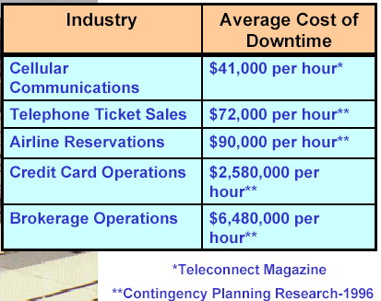
Costs of Outages may lead to DG Installation
An hour of lost power can lead to very high collateral losses in business and government

Slide 131
Distributed Generation (DG)
Distributed generation occurs when power is generated (converted) locally and sometimes might be shared with or sold to neighbors through the electrical grid (or over the fence)
  Large central generation is not directly used
  The Public Service Commission may define only one supplier as a utility!
Distributed generation avoids the losses that occur in transmission over long distances; energy is used nearby
Varying wind and sunshine averages across several houses, blocks, cities, or states, stabilizing the system
  Variability of one source is reduced by dividing by the square root of the number of sources
Supply is robust, but automatic precautions are required to protect electricity workers when main base-load power is out, and a local system might feed back into powerlines
Notes:
Distributed generation is an outgrowth of back-up power generators. Many companies, hospitals, etc., have emergency power systems in case utility power should fail. Where reverse metering is allowed, these systems may drive power into the utility system.
The West Coast power difficulties of the summer of 2001 has led to consideration of the utilities requesting emergency systems to be brought on line to drive the utility grid if power failure is imminent.
The power system becomes more robust with so many providers, but there are difficulties in operating the distribution system without injury or death when the cutoff switches are working backwards.

Slide 132
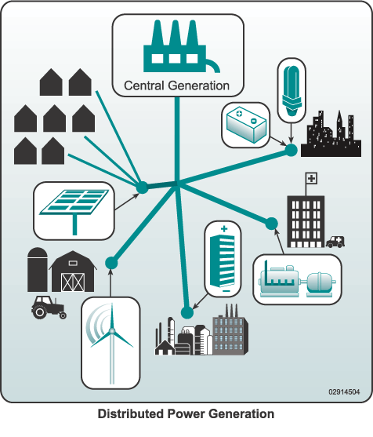
Distributed Generation Diagram
http://www.eere.energy.gov/der/basics.html

Slide 133
How Distributed Generation Differs from Conventional Power
 | Conventional | Distributed
High power capacity | Very high >500MW | Limited ~1-10MW
Outage replacement | No power | Some capacity, but limited
Power sharing | One source | Utility source plus locals
Cost | Inexpensive, about $0.12/kWh | Premium, about $0.15/kWhr
Power line servicing | Controlled hazards | Possible DG hazard
Distributed generation provides power among generating users in remote isolated areas

Slide 134
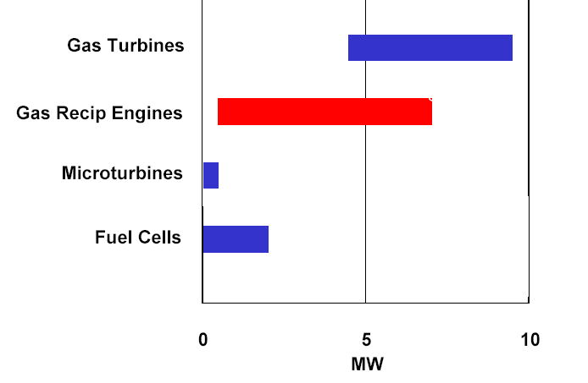
Which type is best-suited to the power?
Gas turbines work well at high and medium powers, while reciprocating engines fill the gap to fuel cells
http://www.eere.energy.gov/der/

Slide 135
Scattered Users vs. “The Grid”
Where users are scattered throughout a remote area, extension of the utility grid may be too expensive
  $18,000 to $50,000 per mile of line depending on terrain; mountain slopes cause more
Often, these homes may use small gasoline or diesel generators, or perhaps hydro, wind, or solar power
PG&E (Pacific Gas and Electric) was offering PV power with trailer systems that could be towed to a residence to provide normal house power without utility lines
Development in Africa may never require long lines since it’s cheaper to build local plants than cut jungle
It’s difficult to establish lines in sandy desert regions since the towers need deep footers

Slide 136
Two-User Grid Example
Suppose Mr. Windy W. has a wind turbine and Ms. Sunny S. has a solar array
Each source has a peak capacity of 1 kilowatt
Sometimes the sky is cloudy a few days, and Sunny hasn’t enough battery capacity to continue powering her inverter
Windy gets a good output power on windy days, but sometimes it’s sunny and calm – no wind
They agree to combine power resources, using a tie-line between their inverters to share power at 120 or 240Vac
Within their battery capacities and wind/solar incoming energy, they extend the period they can use power before protective shutdown
  The availability outweighs the line losses

Slide 137
Potential DG Sources
Diesel engines with very large storage tanks (five days are common)
Reciprocating engines similar to diesels that burn natural gas from a pipeline
Microturbines on natural gas
Wind turbines
Solar arrays
Geothermal
Stream turbine from a small local stream
Wave
Tide
Human or animal powered (really retrogressive)

Slide 138
Diesel Engines
Backup and remote power has traditionally been supplied by diesel engines due to their long life and low maintenance
Large systems have been invited to share metered power by pushing energy into the grid when utility power is stressed or limited
  Unfortunately, this puts more pollution into the air than when occasional outages and weekly test runs were the only source
Smaller diesels are inefficient compared to large 20-cylinder systems
Autostarting engines need less attention

Slide 139
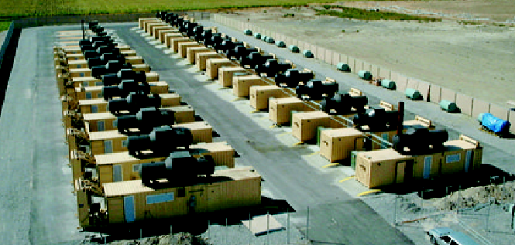
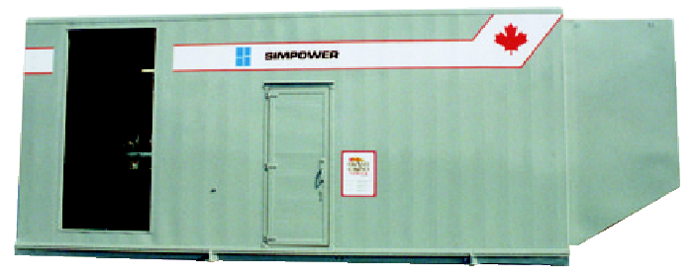
Multiple Generators
Simpower, Ltd. ISO container power plants
http://www.simpower.com/simpower_distributed_power_plants.pdf

Slide 140
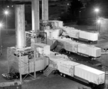

Multiple Generators
These GE trailer plants require only three days to provide power
Reciprocating engines can run on natural gas to drive alternators
http://www.simpower.com/simpower_distributed_power_plants.pdf

Slide 141

Microturbines
Microturbines are approximately the size of a refrigerator and burn natural gas
The Florida Solar Energy Center (FSEC) will begin evaluating a microturbine
http://www.fsec.ucf.edu/pvt/Projects/dg/

Slide 142

Wind
Wind energy is highly variable as the wind gusts and lulls, far more than solar energy
Within a windfarm, the wind may differ enough to cause the system to operate as a DG system with a more stable average output
Adjacent windfarms, perhaps several miles apart will have even more average stability
New batteries can stabilize wind power before delivering to the transmission lines
http://www.epri.com

Slide 143
Solar
Solar arrays of many modules tend to have more stable energy than any one module
Multiple arrays within say several miles tend to not be simultaneously blocked by drifting cumulus clouds (as opposed to generally cloudy conditions
If these sources are linked, the average power will be more steady than that of the individual site
  The standard deviation of the power is proportional to the square root of the number of the sites if the site variabilities are random (independent)
  Suppose that a large solar farm had a standard deviation of 20 kW per section; the total output of 100 of them would be 20 kW/sqrt(100) = 2.0 kW

Slide 144
Fuel Cells
Fuel cells offer a small clean installation that can reform fuel from a tank or use natural gas from a pipeline
Current costs are so much higher than $1000 to $1500/kW peak power that the market is limited
Fuel cells are subject to contamination and failure if the incoming gas is not pure
Currently, fuel cells are best run on natural gas
  A check valve on a storage tank inlet will keep gas from returning to the line if line breaching elsewhere should occur
  If storage is not provided, the pressure and output power quickly fails, though the pipeline tends to act as storage

Slide 145
Aluminum Plant Example
During the California energy crisis of 2001, some of the aluminum plants in the Northwest changed over to selling energy back into the power lines since more money was earned from power than by making aluminum
The Pacific Northwest’s ten plants were idled due to energy costs
The Bonneville Power Administration that provides half the Northwest's electricity used power buyback agreements to gain 1200 MW by paying the companies not to use electricity

Slide 146
Islanding of Power
“Islanding” occurs when a small region of the power grid is isolated by broken lines, etc., and yet local sources provide enough power to keep the voltages up
  This situation is precluded by automatic protection circuits in invertors
  There may be a potential hazard to line workers
  Surges might cause equipment damage
From Utility Plant
Island of “hot” lines
LINE BREAK
Transformer
Generator

Slide 147
Issues and Trends
Licensing of grid intertie equipment remains variable across the United States; safety issues predominate
Use of independent power increases availability when extreme weather or extremists cut transmission lines
Independent power is being marketed to purchasers of expensive remote homes
Distributed power works well with solar power roofs
Hurricane outages of 11 days caused many to buy gasoline engine-powered generators
  They may not realize what 4.5 hours per tank means
  They may not have planned for extra gasoline, or might have a garage full of plastic gasoline jugs

Slide 148
Conclusion: Distributed Generation
Distributed generation is less vulnerable to outages since there are so many local sources of supply
Winter ice storms can stop electrical power over a wider area than a terrorist attack
  Critical loads are better protected when nearby multiple sources are available
Computer and industrial processes require backup power to prevent secondary problems caused by loss of power
Independent energy systems can use failure-resistant sources like multi-day fuel tanks or natural gas pipelines
Islanding of multiple power sources is a safety concern for power line workers, yet this robustness ensures power stability

Slide 149

Olin Engineering Complex 4.7 kW Solar PV Roof Array

Slide 150

GEOTHERMAL ENERGY
By Ahmad Rizwan
150041601006

Slide 151

INTRODUCTION
The word geothermal comes from the Greek words geo (earth) and thermos (heat). Geothermal energy is heat within the earth. People can use this heat as steam or as hot water to heat buildings or to generate electricity.
Geothermal energy is a renewable energy source because heat is continuously produced inside the earth.
The main focus of geothermal energy today is the use of it for generation of electricity.

Slide 152

HISTORY
Humans have been utilizing the heat produced by the earth for a very long time. This can be seen by the following activities:
People during the stone age , have made use of natural hot springs for bathing.
Chinese during 5th century made use of the hot springs as a spa.
Romans used hot springs to feed public baths and underfloor heating.
A geothermal district in France from 14th century is still in operation today.
Lord Kelvin made the heat pump in 1852 that drew heat energy from the ground

Slide 153

MECHANISM
There is a natural source of power found below the surface of the earth that has been around for centuries. Underground, far below us, there are pools of water heated by magma (or molten rocks). These pools of water make up our geothermal reservoirs.
Harnessing the power of the earth’s temperatures to power, heat or cool our homes and businesses, directly or indirectly is the essence of geothermal power.

Slide 154
POWER GENERATION
There are three kinds of geothermal power plants, however, they have one thing in common; they utilize steam turbines to produce electricity. This concept is pretty much comparable to other thermal power plants that use alternative sources of energy other than geothermal.
These are:
- Dry steam power plants
- Binary cycle power plants
- Flash steam power plants

Slide 155

DRY STEAM POWER PLANTS
As the name suggests, these geothermal power plants utilize ‘’dry steam” to generate electricity. Dry steam is, essentially, water vapour or water in gaseous state. The geothermal power plant has two separate wells to the extremely hot water reservoir under the earth’s surface; the production well and injection well. The production well extracts steam with a temperature of at least 150°C (300°F) from the hot water reservoir below and directs it to the turbine.
The steam turns the turbine, which is connected to a generator. The power generated goes to power lines to a power grid and eventually supplied to homes, institutions, and industries. The used steam finds its way to the condenser, where it’s converted into water and sent back down to the hot water reservoir through the injection well and the cycle continues.
Dry steam power plant is the old kind of geothermal power plant. The first dry steam power plant was set up in 1904 in Larderello, Italy.

Slide 156

FLASH STEAM POWER PLANTS
Flash steam plants differ from dry steam because they pump hot water, rather than steam, directly to the surface. These flash steam plants pump hot water at a high pressure from below the earth into a “flash tank” on the surface.
This kind of geothermal power plant utilizes water at temperatures of at least 182°C (360°F). As the name suggests, it uses flash steam to generate electricity. Flash steaming is the process whereby extremely high-pressure hot water is flashed or vaporized into steam in a flash tank by reducing the pressure. The steam is then directed to turn turbines, which turns a shaft connected to a generator leading to production of electricity.
Flash steam power plants are the most common types of geothermal power plants in the modern world. The Wairakei Power Station, built in 1958 in New Zealand, was the first geothermal power plant that utilized flash steam.

Slide 157

BINARY CYCLE POWER PLANTS
In these binary cycle plants, the main difference is that the water or steam from below the earth never comes in direct contact with the turbines. Instead, water from geothermal reservoirs is pumped through a heat exchanger where it heats a second liquid—like isobutene (which boils at a lower temperature than water.)
This second liquid is heated into steam, which powers the turbines that drives a generator. The hot water from the earth is recycled into the earth through the injection well, and the second liquid is recycled through the turbine and back into the heat exchanger where it can be used again.
In a nutshell, binary cycle power plants allow individuals to harvest geothermal energy from hot water reservoirs that flash steam, and dry steam plants would not permit. However, the binary cycle power plants have an efficiency rate of just 10-13%.

Slide 158

ENERGY UTILISATION
The total installed capacity of geothermal is 12,635 MW (as of 2015). Currently, more than 24 countries have installed geothermal power stations.
Due to low efficiency rates, geothermal power plants are not prevalent in the area of power generation. However, for heating and cooling it serves as a dependable mode of energy.

Slide 159

MODE OF TRANSPORTATION
The mode of transportation of geothermal electricity has a lot in common with other sources of power like solar and wind. Voltage is normally enhanced to reduce losses, and the power conveyed onto the electrical grid. Transporting power over long distances needs a highly insulated piping system, which adds upfront costs to the overall geothermal electricity generation.

Slide 160

ENVIRONMENTAL EFFECTS
Fluids drawn from the deep earth carry a mixture of gases, notably carbon dioxide (CO2), hydrogen sulphide (H2S), methane (CH4) and ammonia (NH3). These pollutants contribute to global warming, acid rain, and noxious smells if released. Existing geothermal electric plants emit an average of 122 kilograms (269 lb) of CO2 per megawatt-hour (MWh) of electricity, a small fraction of the emission intensity of conventional fossil fuel plants. Plants that experience high levels of acids and volatile chemicals are usually equipped with emission-control systems to reduce the exhaust.

Slide 161
ADVANTAGES AND DISADVANTAGES
Advantages:
1. Renewable and Sustainable
2. Environmentally Friendly
3. Constant Supply
4. Small Footprint
5. Cost Effective
Disadvantages:
1. Geographical Limitations
2. Large Investment Needed
3. Environmental Impacts
4. Sustainability Concerns
5. Seismic Instability

Slide 162
FUTURE OF GEOTHERMAL
The future of geothermal energy depends on three factors: it’s demand, supply and it’s competitiveness among other renewable resources in terms of cost, availability, reliability etc.. Demand for geothermal energy is going to increase and increase with the increase in the population and extinction of other non-renewable sources. Moreover, today government also support the resources which are cleaner and do not spoil the environment.
Supply of geothermal energy is limited and confined to certain areas only. The entire resource of geothermal energy is fairly bigger than that of coal, oil and gas. Geothermal energy can be made more widely available if the methods and technologies used to extract it are improved.

Slide 163
SOLAR ENERGY

Slide 164

SECOND
EVERY
105500000000000000000 kwh

Slide 165


Slide 166

PANEL
SOLAR

Slide 167

CELL
SOLAR

Slide 168


Slide 169


Slide 170

PHOTONS

Slide 171


Slide 172


SEA
LAND

Slide 173

THERMAL

Slide 174


Slide 175


Slide 176

CONCENTRATED
SOLAR
POWER

Slide 177

HELIOSTATS

Slide 178


Slide 179


Slide 180
Advantages :
Renewable energy
2. Zero emission
3. Abundant silicon
4. Direct conversion to electricity
5. Long life
6. Maximum sunlight utilization using tracker system
7. Low maintenance
Disadvantages:
Low efficiency
2. Uncertain production
3. Requires larger area
4. Expensive tracking system
5. Dust accumulation.

Slide 181
References:
Gupta B.R., "Generation of Electrical Energy", Eurasia Publishing House (P) Ltd,New Delhi, 2003.
J.B.Gupta, “ A course in Power Systems” S.K.Kataria and Sons publishing Limited , New Delhi , 2011.
G.D.Rai, “ Non-Conventional Energy Sources” Khanna Publishers, New Delhi, 2012.
4. Internet sources

Slide 182
THANK YOU

