Slide 1
MODULE IV SYSTEM CONTROLLER
Closed-Loop Controllers - Continuous and discrete process Controllers, Control Modes –Two –Step mode, Proportional Mode, Derivative Mode, Integral Mode, PID Controllers –Digital Controllers –Velocity Control –Adaptive Control

Slide 2
INTRODUCTION
Need for closed loop control???
PROCESS AUTOMATION
Closed loop control???
controller – compares output to a required condition – converts error into control action – to reduce the error
How Error occurs???
Change due to external disturbance / change in set value
Category to control?????
Particular value
Event to occur or not
sequential – clock based / event based
control over a parameter

Slide 3
CONT..
Modes???
How controller reacts to the error / how control action given for a error
Control modes???
Two step mode
Proportional mode
Derivative mode
Integral mode
Combinations of mode – PD, PI, PID

Slide 4
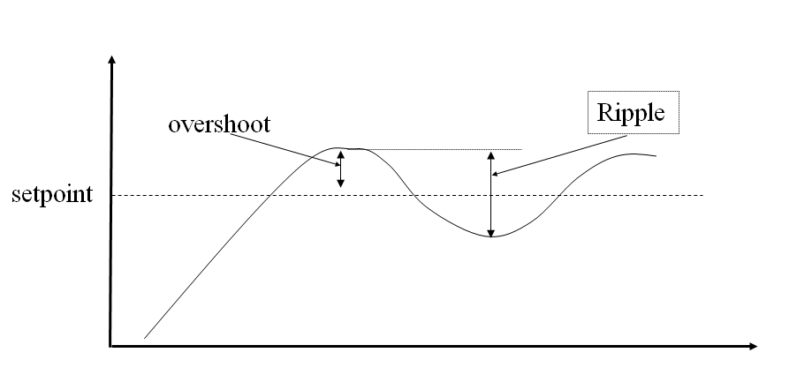
CONT…

Slide 5
TERMINOLOGY
Lag – time taken to respond to change in condition
Steady state error – measure of accuracy of control system in tracking the set value input

Slide 6
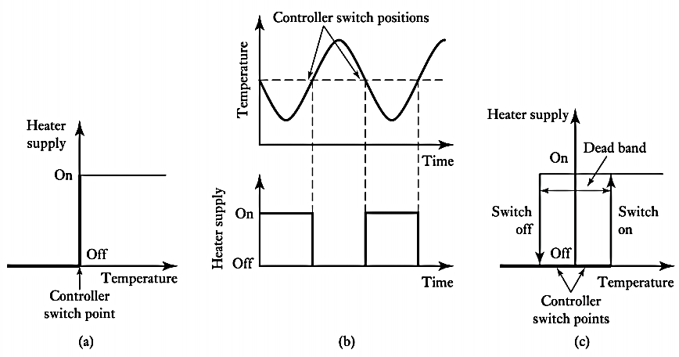
TWO-STEP METHOD

Slide 7
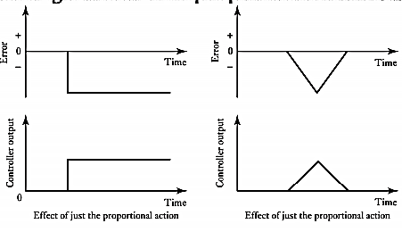
PROPORTIONAL CONTROL MODE
Controller output α Error
I_{out} - I_{o}= K_{p} . e
(I_{out} – I_{o}) (s) = K_{p} . E(s)
Transfer function = K_{P}

Slide 8
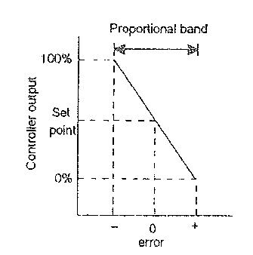
CONT…
Proportional band
Controller output is fully closed to fully
open
Error 0% to 100%
(proportional band)
% change in controller output from
set point = K_{p} . % change in error
100% change in controller output = K_{P} . Proportional band

Slide 9
CONT…
K_{P} is low large steady state error but stable response
K_{P} is high small steady state error but unstable response

Slide 10
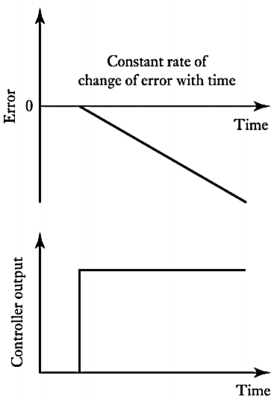
DERIVATIVE CONTROL MODE
Controller output α Rate of change of Error
I_{out} – I_{o} = K_{D} . (de / dt)
(I_{out} – I_{o}) (s) = K_{D} s . E(s)
Transfer function = K_{D} s
Do not respond to steady state error

Slide 11
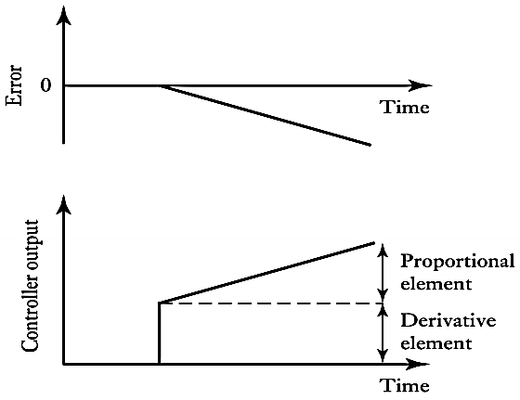
PROPORTIONAL PLUS DERIVATIVE CONTROL MODE
Controller output = K_{p} . e + K_{D} . (de / dt)
I_{out} - I_{o}= K_{p} . e + K_{D} . (de / dt)
(I_{out} – I_{o}) (s) = K_{p} . E(s) + K_{D} s . E(s)
Transfer function = K_{P} + K_{D} s
= K_{D} ( s + 1/T_{D})
T_{D} = K_{P} / K_{D}
T_{D} = derivative time constant

Slide 12
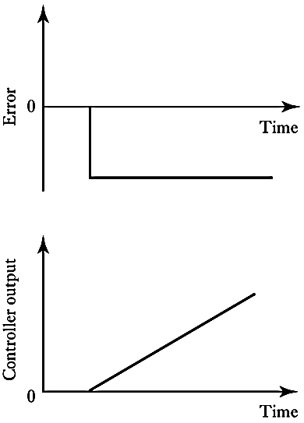
INTEGRAL CONTROL MODE
Rate of change
of Controller output α Error
$I_{out}$ - $I_{o}= K_{I} \int_{0}^{t}{e . dt}$
($I_{out}$ - $I_{o})(s)= \frac{1}{s} K_{I}$ . E(s)
Transfer function = (1/s) K_{I}
No response for sudden
Increase in error

Slide 13
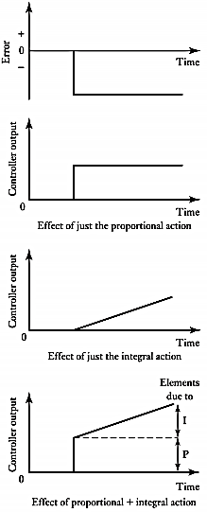
INTEGRAL PLUS PROPORTIONAL CONTROL MODE
Controller output = K_{p} . e + $K_{I} \int_{0}^{t}{e . dt}$
I_{out} - I_{o}= K_{p} . e + $K_{I} \int_{0}^{t}{e . dt}$
(I_{out} – I_{o}) (s) = K_{p} . E(s) + $\frac{1}{s} K_{I}$ . E(s)
Transfer function = K_{P} + (1/s) K_{I}
= K_{P} / s ( s + 1/T_{I})
T_{I} = K_{P} / K_{I}
T_{I} = integral time constant

Slide 14
PID CONTROL MODE
Controller output = K_{p} . e + $K_{I} \int_{0}^{t}{e . dt+\text{K}\text{D}\text{ . (}\text{de}\text{ / }\text{dt}\text{) }}$
I_{out} - I_{o}= K_{p} . e + $K_{I} \int_{0}^{t}{e . dt}$ + K_{D} . (de / dt)
(I_{out} – I_{o}) (s) = K_{p} . E(s) + $\frac{1}{s} K_{I}$ . E(s) + K_{D} s . E(s)
Transfer function = K_{P} + (1/s) K_{I} + s K_{D}
= K_{P} ( 1 + $\frac{1}{T_{I } S}$ + $T_{D }s$)

Slide 15
CONT…
Proportional mode reduces steady-state errors, but always destabilize the system.
Integral control provides robust reduction in steady-state errors, but often makes the system less stable.
Derivative control improves stability, but has almost no effect on the steady state error

Slide 16
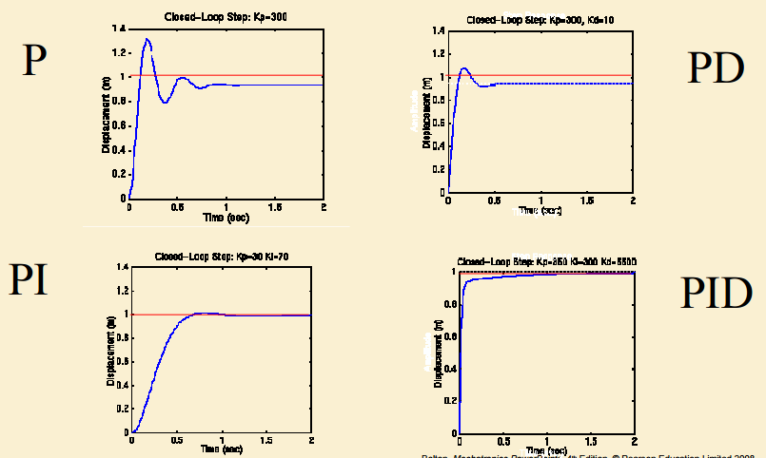
CONT…

