Slide 1
MODULE III SYSTEM MODELS
System Models - Building blocks of Mechanical, Electrical, Fluid and Thermal Systems, Modeling spring, mass & damper systems, Rotational –Translational Systems, Electromechanical Systems, Hydraulic –Mechanical Systems.

Slide 2
INTRODUCTION
How do a system behave w.r.t time when subject to some disturbances?????
It takes time to resume to required state
Eg: motor starts to rotate in full speed only after a time – it takes time to fill required tank level when tap is opened

Slide 3
CONT..
MATHEMATICAL MODEL
a model is required – represent real behavior of a system
Mathematical model – equation – describing relation between input & output of a system
base for this mathematical model???
Fundamental physical laws – governs – the behavior of the system

Slide 4
BUILDING BLOCKS
A block that is used to build up a system
Single property or function
Eg: an electrical system may consist of resistor, inductor & capacitor – resistor is a separate block that has property of resistance – likewise capacitor & inductor are different blocks having property of storing & inducing charges respectively

Slide 5
Cont…
Mechanical
Electrical
Fluid
Thermal

Slide 6
LUMPED PARAMETERS
Eg: an electrical system may consist of resistor, inductor & capacitor – resistor is a separate block that has property of resistance – likewise capacitor & inductor are different blocks having property of storing & inducing charges respectively
Number of electrical circuits can be formed by combining these building blocks in different way
Lumped parameter – system formed by different blocks – these blocks are independent

Slide 7
MECHANICAL BUILDING BLOCKS
Models – represent mechanical systems
Mechanical system – made up of spring/dashpot/mass – or contains their property alone without real spring/dashpot/mass
Input – force & output - displacement
BLOCK | PHYSICAL REPRESENTATION
SPRING | Stiffness of a system
DASHPOT | Forces opposing the motion (ie) friction / dampness effect
MASS | Inertia or Resistance to acceleration

Slide 8
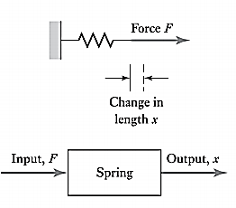
SPRING
F = k . x
F- force to compress / extend the spring
k - stiffness
Due to the input force, spring exerts equal force called as spring force but in opposite direction due to Newton’s 3rd law of motion

Slide 9
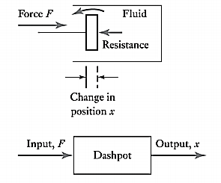
DASHPOT
To push an object through a fluid or move an object against frictional forces
$$F= c . \frac{dx}{dt}$$
F = c . v
c – damping coefficient
Due to the input force, dashpot exerts equal force called as dashpot force but in opposite direction due to Newton’s 3rd law of motion

Slide 10
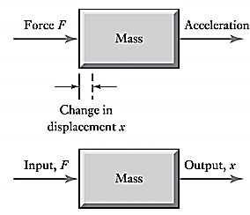
MASS
$$F=m . a=m . \frac{d^{2}x}{{dt}^{2}}$$
a - acceleration
Mass always moves in the direction of input force

Slide 11
ENERGY OF MECHANICAL BUILDING BLOCK
$E= \frac{k . x^{2}}{2}$ = $\frac{1}{2} \frac{f^{2}}{k}$
Spring
Stores energy & release when returned to original position
$$E= \frac{1}{2} . m . v^{2}$$
Mass
Stores energy (kinetic energy) & releases when stops moving
Dashpot
No energy stored & do not return to its original position – dissipates energy - power
$$P=c . v^{2}$$

Slide 12
ROTATIONAL SYSTEM
Spring
Torsional Bar / Torsional spring
Dashpot
Torsional Damper / Rotary Damper
Mass
Moment of Inertia

Slide 13
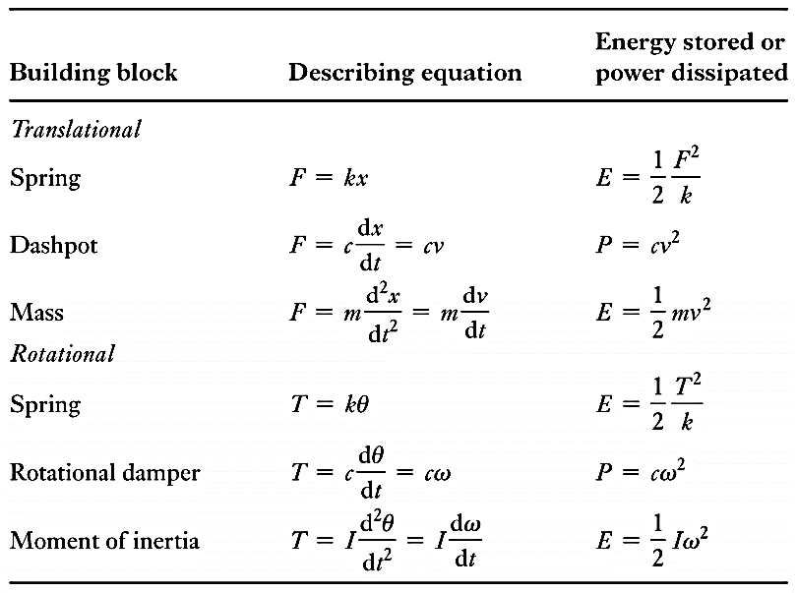
Cont…

Slide 14
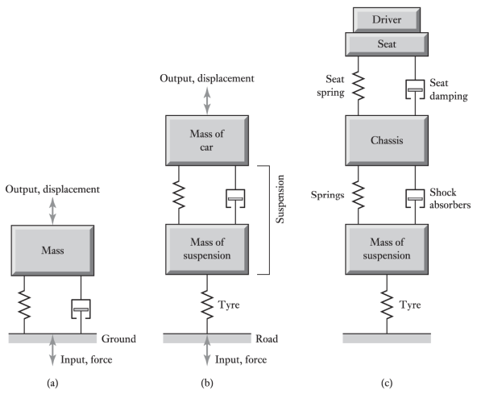
BUILDING A MECHANICAL SYSTEM
Machine mounted on the ground,
The chassis of a car moving with wheel on road
The driver of a car while driving in the road

Slide 15
STEPS TO SOLVE PROBLEMS
Draw a free body diagram of each mass with the forces associated with it ( spring force & dashpot force are always in opposite direction to input force F )
Write the net force acting on the mass
Sign convention: +ve sign for left to right forces - bottom to top forces - clockwise forces
Apply Newton’s Second law of motion
NET FORCE = m . a = m . d²x/dt²

Slide 16
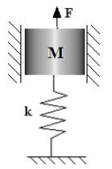
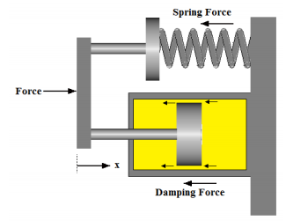
DERIVE AN EQUATION TO RELATE INPUT FORCE F WITH OUTPUT DISPLACEMENT ( X Or )
Refer Notes for Derivation

Slide 17
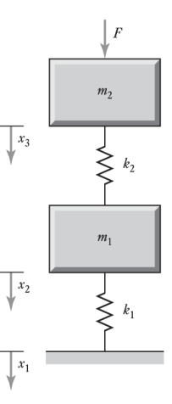
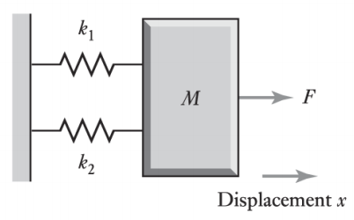
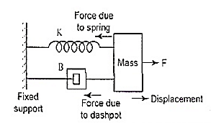
CONT…
Refer Notes for Derivation

Slide 18
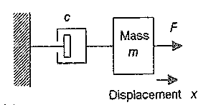
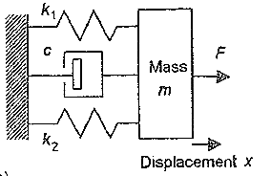
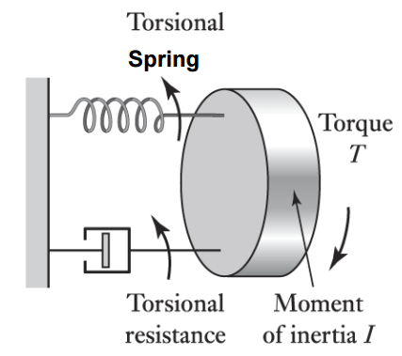
CONT…
Refer Notes for Derivation

Slide 19
ELECTRICAL BUILDING BLOCKS
Models – represent electrical systems
Input – applied voltage & output – voltage across any block given
BLOCK | PHYSICAL REPRESENTATION
RESISTOR | Opposition to movement
CAPACITOR | Store charge
INDUCTOR | Inducing voltage due to change in magnetic field of coil

Slide 20
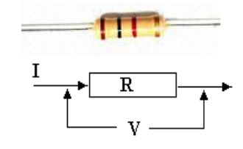
RESISTOR
Potential difference across α current
$$V_{R}=i . R$$
$$P_{R}=\frac{{V_{R}}^{2}}{R}$$
$$i= \frac{V_{R}}{R}$$
V_{R}– voltage across resistor ; i – current ; R – resistance ; P_{R} – power dissipiated

Slide 21
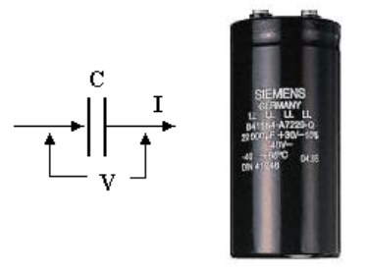
CAPACITOR
Potential difference across α charge
$$V_{C}= \frac{q}{c}$$
$$V_{C}= \frac{1}{C} . \int{i . dt}$$
$q=$ $\int{i dt}$
$$\frac{dq}{dt} = i=C . \frac{dV_{C}}{dt}$$
$$E_{C}=\frac{1}{2} . C .{V_{C}}^{2}$$
V_{C} – voltage across capacitor ; i – current ; C – capacitance ; E_{C} – energy stored

Slide 22
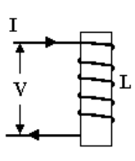
INDUCTOR
Potential difference across α rate of change of current
$$V_{L}=L . \frac{di}{dt}$$
$$E_{L}=\frac{1}{2} . L .i^{2}$$
$$i= \frac{1}{L} . \int{V_{L} . dt}$$
V_{L} – voltage across inductor ; i – current ; L – inductance ; E_{L} – energy stored

Slide 23
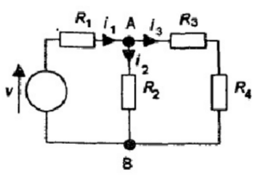
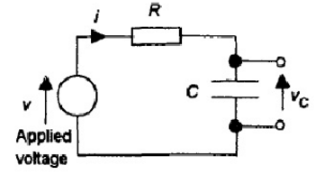
ANALYSIS OF ELECTRICAL SYSTEM
KIRCHOFF’S LAW
Current law – algebraic sum of current at a junction is equal to zero. (more than one loop)
Voltage law – in a loop sum of voltage across each part is equal to applied voltage. (single loop)
$$i_{1}= i_{2 }+ i_{3}$$
$$V = V_{R }+ V_{C}$$

Slide 24
STEPS TO SOLVE PROBLEMS
Draw the circuit diagram
Input is applied voltage (v) & output will be given in the question as V_{c} (voltage across capacitor) or V_{R} (voltage across resistor) or V_{L} (voltage across inductor)
If single loop :
use voltage law ($V = V_{R }+ V_{C}+etc…)$
Convert V_{R ,} V_{L,} V_{c} everything in terms of current equation & then substitute i current with output voltage ( for example if output voltage is V_{C} then write all i interms of V_{C} )

Slide 25
CONT…
If more than one loop:
Use current law ($i_{1}= i_{2 }+ i_{3}$)
Convert all i (current) in the equation in terms of output voltage suitably
Rearrange all the terms in such a way input voltage on one side & output voltage on other side

Slide 26
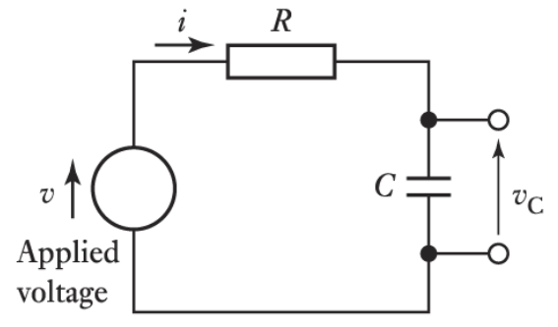
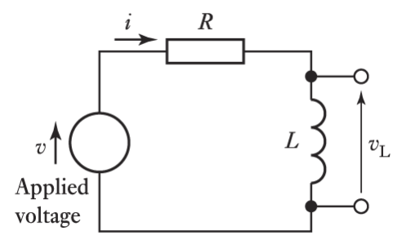
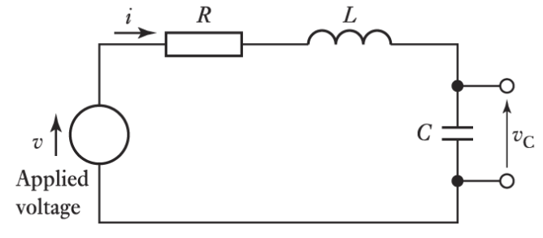
DERIVE A RELATION BETWEEN INPUT VOLTAGE AND OUTPUT VOLTAGE
Refer Notes for Derivation

Slide 27
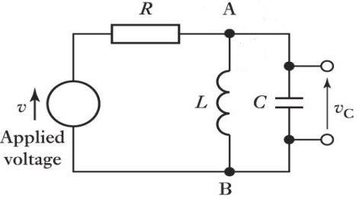
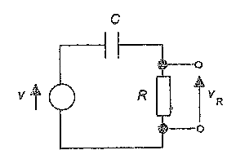
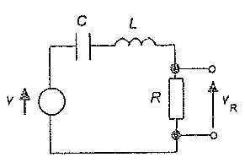
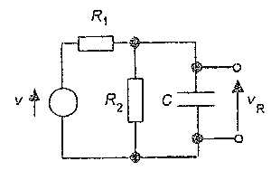
CONT…
Refer Notes for Derivation

Slide 28
ELECTRICAL & MECHANICAL ANALOGY
Spring
Capacitor
Dashpot
Resistor
Mass
Inductor

Slide 29
FLUID BUILDING BLOCK
Hydraulic – liquid – incompressible
Relation between pressure / height and volumetric flow rate
Pneumatic – gas - compressible
Relation between pressure and mass flow rate

Slide 30
HYDRAULIC BUILDING BLOCKS
BLOCK | PHYSICAL REPRESENTATION
HYDRAULIC RESISTANCE | Opposition to flow
HYDRAULIC CAPACITANCE | Store as potential energy
HYDRAULIC INERTANCE | Accelerate a fluid by pressure difference

Slide 31
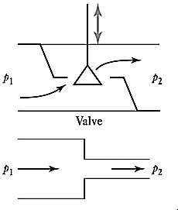
HYDRAULIC RESISTANCE
$$P_{1}− P_{2}=q . R$$
$$q= \frac{P_{1} − P_{2}}{R}$$
$$P_{R}=\frac{1}{R} {(P_{1} − P_{2} )}^{2}$$
Orifices, valves, nozzles and friction in pipes can be modeled as fluid resistors
P₁ & P₂ – pressure @ 1 & 2
q – volume flow rate
R – hydraulic resistance
P_{R} – power dissipiated

Slide 32
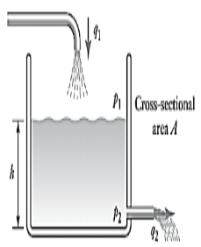
HYDRAULIC CAPACITANCE
Hydraulic cylinder chambers,
tanks, and accumulators are
examples of fluid capacitors
$$q_{1}− q_{2}=C . \frac{dP}{dt}$$
$$P_{1} − P_{2}=\frac{1}{C} . \int{\left(q_{1} − q_{2}\right). dt }$$
$$E_{C}=\frac{1}{2} C . {(P_{1} − P_{2} )}^{2}$$
q₁ & q₂ – volume flow rate @ inlet & outlet
P₁ & P₂– pressure @ 1 & 2
C – hydraulic capacitance
E_{C} – energy stored
C $=\frac{A}{ρ.g}$
Refer Notes for Derivation

Slide 33
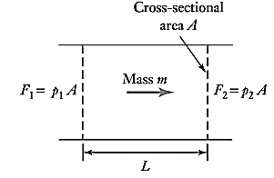
HYDRAULIC INERTANCE
$$P_{1}− P_{2}=I . \frac{dq}{dt}$$
$$q_{1} − q_{2}=\frac{1}{I} . \int{\left(P_{1} − P_{2}\right). dt }$$
$$E_{I}=\frac{1}{2} I . {(q)}^{2}$$
Long pipes are examples of fluid
inertances
q₁ & q₂ – volume flow rate @ 1 & 2
P₁ & P₂– pressure @ 1 & 2
C – hydraulic inertance
E_{I} – energy stored
$$I =\frac{L.ρ}{A}$$
Refer Notes for Derivation

Slide 34
PNEUMATIC BUILDING BLOCKS
BLOCK | PHYSICAL REPRESENTATION
PNEUMATIC RESISTANCE | Opposition to flow
PNEUMATIC CAPACITANCE | Store as potential energy
PNEUMATIC INERTANCE | Accelerate a gas by pressure difference

Slide 35
PNEUMATIC RESISTANCE
$P_{1}− P_{2}=R .$ṁ
$$ṁ= \frac{P_{1} − P_{2}}{R}$$
Orifices, valves, nozzles and friction in pipes can be modeled as fluid resistors
$$P_{R}=\frac{1}{R} {(P_{1} − P_{2} )}^{2}$$
P₁ & P₂ – pressure @ 1 & 2
ṁ – mass flow rate
R – pneumatic resistance
P_{R} – power dissipiated

Slide 36
PNEUMATIC CAPACITANCE
Hydraulic cylinder chambers,
tanks, and accumulators are
examples of fluid capacitors
$$ṁ_{1}− ṁ_{2}=( C_{1}+ C_{2} ) . \frac{dP}{dt}$$
$$P_{1} − P_{2}=\frac{1}{( C_{1}+ C_{2} )} . \int{\left(ṁ_{1}−ṁ_{2}\right). dt }$$
$$E_{C}=\frac{1}{2} ( C_{1}+C_{2} ) . {(P_{1} − P_{2} )}^{2}$$
ṁ₁ & ṁ₂ – mass flow rate @ inlet & outlet
P₁ & P₂– pressure @ 1 & 2
C₁ – pneumatic capacitance (change in volume)
C₂ – pneumatic capacitance (compressibility)
E_{C} – energy stored
$$C_{1}=ρ.\frac{dV}{dP}$$
$$C_{2}=\frac{V}{R.T}$$
Refer Notes for Derivation

Slide 37
PNEUMATIC INERTANCE
$$P_{1}− P_{2}=I . \frac{dṁ}{dt}$$
$$ṁ_{1} − ṁ_{2}=\frac{1}{I} . \int{\left(P_{1} − P_{2}\right). dt }$$
$$E_{I}=\frac{1}{2} I . {(ṁ)}^{2}$$
Long pipes are examples of fluid
inertances
$$I =\frac{L }{A}$$
ṁ₁ & ṁ₂ – mass flow rate @ 1 & 2
P₁ & P₂– pressure @ 1 & 2
I – pneumatic inertance
E_{I} – energy stored
Refer Notes for Derivation

Slide 38
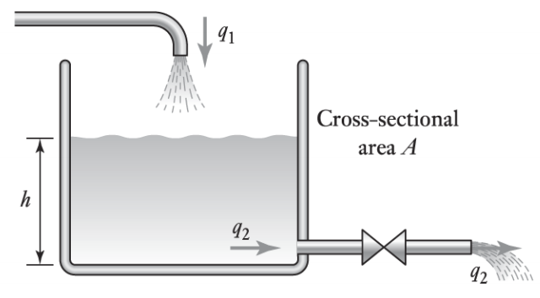
Derive a relation for height of the tank (change in flow rate is slow / neglect inertance)
Refer Notes for Derivation

Slide 39
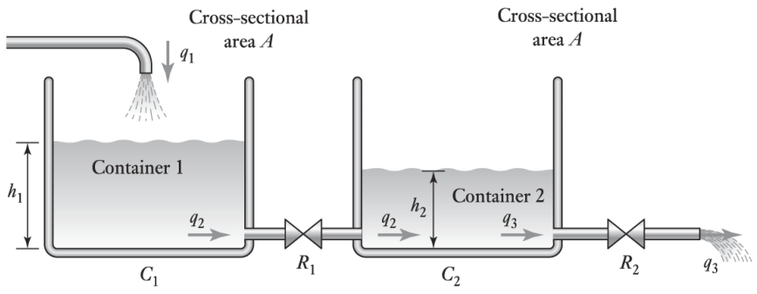
DERIVE A RELATION FOR THE FLUID LEVEL IN TWO CONTAINERS ( CHANGE IN FLOW RATE IS VERY SLOW )
Refer Notes for Derivation

Slide 40
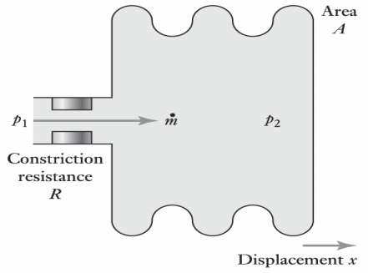
DERIVE A RELATION FOR THE VARIATION ON PRESSURE 2 DUE TO PRESSURE 1 ( CHANGE IN FLOW RATE IS VERY SLOW )
Refer Notes for Derivation

Slide 41
THERMAL BUILDING BLOCKS
BLOCK | PHYSICAL REPRESENTATION
THERMAL RESISTANCE | Opposition to flow of heat
THERMAL CAPACITANCE | Store of internal energy

Slide 42
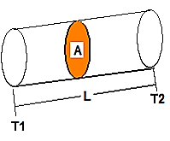
THERMAL RESISTANCE
$T_{1}− T_{2}=R .$q
$$q= \frac{T_{1} − T_{2}}{R}$$
CONDUCTION
CONVECTION
$$R= \frac{L}{k A}$$
$$R= \frac{1}{h A}$$
T₁ & T₂ – temperature @ 1 & 2
q – rate of flow of heat
R – thermal resistance
k – thermal conductivity
h – coefficient of heat transfer
A – area of cross section
L length of pipe

Slide 43
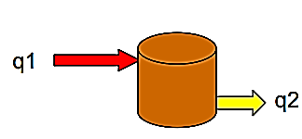
THERMAL CAPACITANCE
$$q_{1}− q_{2}=C\frac{dT}{dt}$$
$$T=\frac{1}{C} \int{\left(q_{1} − q_{2}\right). dt }$$
$E_{C}=$ C.T
C $=m.c$
q₁ & q₂ – heat flow rate @ inlet & outlet
T– temperature
C – thermal capacitance
m – mass of the object
c – specific heat capacity
E_{C} – energy stored

Slide 44
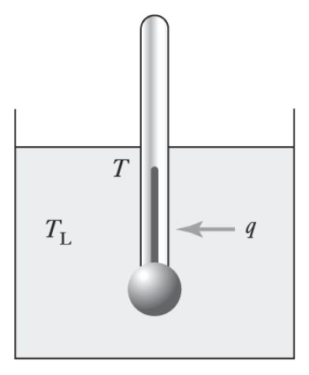
DERIVE A RELATION BETWEEN THE TEMPERATURE OF THERMOMETER AND LIQUID
Refer Notes for Derivation

Slide 45
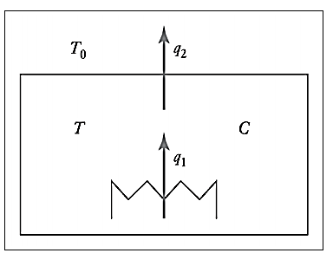
DERIVE A RELATION TO SHOW HOW THE ROOM TEMPERATURE CHANGES WITH TIME
Refer Notes for Derivation

Slide 46
COMBINED BUILDING BLOCK
Many systems in real life involves combination of more than one discipline:
rotational & translational building blocks (Eg: rack & pinion)
Electrical & mechanical building blocks (Eg: potentiometer , dc motor)
Hydraulic & mechanical (Eg: movement of piston by a valve)
Refer Notes for Derivation

