Slide 1
MODULE II
ACTUATORS
Review of Pneumatic and Hydraulic Systems - Control Valves, Actuators.
Review of Mechanical Actuation Systems – Cams, Gear Trains, Ratchet and pawl, Belt and Chain Drives, Bearings. Electrical Actuation Systems – Mechanical Switches, Solid State Switches, Solenoids, Construction and working principle of DC and AC Motors –speed control of AC and DC drives,
Stepper Motors-switching circuitries for stepper motor- Servo motors.

Slide 2
INTRODUCTION
Correction element in control system – transforming the output of microprocessor - into – controlling action on machine or device.
Electrical
Mechanical
Pneumatic & Hydraulic

Slide 3
PNEUMATIC & HYDRAULIC ACTUATORS

Slide 4
INTRODUCTION
Convert energy - pressurized hydraulic oil / compressed air – actuating motion
Basic components:
  Motor – to run pump / compressor
  Pump (to pump liquid from sump) / compressor (to pressurize the atmospheric air)
  Non return valve – to allow flow only in forward direction
  Pressure relief valve – to release excess pressure
  Accumulator / air receiver – smooth out any short term fluctuation
  Filter – to remove dust from air
  Cooler – to cool heated air from compressor
  Water trap – to remove water droplets in air
  Silencer – to reduce noise in the air

Slide 5
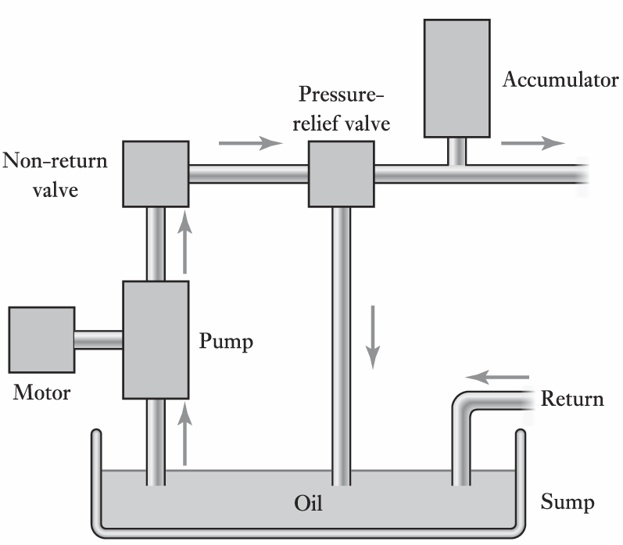
HYDRAULIC POWER SYSTEM

Slide 6
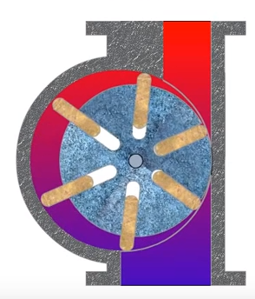
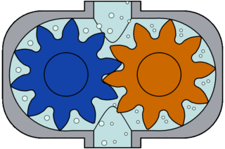
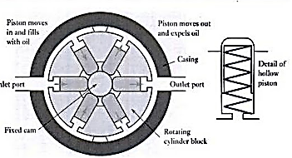
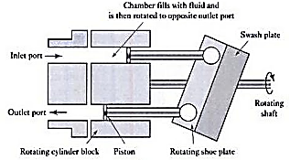
PUMPS
GEAR PUMP
VANE PUMP
RADIAL PISTON PUMP
AXIAL PISTON PUMP
NOTE: view the link https://www.youtube.com/watch?v=Qy1iV6EzNHg for self explanation

Slide 7
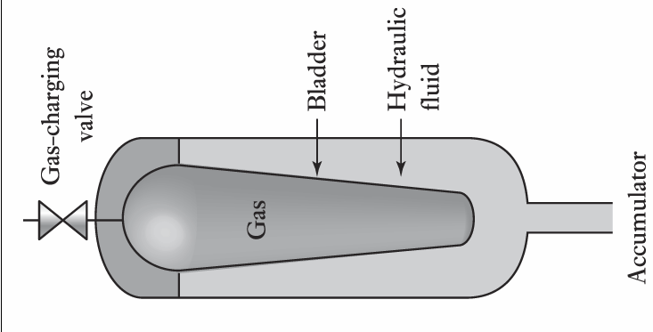
ACCUMULATOR
Container holding oil along with bladder containing pressurized gas
If oil pressure rises - bladder contracts - increases the space to occupy the oil - so reduces the oil pressure in the system
If oil pressure reduces - bladder expands - reduces the space to occupy the oil - so increases the oil pressure in the system

Slide 8
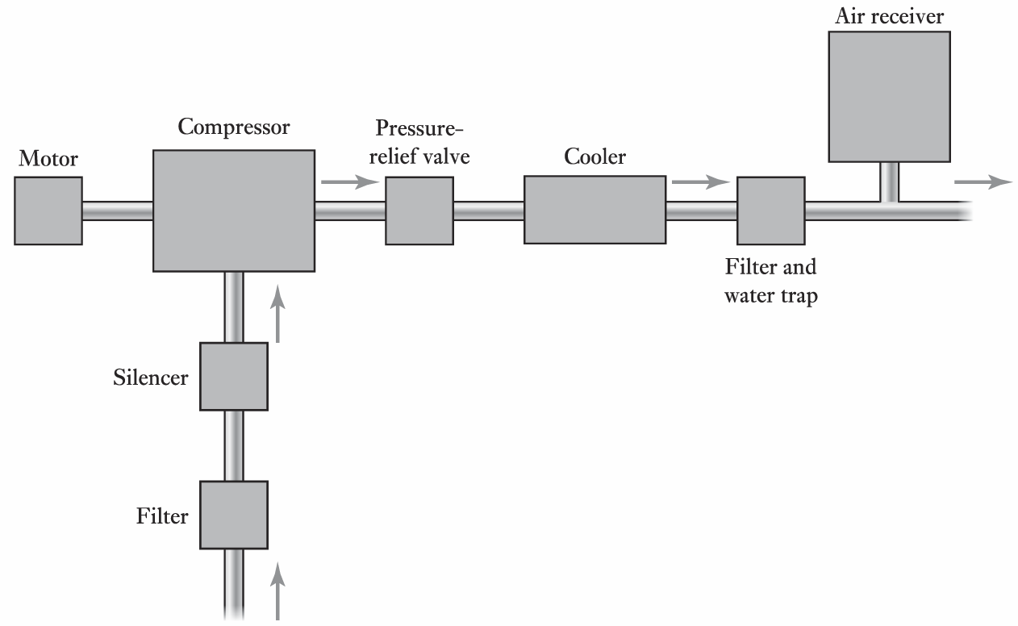
PNEUMATIC POWER SYSTEM

Slide 9
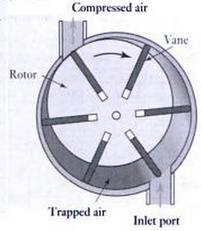
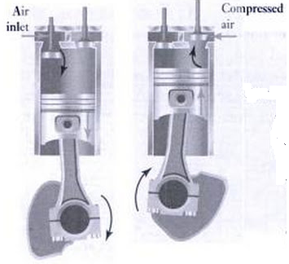
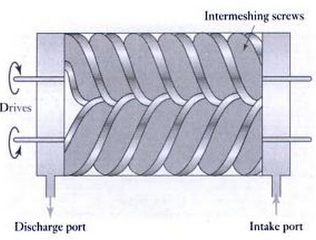
COMPRESSOR
ROTARY VANE COMPRESSOR
https://www.youtube.com/watch?v=z0Y8u6bVSEo
RECIPROCATING COMPRESSOR
https://www.youtube.com/watch?v=fTDkG1y5R34
SCREW COMPRESSOR
https://www.youtube.com/watch?v=iDAKfAib4bY

Slide 10
VALVES
Control of actuators
  Direction
  Pressure
    Pressure limiting / relief valve
    Pressure regulating valve
    Pressure sequencing valve
  Process/Flow
Forms
  Finite position – ON / OFF – direction control valves, pressure relief valves & pressure sequence valves
  Infinite position – fully closed position to fully open position – pressure regulating valves & flow control valves

Slide 11
DIRECTION CONTROL VALVES
Type of construction – spool & poppet
Number of ports (input & output) – 2, 3, 4 & 5
Number of switching position – 2 & 3
Actuating mechanism – mechanical, electrical & pneumatic

Slide 12
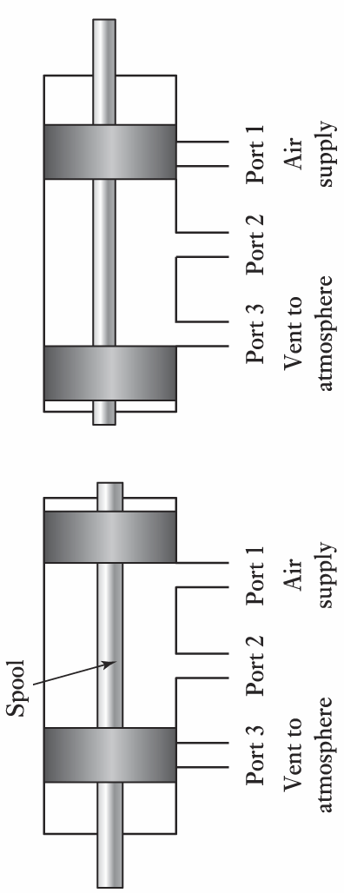
SPOOL VALVES
Spool moves right side blocks the vent & air flow from 1 to 2
Spool moves left side blocks the supply & air flow from 2 to 3

Slide 13
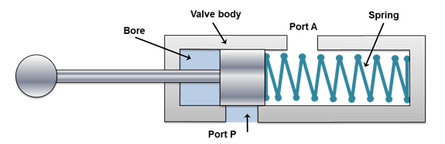
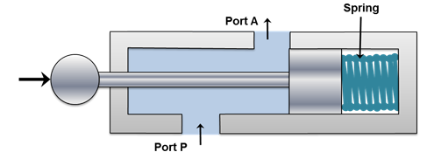
CONT…
Return position of spool valve – spring return

Slide 14
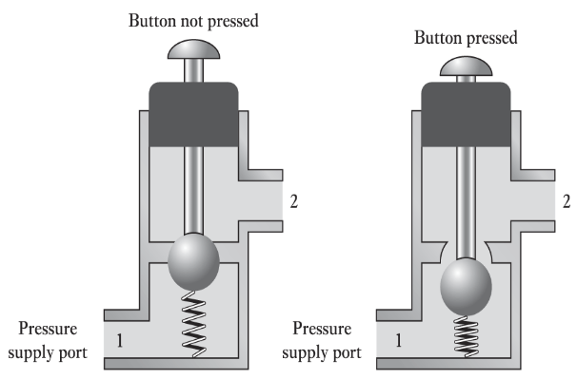
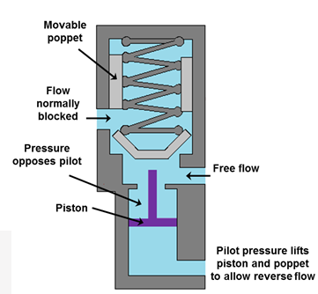
POPPET VALVES
PUSH BUTTON TYPE
PILOT OPERATED TYPE
Poppet valve – normally closed condition – with spring force
Whenever push button pressed / pressurized with air – open against spring force

Slide 15
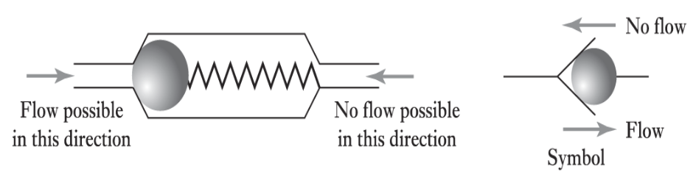
NON RETURN VALVES
Basically a directional valve
Allows one direction against spring force
Ball gets locked in the port for reverse direction with spring force

Slide 16
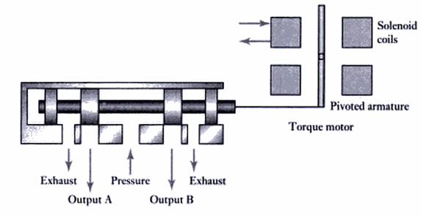
PROPORTIONAL & SERVO CONTROL VALVES
Gives infinite position
By varying the current intensity spool speed differs
Proportional valve – open loop
Servo valve – closed loop

Slide 17
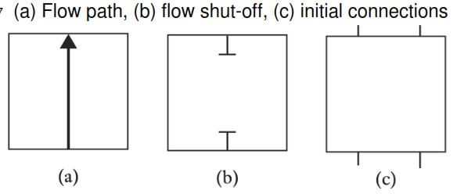
VALVE SYMBOL
Number of ports
Number of positions
Actuation mechanism

Slide 18
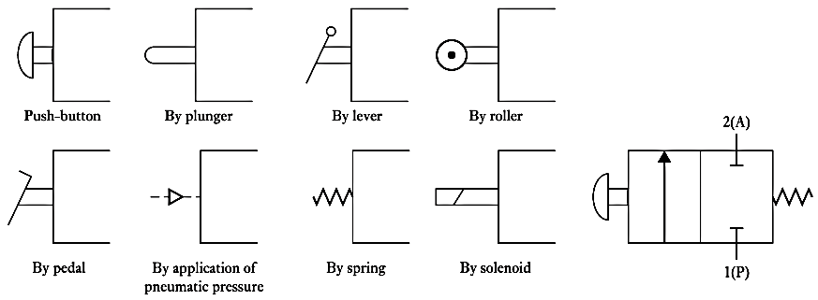
Cont…

Slide 19
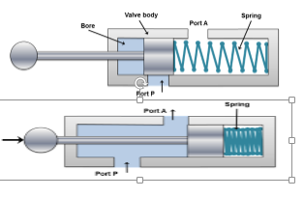
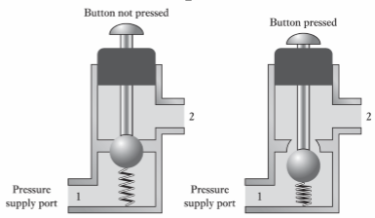
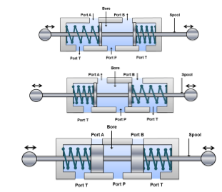
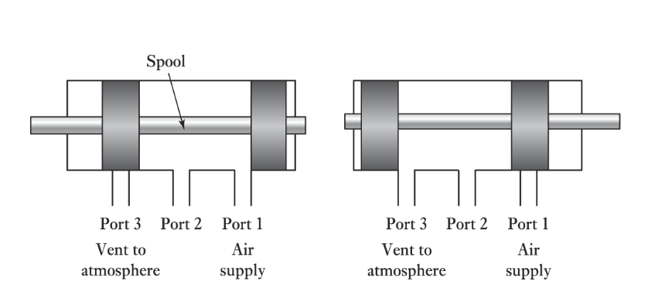
DRAW THE SYMBOL FOR FOLLOWING VALVES
SOLENOID
SOLENOID

Slide 20
PRESSURE CONTROL VALVES
Pressure limiting / relief valves
Pressure regulating valves
Pressure sequencing valves

Slide 21
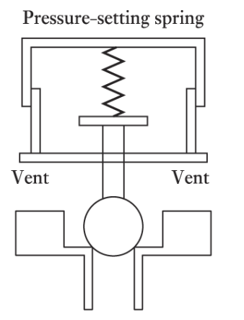
PRESSURE LIMITING /
RELIEF VALVES
Safety device to limit the pressure in the system
Has an orifice , normally closed
Spring is set to safe pressure limit
When the pressure in system overcomes the force exerted by spring, valve opens & vent the air out / back to sump

Slide 22
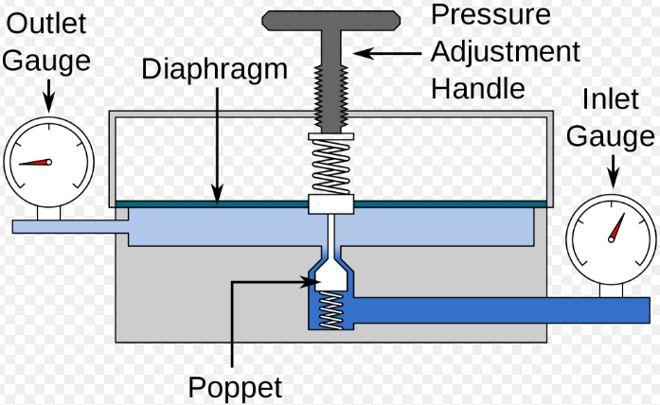
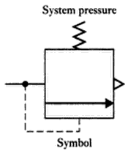
PRESSURE REGULATING VALVES
Control operating pressure in the system
Poppet is set under the spring force – adjustable handle
As per pressure requirement, handle is adjusted, fluid flow across poppet
Pressure can be measured at outlet / both inlet & Outlet – better control

Slide 23
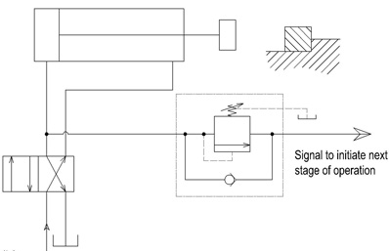
PRESSURE SEQUENCING VALVES
Pressure-control valve - used to force two actuators to operate in sequence
Similar to pressure-relief valves
Instead of sending flow back to the tank, a sequence valve allows flow to a branch circuit, when a preset pressure is reached

Slide 24
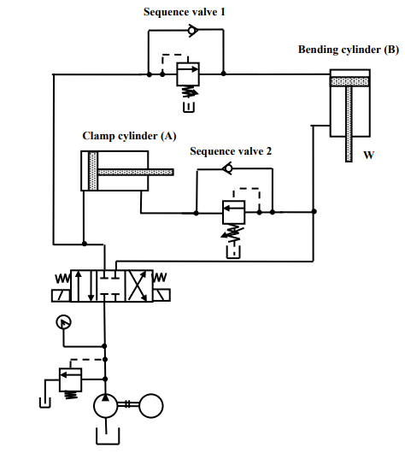
CONT..
Sequence valve 1 is attached with clamping cylinder extension part
Only when clamping cylinder is extended completely, the pressure in sequence valve 1 rises and opens out for extension of bending cylinder
Sequence valve 2 is attached with bending cylinder retraction part
Only when bending cylinder is retracted completely, the pressure in sequence valve 2 rises and opens out for retraction of clamping cylinder
A⁺ B⁺ B⁻ A⁻

Slide 25
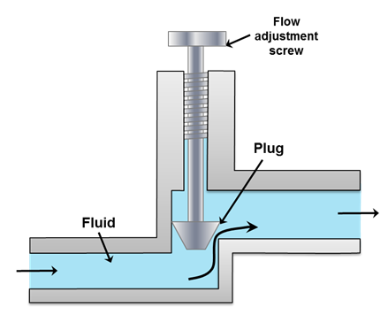
PROCESS / FLOW CONTROL VALVES
Control the rate of fluid flow
Two parts:
  valve actuator – to move the plug into flow pipe
  valve body – restricts the fluid flow rate

Slide 26
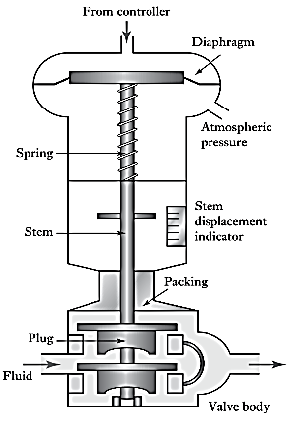
Cont…
Change in input pressure through controller
Consequently diaphragm sandwiched in centre between 2 circular steel disc moves
Moves the valve stem
Inner valve plug moves within vlve body
Restricts the fluid flow
Controls fluid flow rate

Slide 27
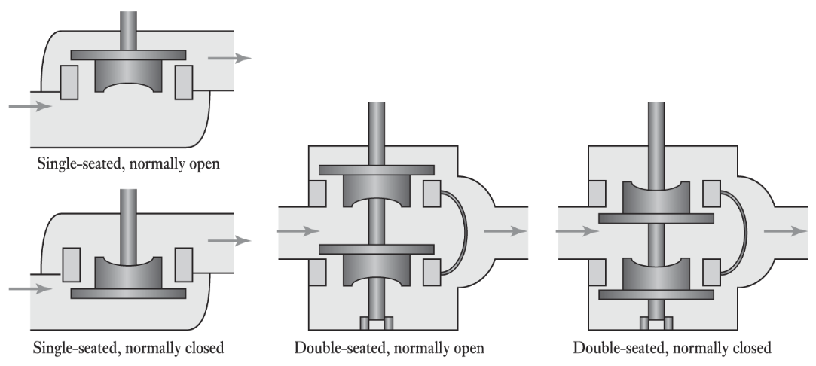
VALVE BODIES
Normally open – allows the free flow until acted upon by external force
Normally close – allows the free flow only when acted upon by external force
Single-seated – one plug to control flow
Double-seated – 2 plugs to control flow

Slide 28
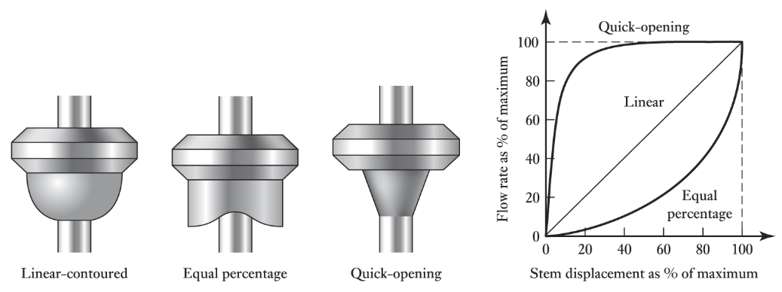
PLUG SHAPES
Linear-contour – change in flow rate – proportional - change in displacement of stem
Equal % - rate of change of flow rate – equal – rate of change of displacement of stem
Quick-opening – large change in flow for small change in displacement of stem

Slide 29
ACTUATOR
Linear – cylinder & piston/ram
  Single acting – extension through pressure & retraction through spring force
  Double acting – extension retraction through pressure
Rotary – linear cylinder & mechanical linkages

Slide 30
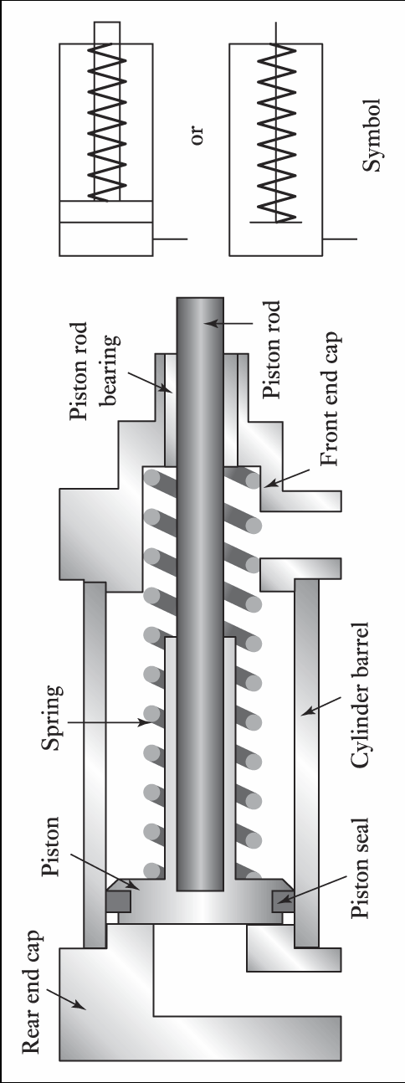
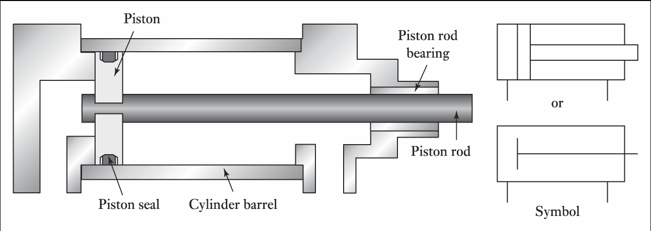
ACTUATORS - CYLINDERS

Slide 31
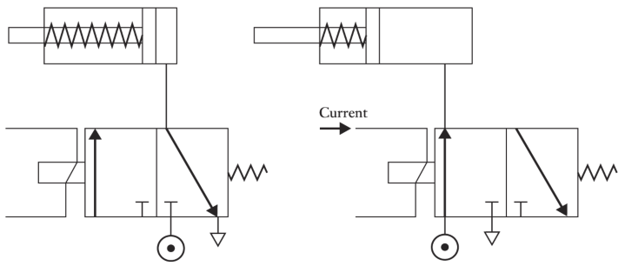
CONTROL OF SINGLE ACTING

Slide 32
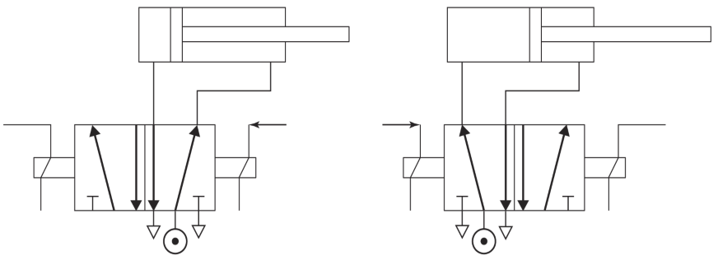
CONTROL OF DOUBLE ACTING

Slide 33
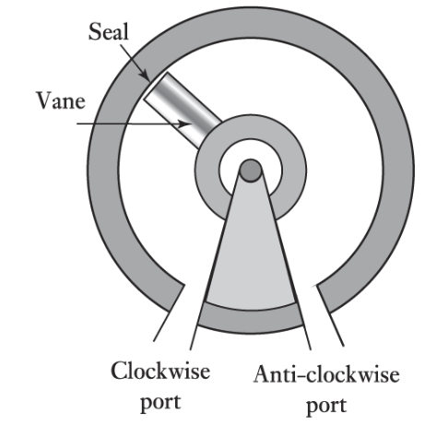
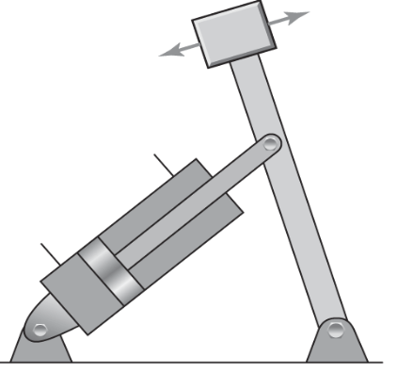
ROTARY ACTUATORS

Slide 34
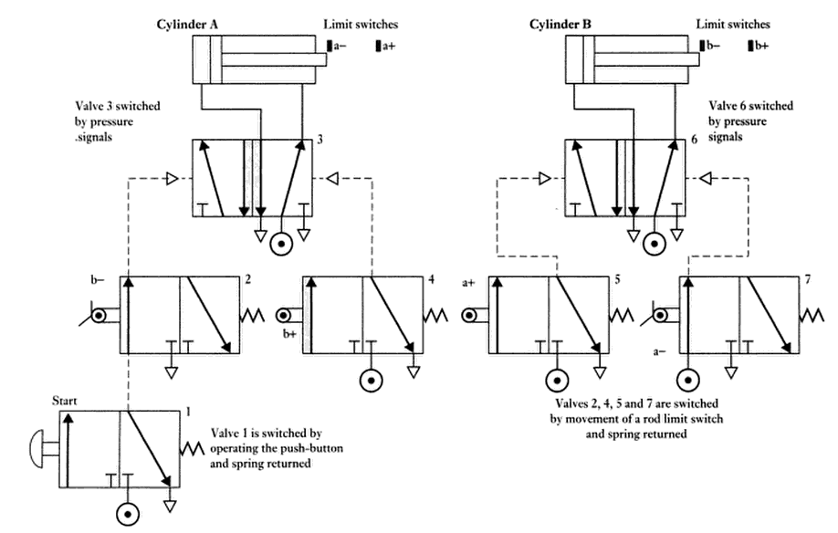
CYLINDER SEQUENCING

Slide 35
MECHANICAL ACTUATORS

Slide 36
INTRODUCTION
Devices - motion converters
Force amplification - Levers
Change of speed – gears
Motion in prescribed manner – toothed belt / timing belt / chain, cams
Transfer of rotation about one axis to rotation about another axis - gears, chains, belt drives
Transfer of rotation about 90o – bevel gears
Rotary to linear & viceversa – rack & pinion
Unidirectional rotation – ratchet & pawl
Particular types of motion – quick return mechanism

Slide 37
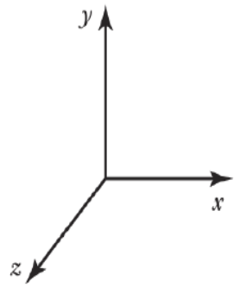
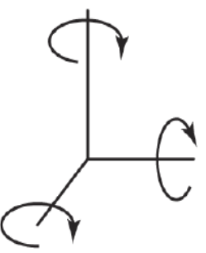
KINEMATICS - TYPES OF MOTION
Translatory motion along X, Y & Z axis
Rotary motion along X, Y & Z axis
Complex motion – combinations of above 6 motion

Slide 38
Cont…
Degrees of freedom (DOF) – number of motion a system can move
Maximum DOF – 6 (3 translator & 3 rotation)
To get complete movement – DOF must be reduced suitably with number of constraints & orientation of same
Constraints – restriction
KINEMATIC DESIGN – principle of least constraint
DOF - 2
DOF - 1

Slide 39
Cont…
Link – moves relative to some other
  Eg: lever, crank, connecting rod, piston, pulley, belt, shaft etc
Nodes – points of attachment
Joints connection between links at nodes
2 nodes
3 nodes
4 nodes

Slide 40
Cont..
Kinematic chains:
  Four bar chain – 4 links & 4 joints – reciprocating movement(lever) & rotary movement(crank)
  Slider crank chain – crank, connecting rod, slider – Eg: in engines
Double lever
Lever Crank
Double Crank

Slide 41
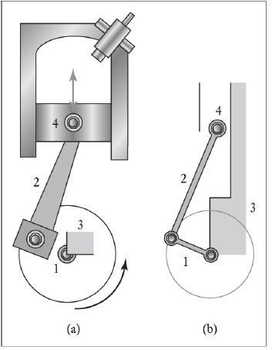

Slide 42
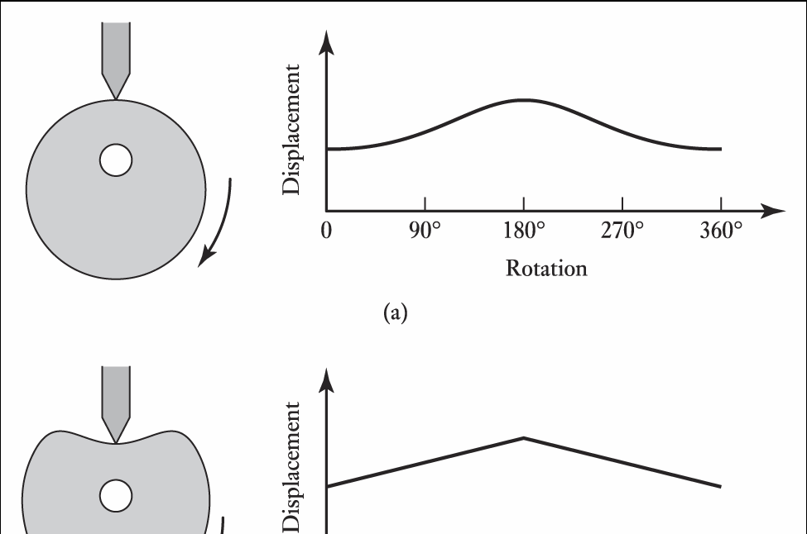
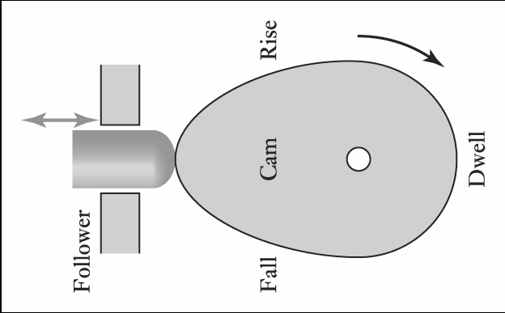
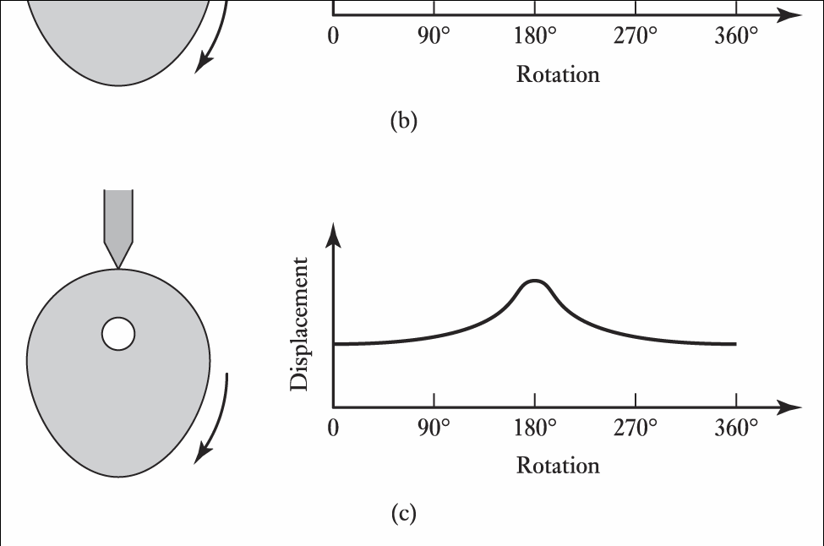
CAMS

Slide 43
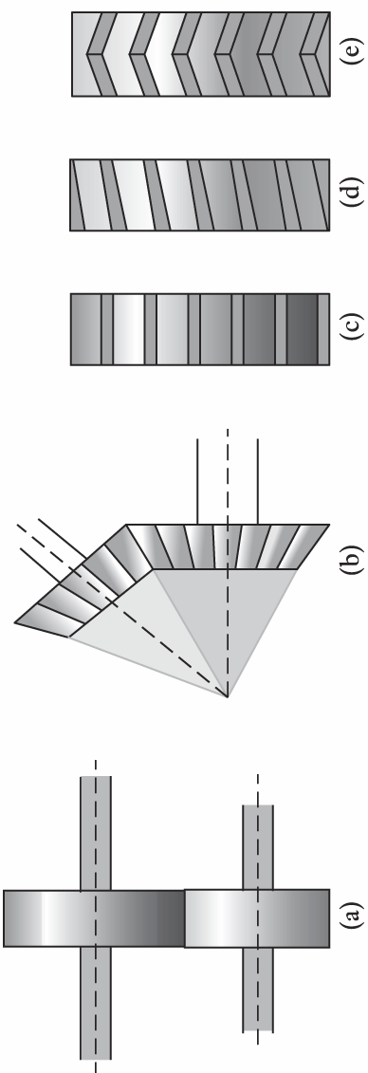
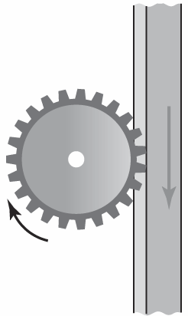
GEAR

Slide 44
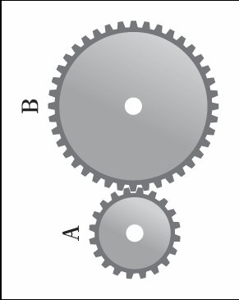

CONT…
GEAR RATIO

Slide 45
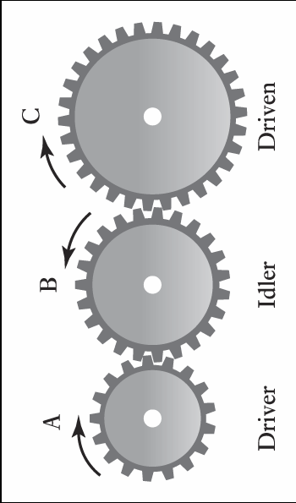
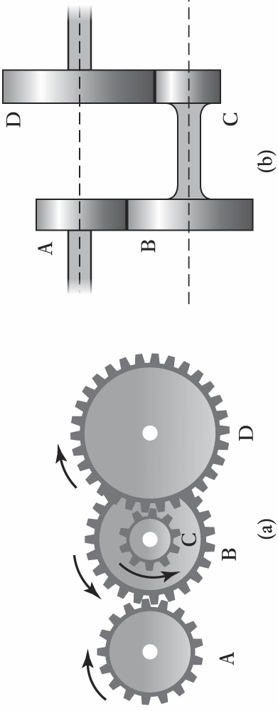
CONT…

Slide 46

RATCHET & PAWL

Slide 47



BELT

Slide 48


CONT…

Slide 49

CHAIN

Slide 50

BEARINGS

Slide 51

JOURNAL BEARINGS

Slide 52

BALL BEARINGS

Slide 53


CONT…

Slide 54

ROLLER BEARINGS

Slide 55
ELECTRICAL ACTUATORS

Slide 56
INTRODUCTION
Converts electrical energy into mechanical force.
Switching devices – mechanical switches (Relay) and solid-state switch
Solenoid type device
Drive system – motors (AC, DC, Stepper)

Slide 57

RELAY
A.C. applied to coil
Magnetic field developed around coil due to A.C.
Attracts the armature made of soft iron
Closes & opens the NO & NC switch respectively

Slide 58

CONT…

Slide 59
SOLID STATE SWITCHES
Diode
Thyristor and triac
Bipolar transistor
MOSFET

Slide 60

DIODES
Combination of p type and n type semiconductor with junction where charges gets accumulated.
Allows current only in one direction (forward biased)

Slide 61

CONT…
Used as rectifier to convert A.C to D.C as it closes the circuit only for positive cycle of A.C

Slide 62

TRANSISTOR
3 terminals – Emitter, base & collector
2 junctions – emitter base & collector base
2 voltage source – Emitter Base (EB) & Collector Base (CB)
EB - forward biased & CB – reverse biased

Slide 63

Cont..

Slide 64
TRANSISTOR as AMPLIFIER
COMMON BASE
Electrons flow from n region (emitter) to p region (base)
Some electrons gets fused with hole and is lost
Rest of abundant electron in base flow to collector (n region)
Emitter base forward biased – low resistance
Collector base reverse biased – high resistance
Emitter current – flow of electron, base current – lost electron, collector – flow of current
More emitter current & low resistance – low voltage
More collector current & high resistance – high voltage
Low voltage (EB) high voltage (CB)

Slide 65

Cont…

Slide 66


TRANSISTOR as SWITCH
COMMON EMITTER

Slide 67

CHARACTERESTICS - TRANSISTOR
@ I_{B} (forward biased), I_{C} increases with increase in V_{CE} and reaches constant
Knee point is saturation point – transistor switch on
I_{B} zero (reverse biased) - cutoff transistor switched off
Active region – function as amplifier.
Saturation
Active
Cut-off

Slide 68

DARLINGTON PAIR
2 transistors
Base of first is base to pair
Emitter of one connected to base of other
Both collectors are connected and made as single collector for pair
Emitter of second is emitter to the pair
Initial base current is amplified and given as base to second in the pair
Used to switch on the device which needs high power input with smaller base current from microprocessor

Slide 69


MOSFET
Metal OxideS Field effect Transistor (MOSFET)
P channel – N+ type (heavily n doped) as gate
N channel – P+ type (heavily p doped) as gate
Voltage controlled device

Slide 70


Gate-source (pn junction) terminal reverse biased
Increases the depletion region
Restricts the flow of charge from source to drain terminal
Restricting the pathway of the flow of charges

Slide 71

THYRISTOR (SCR)
PNPN – 3 junctions & 3 terminals – anode (P) , Cathode (N) & gate (P)
Anode & gate – connected to +ve terminal & cathode - -ve terminal
Function of both diode and transistor – rectifies & also controls the current between cathode and anode
ON condition:
  giving gate current
  increasing the voltage between cathode and anode
OFF condition :
  reduce the voltage between cathode and anode
  introducing resistor in circuit and increasing the resistance

Slide 72


THYRISTOR (SCR)

Slide 73


TRIAC
2 SCR connected parallel and inverted
Anode of one and cathode of other forms a terminal 1 (A1)
Cathode of first and anode of second forms a terminal 2(A2)
Both gates are combined and forms single gate
Rectifies in both the cycles

Slide 74

VOLTAGE CONTROL
THYRISTOR
TRIAC
ELECTRIC HEATER, MOTOR, LAMPS

Slide 75

SOLENOID
Consists of coil & magnet that moves freely inside the coil
Current – clockwise direction, induced field inside coil – left side, magnet pulled in
Current – anticlockwise direction, induced field inside coil – right side, magnet pushed out

Slide 76
DRIVE SYSTEM: DC MOTOR
Brush type DC motor – Stator – magnet; rotor- coil
Commutator & brush have sliding contact – conduct of current through coil
More wear occurs in commutator & brush
Brushless DC motor – Stator – coil; Rotor – magnet
No brushes or sliding contact so no wear

Slide 77

BRUSH TYPE DC MOTOR
Rotor – armature - coil of wire
Stator - field pole/field coil – permanent magnet

Slide 78

Cont..
Fleming left hand rule – current inward; magnetic field right to left; then force towards top
Commutator – split ring type – contact with brush to connect battery
Left side commutator - +ve contact
Right side commutator - -ve contact
Initially current: inward, MF: right –left; force upward
Rotor rotates to 90 degree
Now brush is in between two commtators – so no current, still rotor reaches 180 degree – moment of inertia
Now right & left side of commutator interchanged – current is reversed – so force is downward
Rotor rotated to 270 degree
Now again brush is in between two commtators – so no current, still rotor reaches 360 degree – moment of inertia
Likewise rotates in clockwise direction

Slide 79

BRUSH TYPE DC MOTOR WITH FIELD COILS
Series wound
Shunt wound
Compound wound
Separately excited

Slide 80


CONT..
SERIES WOUND DC MOTOR
Armature coil & field coil are in series
Highest starting torque
Greatest no load speed
SHUNT WOUND DC MOTOR
Armature coil & field coil are in parallel
Lowest starting torque
lowest no load speed
Constant speed regulation achieved

Slide 81


CONT..
COMPOUND WOUND DC MOTOR
2 field coil windings – one in series & other in parallel
Gets best features of series & shunt motor
(ie) highest starting torque & constant speed regulation
SEPERATELY EXCITED DC MOTOR
Separate control of Armature coil & field coil
Special case of shunt motor
Speed and direction of motor is varied by changing the armature / field current & reversing the polarity of coils respectively.

Slide 82


CONTROL OF BRUSH TYPE DC MOTOR (Pulse Width Modulation)
- Speed - Direction
PWM – it chops or converts constant dc to variable one by switching on and off of the circuit continuously

Slide 83


CONT….
R – resistors- resist the base current suitably
T – transistors – switching device
D –diode – for blocking reverse current arising from motor when transistors are switched off
T₁ & T₄ – on – clockwise direction
T₂ & T₃ – on – counter clockwise direction
T₁ & T₂, T₁ & T₃, T₂ & T₄, T₂ & T₁ - off
R
R
T₁
D
D
T₂
R
R
T₃
D
D
T₄

Slide 84

CLOSED LOOP CONTROL – WITH PWM
Closed loop control – feedback control – measurement system - sensors
Microprocessor – signal from sensors controls PWM suitably

Slide 85

BRUSHLESS PERMANENT MAGNET DC MOTOR
No brush – so no wear in commutator & brush – no sparking
Rotor – permanent magnet
stator – 3 pairs of coils (electromagnet)
A pair of coil – current- +ve side becomes north pole & -ve side becomes south pole
Rotor – attracted by poles of electromagnet coils
Eg: B’ - +ve - north & B - -ve – south
Rotor is 300º
A - +ve - north & A’ - -ve – south
Rotor is 360º or 0º

Slide 86

CONT…
Current through stator – controlled – transistors
Hall effect sensors to detect the position of rotor – in order to energise the coil in correct sequence

Slide 87

CONT…

Slide 88
DRIVE SYSTEM - AC MOTOR
Single phase – low power requirements
  Induction – cheaper comparatively
  Synchronous
Poly phase – high power requirements
  Induction - cheaper comparatively
  Synchronous

Slide 89


SINGLE PHASE INDUCTION MOTOR
Stator – current carrying coil
Rotor – windings on copper bars arranged – squirrel cage – end rings connects all bars – completes the circuit
A.C current to stator
Generates alternate magnetic field
Induces alternate emf in rotor
Now current carrying rotor in the magnetic field of stator experiences forces
Force – torque – rotates the rotor

Slide 90

THREE PHASE INDUCTION MOTOR
Same like single phase AC motor but has 3 windings in stator located 120º apart
Each winding connected separately to three lines of supply
Magnetic field generated is rotating magnetic field
Three phase is self starting motor
Direction can be reversed by interchanging connection between any two line of connection

Slide 91

THREE PHASE SYNCHRONOUS MOTOR
Stator is same like induction motor, rotor is permanent magnet
Magnetic field produced by stator rotates and hence magnet rotates with it
Frequency of rotation of rotor is same as the frequency of supply

Slide 92

CONTROL OF AC MOTOR
Speed can be varied by varying the frequency of the supply
Torque is proportional to the ratio of voltage to frequency of supply
Hence to maintain constant torque along with varying speed the voltage of supply need to be varied accordingly
It is complicated and costlier compared to speed control in DC motor

Slide 93
STEPPER MOTOR
Produces rotation through equal angle – steps
Different form of stepper motor (stator is pair of windings):
  Variable Reluctance – soft iron rotor with teeth as poles
  Permanent Magnet – permanent magnet rotor
  Hybrid – permanent magnet rotor enclosed in soft iron end cap with teeths
Rotor poles is always less than stator poles

Slide 94


VARIABLE RELUCTANCE
Opposite pairs of windings energized by current
Magnetic flux created between the pair of windings
Rotor teeth aligns with the energised windings to produce reluctance (magnetic lines resistance)
For next step next pair of windings gets energized
Again rotor aligns itself with new pair of energized windings
Likewise completes one rotation as the energizing of coil is done in cyclic manner
7.5 or 15 degree

Slide 95



PERMANENT MAGNET
Polarity can be changed n the stator coil by reversing the current
Eg: if current flows from A to A’, A – north pole & A’ – south
If current flows from A’ to A, A’ – north & A - south
1.8, 7.5, 15, 30, 34, 90 degree
Holding torque can be achieved

Slide 96

HYBRID
Same like permanent magnet type
Rotor also sets itself in minimum reluctance
Steps per revolution – n*m, n – no of phase in stator; m – no of teeth on rotor
0.9 or 1.8 degree

Slide 97

SPECIFICATION
Phase – number of independent windings - stator
Step angle – equal angle through which rotor rotates
Holding torque – maximum torque to maintain the rotor in static position in the middle of rotation
Pull-in torque – maximum torque against motor starts and reaches synchronization
Pull-out torque - maximum torque to maintain synchronization
Pull-in speed - maximum speed against motor starts and reaches synchronization
Pull-out speed - maximum torque to maintain synchronization
Slew range – range of switching range between pull in & pull out

Slide 98


STEPPER MOTOR (2 PHASE) CONTROL
2 Phase stepper motor – 2 pairs of stator coil windings
Bipolar – each phase has 2 wire connections for control – 8 transistors required to control
Unipolar – each phase has one more wire tapered in the centre other than 2 wires – 4 transistors required
Bipolar – T₁ & T₄ – on – current from A to A’ T₂ & T₃ – on – current from A’ to A
Similarly, T₅ & T₈ – on – current from B to B’ T₆ & T₇ – on – current from B’ to B
Unipolar – T₁ on – current from A to A’ , T₂– on – current from A’ to A
Similarly, T₃ – on – current from B to B’ T₄ – on – current from B’ to B
Bipolar
Unipolar

Slide 99

BIPOLAR

Slide 100

FULL STEP - BIPOLAR

Slide 101

HALF STEP - BIPOLAR

Slide 102

FULL STEP - UNIPOLAR

Slide 103

HALF STEP - UNIPOLAR

Slide 104
MODULE 2 - SUMMARY
Introduction to actuators
Basic components of pneumatic & hydraulic system
Pumps, compressors, accumulators
Types & configuration of valves
Types of pneumatic & hydraulic actuators – cylinders
Cylinder sequencing
Introduction to mechanical actuators
Basics of kinematics
Cams, gears, belt & chain drives, bearings
Introduction to electrical actuators
Relay
Solid state switches – diodes, transistors, thyristor, mosfet, triac
Brush type & brushless DC motor – principle, type & control
AC motors- principle, type & control
Stepper motor - principle, type & control
Servo motor

Slide 105


