Slide 1
MODULE V PLC SYSTEM
Programmable Logic Controllers –Basic Structure, Input / Output Processing, Programming, Mnemonics, Timers, Internal relays and counters, Shift Registers, Master and Jump Controls, Data Handling, Analogs Input / Output, Selection of a PLC.

Slide 2
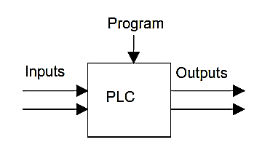
INTRODUCTION
Special form of microprocessor-based controller – programmable memory – store instruction – implement logic, sequencing, timing, counting and arithmetic
Rugged and designed to withstand vibrations, temperature, humidity and noise
Have interfacing for inputs and outputs already inside the controller
Easily understood programming language

Slide 3
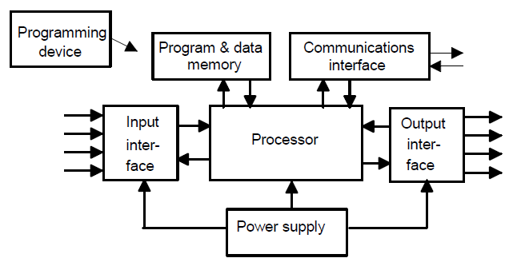
BASIC PLC SYSTEM
Programming device – user program RAM
Program & data memory – system ROM & data RAM
Processor – CPU
Communication interface – address, data, control & I/O system bus
Power supply – battery
Input interface – buffer, optocoupler, input channel
Output interface – latch, driver interface, output channel

Slide 4
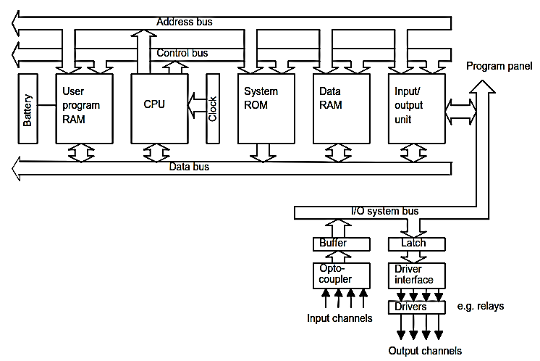
INTERNAL ARCHITECTURE

Slide 5
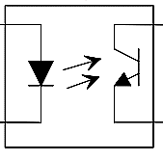
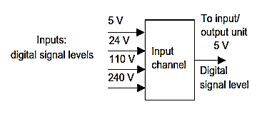
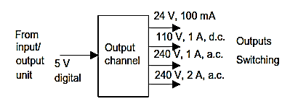
CONT…
OPTOCOUPLER – electrical isolation
INPUT LEVEL
OUTPUT CHANNEL
Relay
Transistor
Triac
OUTPUT LEVEL

Slide 6
CONT…
Inputting programs – loading program into RAM through programing device – then to ROM
Forms of PLC
single box – power supply, processor, memory & input/output unit single box – i/p – 6/8/12/24 – o/p-4/8/16 – 300 to 1000 instructions in memory
rack mounted – separate module for each element

Slide 7
CONT…
Input / output processing
continuous updating – first i/p is read – checked with program instruction – executed – o/p given out – similarly next i/p is processed – delay of 3ms for each execution
Mass I/O copying – all the i/p stored – buffer of RAM – as & program instruction executed o/p are stored – buffer RAM – last send to the output channel
I/O Addresses – each inputs & outputs has address assigned to it

Slide 8
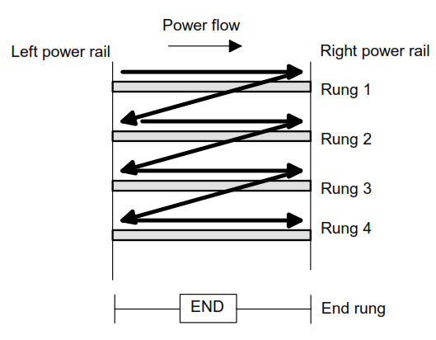
LADDER PROGRAMMING
The vertical lines - power rails & the horizontal lines - rungs.
Each rung - defines one operation in the control process.
A ladder diagram must read from left to right and from top to bottom
Each rung must start with an input & must end with an output
Each rung can have more than one input but only one output
The input - rung left & the output - right end of the rung

Slide 9
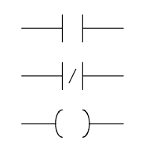
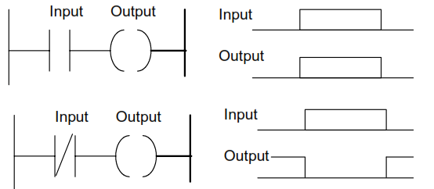
CONT…
Normally open
Normally closed
output
Normally open – output occurs when input is given
Normally closed - output occurs when input is not given

Slide 10
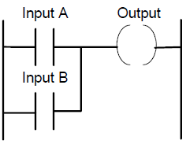
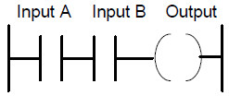
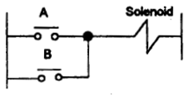
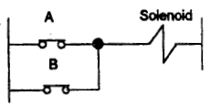
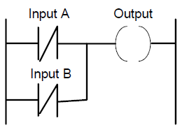
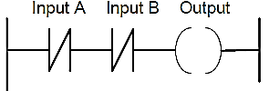
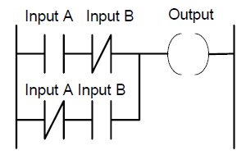
LOGIC FUNCTIONS
AND
OR
NOR
NAND
EX-OR

Slide 11
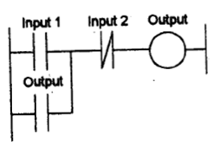
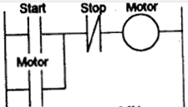
LATCHING
Latching - to hold a coil energized - the input which energized it ceases
Self-maintaining circuit - maintains that state until another input is received
It remembers its last state
Output is given as contact , OR logic with input contact
Output is released only when input 2 (NC) is energizes
Eg: running a motor – motor latched with start & stop as NC

Slide 12
INTERNAL RELAY
Do not exist as real-world switching devices - merely bits in the storage memory - to hold data - behave in the same way as relays - being able to be switched on or off and switch other devices on or off
Multiple inputs
Multiple outputs
Resetting latch
Battery backed
Master control relay
Jump relay

Slide 13
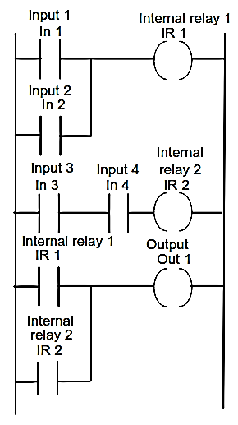
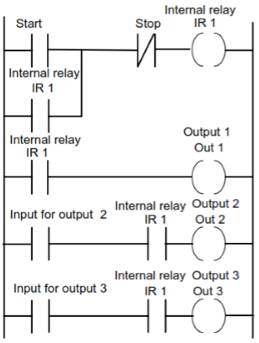
CONT…
MULIPLE INPUTS – so many inputs for single output. Eg: barrier gate
MULTIPLE OUTPUTS - single input activates so many outputs. Eg: CNC machine

Slide 14
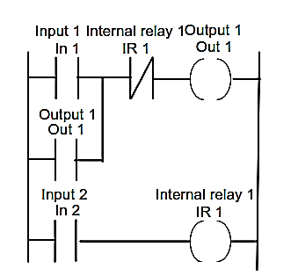
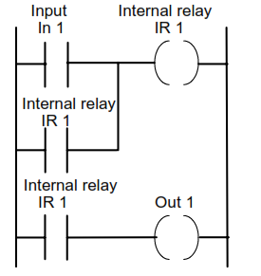
CONT…
BATTERY BACKED – output controlled by internal relay – remains energized even after power failure
RESETTING LATCH – unlatching the output

Slide 15
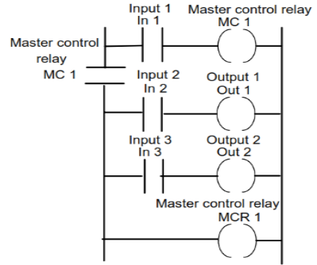
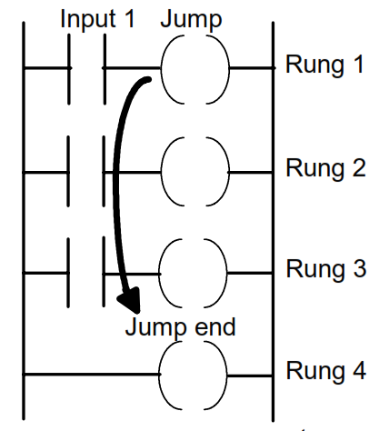
CONT…
(CJP )
(EJP )
MASTER CONTROL RELAY – to control large number of outputs – turn on/off whole section of ladder diagram
JUMP RELAY – to perform a set of instruction if one condition is satisfied if not do some other set of instruction

Slide 16
TIMERS
Timers - behave like relays with coils - when energised - result in the closure / opening of contacts - after some preset time
Timers count fractions of seconds or seconds using the internal CPU clock.
Different forms of timers:
Delay on timer
Delay off timer
On/off cyclic timer
Cascaded timer
Sequencing timer

Slide 17
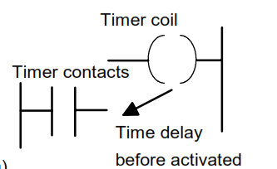
DELAY ON TIMER
When a input is given timer coil is activated – after preset time – timer contact closes – activates the output
Thus it delays input from reaching output / output is delayed to happen

Slide 18
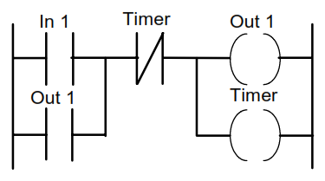
DELAY OFF TIMER
When a input is given – output is activated - & also timer coil is activated – after preset time – timer contact (NC) opens its contact – deactivates the output
Thus it output is deactivated after preset time

Slide 19
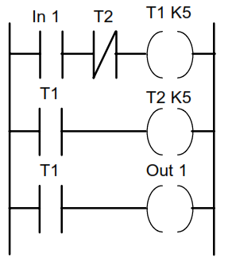
ON / OFF CYCLIC TIMER
When a input is given timer coil T1 is activated – after preset time – timer contact closes – activates the output
And at the same time timer coil T2 also is activated – after preset time – timer contact (NC) opens its contact – deactivates the output
Thus an output is activated for given preset value & deactivated for some other preset value

Slide 20
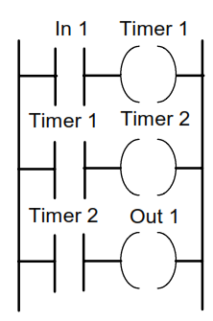
CASCADED TIMER
A timer can have preset value from 0.1 sec to 999 sec
If the delay time exceeds 999 sec, another timer is needed for rest of the time
ie for every 999 sec new timers are used
Eg: if there is delay of 1200 sec, 1200-999=201, hence 2 timers one with 999 sec & other with 201 sec is needed

Slide 21
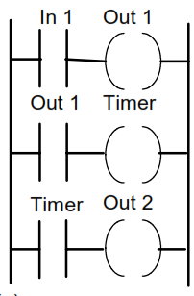
SEQUENCING TIMER
An output may be activated after preset value of a previous output being activated
ie, output 2 is activated after n sec of output 1 activated, delay between 2 outputs activated is n sec
Eg; a pump need to be activated after motor is on but with time delay of n sec from motor being on

Slide 22
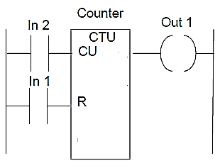
COUNTERS
Built-in elements in PLCs - allow the number of occurrences of input signals to be counted.
Eg: items have to be counted as they pass along a conveyor belt / the number of revolutions of a shaft / perhaps the number of people passing through a door.
A counter - set to some preset number value - when this value of input pulses received - operate its contacts - normally open contacts closed - normally closed contacts opened.

Slide 23
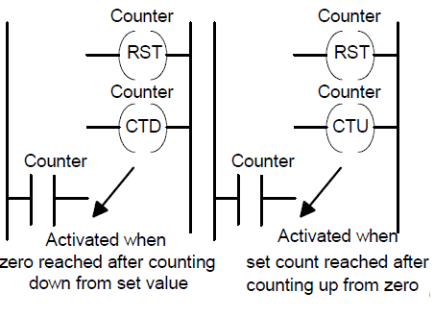
FORMS OF COUNTERS
Down-counters count down from the preset value to zero, i.e. events are subtracted from the set value - counter reaches the zero value - its contacts change state.
Up-counters count from zero up to the preset value, i.e. events are added until the number reaches the preset value - counter reaches the preset value - its contacts change state.

Slide 24
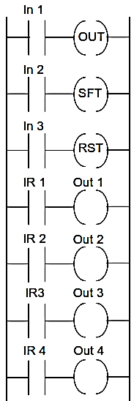
SHIFT REGISTER
Register – group of internal relay (EG: 4bit, 8 bit, 16 bit etc.,) – space - data stored
Each internal relay - effectively open or closed – states being designated as 0 & 1
Shift register - number of internal relays grouped together – allow stored bits to be shifted from one relay to another
3 inputs - 1st to load data into the first location of the register – 2nd command to shift data along by one location – 3rd to reset or clear data

Slide 25
Cont..
Eg: 8bit register – 8 internal relays
Data stored are given below
First command is given to load input 0 into IR 1
Second command is to shift – hence every data moves by one location – so a data overflows out at the end
Each internal relay is connected to output so accordingly output activated (if IR has 1) or deactivated (if IR has 0)

Slide 26
DATA HANDLING
Timers, counters & individual internal relays - concerned with the handling of individual bits - i.e. single on-off signals
Eg for data handling:
Data movement
Data comparison
Arithmetic operations
Code conversions

Slide 27
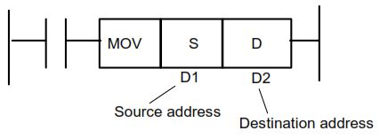
DATA MOVEMENT
Used to move data from one address to another
when an input given in the rung - move occurs from the designated source address to the designated destination address
Eg: used to move preset value to a timer / counter or from a timer / counter to a register

Slide 28
DATA COMPARISON
Used to compare two data values – from two different address
when the data comparison instruction is activated - compares the data from source (S) address to the data in destination (D) address – if true output is activated or false output is deactivated.
Eg: used to compare a digital value read from some input device with a second value contained in a register

Slide 29
DATA CONVERSION
BCD-to-binary and binary-to-BCD conversions
when the data conversion instruction is activated - converts the data from source (S) address to the data in destination (D) address
Eg: the input might be for a thumbwheel switch or the output to a
decimal display

Slide 30
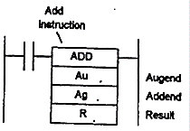
ARITHMATIC OPERATION
ADDITION, SUBTRACTION, MULTIPLICATIN & DIVISION
when the arithmetic operation instruction is activated - does the operation from 2 different address & stores in 3rd address

Slide 31
INSTRUCTION LIST
IEC 1131-3 | Mitsubishi | OMRON | Siemens | Operation | Ladder diagram
LD | LD | LD | A | Load operand into result register | Start a rung with open contacts
LDN | LDI | LD NOT | AN | Load negative operand into result register | Start a rung with closed contacts
AND | AND | AND | A | Boolean AND | A series element with open contacts
ANDN | ANI | AND NOT | AN | Boolean AND with negative operand | A series element with closed contacts
OR | OR | R | O | Boolean OR | A parallel element with open contacts
ORN | ORI | OR NOT | ON | Boolean OR with negative operand | A parallel element with closed contacts
ST | OUT | OUT | = | Store result register into operand | An output from a rung

Slide 32
SELECTION OF PLC
Number of input / output required
Type of input / output
Memory size required
Speed and power of a CPU

