Slide 1
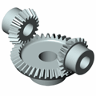
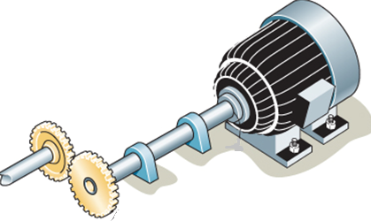
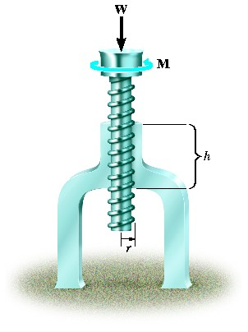
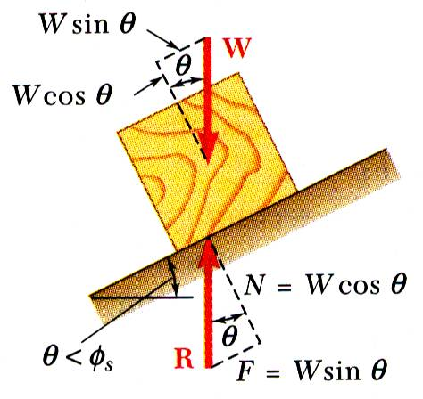
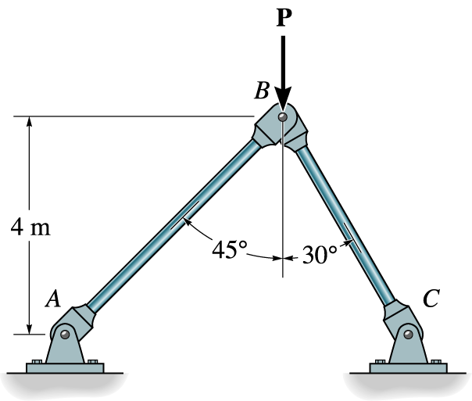
KINEMATICS OF MACHINERY
MEC 2211
MODULE 6
Friction Drives (Clutches)

Slide 2
Friction in Clutches
Clutches transmit power from one rotating shaft to other rotating shaft
In automobiles during engaging and disengaging gears
To allow the driver to operate the engine in its most efficient speed range - nominally 2000 - 3500 RPM
Allows driver to select a suitable gear ratio to increase engine torque (torque multiplication) to match an increased load requirement

Slide 3
Classification of Clutches
CLUTCHES
MECHANICAL
POSITIVE CLUTCHES
(Eg. Jaw Clutch)
OVER RUNNING CLUTCHES
(Eg. Paw & ratchet)
ELECTROMAGNETIC
HYDRO DYNAMIC
FRICTION CLUTCHES
(Eg. Disc, Cone clutches)

Slide 4
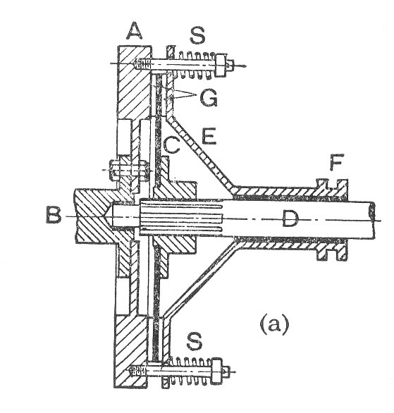
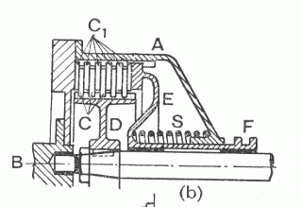
Disc (Plate ) Clutch
Fig (a) Single plate clutch Fig (b) Multi plate clutch

Slide 5
Disc Clutch (Contd.)

Slide 6
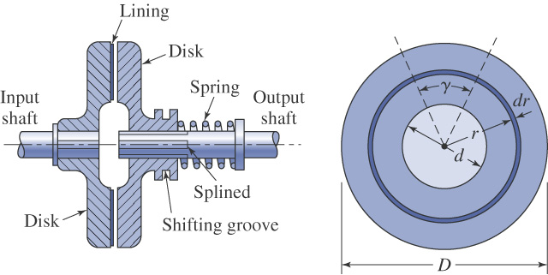
Single Plate Clutch

Slide 7
Single Plate Clutch (Contd.)

Slide 8
Problem 1

Slide 9
Problem 2

Slide 10
Solution (Contd.)

Slide 11
Problem 3

Slide 12
Solution (Contd.)

Slide 13
Problem 4

Slide 14
Problem 6

