Slide 1
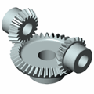
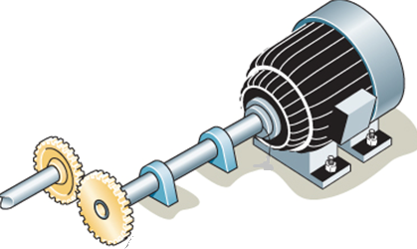
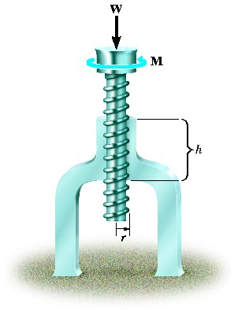
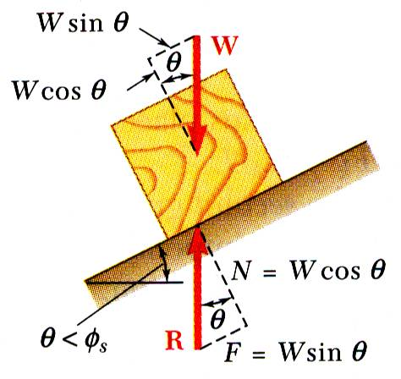
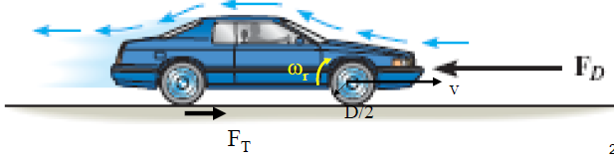
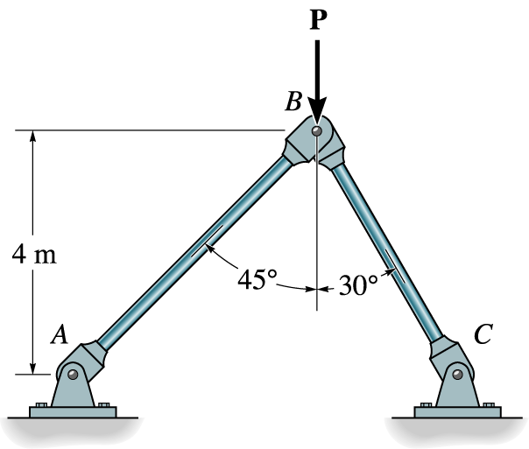


KINEMATICS OF MACHINERY
MEC 2211
MODULE 6
Friction Drives

Slide 2
Introduction
Friction is defined as a force of resistance acting on a body which prevents or retards slipping of the body relative to another body.
Friction is caused by the “ microscopic” interactions between two surfaces
Friction results in a force in the direction opposite to the direction of motion!
Hence It opposes motion!
Friction! Is it a BOON or BAN?

Slide 3
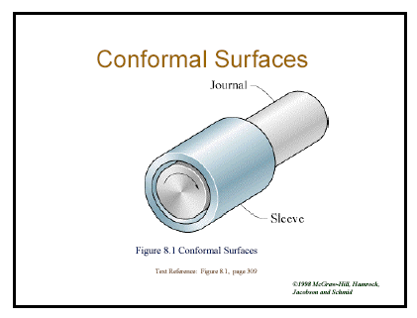
Introduction (Contd.)
Application
BAN
BOON

Slide 4
Belt Drives
BELT is a looped strip of flexible material, used to mechanically link two or more rotating shafts.
They may be used as a source of motion, to efficiently transmit power, or to track relative movement.

Slide 5
Components of a Belt Drive
Driver
Pulley
Belt
Follower Pulley
+
+
Axis of Rotation (Shaft Centre)

Slide 6
Types Of Belt Drives
D
F
D
F
+
+
+
+
Open
Cross
I
F
D
F
+
D -Driver
F -Follower
I -Idle
G -Guide
+
I
D
+
+
F
G
I
Right Angled
Multiple Shaft

Slide 7




Types of Belts
Flat belt
V-Belt
Wedge
Cut belts

Slide 8
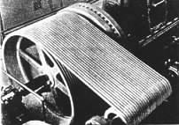


Types of Belts- (Contd.)
Positive Belts
Multiple belts

Slide 9
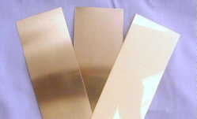
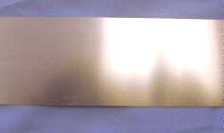
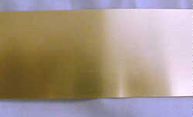
Belt Materials
 | Standard Belts Leather Rubber Canvas
 | Corrosion Resistant Steel popular belt materials. Works well in most industrial applications where rust inhibitors are not a component of the wash water.
 | Carbon Steel A special application belt material for continuous use.

Slide 10
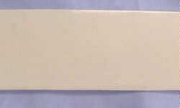
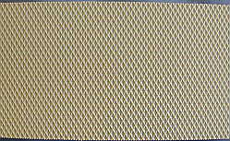
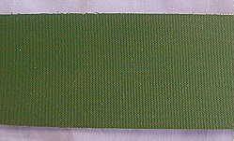
Belt Materials( Contd..)
 | Elastomer Can handle abrasive and harsh environments. Used where rust inhibitors are a component of the wash water.
 | Standard Polymer Reinforced to resist stretching, able to withstand reasonably high temperatures (up to 170°F), Used where rust inhibitors and temperature are a component of the wash water or where UV sensitivity is an issue.
 | HT (High Temp) Polymer Similar to the Standard Polymer but for higher temperature applications (up to 212°F continuous, 300°F intermittent). Also used when a smoother surface is required.

Slide 11
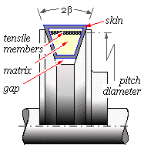
Components of a Belt

Slide 12
Types of Pulleys
F
Driver and Follower pulleys
Guide pulley
Idle pulley
Intermediate pulley
Loose and Fast pulleys
Driver
+
Guide
I
D
Follower
+
+
Idle
+
F
I
Intermediate
Loose & Fast

Slide 13
Applications
Compressors
Sawing Machines
Textile Machines
Mixing Machines
Washing Machines
Printing Machinery
Pumps
Machine Tools
Crushing Machinery
Automotive devices
  Water pumps
  Fans
  Starters

Slide 14
Advantages
Belts will not break because of overload.
Belts will not break because of overload.
They are more versatile with many geometries as well as large center distances. Belts increase bearing load because of the initial tension required.
Belts are least expensive and
produce least amount of noise and vibration.

Slide 15
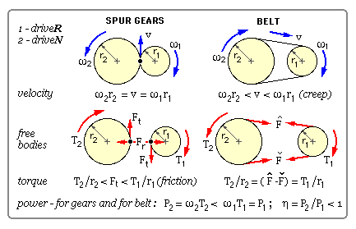
Disadvantages

Slide 16
Disadvantages- (contd.)
In Gears, moment of F_{t}, tangential force about the center equilibrates the torque T.
In belt, the moment of net tension F₁-F₂ equilibrates the torque if no slip.

Slide 17
Selection of Belt Drive
The selection of a belt drive depends on the following factors :
  i. center distance between shafts
  ii. power to be transmitted
  iii. speed of the driving and driven shafts
  iv. space available
  v. speed reduction ratio
  vi. service condition

Slide 18
Velocity ratio
Peripheral Velocity V = ω₂r₂=ω₁r₁
Since
For example
If the radius of
Smaller pulley is
150 mm and of bigger is
300 mm, then
,
i.e. N₁= 2 x N₂

Slide 19
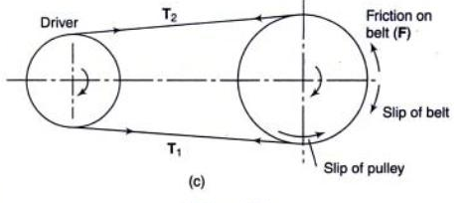
Slip in Belts
Slip is the movement of belt over the pulley against its direction of rotation
Slip may occur due to low tension in belts
It will reduce the efficiency of power transmission
It will also affect the velocity ratio, as shown below
where S is the percentage slip

Slide 20
Belt Speed
Belt Speed is defined as the linear velocity of the belt.
The magnitude of this velocity corresponds to the magnitude of the linear velocity of a point on the pitch diameter of each sheave.

Slide 21
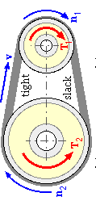
Power
= (T₂-T₁) X V watts
Where T₂- Tension at tight side
T₁- Tension at slack side
V- Velocity of belt = ω₁r₁
= ω₂r₂

Slide 22
Problem 1
A belt drive is used to transmit power from an electric motor to a compressor for a refrigerated truck. The compressor must still operate when the truck is parked and the engine is not running. The electric motor is rated at 3550 rpm, and the motor sheave diameter is 12 cm. The compressor sheave has 24 cm diameter.
Find the operating speed of the compressor and the belt speed.

Slide 23
Solution
Given Motor speed = 3550 rpm
Diameter of motor sheave=12 cm
Diameter of compressor sheave=24 cm

Slide 24
Problem 2
A shaft runs at 80 rpm and drives a machine at 150 rpm through belt . Diameter of driving pulley is 600 mm . Find the diameter of driven pulley, if the total slip is 4%.
Solution:

Slide 25
Length of Belt and Angle of Lap for Open Belt
Consider an open belt drive as shown
Total length of the belt is L=(Arc AB)+ BC+ (Arc CD)+DA
β
β
C
B
M
O
β
A
D
β
β

Slide 26
Length of Belt and Angle of Lap (Contd.)
Substituting the values for cosβ and β and simplifying
Similarly the angle of laps are given as

Slide 27
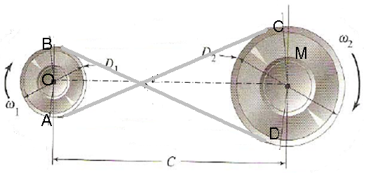
Length of Belt and Angle of Lap for Cross Belt
Following the similar trigonometric approach, the length of belt and angle of lap can be obtained

Slide 28
Tension in Belts
R
Consider a flat belt- pulley assembly as shown
Angle suspended by a small element be δθ
Let T be the tension in slack side
T+ δT be the tension in tight side
R be the reaction of belt element
µR be the frictional force, where µ is coefficient of friction
Resolving the forces tangential to the pulley and considering the equilibrium equation
as δθ/2 is small and cosδθ/2=1
Resolving the forces radial to the pulley and considering the equilibrium equation
δθ/2
δθ/2
µR
T
δθ
T+δT

Slide 29
Tension in Belts (Contd.)
Substituting equation (2) in equation (1)
Integrating for the complete belt
Initial Tension in belt, T₀
Where T1 = tension in tight side,
T2 = tension in slack side
µ = Coefficient of friction and
θ =angle of lap

Slide 30
Centrifugal Tension
The centrifugal force acting on the belt will try to throw the belt away from pulley
There by it produces a tension called centrifugal tension
as m=mass/unit length
Resolving the tension radially
Hence
Total Tension in tight side= T₁+T_{C}
δθ/2
F_{C}
δθ/2
T_{C}
δθ
T_{C}

Slide 31
Condition for Maximum Power Transmission
The power transmitted by a belt drive is given as
asT₁/T₂=e^{µθ}
where
Considering the centrifugal tension
Maximizing the power

Slide 32
Problem 3
Two pulleys 450 mm and 200 mm diameter are on parallel shafts 1.95 m apart and are connected by crossed belt .Speed of the larger pulley is 200 rpm and maximum tension in belt is 1 kN. Find
(i) the length of belt required,
(ii) angle of contact between each pulley and belt and (iii) Power transmitted by the belt if the coefficient of friction is 0.25

Slide 33
Solution
Given D₁=200 mm D₂=450 mm N₂=200rpm T₁=1kN µ=0.25 C=1.95 m
(i)
(ii) Angle of Contact

Slide 34
Solution (Contd.)
For finding the power, tensions in belts are to be found
In cross belt drive , higher angle of lap is considered to find them
Hence
The power transmitted is

Slide 35
Problem 4
A shaft running at 200 rpm drives another shaft at 300 rpm and transmits 6kW through belt. Distance between shafts is 4m. If the smaller pulley is 0.5 m in diameter, calculate the tensions in belt, if it is open belt having µ=0.3.

Slide 36
Problem 5
A belt drive is required to transmit 10 kW from a motor running at 600 rpm. The belt is 12 mm thick and 100 mm wide with mass density 0.001 g/mm³. Diameter of driving pulley is 250 mm and that of driven is 220 mm. The two shafts are 1.25 m apart. Take µ as 0.25. Find the maximum tension in the belt , if it is cross drive.

Slide 37
Problem 6
A 100 mm wide belt with 10 mm thickness transmits 5 kW between two parallel shafts which are 1.5 m apart. The diameter of smaller pulley is 440 mm. The driving and driven shafts rotate at 60 and 150 rpm respectively. Find the stress in the belt if they are connected (i) Open and (ii) Cross

Slide 38
V -Belt
Vee belts (also known as V-belt) solved the slippage and alignment problem.
They are used for high the basic belt for power transmission.
They provide the best combination of traction, speed of movement, load of the bearings, and long service life.
The "V" shape of the belt tracks in a mating groove in the pulley (or sheave), with the result that the belt cannot slip off.
The belt also tends to wedge into the groove as the load increases
— the greater the load, the greater the wedging action
— improving torque transmission and making the V-belt an effective
---needing less width and tension than flat belts.
Optimal speed range is 1000–7000 ft/min.
V-belts need larger pulleys for their larger thickness than flat belts.
For high-power requirements, two or more vee belts can be joined side-by-side in an arrangement called a multi-V, running on matching multi-groove sheaves.

Slide 39
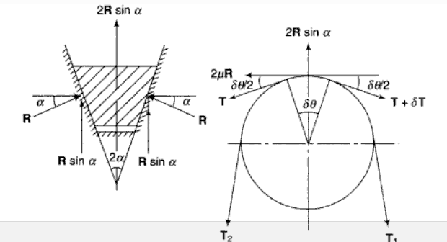
V –Belt Tension
The V belt has more contact of belt on the groove sides, thus develop a reaction as shown.

Slide 40
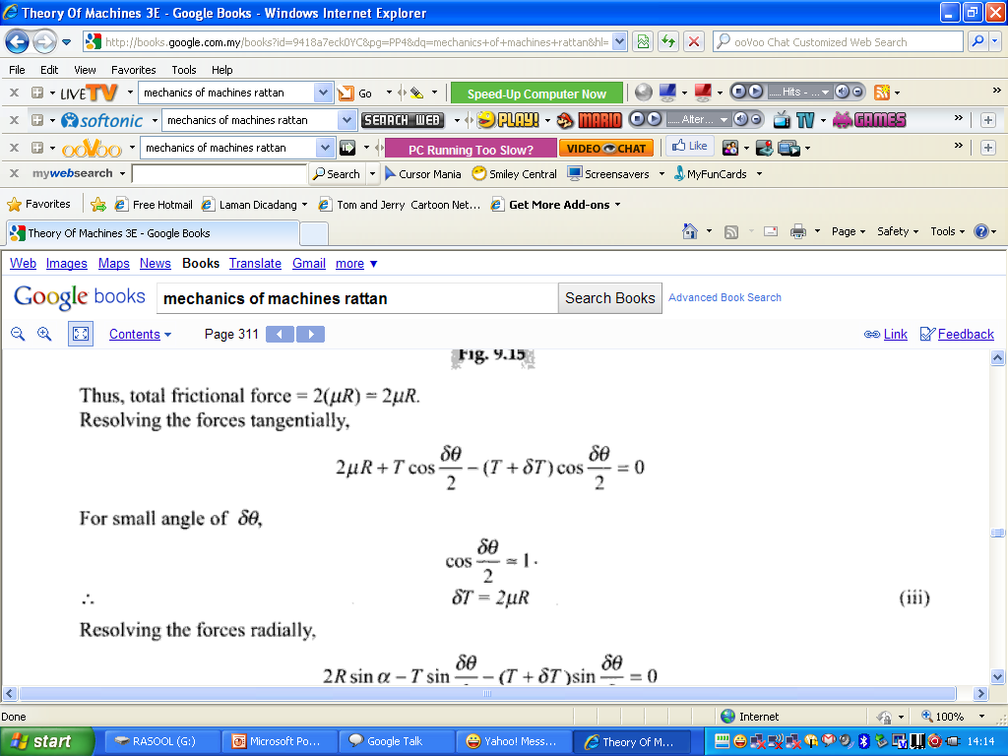
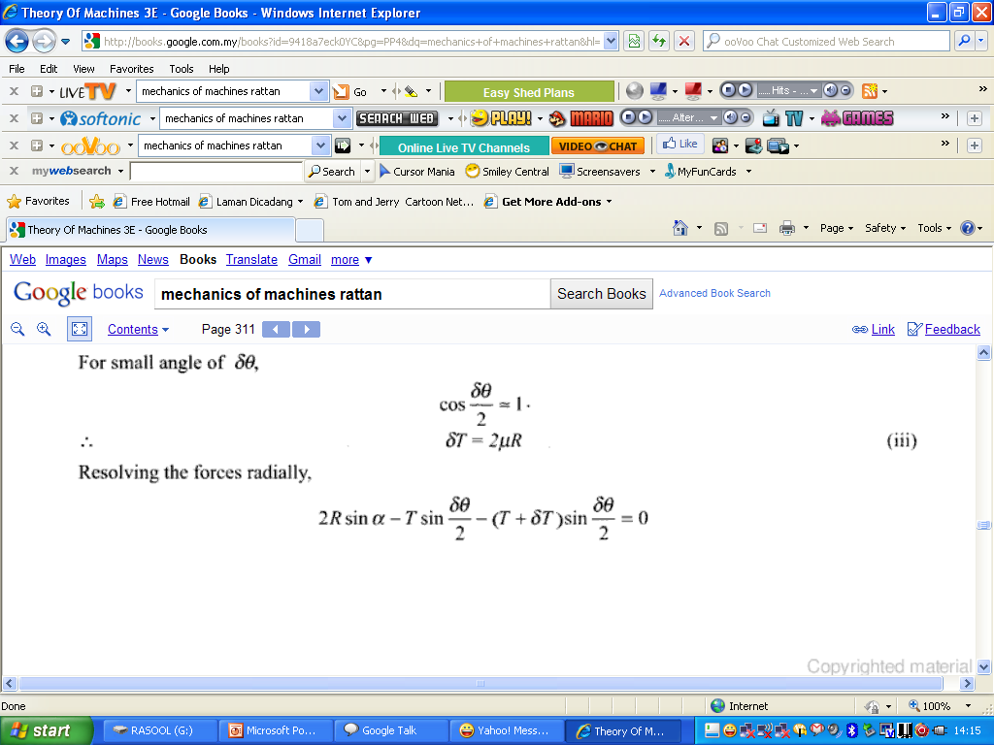
V –Belt (Contd.)
-----(1)

Slide 41
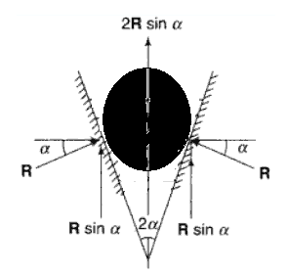
V –Belt (Contd.)
Substituting the R value from equation (2) to equation (1)
Integrating for the complete belt
where 2α is the groove angle
The same relation is applicable to rope also as it produces same kind of friction and reaction with grooves

Slide 42
Problem 7
If is 60°
(Assume open belt drive)
Solution:
Given C=1.2 m
D₁ = 40 cm=0.4 m (Smaller)
N₁=350 rpm
D₂=100 cm=1 m (Larger)=
µ=0.3
T_{max}= T₁= 600 N (as mass or density of the belt is not given, centrifugal tension (T_{C}) is neglected)
2α=60 °

Slide 43
Solution (Contd.)
Since T₁ is given , T₂ can be found by using tension ratio
Hence for Open belt drive
Substituting and finding T₂
(a)
(b) Initial Tension=(T₁+T₂)/2=361.75 N
α

Slide 44
Problem 8
Determine the maximum power transmitted by a V-belt drive having the included V-groove angle of 35°. The belt used is 18 mm deep with 18 mm wide and weighs 300 g per meter length. The angle of lap is 145° and the maximum permissible stress is 1.5N/mm². Take µ as 0.2

Slide 45
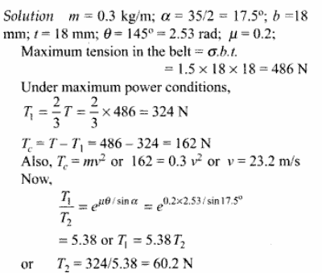
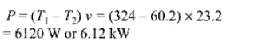
Solution
Given:
mm

Slide 46
Problem 9
A V belt drive with following Data transmits power from electric motor to a compressor:
  Power transmitted = 100 kW
  Speed of electric motor = 750 rpm
  Speed of compressor = 300 rpm
  Diameter of compressor pulley = 800mm
  Centre distance between pulleys = 1.5 m
  Maximum speed of belt = 30 m/sec
  Cross sectional area of belt = 350 mm²
  Allowable stress of belt material = 2.2 N/mm²
  Groove angle of pulley = 38°
  Coefficient of friction = 0.28
Determine the number of belt required and length of each belt

Slide 47
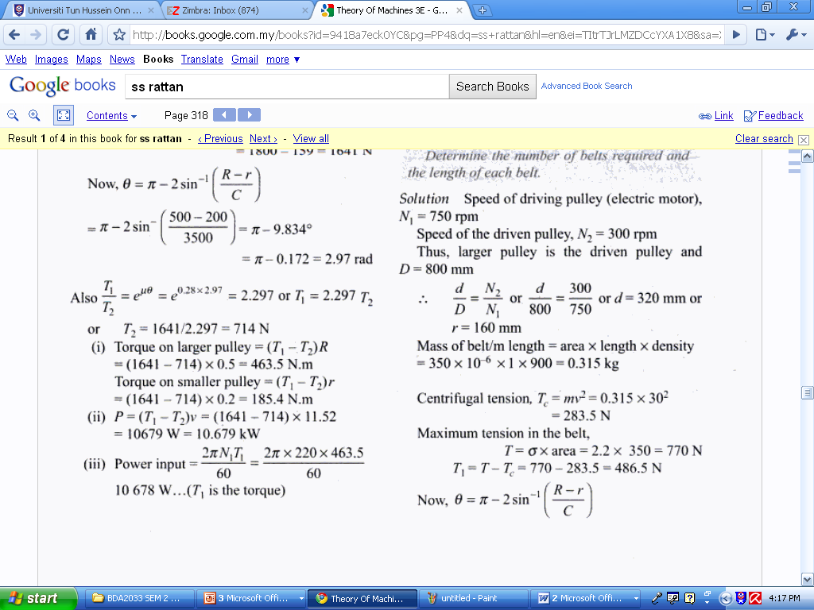
Solution
Given

Slide 48
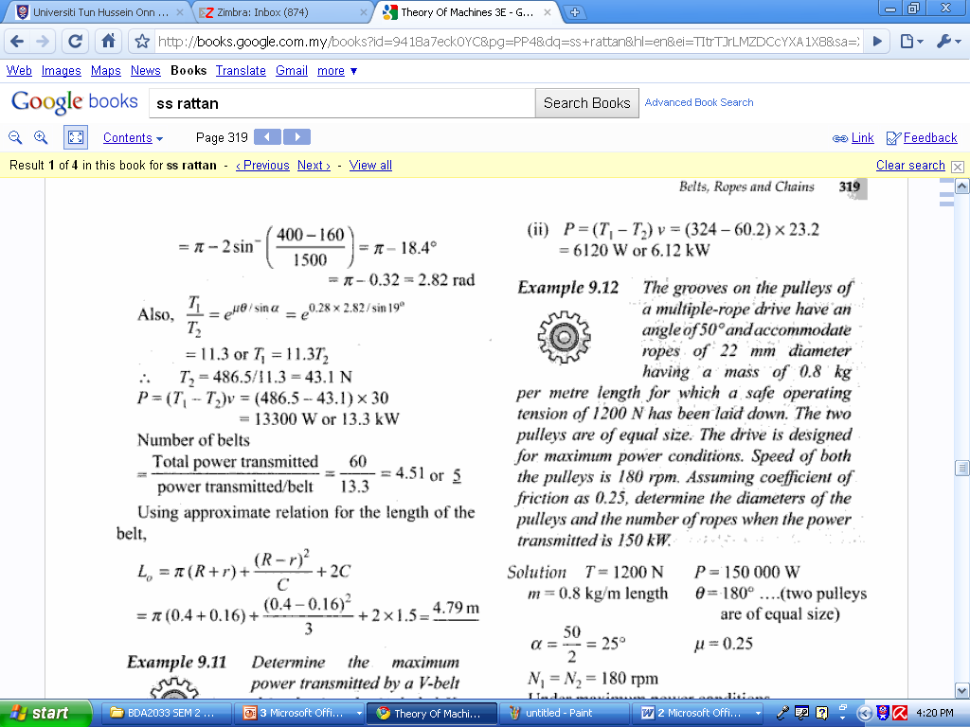
Solution (Contd.)

