Slide 1
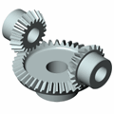
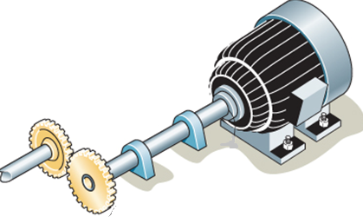
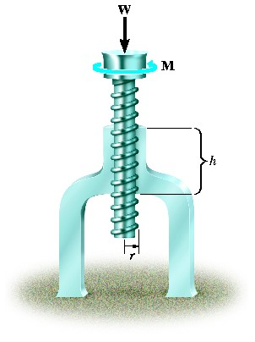
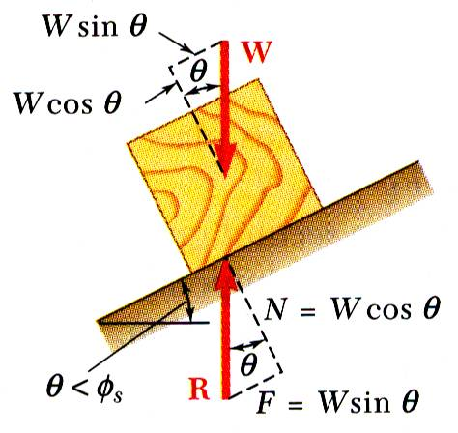
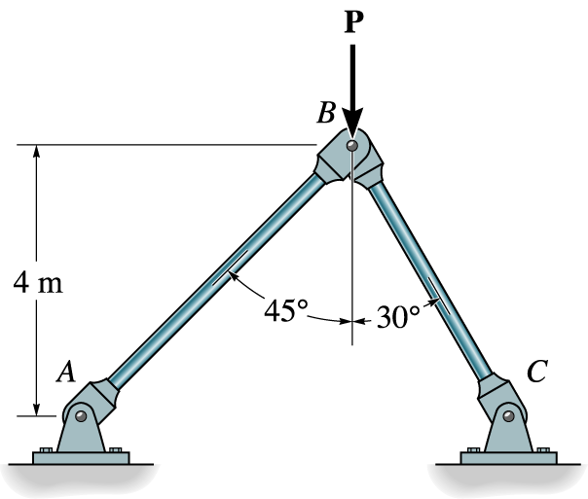
KINEMATICS OF MACHINERY
MEC 2211
MODULE 4
CAMS

Slide 2
MODULE 4 KINEMATICS OF CAM
Introduction
Classifications
Displacement diagrams
Simple harmonic,
parabolic, and
Cycloidal motions
Layout of plate cam profiles - Derivatives of Follower motion
High speed cams
Circular arc and
Tangent cams
Standard cam motion
Pressure angle and undercutting

Slide 3
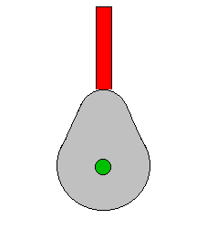
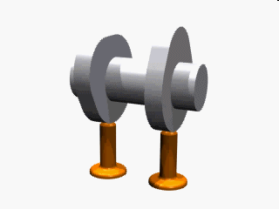
Introduction
The cam and follower set is a device which can convert rotary motion (circular motion) into linear motion (movement in a straight line).
Follower
Cams
Cam
Followers (valves)

Slide 4
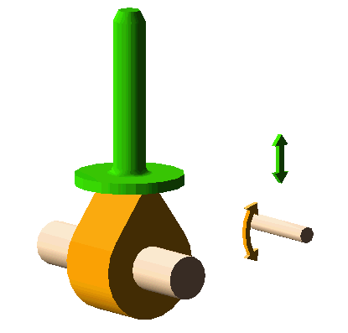
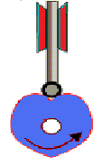
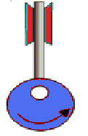
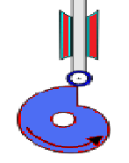
Introduction (Contd.)
follower
The cam can have various shapes. These are know as cam profiles.
Cam
Pear
Heart
Circular
Drop

Slide 5
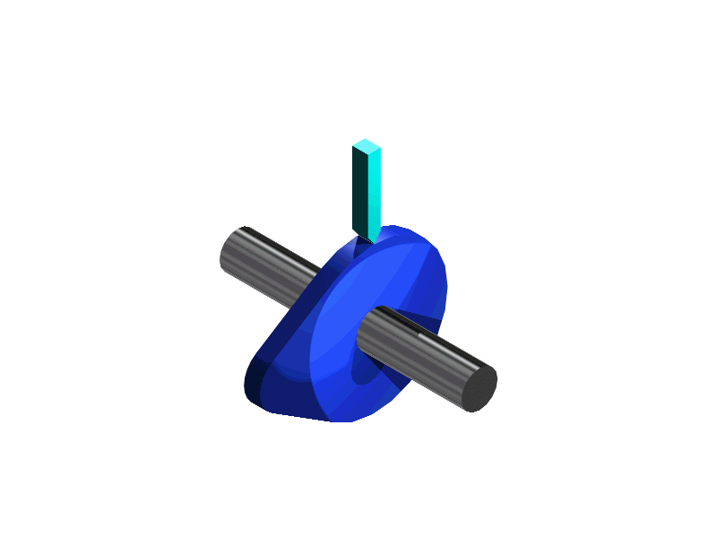
Cam and Follower
Follower
A follower is a component which is designed to move up and down as it follows the edge of the cam.
cam
Knife edge
Follower
Flat foot
follower
Off set
follower
Roller
follower

Slide 6
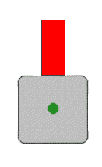
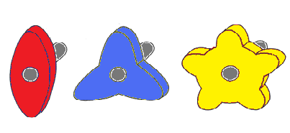
Cam and Follower
The 'bumps' on a cam are called lobes.
The square cam illustrated has four lobes, and lifts the follower four times each revolution.
Follower
Square cam
Examples of other rotary cam profiles.

Slide 7
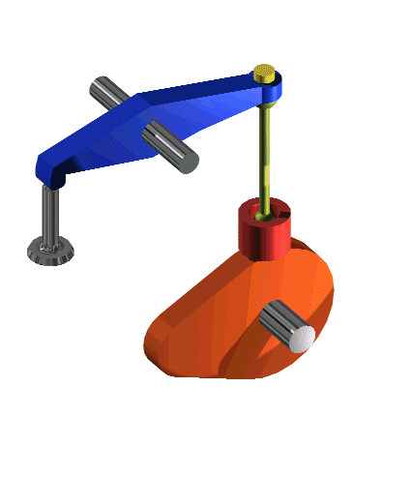
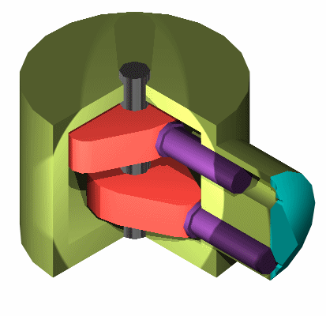
Cam and Follower
Examples of a Rotary cams in operation.
Cams used in a pump.
Control the movement of the engine valves.

Slide 8
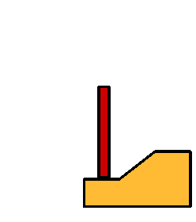
Cam and Follower
The linear cam moves backwards and forwards in a reciprocating motion.
Cam Follower
Linear cam
Distance moved by the follower

Slide 9
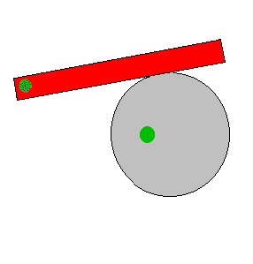
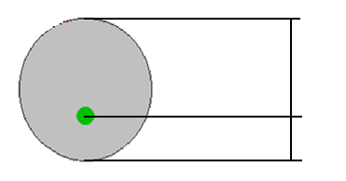
Cam and Follower
Cams can also be cylindrical in shape
Below a cylindrical cam and roller follower.
Cam rise and Fall
The cam follower does not have to move up and down - it can be an oscillating lever as shown above.
Max Lift
Min Lift

Slide 10
Examples for cam
In IC engines to operate the inlet and exhaust valves

Slide 11
Classification of Cams
Cams are classified according to
1. shape,
2. follower movement, and
3. manner of constraint of the follower.

Slide 12
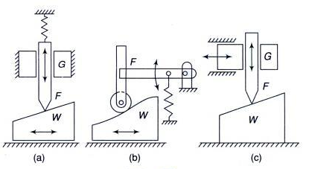
According to Shape 1) Wedge and Flat Cams
A wedge cam has a wedge W which, in general, has a translational motion.
The follower F can either translate [Fig.(a)] or oscillate [Fig.(b)].
A spring is, usually, used to maintain the contact between the cam and the follower.
In Fig.(c), the cam is stationary and the follower constraint or guide G causes the relative motion of the cam and the follower.

Slide 13
Wedge and Flat Cams (Contd.)
Cam Follower
Linear cam
Distance moved by the follower

Slide 14
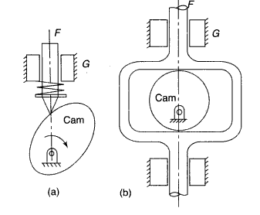
According to Shape 2)Radial or Disc Cams
A cam in which the follower moves radially from the centre of rotation of the cam is known as a radial or a disc cam (Fig. (a) and (b)].
Radial cams are very popular due to their simplicity and compactness.

Slide 15
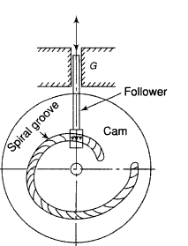
According to Shape 3) Spiral Cams
A spiral cam is a face cam in which a groove is cut in the form of a spiral as shown in Fig.
The spiral groove consists of teeth which mesh with a pin gear follower.
The velocity of the follower is proportional to the radial distance of the groove from the axis of the cam.
The use of such a cam is limited as the cam has to reverse the direction to reset the position of the follower. It finds its use in computers.

Slide 16
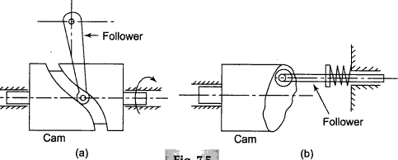
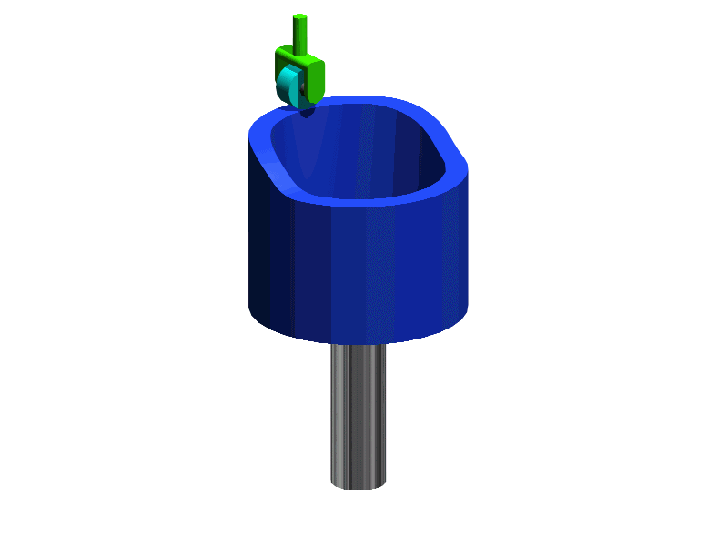
According to Shape 4) Cylindrical Cams
In a cylindrical cam, a cylinder which has a circumferential contour cut in the surface, rotates about its axis.
The follower motion can be of two types as follows: In the first type, a groove is cut on the surface of the cam and a roller follower has a constrained (or positive) oscillating motion [Fig.(a)].
Another type is an end cam in which the end of the cylinder is the working surface (b).
A spring-loaded follower translates along or parallel to the axis of the rotating cylinder.

Slide 17
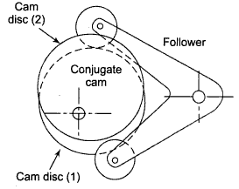
According to Shape 5) Conjugate Cams
A conjugate cam is a double-disc cam, the two discs being keyed together and are in constant touch with the two rollers of a follower (shown in Fig.).
Thus, the follower has a positive constraint.
Such a type of cam is preferred when the requirements are low wear, low noise, better control of the follower, high speed, high dynamic loads, etc.

Slide 18
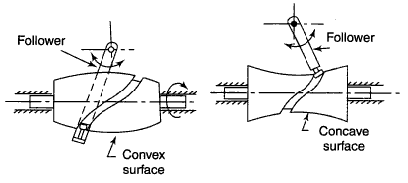
According to Shape 6) Globoidal Cams
A globoidal cam can have two types of surfaces, convex or concave.
A circumferential contour is cut on the surface of rotation of the cam to impart motion to the follower which has an oscillatory motion (Fig.).
The application of such cams is limited to moderate speeds and where the angle of oscillation of the follower is large.

Slide 19
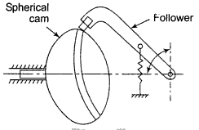
According to Shape 7) Spherical Cams
In a spherical cam, the follower oscillates about an axis perpendicular to the axis surface of rotation of the cam.
Note that in a disc cam, the follower oscillates about an axis parallel to the axis of rotation of the cam.
A spherical cam is in the form of a spherical surface which transmits motion to the follower (Fig.).

Slide 20
According to Follower Movement
Rise-Return-Rise (R-R-R)
In this, there is alternate rise and return of the follower with no periods of dwells (Fig. a).
The follower has a linear or an angular displacement.
Dwell-Rise-Return-Dwell (D-R-R-D)
In such a type of cam, there is rise and return of the follower after a dwell Fig.(b).
this type is used more frequently than the R-R-R type of cam.

Slide 21
According to Follower Movement (Contd.)
3. Dwell-Rise-Dwell-Return-Dwell
(D-R-D-R-D)
It is the most widely used type of cam.
The dwelling of the cam is followed by rise and dwell and subsequently by return and dwell as shown in rig. (c).
In case the return of the follower is by a fall [Fig.(d)], the motion may be known as Dwell-Rise-Dwell (D-R-D).

Slide 22
According to Manner of Constraint of the Follower
To reproduce exactly the motion transmitted by the cam to the follower, it is necessary that the two remain in touch .The cams are also classified according to the manner in which this is achieved.
Pre-loaded Spring Cam
A pre-loaded compression spring is used for the purpose of keeping the contact between the cam and the follower.
Positive-drive Cam
In this type, constant touch between the cam and the follower is maintained by a roller follower operating in the groove of a cam.
The follower cannot go out of this groove under the normal working operations.
A constrained or positive drive is also obtained by the use of a conjugate cam
Gravity Cam
If the rise of the cam is achieved by the rising surface of the cam and the return by the force of gravity or due to the weight of the cam, the cam is known as a gravity cam.
However, these cams are not preferred due to their uncertain behavior.

Slide 23
Classification of followers
According to the shape of follower
Knife edge follower
Roller follower
Flat faced follower
Spherical faced follower

Slide 24
a) Knife edge follower

Slide 25
b) Roller follower

Slide 26
c) Flat faced follower

Slide 27
d) Spherical faced follower

Slide 28
According to the path of motion of follower
Radial follower
Offset follower

Slide 29
a) Radial follower
When the motion of the follower is along an axis passing through the centre of the cam, it is known as radial followers. Above figures are examples of this type.

Slide 30
b) Offset follower
When the motion of the follower is along an axis away from the axis of the cam centre, it is called off-set follower. Above figures are examples of this type.

Slide 31
CAM Nomenclature
Cam profile: The outer surface of the disc cam.
Base circle : The circle with the shortest radius from the cam center to any part of the cam profile.
Trace point: It is a point on the follower, and its motion describes the movement of the follower. It is used to generate the pitch curve.

Slide 32
CAM Nomenclature (contd.)
Pitch curve : The path generated by the trace point as the follower is rotated about a stationery cam.
Prime circle: The smallest circle from the cam center through the pitch curve

Slide 33
CAM Nomenclature (contd.)
Pressure angle: The angle between the direction of the follower movement and the normal to the pitch curve.
Pitch point: Pitch point corresponds to the point of maximum pressure angle.

Slide 34
CAM Nomenclature (contd.)
Pitch circle: A circle drawn from the cam center and passes through the pitch point is called Pitch circle
Stroke: The greatest distance or angle through which the follower moves or rotates

Slide 35
3Motion of the follower
As the cam rotates the follower moves upward and downward.
The upward movement of follower is called rise (Outstroke)
The downward movement is called fall (Returnstroke).
When the follower is not moving upward and downward even when the cam rotates, it is called dwell.

Slide 36
3.1 Types of follower motion
Uniform motion ( constant velocity)
Simple harmonic motion
Uniform acceleration and retardation motion
Cycloidal motion

Slide 37
a) Uniform motion (constant velocity)
Displacement diagram: Displacement is the distance that a follower moves during one complete revolution (or cycle) of the cam while the follower is in contact with the cam.
It is the plot of linear displacement (s) of follower V/S angular displacement (θ) of the cam for one full rotation of the cam.
A period is a part of the cam cycle and it includes the following:
Rise (Outstroke) – the upward motion of the follower caused by cam motion.
Fall (Return stroke) – the downward motion of the follower caused by cam motion.
Dwell – the stationary position of the follower caused by cam motion.

Slide 38
a) Uniform motion (constant velocity)

Slide 39
a) Uniform motion (constant velocity)
Displacement diagram
Since the follower moves with uniform velocity during its rise and fall, the slope of the displacement curve must be constant as shown in fig

Slide 40
b) Simple Harmonic motion

Slide 41
b) Simple harmonic motion
Since the follower moves with a simple harmonic motion, therefore velocity diagram consists of a sine curve and the acceleration diagram consists of a cosine curve.

Slide 42
c) Uniform acceleration and retardation
Since the acceleration and retardation are uniform, therefore the velocity varies directly with time.

Slide 43
d) Cycloidal motion

Slide 44
CAM Profile

Slide 45
Problem 1
Displacement Diagram
Cam Profile

Slide 46
Problem 2
Displacement Diagram
Cam Profile

Slide 47
Problem 3
Displacement Diagram
Cam Profile

Slide 48
Problem 4
Displacement Diagram
Cam Profile

