Slide 1
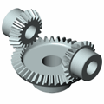
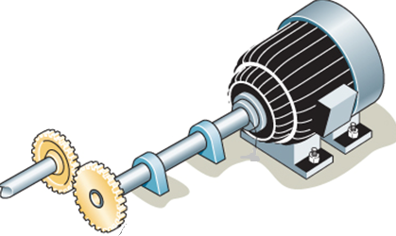
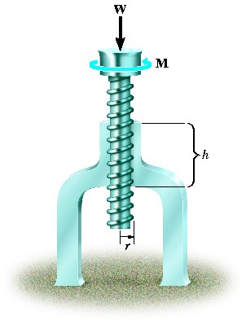
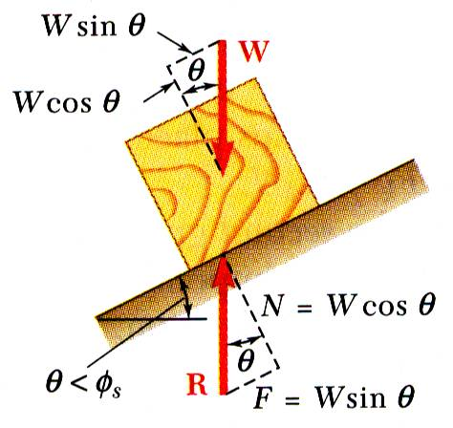
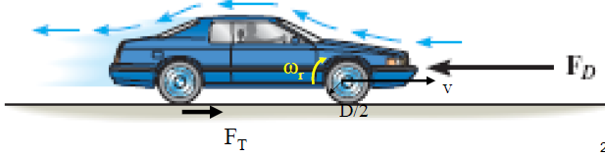
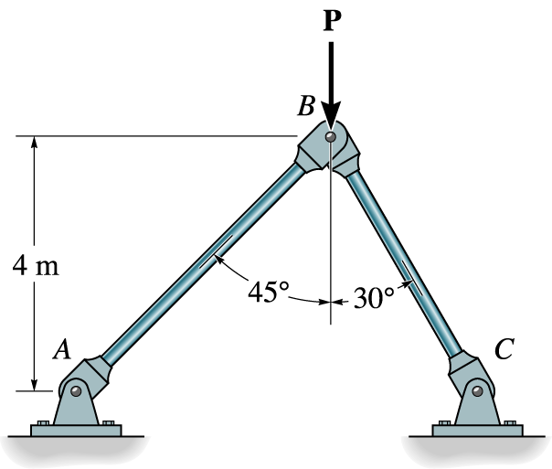


KINEMATICS OF MACHINERY
MEC 2211
MODULE 1

Slide 2
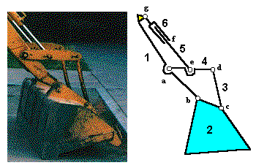
Basic Mechanism
Four Bar Mechanism (FBM)
The ancestor of all mechanism is a four bar mechanism
Made of four links, forming four turning pair
1-2
2-3
3-4
4-1
B
3
2
C
4
A
D
1
Turning pair

Slide 3
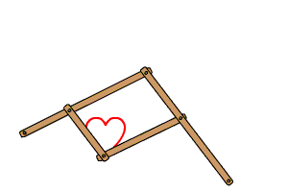
Four Bar Mechanism (Contd..)
Inversion of FBM
Inversion - Modification obtained by changing the motion of one pair
  Double Crank Mechanism
  Double Lever Mechanism
  Crank lever Mechanism
Locomotive mechanism
Pantograph mechanism

Slide 4
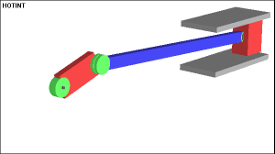
Slider Crank Mechanism
(SCM)
Mechanism developed by modifying the FBM
One of the turning pair of FBM is replaced with sliding pair
1-2
2-3 Turning pair
3-4
4-1 Sliding pair

Slide 5
Slider Crank Mechanism (Contd..)
Inversion of SCM
Inversion - Modification obtained by changing the fixed link with out altering the motion of pair
Schematic representation of mechanism
TP
TP
LINK 1
LINK 2
LINK 3
SP
TP
LINK 4

Slide 6
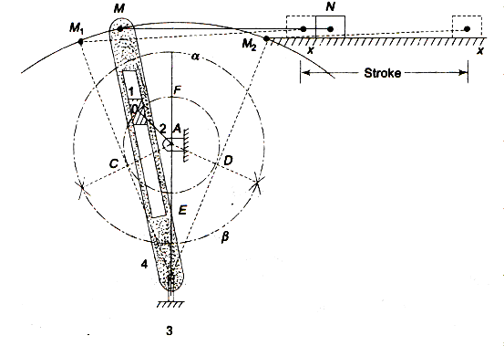
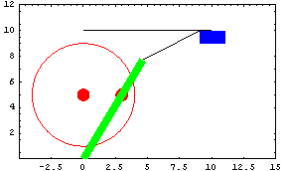
Inversion of SCM (Contd..)
Inversion 1 – Fixing Link 2
Crank & Slotted lever Quick return mechanism
TP
TP
LINK 1
LINK 2
LINK 3
SP
TP
LINK 4

Slide 7
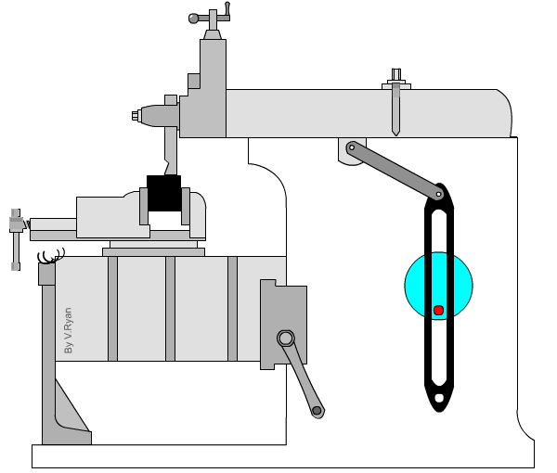
Inversion of SCM (Contd..)
Shaper machine Application of Quick Return Mechanism

Slide 8
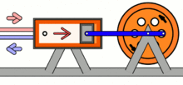
Inversion of SCM (Contd..)
Inversion 1 – Fixing Link 3
Oscillating Cylinder mechanism
TP
TP
LINK 1
LINK 2
LINK 3
SP
TP
LINK 4

Slide 9
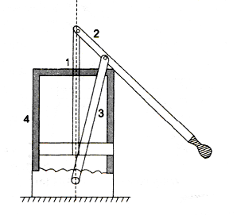
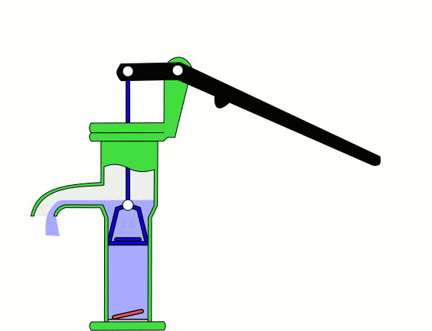
Inversion of SCM (Contd..)
Inversion 1 – Fixing Link 4
Hand Pump
mechanism
TP
TP
LINK 1
LINK 2
LINK 3
SP
TP
LINK 4

Slide 10
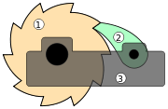
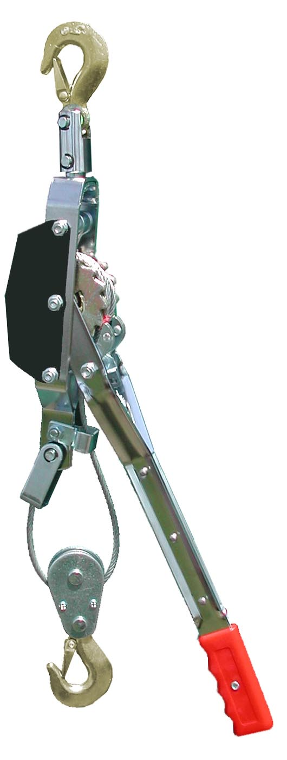
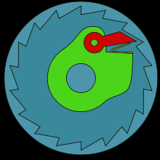

Ratchets And Escapements
A ratchet is a mechanical device that allows continuous linear or rotary motion in only one direction while preventing motion in the opposite direction.
Ratchets are widely used in machinery and tools.
Applications of ratchets:
Capstans
Clocks
Freewheel (overrunning clutch)
Jacks
Anti-rollback devices used in roller coasters
Slacklines
Tie down straps
Turnstiles
Handcuffs
A ratchet featuring gear (1) and pawl (2) mounted on base (3)
A ratchet lever hoist
Ratcheting freewheel mechanism
Ratcheting socket wrench or spanner

Slide 11
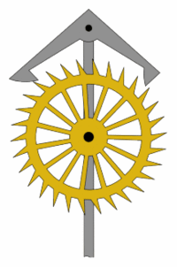
Escapements
An escapement is a device in mechanical watches and clocks that transfers energy to the timekeeping element (the "impulse action") and allows the number of its oscillations to be counted (the "locking action").
The impulse action transfers energy to the clock's timekeeping element (usually a pendulum or balance wheel) to replace the energy lost to friction during its cycle and keep the timekeeper oscillating.
The escapement is driven by force from a coiled spring or a suspended weight, transmitted through the timepiece's gear train.
Each swing of the pendulum or balance wheel releases a tooth of the escapement's escape wheel gear, allowing the clock's gear train to advance or "escape" by a fixed amount.
Escapements are used elsewhere as well.
  Manual typewriters used escapements to step the carriage as each letter (or space) was typed.

Slide 12
Indexing Mechanisms
Indexing mechanisms generally convert a rotating or oscillatory motion to a series of step movements of the output link or shaft.
  In machine tools the cutting tool has to be indexed in the tool turret after each operation.
  In the production machines the product has to be indexed from station to station and need to be stopped if any operation is being performed in the station.
Indexing mechanisms are also useful for machine tool feeds.
There are several methods used to index
  ratchet and pawl,
  rack and pinion,
  Geneva mechanism and
  cam drive.

Slide 13
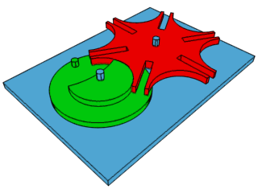
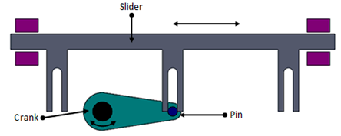
Geneva Mechanism
The Geneva mechanism translates a continuous rotation into an intermittent rotary motion.
The rotating drive wheel has a pin that reaches into a slot of the driven wheel.
The drive wheel also has a raised circular blocking disc that locks the driven wheel in position between steps
There are three basic types of Geneva motion mechanisms namely external, internal and spherical.
The spherical Geneva mechanism is very rarely used. In the simplest form, the driven wheel has four slots and hence for each rotation of the drive wheel it advances by one step of 90°. If the driven wheel has n slots, it advances by 360°/n per full rotation of the drive wheel.
Applications:
  Motion Picture Projectors
  Automated Work Assembly
  Material inspection table
  Tool Changer in Turret and CNC lathes
External Geneva mechanism
Linear intermittent motion using Geneva mechanism

Slide 14
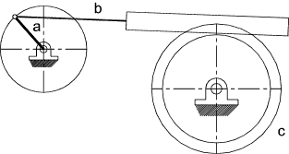
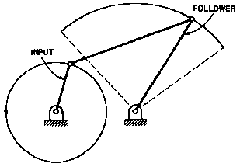
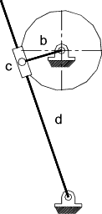
Rocking Mechanisms
This type of mechanism produces a swinging or rocking motion of a link
The motion is generally less than 360º and is an oscillatory motion
Toothed Rack System
Crank and Lever Mechanism
Quick Return Linkage

Slide 15
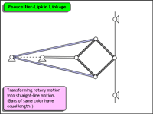
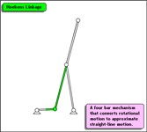
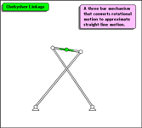
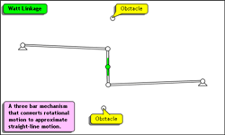
Straight Line Mechanisms
A straight-line mechanism converts rotary motion into straight-line motion
Some of them are :
  the peaucellier-lipkin linkage,
  the Hoekens linkage,
  the Chebyshev linkage and
  the Watt linkage.

Slide 16
Mobility
Mobility is the degree of freedom of a mechanism
It is determined by GRUBLER’S equation
N=3(n-1)-2p-h
where N is the mobility
n is the no. of links
p is the no. of lower pair
h is the no. of higher pair

