Slide 1
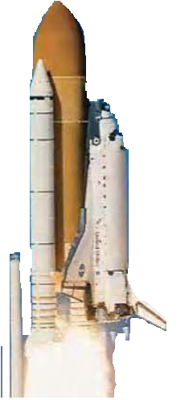

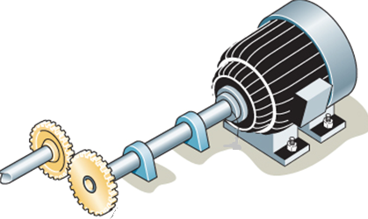
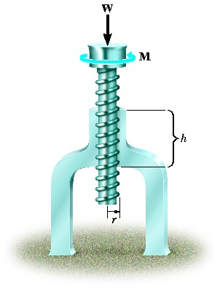
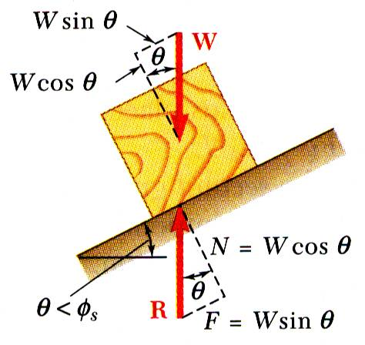
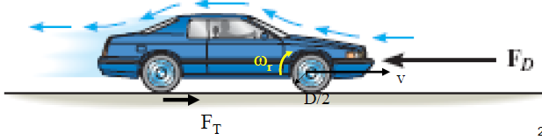
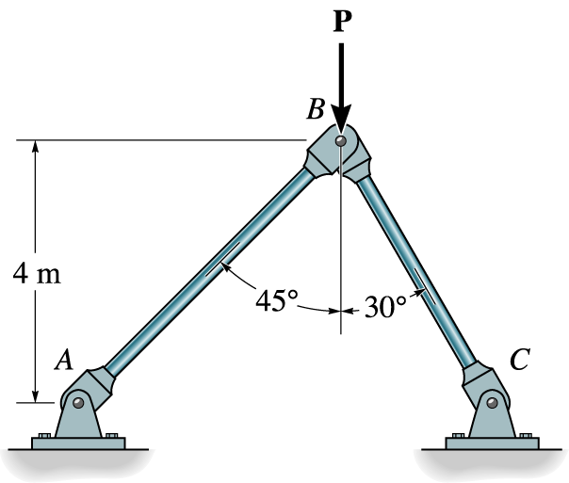


ENGINEERING MECHANICS
GE 107
Lecture 9

Slide 2
Unit III Properties of Surfaces and Solids
Determination of Areas and Volumes –
  First moment of area and the Centroid of sections –
  Rectangle, circle, triangle from integration –
  T section, I section, Angle section, Hollow section by using standard formula –
Second and product moments of plane area –
  Physical relevance –
  Rectangle, triangle, circle from integration –
  T section, I section, Angle section, Hollow section by using standard formula –
Parallel axis theorem and perpendicular axis theorem –
Polar moment of inertia
Mass moment of inertia –
  Derivation of mass moment of inertia for rectangular section, prism, sphere from first principle –
  Relation to area moments of inertia.

Slide 3
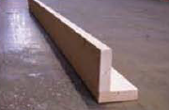
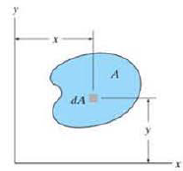

Product Moment of Inertia
Product of Inertia for an Area is required in order to determine the maximum and minimum moments of inertia for the area.
The maximum and minimum values are important properties needed for designing structural and mechanical members such as beams, columns and shafts.
The effectiveness of the beam shown in figure (a) to resist bending, can be determined once its moments of inertia and its product of inertia are known.
The product of inertia of the area as shown in figure (b) with respect to the x and y axes is defined as
Fig. (a)
Fig. (b)

Slide 4
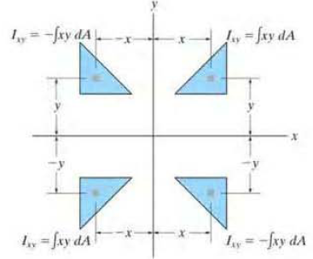
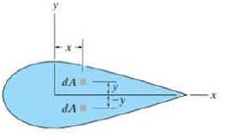
Product Moment of Inertia (Contd.)
Unlike the moment of inertia I_{x} or I_{y}, the product of inertia I_{xy} may either be
  positive,
  negative or
  even zero,
  depending on the location and orientation of the coordinate axes.
If x or y is negative, the product of inertia will be negative and
if x or y axis is an axis of symmetry for the area, it will be zero.

Slide 5
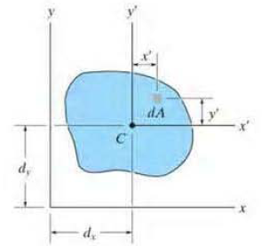
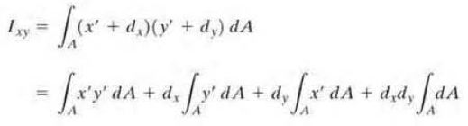
Product Moment of Inertia (Contd.)
Applying Parallel Axis Theorem, for the shaded area shown in figure,
x ' and y ' represent a set of axes passing through the centroid or the area
x and y represent a corresponding set of parallel axes.
As the product of inertia of dA with respect to the x and y axes is dI_{xy} = (x' + dx)(Y' + dy) dA
For the entire area,

Slide 6
Principal Moment of Inertia
The axes about which the moments of inertia for the area are maximum and minimum is called the Principal Axis Of The Area and
The corresponding moments of inertia with respect to these axes are called the Principal Moment of Inertia
In general, there is a set of principal axes for every chosen origin O, but for structural and mechanical design, the origin O is located at the centroid of the area.

Slide 7
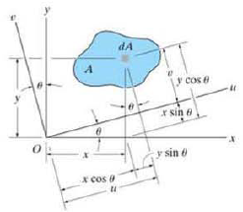


Principal Moment of Inertia (Contd.)
Let the principal axes be U and V axes as shown
The coordinates for the axes in relation to x and y is given as
With these equations. the moments and product of inertia of dA about the U and V axes become

Slide 8

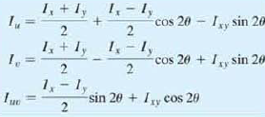
Principal Moment of Inertia (Contd.)
Expanding each expression and integrating, we get
Using the trigonometric identities sin 2θ = 2sinθ cosθ and cos2 θ= cos²θ - sin²θ the above expressions can be simplified as

Slide 9

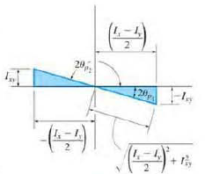


Principal Moment of Inertia (Contd.)
The orientation of the principal axes about which the moment of inertia is minimum or maximum can be found by differentiating any of the above equations with respect to θ
Therefore
The two roots θ₁ and θ₂ can be obtained by Substituting each of the sine and cosine ratios into the first or second Equations shown in the previous slide, we get

Slide 10
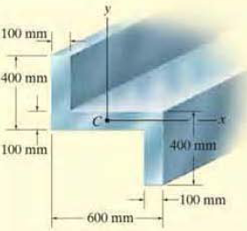
Problem 1
Determine the principal moments of inertia and the orientation of the principal axes for the cross-sectional area of the member shown in figure with respect to an axis passing through the centroid.

Slide 11
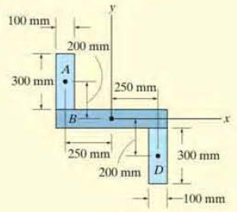



Solution to Problem 1
The I_{x} and I_{y} for the given beam cross section is already determined in the problem 6 of Lecture slide 8.
To find the product moment of inertia,
The total product moment of area is

Slide 12


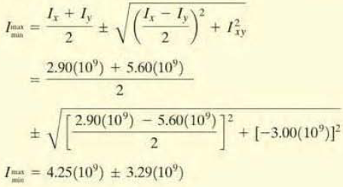
Solution to Problem 1 (Contd.)
The angle of inclination of Principal axes is determined as
By inspection,
Thus the principal moments of inertia are

Slide 13
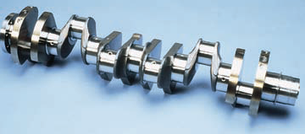
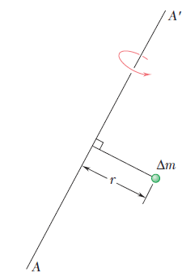
Mass Moment of Inertia
The mass moment of inertia of a body is a measure of the body's resistance to angular acceleration.
  the rotational behavior of the cranks haft shown is dependent upon the mass moment of inertia of the crank shaft with respect to its axis of rotation
Consider a small mass Δm mounted on a rod of negligible mass which can rotate freely about an axis AA’ as shown in figure.
If a couple is applied to the system, the rod and mass, assumed to be initially at rest, will start rotating about AA’.
The time required for the system to reach a given speed of rotation is proportional to the mass Δm and to the square of the distance r.

Slide 14
Mass Moment of Inertia (Contd.)
The product r² Δm provides, therefore, a measure of the inertia of the system, i.e., a measure of the resistance the system offers when we try to set it in motion.
For this reason, the product r² Δm is called the moment of inertia of the mass Δm with respect to the axis AA’.

Slide 15
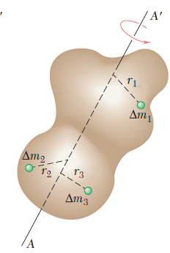

Mass Moment of Inertia (Contd.)
Consider now a body of mass m which is to be rotated about an axis AA’ (Figure).
Dividing the body into elements of mass Δm₁, Δm₂, etc., we find that the body’s resistance to being rotated is measured by the sum r₁² Δm1 + r₂² Δm₂+. .
This sum defines the moment of inertia of the body with respect to the axis AA’.
Increasing the number of elements, we find that the moment of inertia is equal, in the limit, to the integral

Slide 16
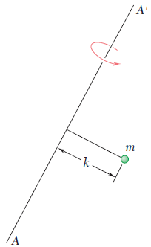

Mass Moment of Inertia (Contd.)
The radius of gyration k of the body with respect to the axis AA’ is defined by the relation
The radius of gyration k represents, therefore, the distance at which the entire mass of the body should be concentrated if its moment of inertia with respect to AA’ is to remain un change
Whether it is kept in its original shape or whether it is concentrated as shown in the mass m will react in the same way to a rotation, or gyration, about AA’

Slide 17
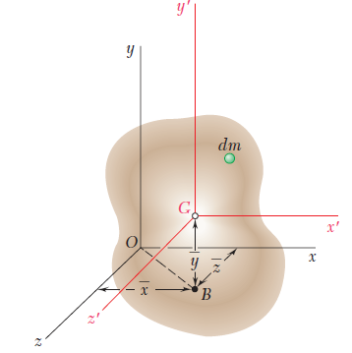
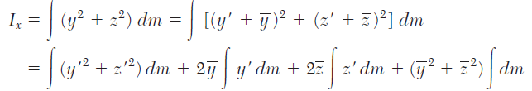
Parallel Axis theorem for Mass Moment of Inertia
Consider a body of mass m.
Let Oxyz be a system of rectangular coordinates whose origin is at the arbitrary point O, and
Gx’y’z’ a system of parallel centroidal axes, i.e., a system whose origin is at the center of gravity G of the body and whose axes x’, y’, z’ are parallel to the x, y and z axes, respectively .
Denoting by x, y, z the coordinates of G with respect to Oxyz, we write the following relations between the coordinates x, y, z of the element dm with respect to Oxyz and its coordinates x’, y’, z’ with respect to the centroidal axes Gx’y’z’:

Slide 18

Parallel Axis theorem for Mass Moment of Inertia (Contd.)
The first integral in this expression represents the moment of inertia I_{x’} of the body with respect to the centroidal axis x’
the second and third integrals represent the first moment of the body with respect to the z’x’ and x’y’ planes, respectively and
since both planes contain G, the two integrals are zero;
the last integral is equal to the total mass m of the body. We write, therefore,

Slide 19
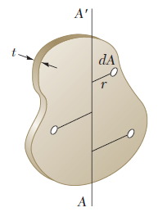



Mass Moments of Inertia of Thin Plates
Consider a thin plate of uniform thickness t, which is made of a homogeneous material of density ρ (density= mass per unit volume).
The mass moment of inertia of the plate with respect to an axis AA’ contained in the plane of the plate (as in figure) is
As ρt dA = dm,
Or

Slide 20
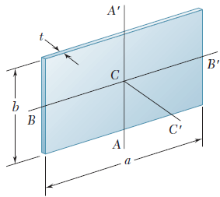



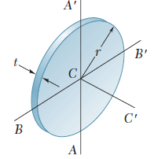
Mass Moments of Inertia of Thin Plates (Contd.)
In the case of a rectangular plate of sides a and b
Similarly
And
In the case of a circular plate, or disk, of radius r

Slide 21
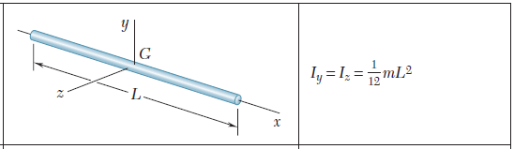
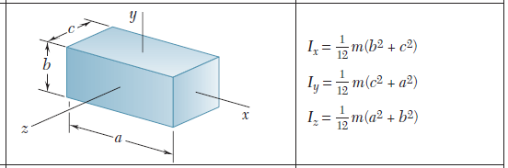
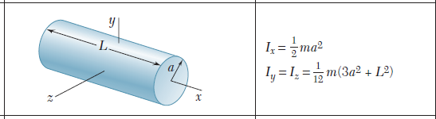
Mass Moments of Inertia of Thin Plates (Contd.)

Slide 22
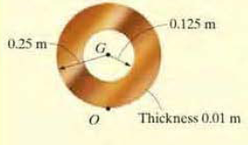
Problem 2
If the plate shown in figure has a density of 8000 kg/m³ and a thickness of 10 mm, determine its mass moment of inertia about an axis perpendicular to the page and passing through the pin at O.

Slide 23
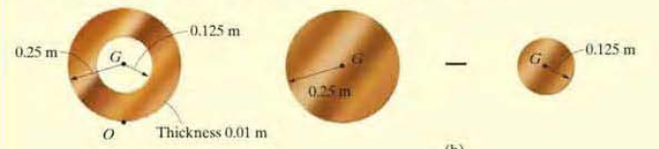
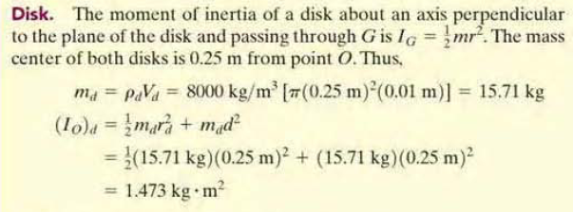
Solution to Problem 2

Slide 24




Solution to Problem 2 (Contd.)

Slide 25
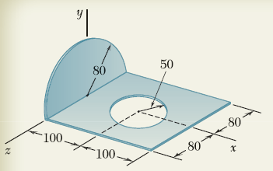
Problem 3
A thin steel plate which is 4 mm thick is cut and bent to form the machine part shown. Knowing that the density of steel is 7850 kg/m3, determine the moments of inertia of the machine part with respect to the coordinate axes.

Slide 26
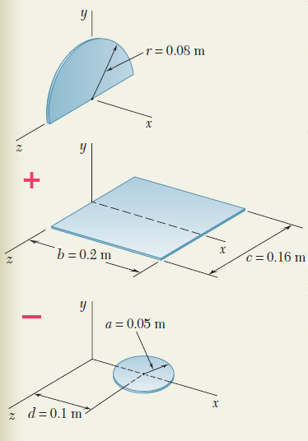
Solution to Problem 3
The machine part consists of
  a semicircular plate and
  a rectangular plate from which
  a circular plate has been removed

Slide 27
Solution to Problem 3 (Contd.)
As only the density is given, to determine the mass, their volumes are needed
For Semicircular Plate
For the rectangular plate
For the circular plate

Slide 28


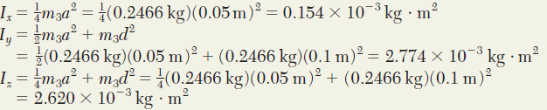
Solution to Problem 3 (Contd.)
To find the total mass moments of Inertia, the moments of inertia of each component is to be obtained.
For the Semicircular Plate,
For the rectangular Plate,
For the circular plate (hole)

Slide 29

Solution to Problem 3 (Contd.)
For the entire machine

