Slide 1
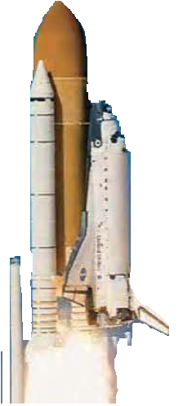

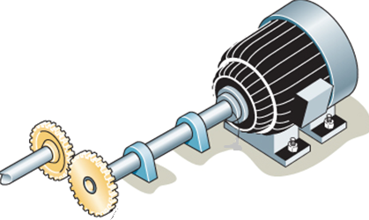
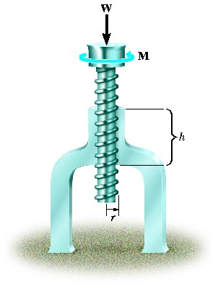
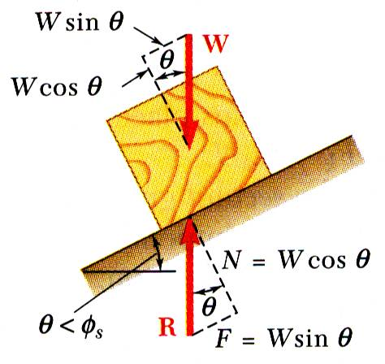
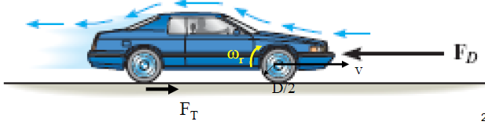
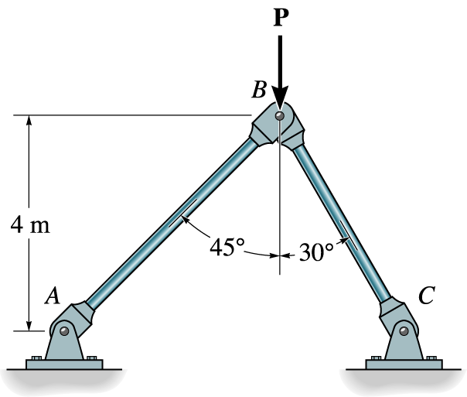


ENGINEERING MECHANICS
GE 107
Lecture 7

Slide 2
UNIT II EQUILIBRIUM OF RIGID BODIES
SYLLABUS
Moments and Couples – Moment of a force about a point and about an axis –Vectorial representation of moments and couples – Scalar components of a moment –Varignon’s theorem
Free body diagram – Types of supports and their reactions – requirements of stable equilibrium
Equilibrium of Rigid bodies in two dimensions
Equilibrium of Rigid bodies in three dimensions Examples

Slide 3
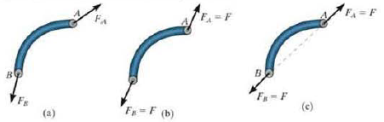
Equilibrium in Two Force Members
As the name implies. A two force member has forces applied at only two points on the member.
An example of a two force member is shown in Figure a
To satisfy force equilibrium. F_{A} and F_{B} must be equal in magnitude. F_{A} = F_{B} = F, but opposite in direction as in Figure b.
Moment equilibrium requires that F_{A} and F_{B} should have the same line of action,(∑M=M_{A} = M_{B} =0) which can only happen if they are directed along the line joining points A and as shown in Figure c

Slide 4
Equilibrium in Two Force Members (Contd..)
Hence for any two-force member to be in equilibrium, the two forces acting on the member
  Must have same magnitude
  Opposite in direction
  Acting on the same line of action
Directed along the line connecting two points where the two forces are applied.

Slide 5
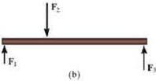
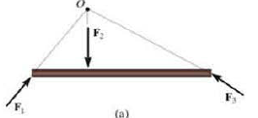
Equilibrium in Three Force Members
The member are subjected to only three forces
Moment equilibrium can be satisfied only if the three forces form a concurrent or parallel force system
For example, consider the member subjected to the three forces as shown in Figure a
the lines of action of F₁ and F₂ intersect at point D.
Then the line of action of F₃ must also pass through point D so that the forces satisfy ∑Mo = O.
As a special case, if the three forces are all parallel as in Figure b, the location of the point of intersection D will approach infinity.

Slide 6
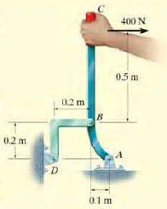
Example
The lever ABC is pin supported at A and connected to a short link BD as shown in Figure. If the weight of the members is negligible, determine the force of the pin on the lever at A.

Slide 7
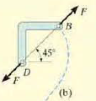
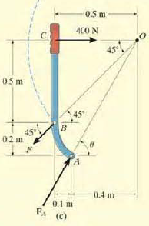

Example(Contd.)
Free -Body Diagrams for the given lever setup is to be drawn
As shown in Fig. b, the short link BD is a two force member.
Hence the forces at pins D and B must be equal. opposite. and collinear.
Although the magnitude of the force is unknown. the line of action is known since it passes through B and D.
For the lever ABC, as it is is three force member,, the three nonparallel forces acting on it must be concurrent.

Slide 8


Example(Contd.)

Slide 9
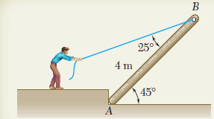
Problem 1
A man raises a 10-kg joist, of length 4 m, by pulling on a rope. Find the tension T in the rope and the reaction at A.

Slide 10
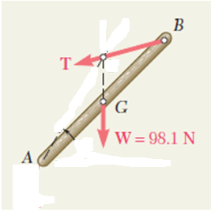
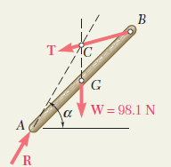

Solution to Problem 1
Free-Body Diagram
  The joist is a three-force body, since it is acted upon by three forces:
    weight W,
    the force T exerted by the rope,
    And its reaction R of the ground at A
  The joist is a three force body and hence the forces should be concurrent for equilibrium
  The reaction R, therefore, will pass through the point of intersection C of the lines of action of the weight W and the tension force T.

Slide 11
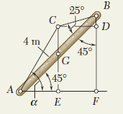


Solution to Problem 1 (Contd.)
Drawing the vertical BF through B and the horizontal CD through C, we note that
The direction of force R can be thus found as

Slide 12
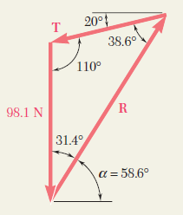
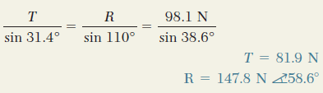
Solution to Problem 1 (Contd.)
A force triangle is drawn as shown, and its interior angles are computed from the known directions of the forces.
Using the sine rule,

Slide 13
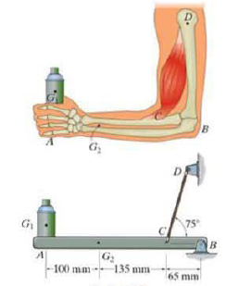
Problem 2
A skeletal diagram of a hand holding a load is shown in the figure. If the load and the forearm have masses of 2 kg and 1.2 kg respectively. and their centre of mass are located at G₁and G₂, determine the force developed in the biceps CD and the horizontal and vertical components of reaction at the elbow joint B.
The forearm supporting system can be modeled as the structural system shown

Slide 14

Equilibrium of a rigid body in three dimensions
A body in a 3D space will have six degrees of freedom
Hence six scalar equations are required to express the conditions for the equilibrium of a rigid body in the general three-dimension
The above scalar equations will be more conveniently obtained if we first express in vector form
These equations can be solved for no more than six unknowns, which generally will represent reactions at supports or connections.

Slide 15
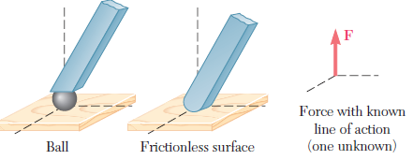
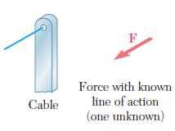
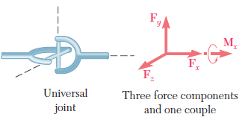
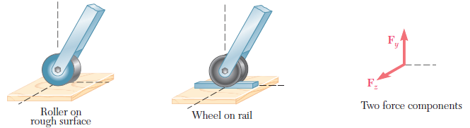
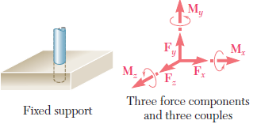
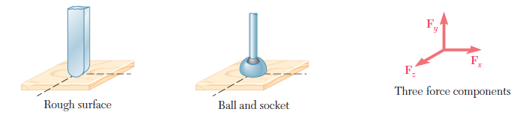
Support Reactions in 3D

Slide 16
FBD in 3D
Z
Y
Z
Z
F_{Z}
M_{Z}
F_{Z}
Y
M_{Z}
M_{Y}
M_{Y}
F_{Y}
F_{Y}
Y
X
Find the constraint forces and moments for the given assembly and show them in the FBD
X
F_{X}
F_{X}
X
FBD of 1
FBD of 2
As the shaft system is free to move in one direction only (rotate around X), it has five constraints namely Fx, Fy, Fz, M_{Z} and M_{y}.

Slide 17
Exercises
Problem 1
Problem 2
Problem 3
Problem 4

Slide 18
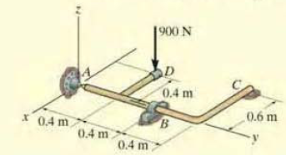
Example
Determine the components of reaction that the ball and socket joint at A, the smooth journal bearing at B and the roller support at C exert on the rod assembly as shown in Figure

Slide 19
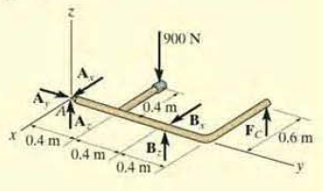

Example (Contd.)
As shown on the free-body diagram, the reactive forces of the supports will prevent the assembly from rotating about each coordinate axis and the journal bearing only exerts reactive forces on the member.
Equations of Equilibrium can be used to solve the unknowns
The force A_{y} obtained by summing forces along the y axis.
The force F_{C} can be determined directly by summing up moments about the y axis.

Slide 20
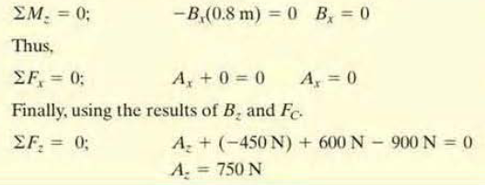
Example (Contd.)
Using this results , reaction B_{Z} can be determined by summing up the moments about x axis.
  The negative sign indicates that B, acts downward.
The force B_{X} can bee found by summing moments about the z axis.

Slide 21
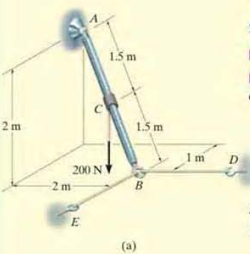
Problem 3
Rod AB shown in Fig.(a) is subjected to the 200 N force. Determine the reactions at the ball-and-socket joint A and the tension in the cables BD and BE.

Slide 22
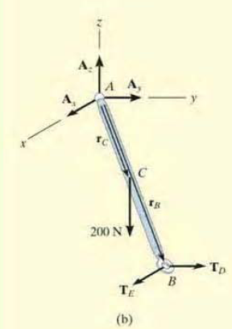
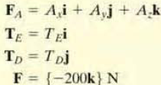
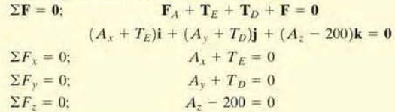
Solution to Problem 3
Free-Body Diagram is shown in Fig.(b)
Representing each force on the free-body diagram in Cartesian vector form,
Applying the force equation of equilibrium,

Slide 23
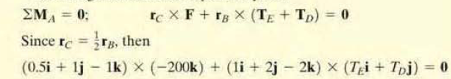
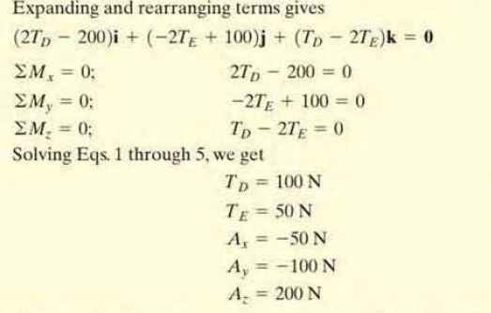
Solution to Problem 3 (Contd.)
Summing up moments about point A yields,
Expanding and arranging the terms
Solving the above equations

