Slide 1

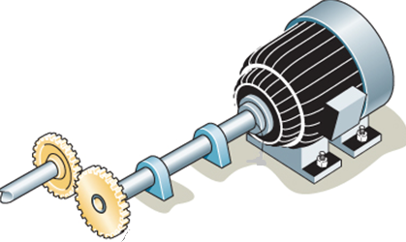
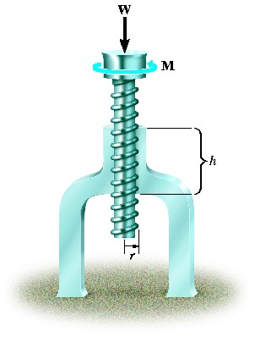
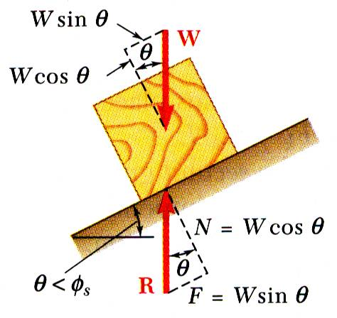
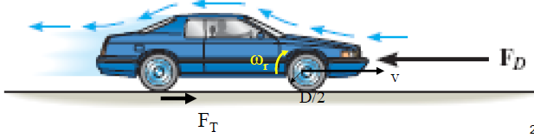
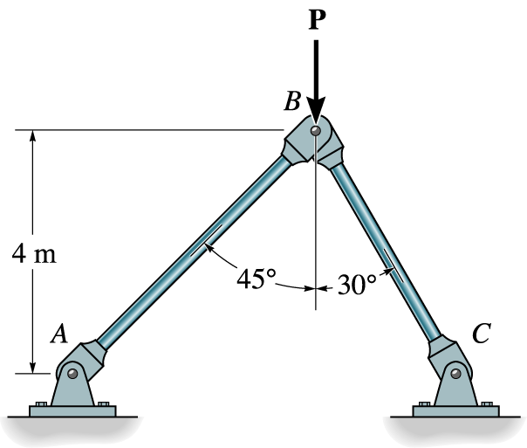


ENGINEERING MECHANICS
GE 107
Lecture 5

Slide 2
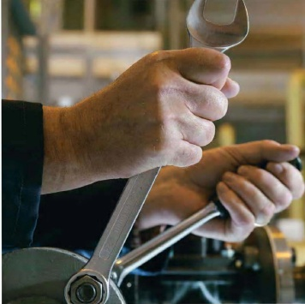
Moment of a Force
  The analysis of a system of forces requires knowledge about the equilibrium
  For a particle or a system to be in equilibrium, not only the resultant forces but also the resultant of another component known as moment should be equal to zero
  When a force is applied to a body , it will produce a tendency for the body to rotate about a point that is not on the line of action of the force.
  This tendency to rotate is sometimes called a torque but most often it is called the moment of a force or simply the moment

Slide 3
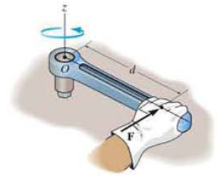
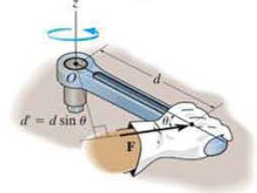
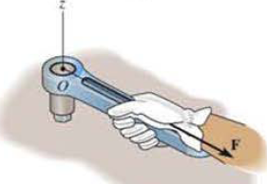

Magnitude of Moment
For example. consider a wrench used to unscrew the bolt as shown in Fig.1
If a force is applied to the handle of the wrench, it will tend to turn the bolt about point 0 (or the z axis).
The magnitude of the moment is directly proportional to the magnitude of F and the perpendicular distance or moment arm d
if the force F is applied at an angle 0≠90°. then it will be more difficult to turn the bolt since the moment arm d‘ =dsinθ will be smaller than d.
lf F is applied along the wrench. its moment arm will be zero since the line of action of F will intersect point 0 (the = axis).
As a result. the moment of F about 0 is also zero and no turning can occur.
The Magnitude of Moment about the axis O is

Slide 4
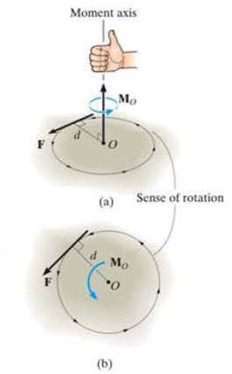
Direction of Moment
The direction of Mo is defined by its moment axis, which is perpendicular to the plane that contains the force F and its moment arm d
The right-hand rule is used to establish the sense of direction of Mo
According to this rule. the natural curl of the fingers of the right Hand, as they are drawn towards the palm, represent the tendency for rotation caused by the moment.
As this action is performed. the thumb of the right hand will give the directional sense of M_{O} as in Fig. a.
The moment vector is represented three dimensionally by a curl around an arrow.
In two dimensions this vector is represented only by the curl as in Fig. b. in counterclockwise rotation.

Slide 5
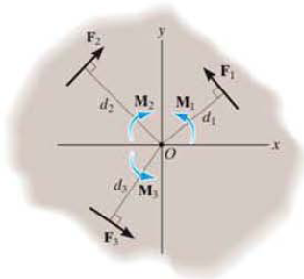

Resultant Moment
For two-dimensional problems. where all the forces lie within the .X-Y plane as in Fig., the resultant moment (M_{R}) _{O} will be about point 0 (the z axis)
It can be determined by the algebraic sum of the moments caused by all the forces in the system.
As a convention, we will generally consider positive moment as counter clock wise since they arc directed along the positive z axis (out of the page).
Clockwise moments will be negative
Doing this, the directional sense of each moment can be represented by a plus or minus sign.
Using this sign convention, the resultant moment in Fig. is therefore

Slide 6
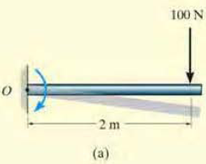

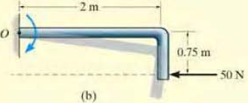
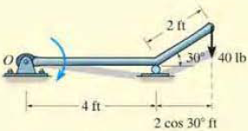
Example
For each case illustrated in Fig. determine the moment of the force about point O.
Solution:
The line of action of each force is extended as a dashed line in order to establish the moment arm d.

Slide 7
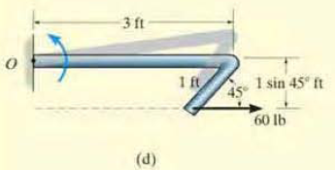
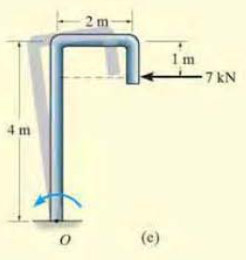
Example 1 (Contd.)

Slide 8
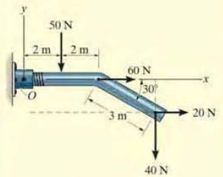
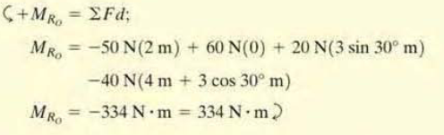
Example 2
Determine the resultant moment of the four forces acting on the rod as shown in Fig. about point 0

Slide 9
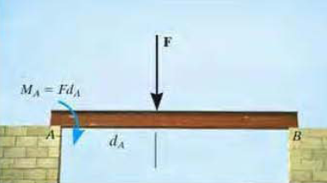
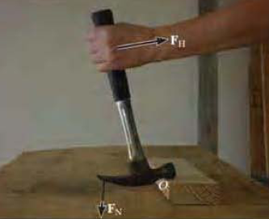
Effect of Moment
Bending Moment
Nail removal

Slide 10
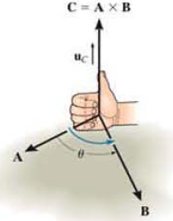
Cross Product
The knowledge of cross product of vectors is necessary to derive the vector formulation of moment
The cross product of two vectors A and B yields the vector C, which is written as
C = A x B
The magnitude of cross product C is defined as the product of the magnitudes of A and B and the sine of the angle θ between their tails. Thus. C = AB sin θ.
The direction of Vector C is perpendicular to the plane containing A and B such that C is specified by the right-hand rule: i.e ..curling the fingers of the right hand from vector A (cross) to vector B, the thumb points in the direction of C. as shown in Fig.
Knowing both the magnitude and direction of C, we can write
C = A xB= (AB sin θ)u_{C}
where the scalar AB sin θ defines the magnitude of C and the unit vector defines the direction of C.

Slide 11
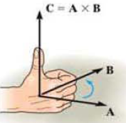
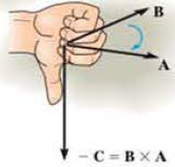
Cross Product (Contd..)
The cross product is not commutative
i.e ., A X B ≠ B X A, Rather A X B = - B X A
If the cross product is multiplied by a scalar a, it obeys the associative law:
a(A X B) = (aA) xB= A X (aB) = (A X B)a
The vector cross product ,also obeys the distributive law of addition
A X (B + D)=(A X B ) + (A X D)

Slide 12
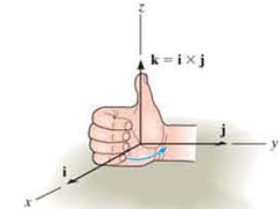
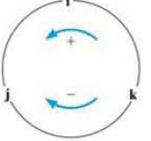

Cross Product (Contd..)
Cartesian Vector Formulation
The Equation C=AB sinθ may be used to find the cross product of any pair of Cartesian unit vectors.
For example, to find i X j, the magnitude of the resultant vector is ( i)( j )(sin 90") = (1)( 1)( 1) = 1.
Its direction is determined using the right hand rule, As shown in Fig., the resultant vector points in the +k direction.
Thus i x j =(1)k.
In a similar manner.

Slide 13
Cross Product -
Cartesian Vector Formulation (Contd..)
Let us now consider the cross product of two general vectors A and B which are to be expressed in Cartesian Vector form.
Carrying out the cross product we get

Slide 14
Cross Product -
Cartesian Vector Formulation (Contd..)
The equation can also written in then matrix form as
Hence to find the cross product of any two Cartesian vectors A and B, it is necessary to expand a determinant
whose first row of elements consists of the unit vectors i, j and k and
whose second and third rows represent the x. y, z components of the two vectors A and B respectively

Slide 15
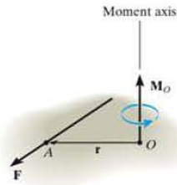
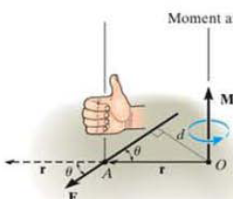
Moment of Force- Vector Formulation
The moment of a force F about point O, or actually about the moment axis passing through 0 and perpendicular to the plane containing O and F as shown in Fig. can be expressed using the vector cross product as
-Where r represents a position vector directed from o to any point on the line of action of F.
The magnitude of the cross product is defined from M_{O}=rFsinθ
  where the angle θ is measured between the tails of r and F.
Since rsinθ =d, the moment arm, M_{O}=R(rsin θ)= Fd
The direction and sense of M_{O} can be determined by the right-hand rule as it applies to the cross product.

Slide 16
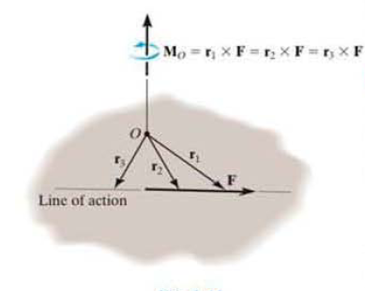
Principle of Transmissibility
The cross product operation is often used in three dimensions since the perpendicular distance or moment arm from point O to the line of action of the force (which is difficult to obtain) is not needed.
In other words. we can use any position vector r measured from point O to any point on the line of action of the force F, as shown in Fig.
Since F can be applied at any point along its line of action and still create the moment about point O, then F can be considered a sliding vector
This property is called the principle of transmissibility of a force.

Slide 17
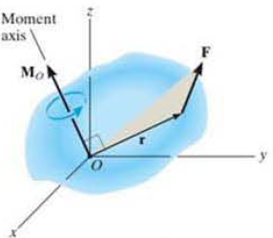
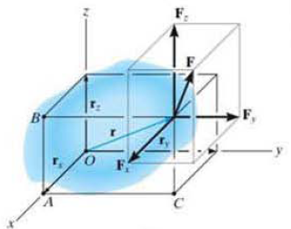
Cartesian Vector Formulation for Moment
Considering the coordinate axes x,y and z. then the position vector r and force F can be expressed as Cartesian vectors.
Applying cross product equation
where r_{x} , r_{y,} r_{z} represent the x, y, z components of the position Vector from point O to any point on the line of action of the force
Fx ,Fy, Fz represent the force components of the force vector.

Slide 18
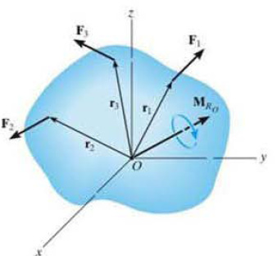
Resultant Moment of Forces
If a body is acted upon by a system of forces as shown in Fig.,
the resultant moment of the forces about point O can be determined by vector addition of the moment of each force.
This resultant can be written symbolically as

Slide 19
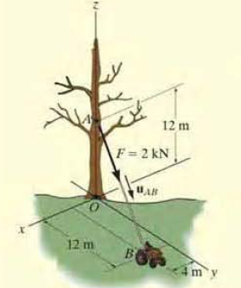
Problem 1
Determine the moment produced by the force F as shown in fig. about point O. Express the result as a Cartesian vector.

Slide 20
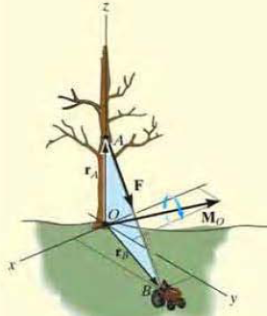
Solution to Problem1
As shown in Fig., either r_{A}. or r_{B} can be used to determine the moment about point O.
The position vectors are
Force F can be expressed in Cartesian form as

Slide 21
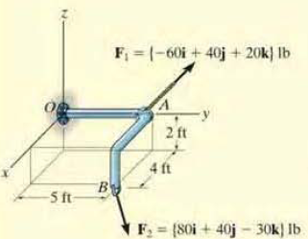
Problem 2
Two forces act on the rod as shown in Fig. Determine the resultant moment they create about the flange at O. Express the result as a Cartesian vector.

Slide 22
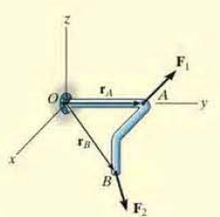

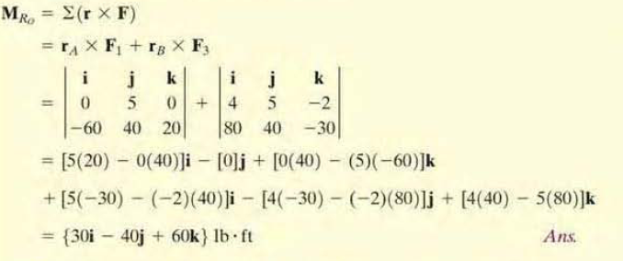
Solution to Problem 2
Position vectors for each are to be determined first.
The resultant moment about 0 is therefore

Slide 23
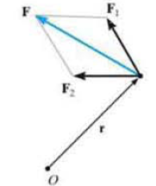
Principle of Moments
A concept often used in mechanics is the principle of moments, which is sometimes referred to as Varignon’s Theorem
It was originally developed by the French mathematician Varignon (1654- 1722).
It states that the moment of the of force about a point is equal to the sum of the moments of components of the force about that point.
This theorem can be shown by the distribution law of cross product.
Considering the forces shown in Fig.,
As
Therefore

Slide 24

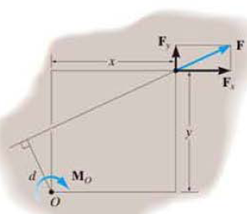
Principle of Moments (Contd..)
For two dimensional problem, we can use the principle of moments by resolving the force into its rectangular components
Then determine the moment using a scalar analysis.
as

Slide 25
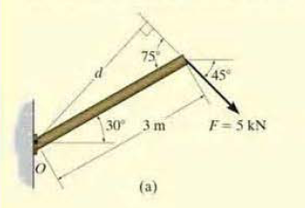
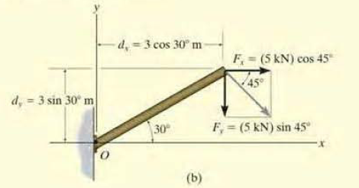

Principle of Moments Contd..) Example1
To determine the moment of the force in Fig. a about point O.
The moment arm d as in Fig. b, can be found from trigonometry.
d = (3 m) sin 7S°= 2.898 m

Slide 26

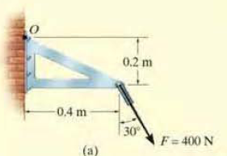
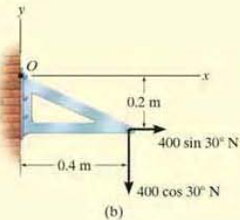
Principle of Moments Contd..) Example 2
Force F acts at the end of the angle bracket as shown in Fig.a. Determine the moment of the force about point O.
The force is resolved into two components as shown in Fig.b., then

Slide 27
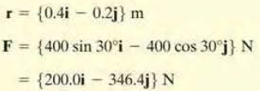
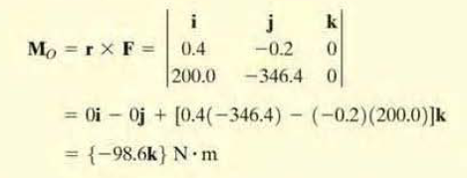
Principle of Moments
Example 2 (Contd..)
Alternative Method using Varignon’s theorem
Using a Cartesian vector approach, the force and position vectors are determined
The moment is therefore

Slide 28
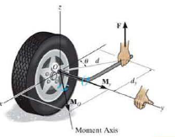
Moment of a Force about a
Specified Axis
Some times-the moment produced by a force about a specified axis must be determined.
For example, suppose the lug nut at a on the car tire as in Fig. needs to be loosened.
The force applied to the wrench will create a tendency for the wrench and the nut to rotate about axis passing through 0
But the nut can only rotate about the y axis.
Hence only the y component of the moment is needed. and the total moment produced is not important.
To determine this component, we can use either a scalar or vector analysis.

Slide 29
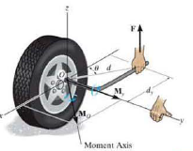
Moment of a Force about a Specified Axis (Contd..)
Scalar Method
To use a scalar analysis in the case of the lug nut as in Fig.,
Moment arm, the perpendicular distance from the axis to the line of action of the force is
d_{y} = d cos θ.
Thus. the moment of F about the y axis is M_{y}=Fd_{y}= F(d cos θ).
According to the right-hand rule. M_{y} is directed along the positive y axis as shown in the figure.
In general, about any axis a, the moment is

Slide 30
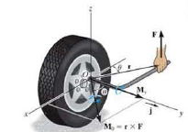


Moment of a Force about a Specified Axis (Contd..)
Vector Method
To find the moment of force F about the y axis using a vector analysis, we must first determine the moment of the force about the point 0 on they axis by applying Equation Mo = r X F.
The component My along the y axis is the projection of Mo on the y axis.
It can be found using equation of dot product
  M _{y}= j · M_{o}= j . (r X F).
  where j is the unit vector for the y axis.
Let u_{d} be the unit vector along any axis a, then
The result can be written in the matrix form as

Slide 31
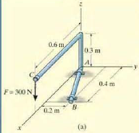
Problem 3
Determine the moment M_{AB} produced by the force F in Fig.a, which tends to rotate the rod about the AB axis.

Slide 32

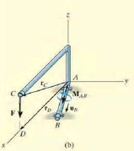
Solution to Problem 3
The vector approach M_{AB}= u_{B}⋅(r X F) can be used to find the moment
u_{B} defines the direction of AB axis of the rod
r is the position vector directed from any point on AB to any point on the line of action of force
The force is

Slide 33
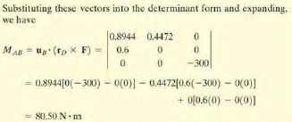

Solution to Problem 3 (Contd..)

Slide 34

Problem 4
Determine the magnitude and direction of moment of force F about segment OA

Slide 35




Solution to Problem 4
To get the force in vector form ,
find the unit vector along OA
Find the position vector for force segment OA
Hence the moment about OA is

Slide 36

Moment of a Couple
A couple is defined as
  two parallel forces that have
  the same magnitude
  but opposite directions and
  are separated by a perpendicular distance d.

Slide 37

Moment of a Couple (Contd..)
For example, imagine that you are driving a car with both hands on the steering wheel and you are making a turn.
One hand will push up on the wheel while the other hand pulls down, which causes the steering wheel to rotate
Since the resultant force is zero, the only effect of a couple is to produce a rotation or tendency of rotation in a specified direction.
This is nothing but a moment or moment of a couple
The moment produced by a couple can be called as Couple Moment.

Slide 38


Couple Moment -
Scalar Formulation
The moment of a couple as shown in the Fig. is defined as having a magnitude of
  Where F is the magnitude of one of the forces and
  d is the perpendicular distance or moment arm between the forces.
The direction and sense of the couple moment are determined by the right hand rule,
  where the thumb indicates this direction and
  the fingers are curled with the sense of rotation caused by the couple forces.
In all cases, M will act perpendicular to the plane containing the forces.

Slide 39

Couple Moment – vector Formulation
Moment can be determined by finding the sum of the moments of both couple forces about any arbitrary point.
For example as in Fig. the position vectors r_{A} and r_{B} are directed from point 0 to points A and B lying on the line of action of - F and F
The couple moment determined about 0 is
But the position vectors are added as
Hence
This result indicates that a couple moment is a free vector i.e., it can act at any point since M depends only upon the position vector r directed between the forces.

Slide 40



Resultant Couple Moment
Since couple moments are vectors, their resultant can be determined by vector addition.
For example, consider the couple moments M₁ and M₂ acting on the pipe as shown in the Fig.a.
Since each couple moment is a free vector, we can join their tails at any arbitrary point and find the resultant couple moment as shown in Fig.b.
M_{R}=M₁+M₂
If more than two couple moments act on the body, we may generalize this concept and write the vector resultant as

Slide 41

Problem 5
Determine the magnitude and direction of the couple moment acting on the gear as shown in the Figure. (R.C. Hibbeler p151)

Slide 42

Solution to Problem 5
Scalar Approach
  The distance d can be found graphically and
  substituting in the formula M= Fd , its magnitude can be found
  Analytical method to find d is complicated and hence vector approach is used

Slide 43


Solution to Problem 5 (Contd..)
The forces are resolved in to two components
The moments of respective resolved components are found about any point (say O)
Summing up the moments will give the resultant couple moment caused by the forces
This positive result indicates that M has a counter clock wise rotational sense and it is directed outward . perpendicular to the p:lgc.
600 sin30°N
0.2 m
M₁
600 sin30°N
0.2 m
600 cos30°N
M₂
600 cos30°N

Slide 44

Problem 6
Replace the two couples acting on the pipe column as shown in the figure by a resultant couple moment.

Slide 45
Solution to Problem 6
Let the couple moments M₁ and M₂ are produced by the forces F₁ and F₂ respectively
  Where F₁ = 150 N and F₂= 125 N
The vector M₁ is given as

Slide 46



Solution to Problem 6 (Contd..)
The vector M₂ is computed in the similar manner as
The resultant moment is thus

Slide 47






Simplification of Force and couple system

Slide 48




Example

Slide 49



Example (Contd.)

Slide 50




Problem 7
Find the resultant moment for the system shown

