Slide 1

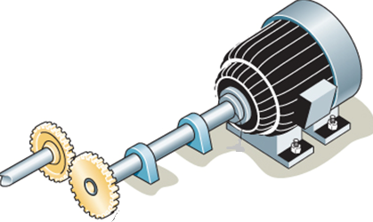
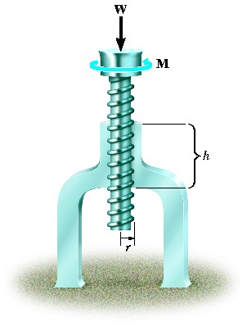
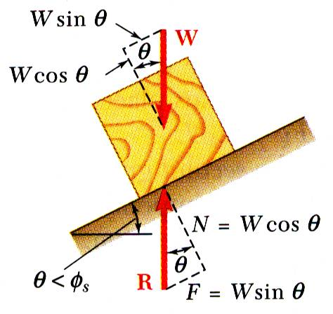
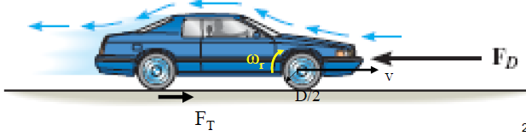
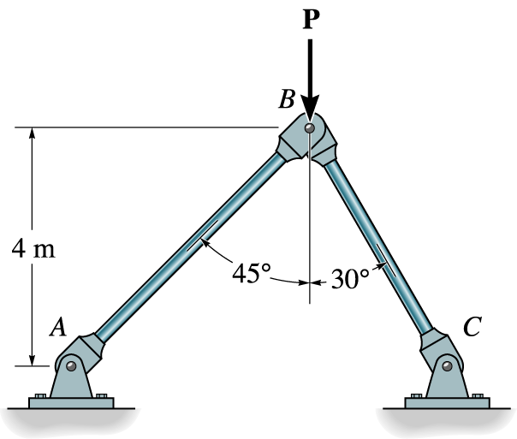


ENGINEERING MECHANICS
GE 107
Lecture 5

Slide 2
Dot Product
The angles between two vectors cannot be found by trigonometry easily in three dimension
The vector method using dot product will be useful
Dot product of two vectors A and B is defines as the product of magnitudes of A and B and the cosine of angle between their tails
where 0° <θ<180 °
The dot product is a scalar product
Dot product is commutative
When multiplied by scalar
Similarly
A
θ
B

Slide 3
Dot Product (Contd.)
Dot product and Cartesian Vector
Considering the unit vectors acting along X, Y and Z axes
as i, j and k respectively
Dot product of these unit vectors can be found by using formula as
The dot product of two vectors A and B expressed in Cartesian form is given as
Z
Similarly
B
k
j
i
Y
X

Slide 4
Dot Product (Contd.)
Application of Dot product
It has two main applications in Engg. Mechanics
  Angle formed between two intersecting vectors can be found as shown below
  The components of a vector parallel and perpendicular to a line can be obtained (resolution of vector)
  The parallel component has magnitude
  Acosθ, therefore
A
Z
A_{II}
A⊥
A
A
θ
u
Y
A_{II}=Ac osθ u
X

Slide 5
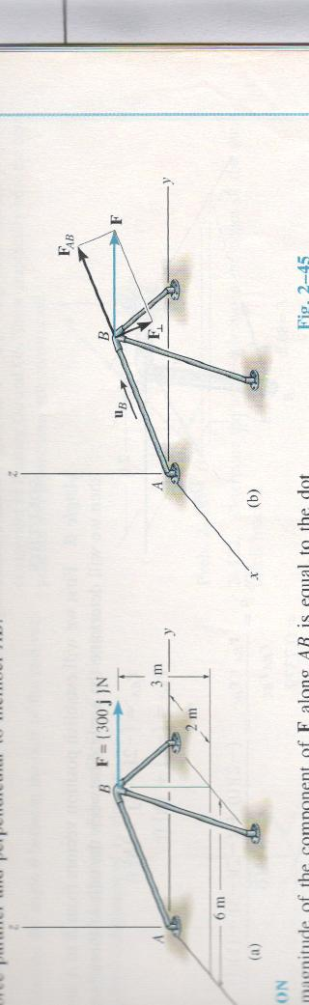
Example
Determine the magnitude of given force parallel and perpendicular to AB

Slide 6
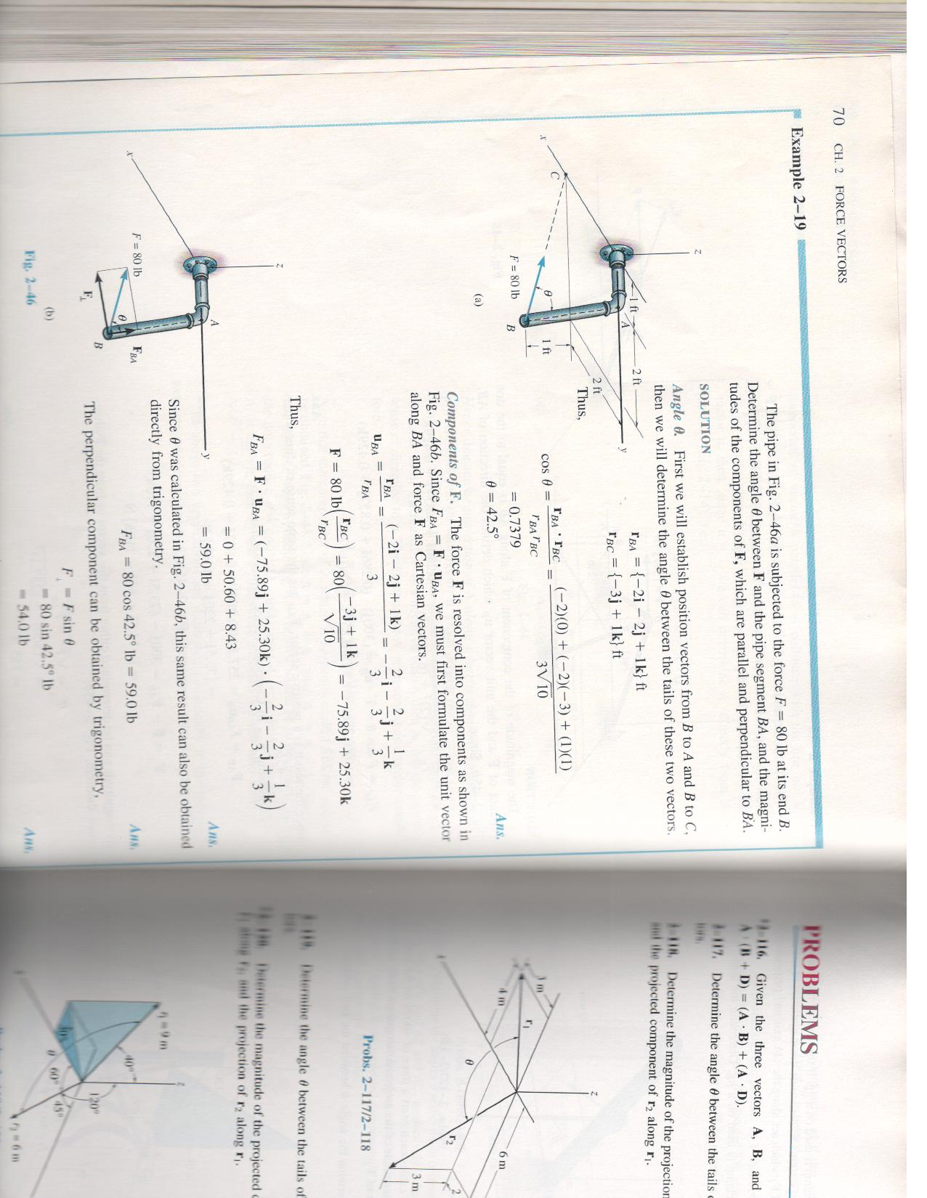
Problem 1
The pipe shown below is subjected to a force of 80 N at the end B. Determine the angle between F (i.e. line BC) and pipe segment BA and the magnitudes of components of F parallel and perpendicular to BA
1m
2m
2m
1m
F=80 N

Slide 7
Solution to Problem 1
To find θ, consider the position vectors along BA and BC
To resolve the given force in to components Parallel and perpendicular to BA:
Unit vector along BA is to be found.

Slide 8
Problem1 Solution(Contd..)
The unit vector along BA is therefore,
F=80 N

Slide 9
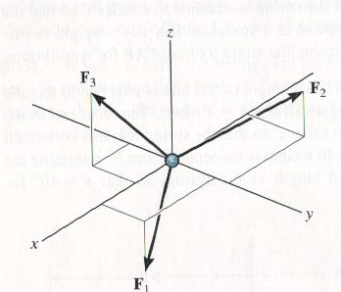
Equilibrium of 3D Force System
The particle will be in equilibrium when

Slide 10
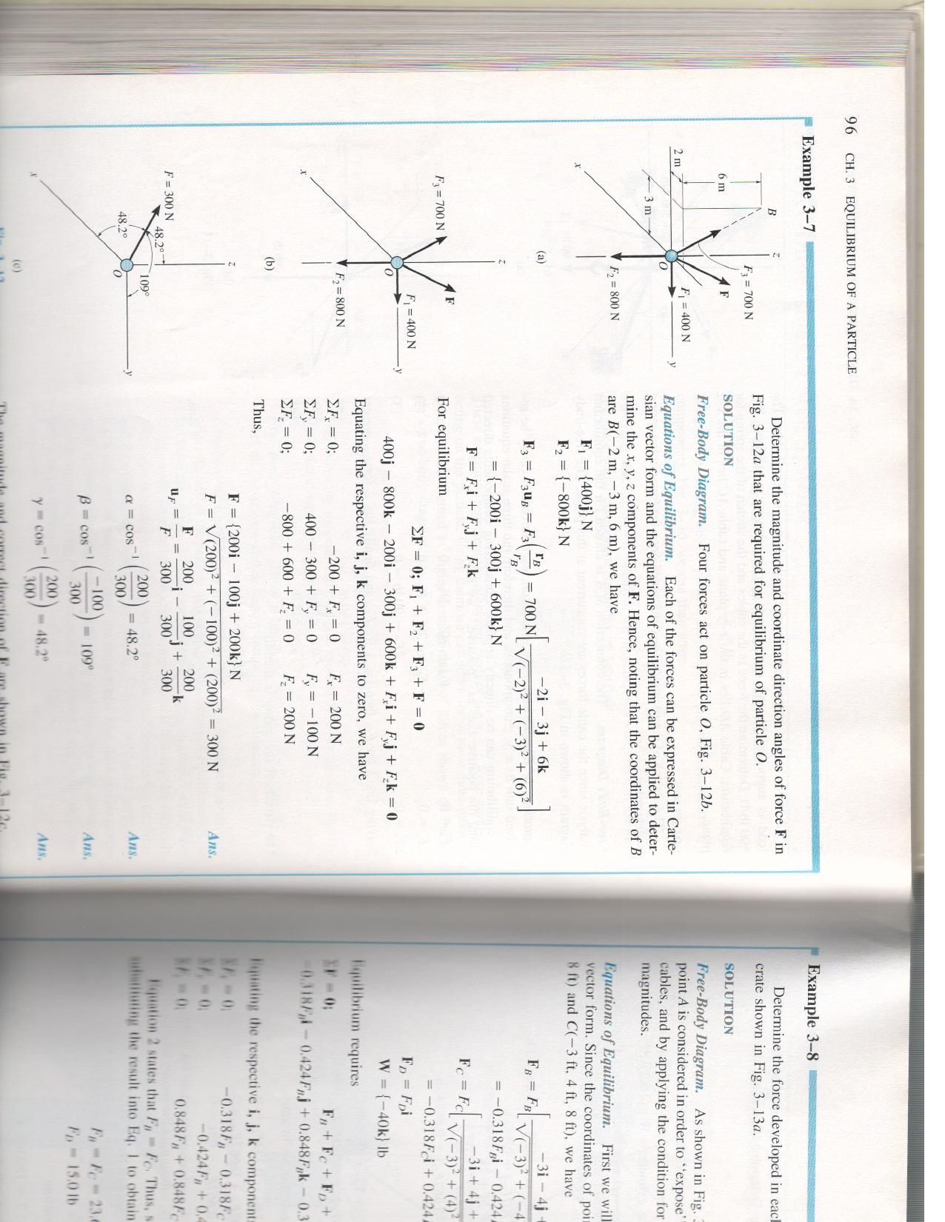
Problem 2
Fig.

Slide 11
Problem 2 (Contd.)
Solution

Slide 12
Problem 2 (Contd.)
Solution

Slide 13
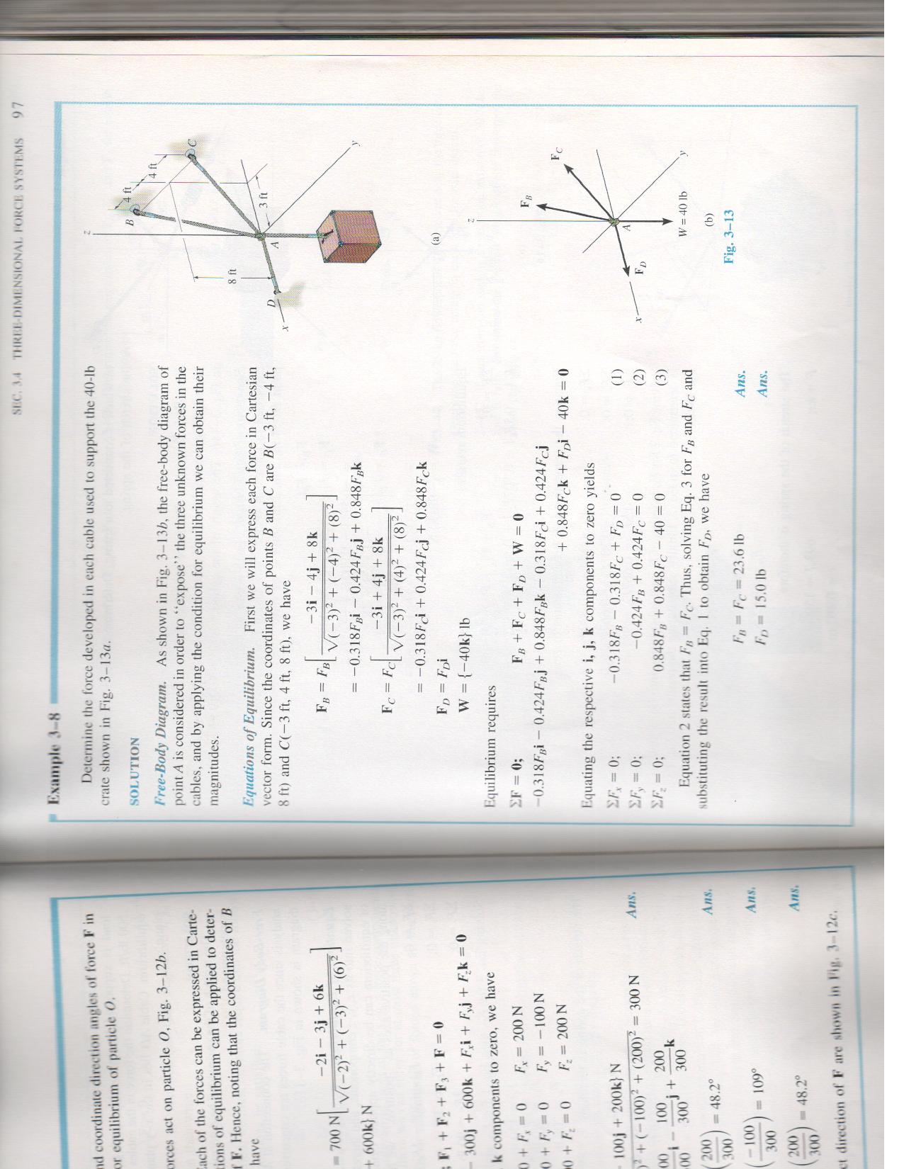
Problem 3

Slide 14
Problem 3(Contd..)
Solution

Slide 15
Problem 3
Solution (Contd..)

Slide 16
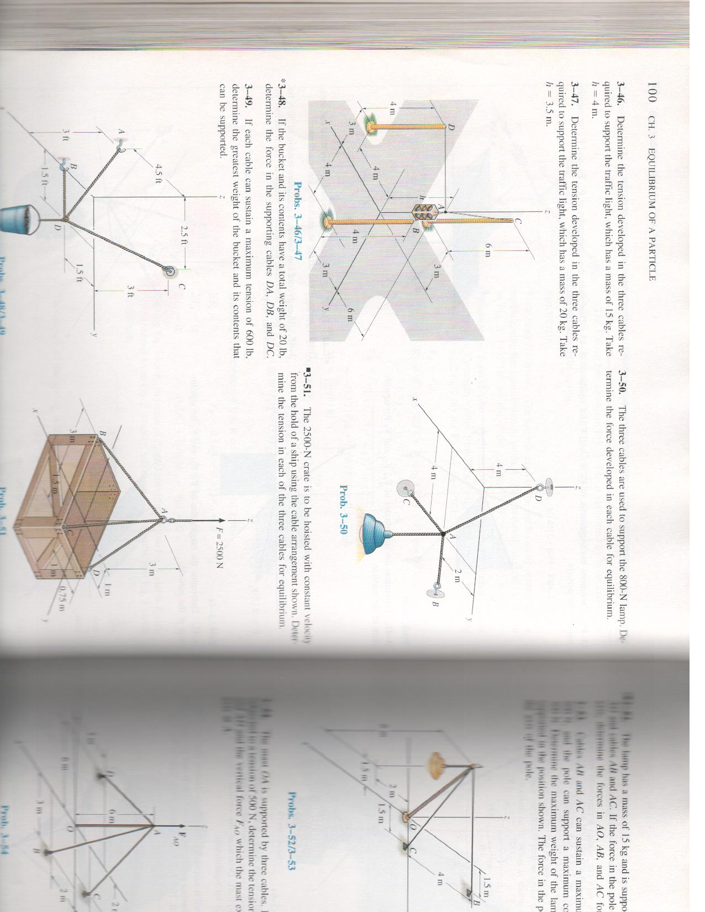
Problem 4

Slide 17
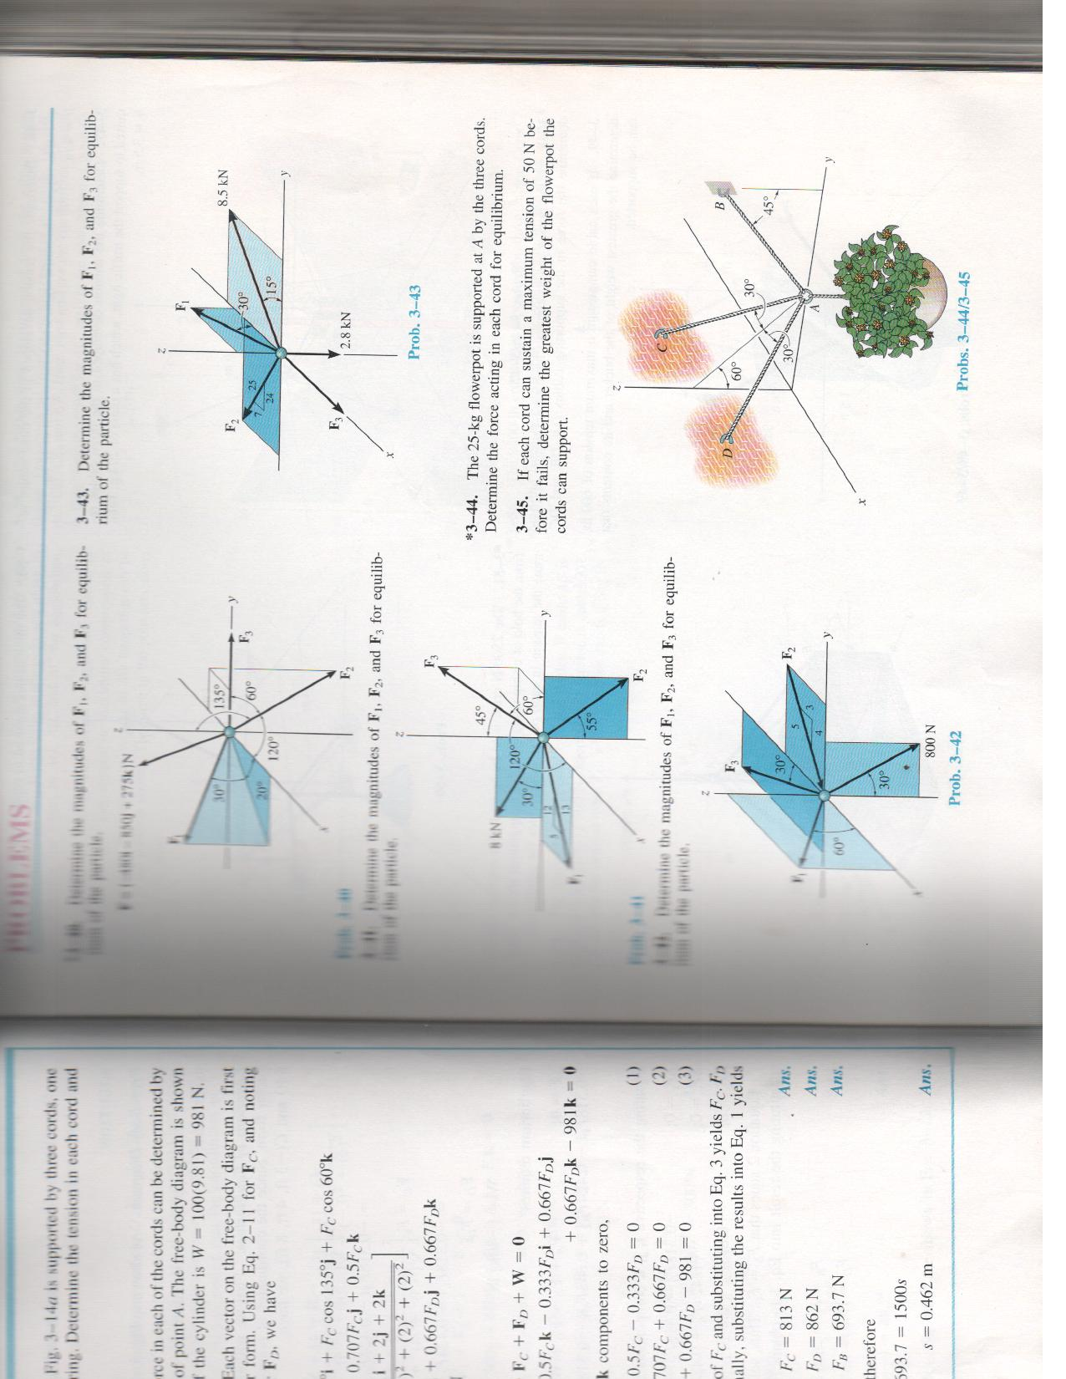
Problem 5

