Slide 1

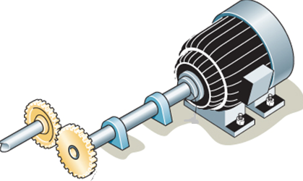
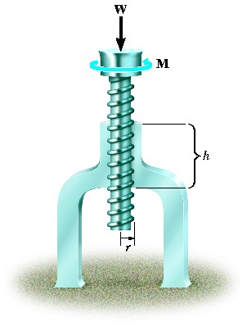
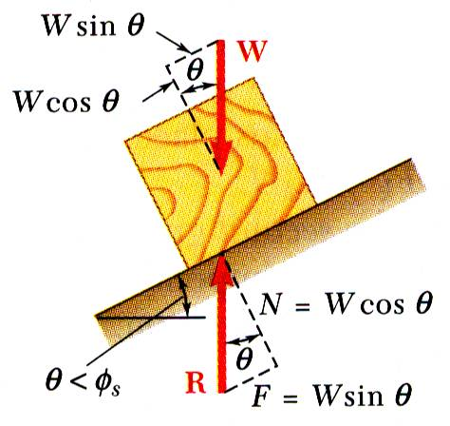
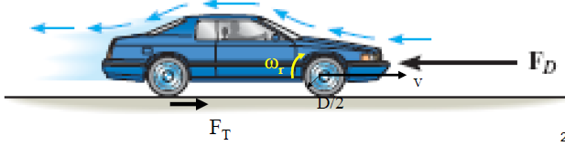
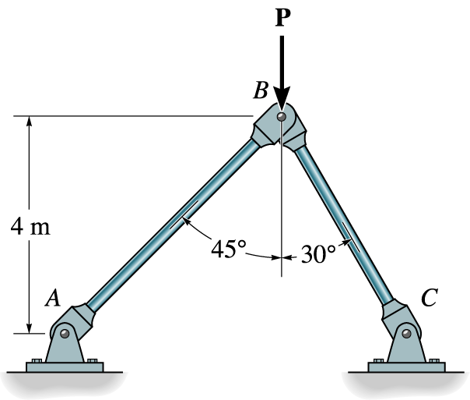


ENGINEERING MECHANICS
GE 107
Lecture 4

Slide 2
Forces (on Particles) in Space
A particle in space is represented in a three dimensional coordinate system
A right handed coordinate system will be used
For example, vector A in space can resolved by applying parallelogram law successively
Z
A
A_{Z}
A_{X}
A_{Y}
A’
X
Y

Slide 3
Unit Vectors in Three Dimension Space
Unit Vectors can be used to represent the magnitude and directions separately
For example, the vector A can be represented using unit vector as A=AU_{A}
  Where A is the scalar ( magnitude of vector A )
  and U_{A} is the unit vector for A
  U_{A}=
Z
A
A
A
A
U_{A}
X
Y

Slide 4
Cartesian Unit Vectors
In three dimensions, the set of Cartesian vectors i, j and K are used to represent X, Y and Z axes
This will be useful simplifying vector algebraic operations.
The vector A is now represented as

Slide 5
Cartesian Unit Vectors (Contd..)
The magnitude of Cartesian vectors can be obtained by applying the Pythagoras theorem successively to the two triangles shown
Similarly , the direction of the Cartesian vector can be obtained by considering the angles α,β and γ as shown below
Z
A
A_{Z} k
A_{Y} j
A_{X} i
A’
X
Y
Z
Z
Z
γ
A
A
A
β
α
X
X
X
Y
Y
Y

Slide 6
Cartesian Unit Vectors (Contd..)
The right angled triangles formed by each component of A and the angle between the vector and its resolved components are shown below as
Z
Z
Z
A
γ
A
A
β
α
X
X
X
Y
Y
Y
Hence the direction cosines are given as
We know that
Z
k
γ
A
β
α
Since magnitude of a vector is the positive square root of sum of its components
i
X
j
Y

Slide 7
Cartesian Unit Vectors (Contd..)
We know that
Z
k
γ
A
β
α
i
X
j
Y

Slide 8
Addition and subtraction of Cartesian Vectors
Consider two vectors A and B in the Cartesian form as
and
Z
(A_{Z} +B_{Z} )k
Then the resultant vector will be
A
B
(A_{X} +B_{X} )i
X
(A_{Y}+B_{Y} )j
Similarly the resultant difference will be given as
Y
For a system of concurrent forces, resultant vector will be the sum of all forces
Where are the algebraic sum of respective x , y and z components

Slide 9
Example
A hanging eye is acted upon by two forces as shown . To find the magnitude of resultant
  The magnitude of resultant is
  The direction cosines of resultant are

Slide 10
Position Vectors
Important in formulating Cartesian force vector directed between two points in space
Also in finding the moment of a force
Position vector is denoted as r
Position vector directed along points A and B is r_{AB}
From the figure, considering the head tail sequence in the triangle,
For example, if A and B are located as shown below then their position vector is
Z
B
r_{AB}
r_{B}
A
Y
r_{B}
X
Z
B (-2,-2,3)
r_{AB}
3m
2m
2m
Y
X
3m
(1,0,-3) A
1m

Slide 11
Position Vectors (Contd.)
To find the magnitude and direction of the position vector
Applying unit vector formula
γ
r_{AB}
Hence the direction cosines are found as
β
α

Slide 12
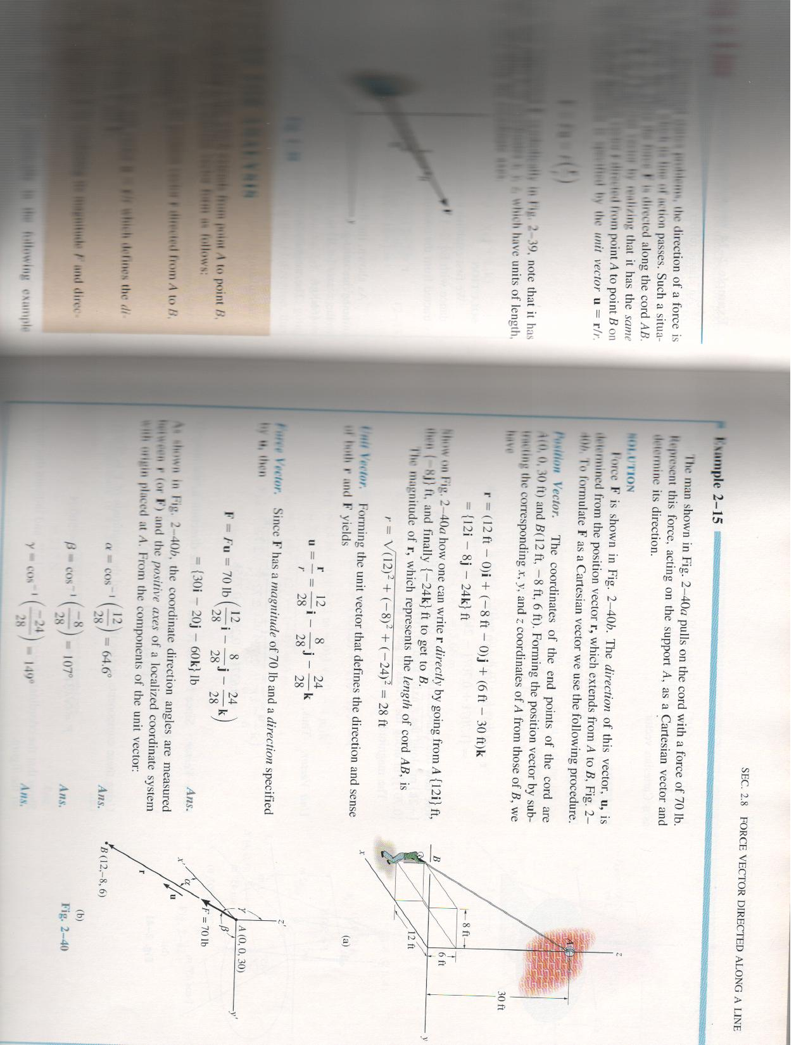
Problem 1
A man pulls on the cord with a force of 70N . Represent the force acting on the support as Cartesian vector. Determine its direction
The position vector along the cord is
30 m
8 m
The magnitude of position vector is
6 m
12 m
Direction cosines
The Force acting along the cord is written as

Slide 13
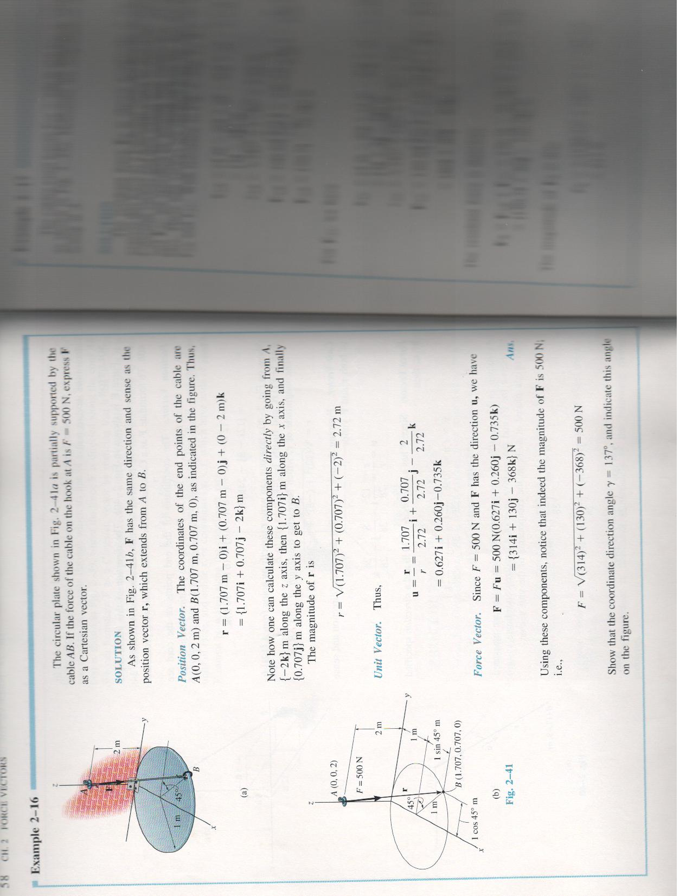
Problem 2
The circular plate shown below is partially supported by the cable AB, If the force of the cable on the hook at A is 500 N, express it as Cartesian vector,

Slide 14
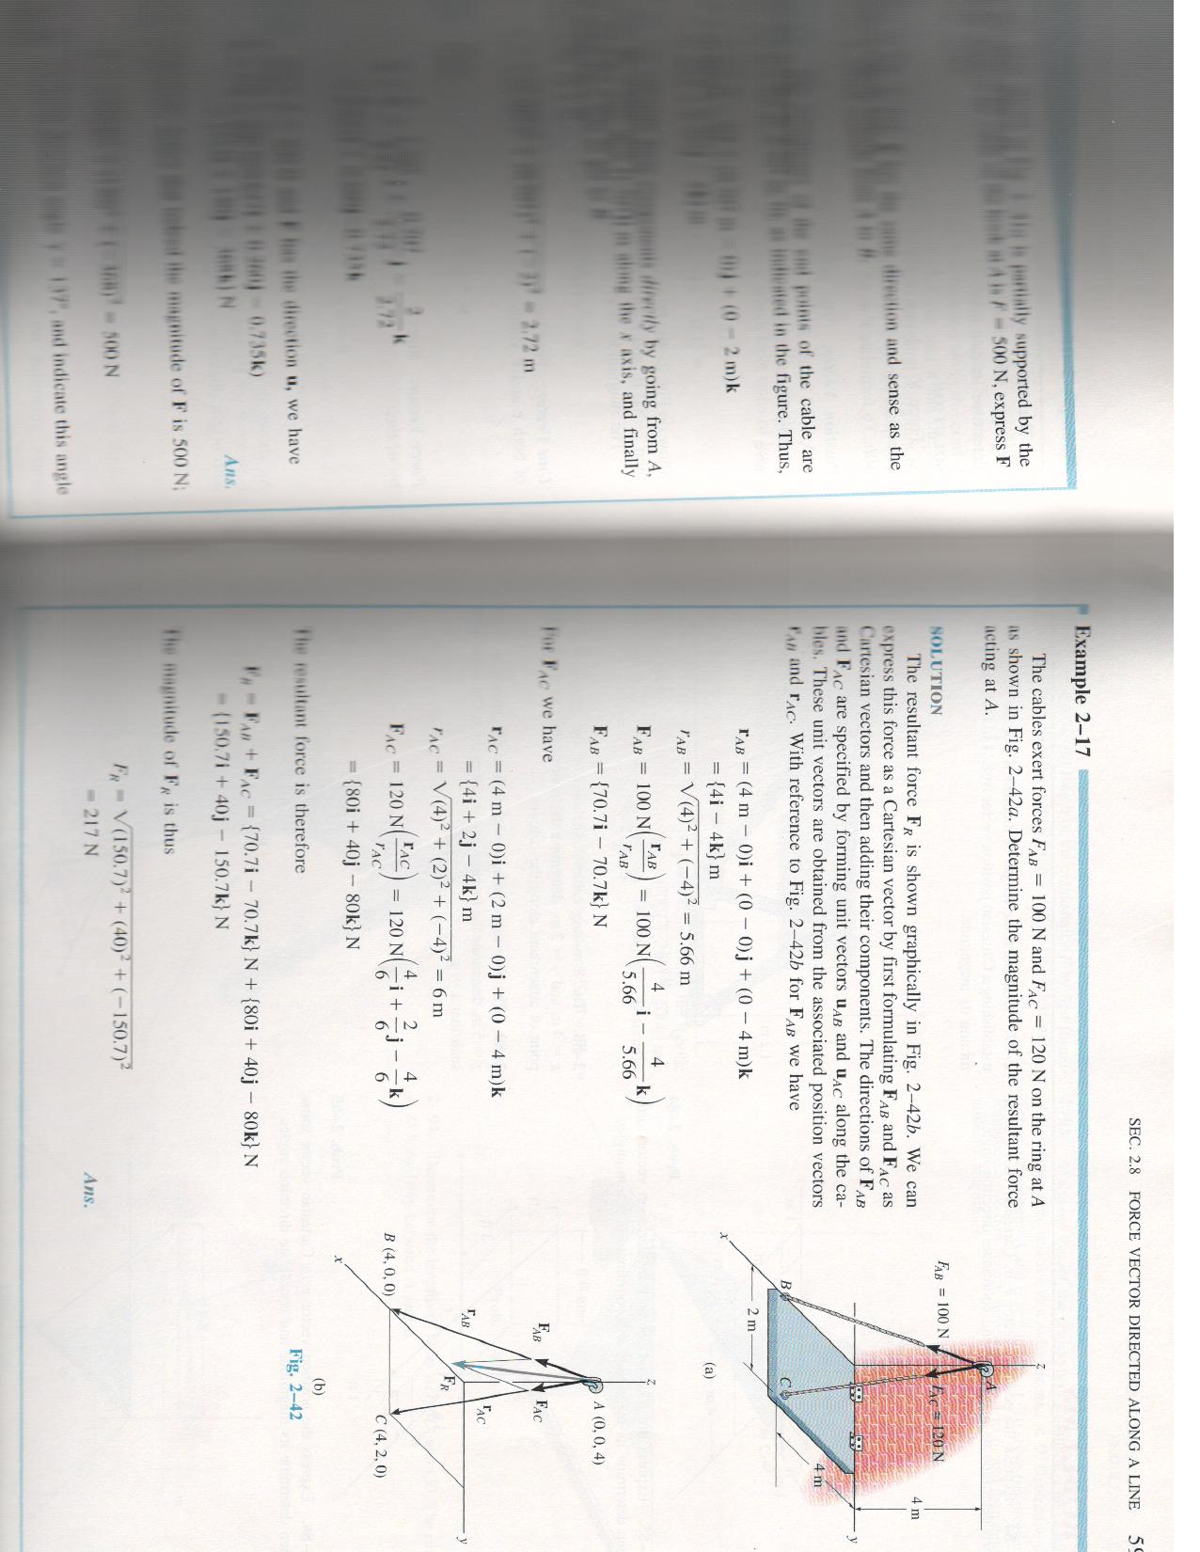
Problem 3
The cable exerts force FAB=100Nand FAC=120 N on the ring at A as shown. Determine the magnitude of the resultant force (Ans:217N)

