Slide 1


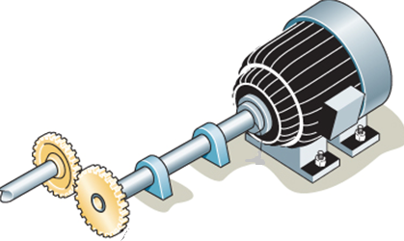
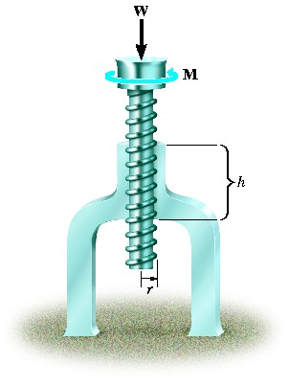
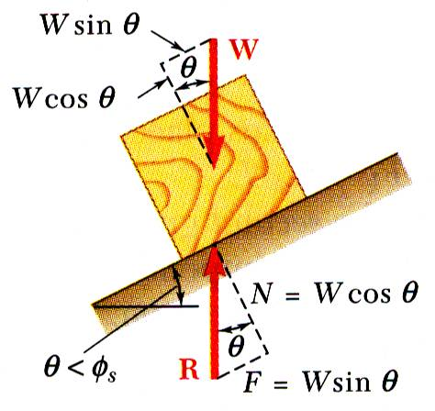
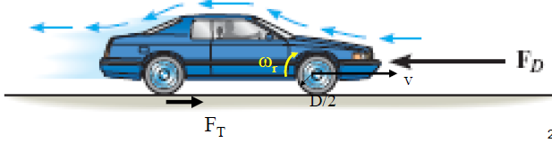
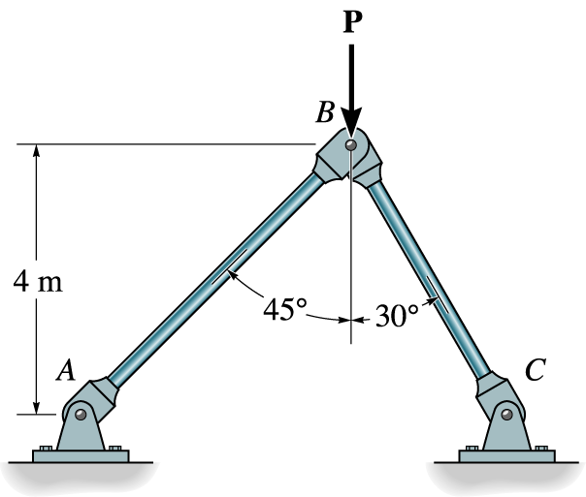


ENGINEERING MECHANICS
GE 107
Lecture 13

Slide 2
Unit IV
Dynamics Of Particles
Review of laws of motion
  – Newton’s law
  – Work Energy Equation of particles
  – Impulse and Momentum
  – Impact of elastic bodies.
Introduction to vibrations
  - Single degree of freedom systems
  – with and without damping

Slide 3
Introduction
Mechanical vibration is the motion of a particle or body which oscillates about a position of equilibrium.
Most vibrations in machines and structures are undesirable due to increased stresses and energy losses.
Time interval required for a system to complete a full cycle of the motion is the period of the vibration.
Number of cycles per unit time denotes the frequency of the
vibrations.
Maximum displacement of the system from the equilibrium position is the amplitude of the vibration.
.

Slide 4
Classification
LONGITUDINAL TRANSVERSE TORSIONAL

Slide 5
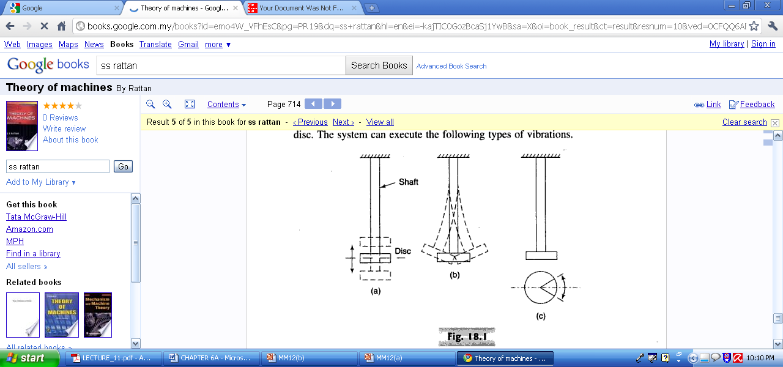
Classification (Contd.)
LONGITUDINAL TRANSVERSE TORSIONAL

Slide 6
Equation of Motion for Undamped Free Vibration

Slide 7
Equation of Motion for Undamped Free Vibration (Contd.)

Slide 8
Equation of Motion for Undamped Free Vibration (Contd.)

Slide 9
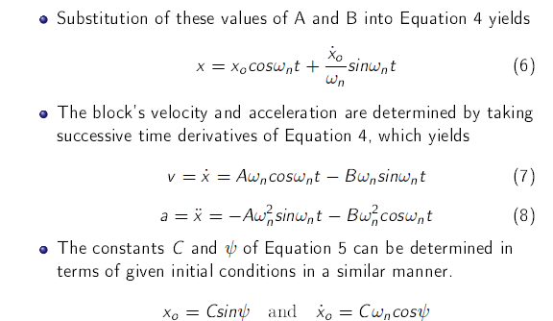
Equation of Motion for Undamped Free Vibration (Contd.)

Slide 10
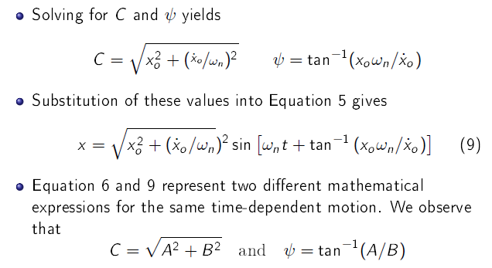
Equation of Motion for Undamped Free Vibration (Contd.)

Slide 11
Graphical Representation of Motion

Slide 12
Graphical Representation of Motion (Contd.)

Slide 13
Equivalent Spring Mass System
Any vibrating machine may consists of masses cause vibration
There are elastic members in the machine lead to vibration
The masses and elastic members are modeled as single mass and spring system for vibration analysis
This is known as equivalent spring mass system

Slide 14
Equivalent Spring Mass System (Contd.)

Slide 15
Problem 1
For the spring-mass system in the figure shown, determine the natural frequency of the system in both rad/s and cycles/s (Hz),

Slide 16
Solution to Problem 1
Given k=4.5 kN/m and m=20 kg
To find the frequency

Slide 17
Problem 2
For the spring-mass system shown, determine the static
deflection and the system period

Slide 18
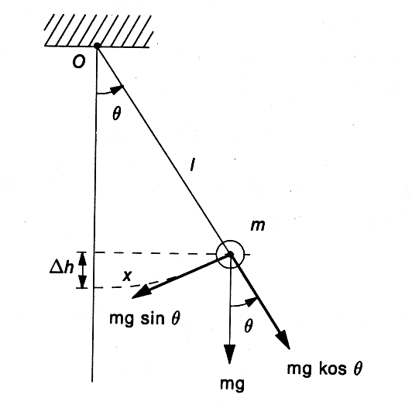
Pendulum System
The natural frequency of a system can be determined Newton’s Law of Motion as follows
When the pendulum moves to θ distance, therefore the force is occurred cause of the gravity.
when the moment force is move at the origin O,
(sin θ = θ because θ too small)
According to Newton’s Second Law of Motion
Therefore;
The equation above is similar to simple Harmonic Motion expression when you simplify ;
Hence and suppose Moment of inertia of m at O is , then
So the Natural frequency in Hz is

Slide 19
Inertia-Shaft / Disc System
Equation of motion is derived as
Hence
Where K is the torsional stiffness and
J_{D} is the polar mass moment of inertia of disc
and
where ρ is the mass density, h is the thickness, D is the diameter and W is the weight of the disc
l
K_{t}, θ
θ
J

Slide 20
Equivalent Stiffness
In a system comprising of many springs, it can be modeled as single spring by finding equivalent stiffness
Springs in Series
For a system comprising of two springs with stiffness K₁ and K₂(Fig a) and displacements ‘a’ and ‘b’, can be replaced with a spring with equivalent stiffness k_{e} to displace ‘c’ distance (Fig b)
K₁
K₁
K’
K’_{e}
a
K₂
m
c
K₂
m
m
b
m
(a)
(b)

Slide 21
Equivalent Stiffness (Contd.)
We know kδ=mg , δ=mg/k
Applying this to figure (b), c=mg/k_{e,} a+b=mg(1/k₁+1/k₂)
Therefore or
For the parallel system displacements a=b = mg(k₁+k₂)
In the equivalent system c=mg k_{e}
a=b=c and mg (k₁+k₂)= mg k_{e}
Hence k₁+k₂=k_{e}
    Spring in Parallel
K₁
K₂
K_{e}
m
x
m
x

Slide 22
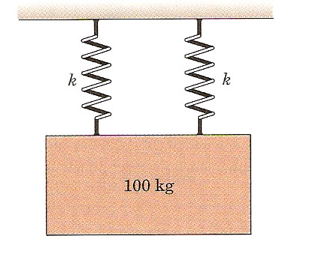
Problem 3
A 100 kg mass has a downward velocity of 0.5 m/s as it passes through its equilibrium position. Calculate the magnitude of its maximum acceleration. Each of two springs has a stiffness k = 180kN/m.

Slide 23
Problem 4

Slide 24
Damped Free Vibrations
The vibrating systems seen before were assumed free of damping.
Actually all vibrations are damped to some degree by friction forces.
These forces can be caused by dry friction, or Coulomb friction, between rigid bodies, by fluid friction when a rigid body moves in a fluid, or by internal friction between the molecules of a seemingly elastic body.
A type of damping of special interest is the viscous damping caused by fluid friction at low and moderate speeds.
Viscous damping is characterized by the fact that the friction force is directly proportional and opposite to the velocity of the moving body.

Slide 25
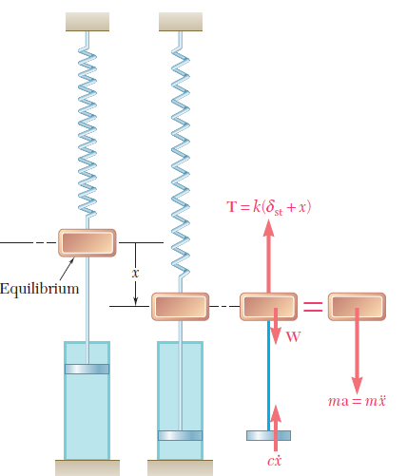
Damped Free Vibrations (Contd.)
As an example, let us again consider a body of mass m suspended from a
spring of constant k, assuming that the body is attached to the plunger of a dashpot (as shown in Figure).
The magnitude of the friction force exerted on the plunger by the surrounding fluid is equal to cx˙, where the constant c, expressed in N . s/m and known as the coefficient of viscous damping, depends upon the physical properties of the fluid and the construction of the dashpot.

Slide 26
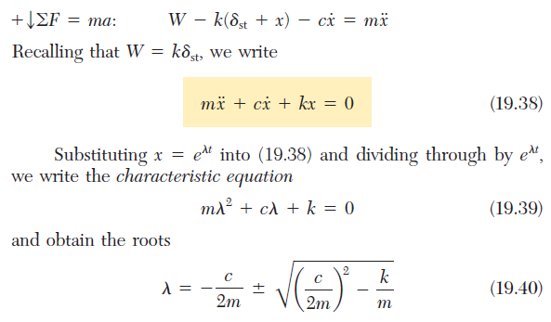
Damped Free Vibrations (Contd.)
The equation of motion is

Slide 27
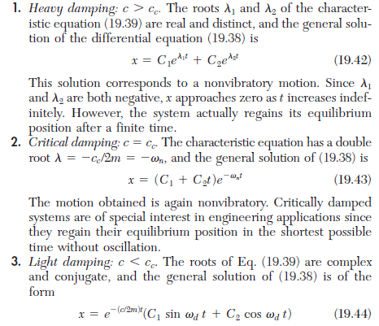
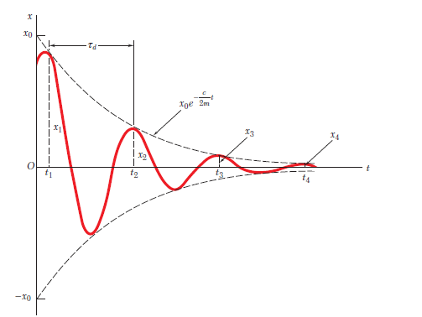
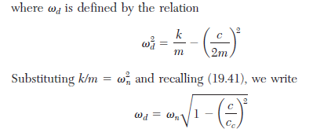
Damped Free Vibrations (Contd.)

