Slide 1


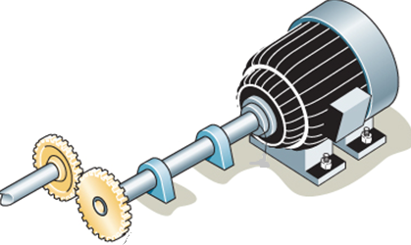
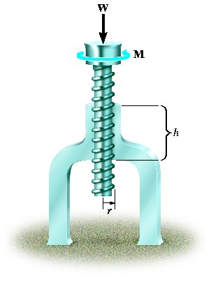
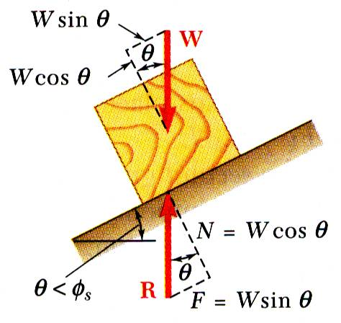
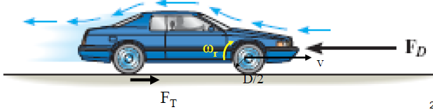
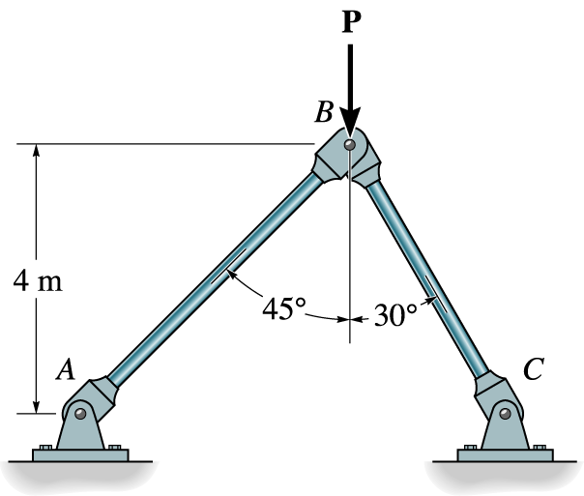


ENGINEERING MECHANICS
GE 107
Lecture 12

Slide 2
UNIT V FRICTION AND ELEMENTS OF RIGID BODY DYNAMICS
Frictional force –
  Laws of Coloumb friction
  Simple contact friction
  Rolling resistance –
  Belt friction
Translation and Rotation of Rigid Bodies
  Velocity and acceleration
  General Plane motion.

Slide 3
Introduction
Friction is defined as a force of resistance acting on a body which prevents or retards slipping of the body relative to another body.
Friction is caused by the “microscopic” interactions between the two surfaces
Friction results in a force in the direction opposite to the direction of motion!
Hence It opposes motion!
Friction! Is it a BOON or BAN?

Slide 4
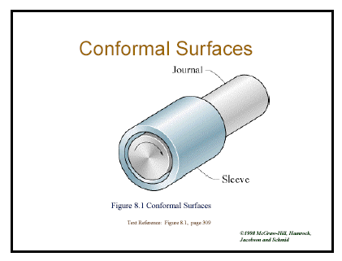
Introduction (Contd.)
Application
BOON
BAN

Slide 5
Introduction (Contd.)
Classification

Slide 6
Dry Friction

Slide 7
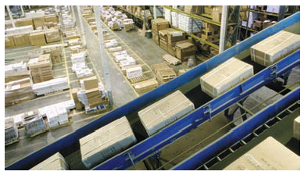
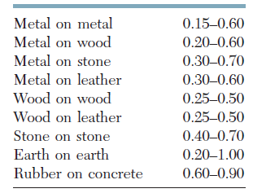
Dry Friction (Contd.)
Coefficients of Friction
The coefficients of friction μ_{s} and μ_{k} do not depend upon the area of the surfaces in contact.
Both coefficients, however, depend strongly on the nature of the surfaces in contact.
Approximate Values of Coefficient of Static Friction for Dry Surfaces
The coefficient of static friction
between a package and the inclined conveyer belt must be sufficiently large to enable the package to be transported without slipping.

Slide 8
Dry Friction (Contd.)

Slide 9
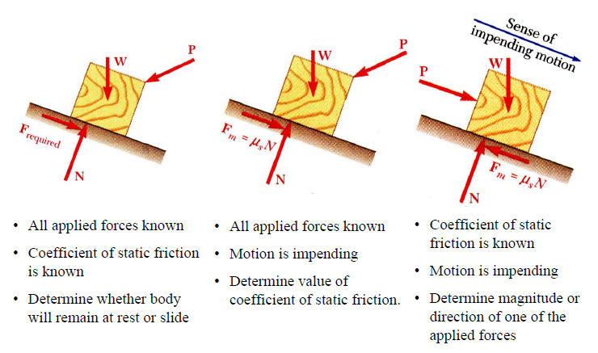
Friction (Contd.)
Types of Problems

Slide 10
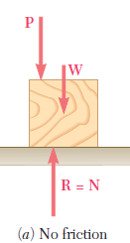
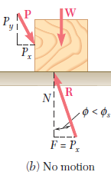
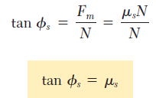
Angles of Friction
It is sometimes convenient to replace the normal force N and the friction force F by their resultant R.
Let us consider again a block of weight W resting on a horizontal plane surface.
If no horizontal force is applied to the block, the resultant R reduces to the normal force N (Fig.a).
However, if the applied force P has a horizontal component P_{x} which tends to move the block, the force R will have a horizontal component F and, thus, will form an angle φ with the normal to the surface (Fig. b).
If P_{x} is increased until motion becomes impending, the angle between R and the vertical grows and reaches a maximum value so that φ = φ_{s} .
This value is called the angle of static friction and is denoted by φ_{s}.

Slide 11
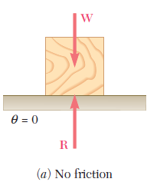
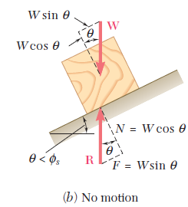
Angles of Repose
Consider a block resting on a board and subjected to no other force than its weight W and the reaction R of the board.
The board can be given any desired inclination.
If the board is horizontal, the force R exerted by the board on the block is perpendicular to the board and balances the weight W (Fig. a).
If the board is given a small angle of inclination θ, the force R will deviate from the perpendicular to the board by the angle θ and will keep balancing W (Fig. b)
It will then have a normal component N of magnitude N = W cos θ and a tangential component F of magnitude F = W sin θ.

Slide 12
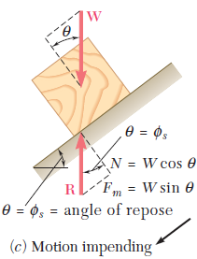
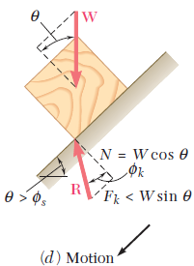
Angles of Repose (Contd.)
If we keep increasing the angle of inclination, motion will soon become impending.
At that time, the angle between R and the normal will have reached its maximum value φ_{s} (Fig. c).
The value of the angle of inclination corresponding to impending motion is called the angle of repose.
Clearly, the angle of repose is equal to the angle of static friction φ_{s} .
If the angle of inclination u is further increased, motion starts and the angle between R and the normal drops to the lower value φ_{k} (Fig. d).
The reaction R is not vertical any more, and the forces acting on the block are unbalanced.

Slide 13
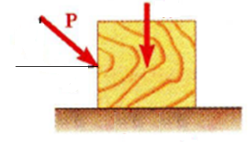
Problem 1
Find the static coefficient friction of between the block shown in the figure having a mass of 75 kg and the surface.
P=300 N
75 kg
30°

Slide 14
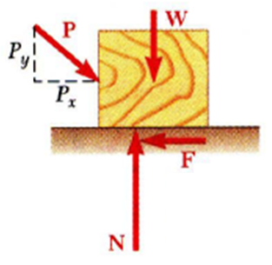
Solution to Problem 1
System of forces on the block are shown
Resolving the forces horizontally
Resolving the forces vertically
Hence to find the static friction

Slide 15
Problem 2
A 450 N force acts as shown on a
1350 N block placed on an inclined
plane. The coefficients of friction
between the block and plane are μ_{s} =0.25 and μ_{k} = 0.20. Determine whether
the block is in equilibrium and find the
value of the friction force.

Slide 16
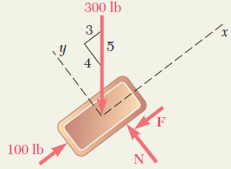
Solution to Problem 2 (Contd.)
Step 1: Determine values of friction force and normal reaction force from plane required to maintain equilibrium.
  Assuming that F is directed down and to the left, free-body diagram of the block is drawn
  Resolving the forces parallel and perpendicular to the incline
The force F required to maintain equilibrium is an -360 N and is directed up and to the right; the tendency of the block is thus to move down the plane.
1350 N
450 N

Slide 17
Solution to Problem 2 (Contd.)
Step 2: Calculate maximum friction force and compare with friction force required for equilibrium.
  The magnitude of the maximum friction force which may be developed is
  F_{m}= μ_{s}N= 0.25(1080) =270 N
  Since the value of the force required to maintain equilibrium (360 N) is larger than the maximum value which may be obtained (270N), equilibrium will not be maintained and the block will slide down the plane.
Step 3: The magnitude of the actual friction force is obtained as follows:
Factual = Fk = μkN= 0.20(270) = 54 N
  The sense of this force is opposite to the sense of motion; the force is thus directed up and to the right

Slide 18
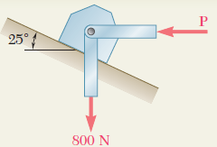
Problem 3
A support block is acted upon by two forces as shown. Knowing that the coefficients of friction between the block and the incline are μ_{s} = 0.35 and μ_{k} = 0.25, determine the force P required
  (a) to start the block moving up the incline,
  (b) to keep it moving up,
  (c) to prevent it from sliding down.

Slide 19
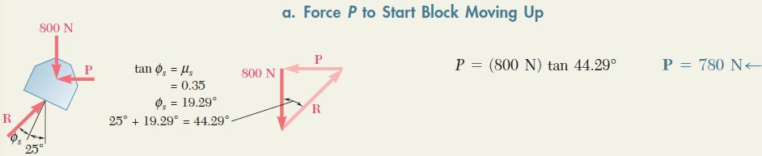
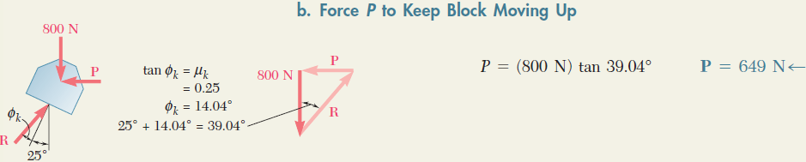
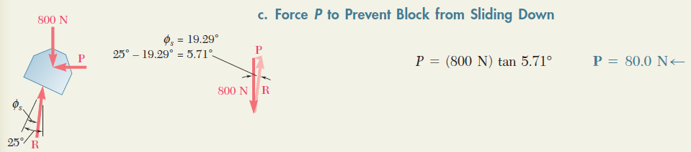
Solution to Problem 3

Slide 20
Friction in Screws
Dr.S.Rasool Mohideen
Department of Mechanical Engineering
Faculty of Mechanical and Manufacturing Engineering
University Tun Hussein Onn Malaysia

Slide 21
Friction in Screws (Contd.)
Dr.S.Rasool Mohideen
Department of Mechanical Engineering
Faculty of Mechanical and Manufacturing Engineering
University Tun Hussein Onn Malaysia

Slide 22
Friction in Screws (Contd.)
Dr.S.Rasool Mohideen
Department of Mechanical Engineering
Faculty of Mechanical and Manufacturing Engineering
University Tun Hussein Onn Malaysia

Slide 23
Friction in Screws (Contd.)
Dr.S.Rasool Mohideen
Department of Mechanical Engineering
Faculty of Mechanical and Manufacturing Engineering
University Tun Hussein Onn Malaysia

Slide 24
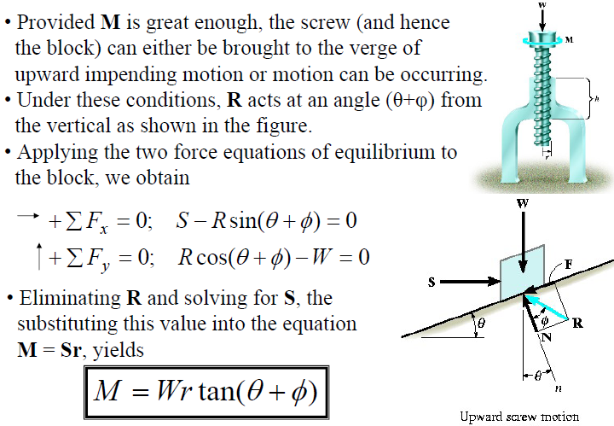
Friction in Screws (Contd.)
Upward Motion
Dr.S.Rasool Mohideen
Department of Mechanical Engineering
Faculty of Mechanical and Manufacturing Engineering
University Tun Hussein Onn Malaysia

Slide 25
Friction in Screws
Upward Motion (Contd.)
Dr.S.Rasool Mohideen
Department of Mechanical Engineering
Faculty of Mechanical and Manufacturing Engineering
University Tun Hussein Onn Malaysia

Slide 26
Friction in Screws (Contd.)
Downward Motion
Dr.S.Rasool Mohideen
Department of Mechanical Engineering
Faculty of Mechanical and Manufacturing Engineering
University Tun Hussein Onn Malaysia

Slide 27
Self Locking
Dr.S.Rasool Mohideen
Department of Mechanical Engineering
Faculty of Mechanical and Manufacturing Engineering
University Tun Hussein Onn Malaysia

Slide 28
Problem 2
Dr.S.Rasool Mohideen
Department of Mechanical Engineering
Faculty of Mechanical and Manufacturing Engineering
University Tun Hussein Onn Malaysia

Slide 29
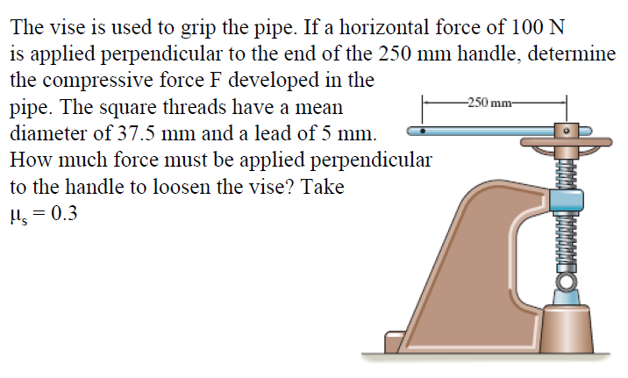
Problem 3
Dr.S.Rasool Mohideen
Department of Mechanical Engineering
Faculty of Mechanical and Manufacturing Engineering
University Tun Hussein Onn Malaysia

Slide 30
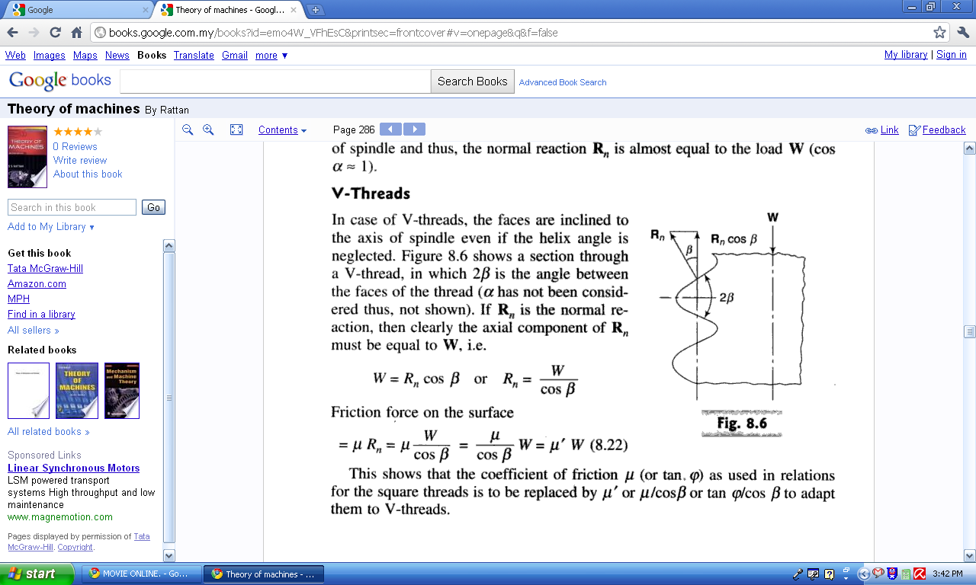
Friction in V Threads
Hence
Dr.S.Rasool Mohideen
Department of Mechanical Engineering
Faculty of Mechanical and Manufacturing Engineering
University Tun Hussein Onn Malaysia

Slide 31
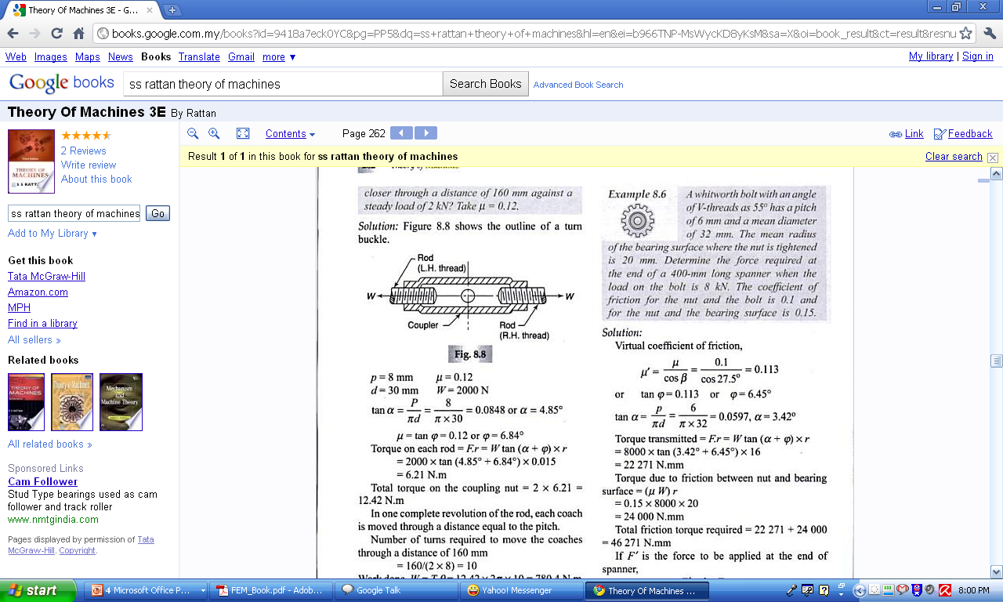
Problem 1
Dr.S.Rasool Mohideen
Department of Mechanical Engineering
Faculty of Mechanical and Manufacturing Engineering
University Tun Hussein Onn Malaysia

Slide 32
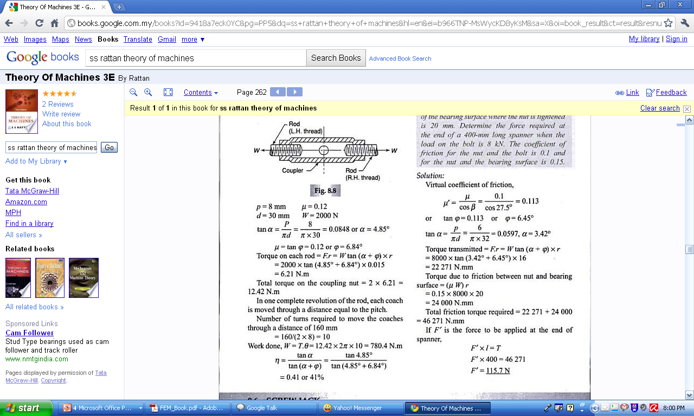
Solution
Dr.S.Rasool Mohideen
Department of Mechanical Engineering
Faculty of Mechanical and Manufacturing Engineering
University Tun Hussein Onn Malaysia

