Slide 1

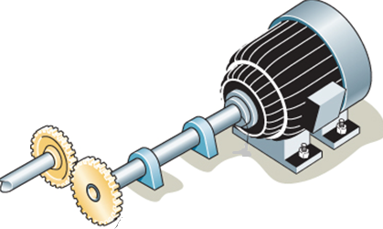
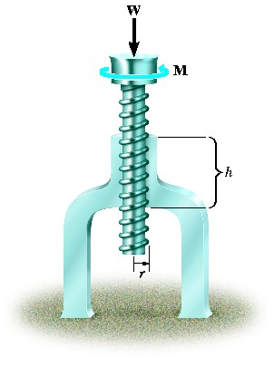
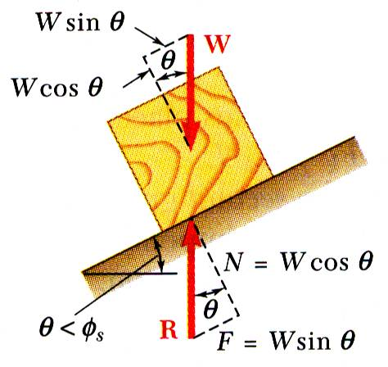
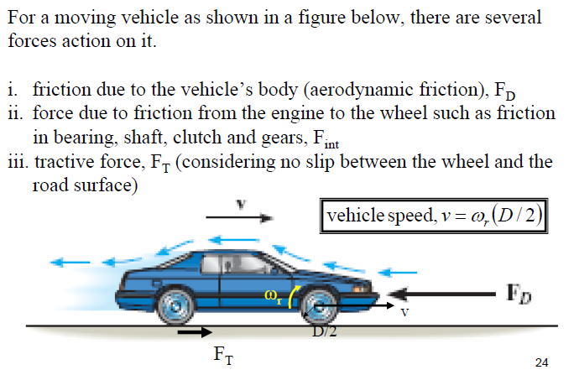
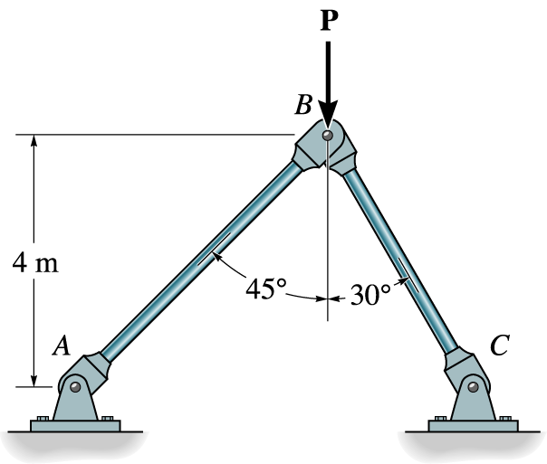


ENGINEERING MECHANICS
GE 107

Slide 2
INTRODUCTION
Every body needs power
Power is the capacity to do work
Work can be done with the manipulation of force(s)
Hence the study of effect of forces on the bodies is necessary
And this is widely known as
ENGINEERING MECHANICS

Slide 3
Introduction (Contd..)
For example, an automobile engineer may need to know
the various forces acting on every components of automobile
To design the vehicle

Slide 4
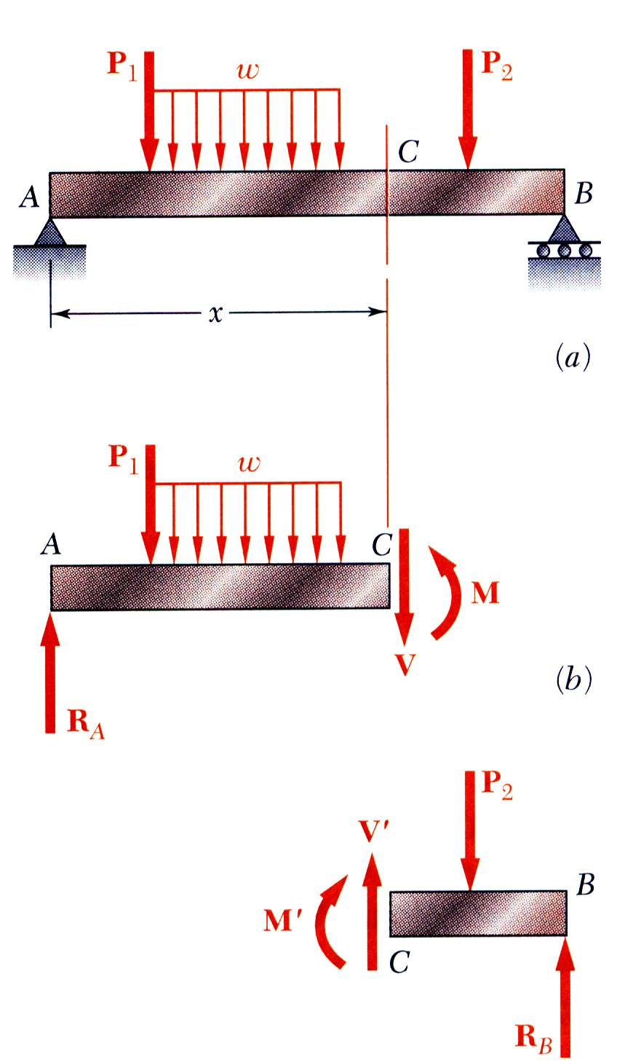
Introduction (Contd..)
A civil engineer may have to consider
the various force acting on the beams and columns
to design a structure

Slide 5
Introduction (Contd..)
An electrical engineer may consider
the torque of the motor
to determine the power of the motor

Slide 6
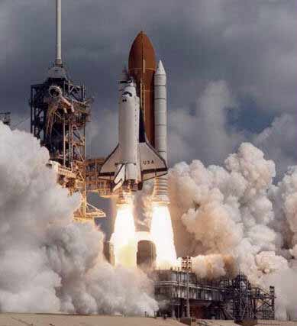

Introduction (Contd..)
An Aero-crat may need to consider
  Various forces acting in and around the aircraft
  to design and analyse the craft

Slide 7

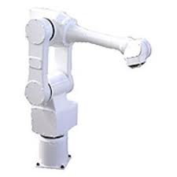
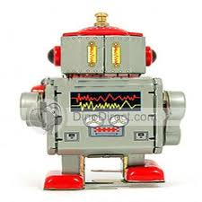
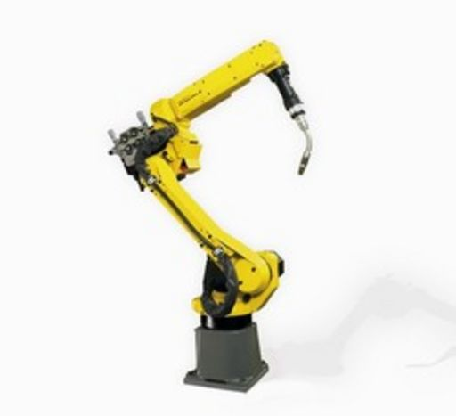

Introduction (Contd..)
In Robotics, movements of a robot
  to achieve its goal with out any jerks
  demands the study of forces

Slide 8
Introduction (Contd..)
Continuum Hypothesis
A body may consist of different particles
Each particle may be made-up of atoms and electrons
Engineering problems cannot be solved if we consider a body as discrete particles
Instead it is assumed to a continuum
This is known to be continuum hypothesis

Slide 9
Introduction (Contd..)
Classification

Slide 10
Introduction (Contd..)
Classification
Mechanics can be classified according to the nature of bodies it handle as
  Rigid body mechanics
  Deformable body mechanics and
  Fluid mechanics
If the body or particle is larger than atom or the velocity is less than that of light
  This is classical mechanics
If the particle is reaching the size of atom or its speed approaches that of light
  This is known as Quantum Mechanics

Slide 11
Introduction (Contd..)
Classification
Rigid body mechanics is further classified as
  Statics which deals with equilibrium of bodies and
  Dynamics which deals with the accelerated motion of bodies

Slide 12
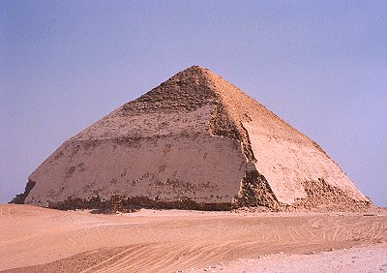
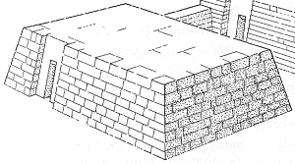

Introduction (Contd..)
History
The concept of mechanics were used in the ancient history for building Giant structure such as Pyramids , Coliseum etc.,
The major task was lifting of weights
The Greek work “Mecha “ means lifting of weights

Slide 13
Introduction (Contd..)
History
Archimedes 287-212 BC
  Principle of Lever
Galilelo 1564-1642 AD
  Pendulum Experiments
Sir Isaac Newton 1642-1727 AD
  Laws of Motion
Euler
D’Alembert
Lagrange

Slide 14
Units and Dimensions
The three quantities are
Length
  Which describes the size of a physical system
Mass
  Which one can compare the body with another
Time
  Measure of succession of events
Force
  Push or Pull exerted by the bodies on one another
  Either directly or indirectly
  Has magnitude , direction and sense

Slide 15
Laws of Mechanics
Newtonian Laws
I Law of motion
  A particle remains in its state of rest or uniform motion , if the resultant force is zero
II Law of motion
  If the resultant force is not zero, then the particle will have an acceleration proportional to the magnitude of the force and in the direction of the force
III Law of motion
  The force of action and reaction between the bodies in contact will have same magnitude , same line of action and opposite sense

Slide 16
Laws of Mechanics (Contd..)
Newton’s Law of Gravitation
  Two particles of mass M and m , if mutually attracted by equal and opposite forces F and –F, then the magnitude of force is given as
F=G Mm/r²
where G is the constant of gravitation and is equal to 9.8 m/s²

Slide 17
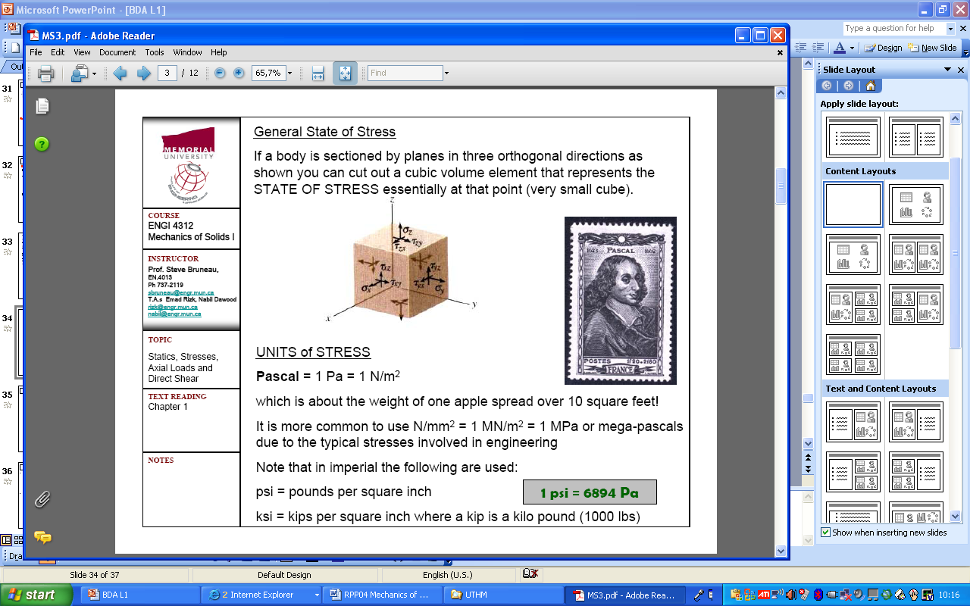
Units and Dimensions (Contd..)
S.I. Units
International System of units
Systeme International d units-French
Lower case letters
  For example, kg for kilo-gram
Except those called after individuals
  For example N-Newton, P-Pascal
And also G- giga, M-mega
Use m for milli and μ for micro

Slide 18
Units and Dimensions (Contd..)
S.I. Units
Length is given in meters, denoted as m
Mass is in kilo-gram, kg
Time is in seconds, s and
Force is in Newton, N
Force is a derived unit from Newton’s second law, F=ma
It is defined as Force which gives 1 m/s² to a mass of 1 kg is given as 1N and is equal to 1kg.m/s²
Weight of the body is the force of gravity exerted on the body and hence given as
  W=mg
  Where m is the mass and
  g is the acceleration due to gravity

Slide 19
Vectors
  Physical quantities are generally represented as scalars and vectors
  Scalar quantity
    Has magnitude only
    Described by positive number
    Example , mass, volume, length
  Vector quantity
    Has magnitude, direction and sense
    Example, force, velocity, moment

Slide 20
Vectors (Contd..)
  Vectors are denoted by an alphabet super scribed by an arrow
  For example vector A is given as
  Vector has magnitude and is a positive scalar
  Graphically the vector is represented by an arrow
    Length of the arrow gives the magnitude
    Angle of inclination shown the direction
    Position of arrow head shows the direction

Slide 21
Vectors (Contd..)
Vector Operations
    Vector Multiplied by a scalar
    Direction remains same
    The magnitude and sense may change

Slide 22
Vectors (Contd..)
Vector Operations
    Vector Addition
    Vectors of same type (+ve) may be added to forma resultant vector
    For example, Vectors and added to give
    The magnitude of resultant vector is obtained graphically by parallelogram law

Slide 23
Vectors (Contd..)
Vector Operations
    Parallelogram Law
    If and are the two vectors to be added to produce a resultant
    Draw vectors and so that their tails are touching each other
    Draw a line parallel to vector from the head of and another line parallel to from the head of . to produce a parallelogram.
    The diagonal of the parallelogram gives the resultant vector

Slide 24
Vectors (Contd..)
Vector Operations
    Triangular Law
    The other method to obtain the resultant of two vectors when added is given below
    If and are the two vectors to be added to produce a resultant
    Draw vectors and as the adjacent two sides o f a triangle in the same order
    The closing side of the triangle will be the resultant diagonal of the parallelogram gives the resultant vector

Slide 25
Vectors (Contd..)
Vector Operations
    Subtraction of Vectors
    If and are the two vectors and their resultant difference is to be found
    It can be obtained by both parallelogram method as well as triangular law as shown below

Slide 26
Vectors (Contd..)
Vector Operations
    Addition of more than two vectors:
    If more than two vectors are to be added, successive application of parallelogram law can be carried out to obtain the resultant force.
    If , and are the two vectors and their resultant vector is to be found .
    First the three vectors are to be drawn with their tails touching each other.
    It can be obtained by applying parallelogram method to vectors and first to get the resultant .
    Then a parallelogram is constructed for vectors and as shown below to get the resultant .

Slide 27
Vectors (Contd..)
Vector Operations
    Addition of more than two vectors by triangular rule:
    If more than two vectors are to be added, successive application of triangle law can also be applied similar to parallelogram law to obtain the resultant force.
    If , and are the two vectors and their resultant vector is to be found .
    First the three vectors are to be drawn successively with the first vector’s head touching the next one’s tail their tails touching each other.
    .
Polygon Rule

Slide 28
Vectors (Contd..)
Resolution of Vector
    A vector can be resolved in to two components, if the line of action of two components are known
    This can be done by using parallelogram law or triangular law
    For example, if is the vector , which is to resolved in to vectors and
    The lines of action of and are given as shown in Figure 1
    From the head of given vector , draw lines parallel to line of action to complete the parallelogram.
    Sides of the parallelogram parallel to the corresponding lines of action gives the respective resolved vectors

Slide 29
Vectors (Contd..)
Numerical Solution
    Numerical solution to vector resolution can be obtained by using trigonometric principle
    Sine Law
      If the three sides of the triangle are A,B &C and their opposite angles are α,β &γ, then according to sine law
      Cosine Law
        According to cosine law
α
α
γ
β

Slide 30
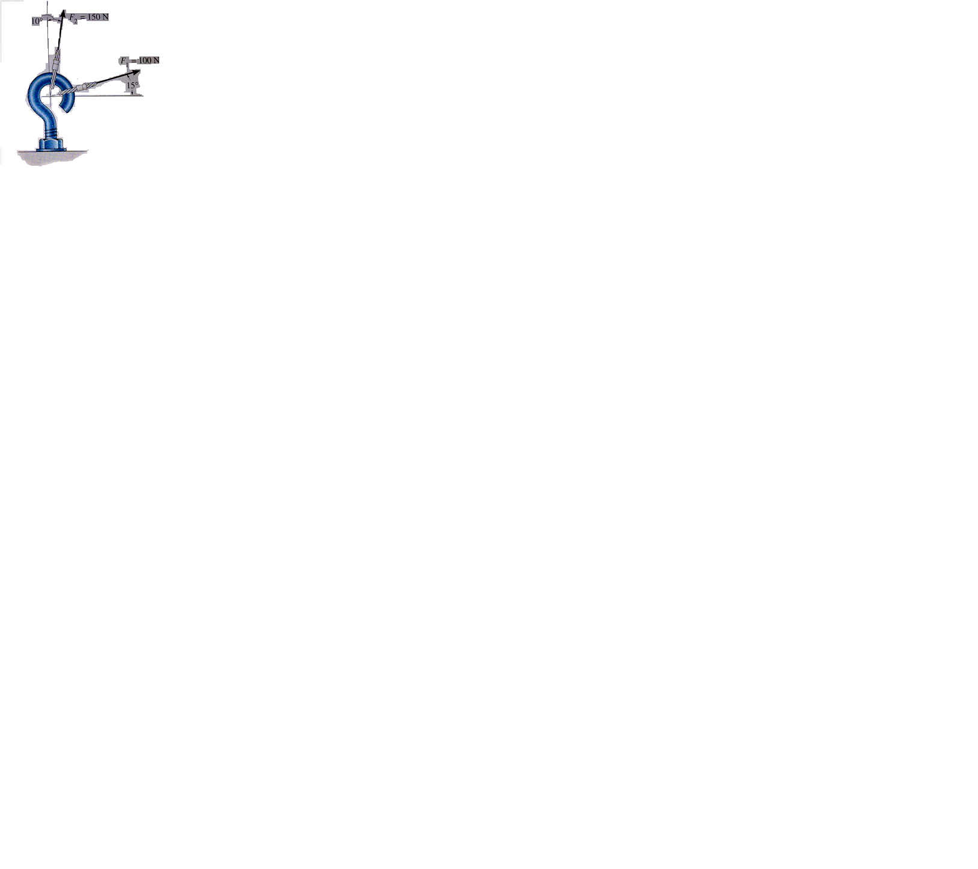
Example 1
    The screw eye shown below is subjected to two forcesF₁ and F₂. Find the magnitude and direction of resultant force. Solution: The Unknowns to be found are R and φ.
    R can be found by using cosine law
115°
θ°
φ°
15°
Courtesy: Hibbeler/Eg.1

Slide 31
Example 1 Solution (Contd..)
To find φ, we need θ. This can be obtained from Sine law .

Slide 32
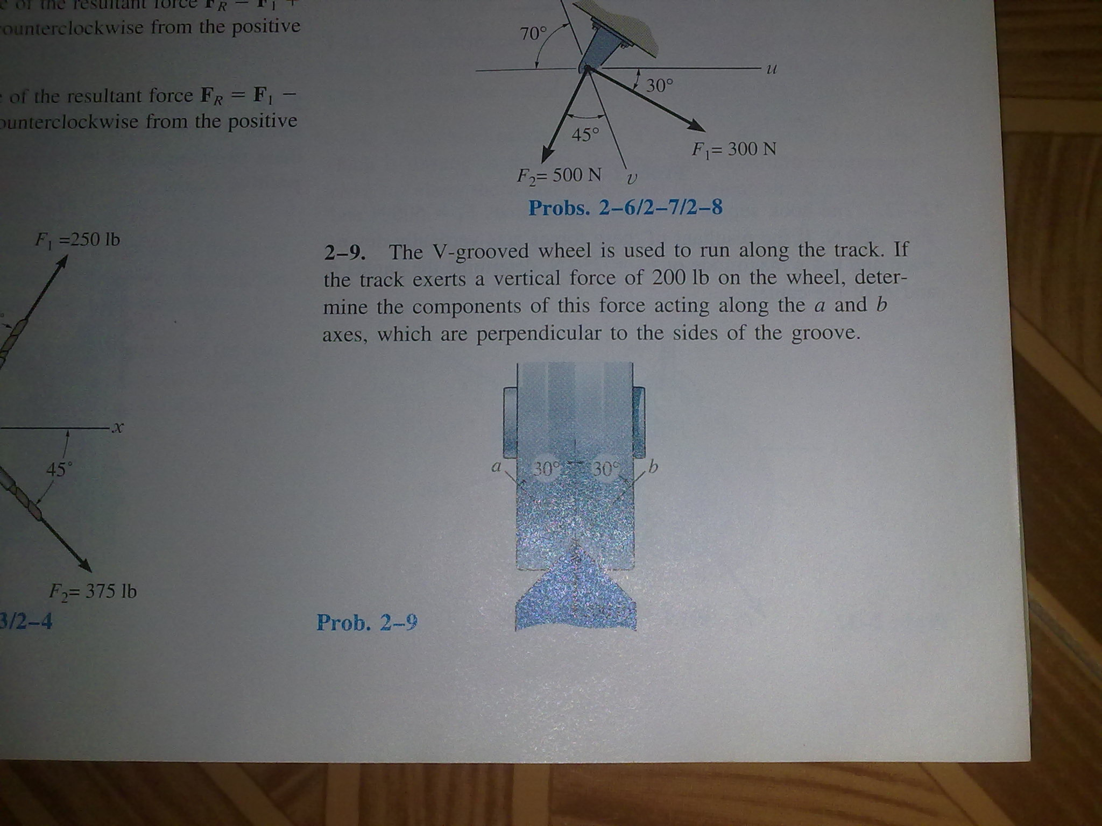
Problem 1
The V grooved wheel is used to run along a track. If the track exerts a vertical force of 200N on the wheel, determine the components of forces acting along the axes a and b, which are perpendicular to the sides of the groove.
200 N

Slide 33
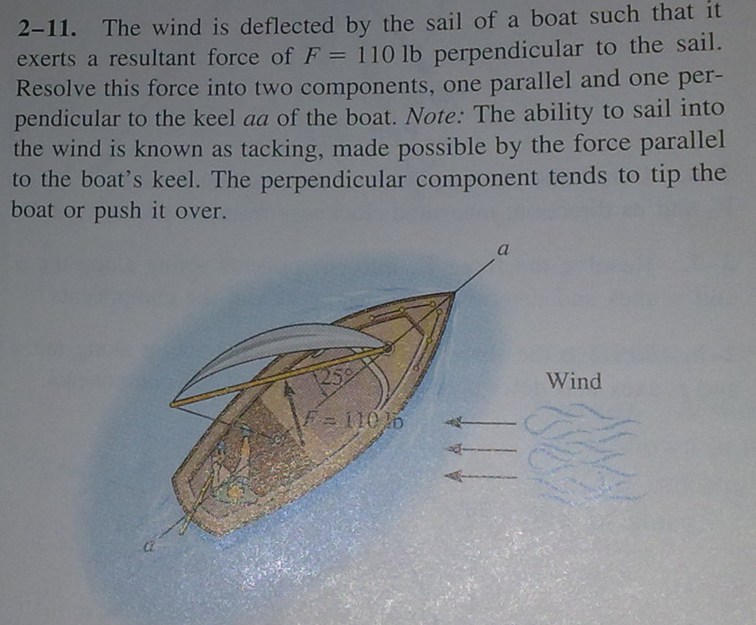
Problem 2

Slide 34
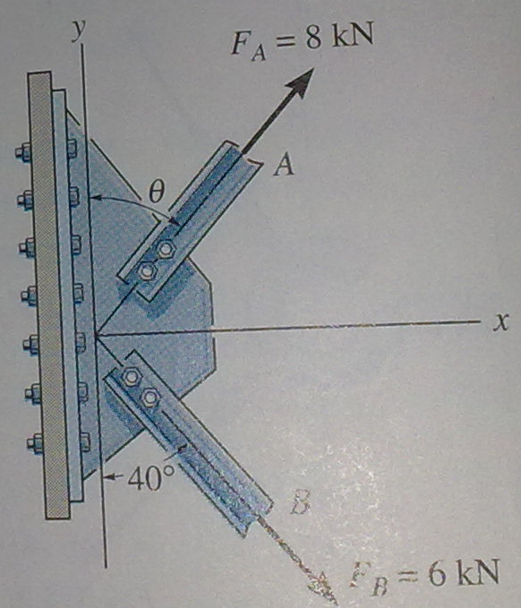
Problem 3
The plate is subjected to two forces at A and B as shown below. If θ=60°, determine the magnitude of the resultant of these forces and its direction measured clockwise from the positive x axis.

Slide 35
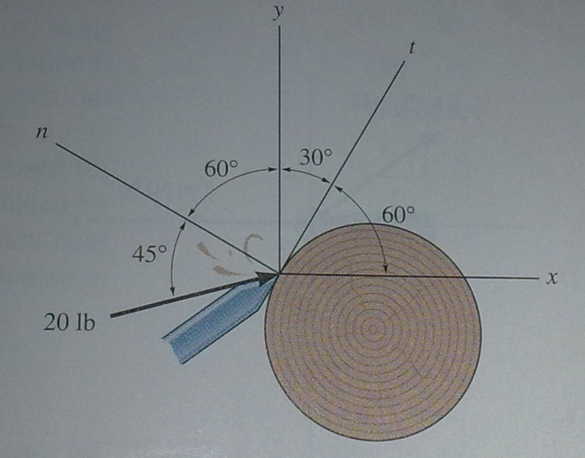
Problem 4
The chisel exerts a force of 20 N on the wood dowel rod which is turning in the lathe. Resolve this force in to components acting along (i) x and y axes and (ii) n and t axes

